Slide 1

Student feedback on assessment design for learning success: Findings from a qualitative study
Dr Moira Cachia (Presenter) & Dr Siobhan Lynam

Slide 2

Background & Rationale
An understanding of students’ perceptions and experience of assessments allows for better design of assessments by teaching staff (Fletcher et al., 2012)
Assessments affect the quality and quantity of student learning (Raupach et al., 2013)
Researchers have called for the use of more alternative assessments that prepare students for the real-world by building on their skill sets (Keppell & Carless, 2006; Libman, 2010) – referred to as ‘authentic assessments’

Slide 3
Aims and Research Questions
Personal factors affect student learning including emotional response to assignments (Rust, 2002), perception of workload (Naude et al., 2016), time management, self- regulation skills, motivation, conscientiousness and social support all have an impact on academic success (Asikainen et al., 2013; Busato et al., 2000; Rytkoen et al., 2012)
The research question:
What is our psychology students’ experience of assessments in higher education?

Slide 4
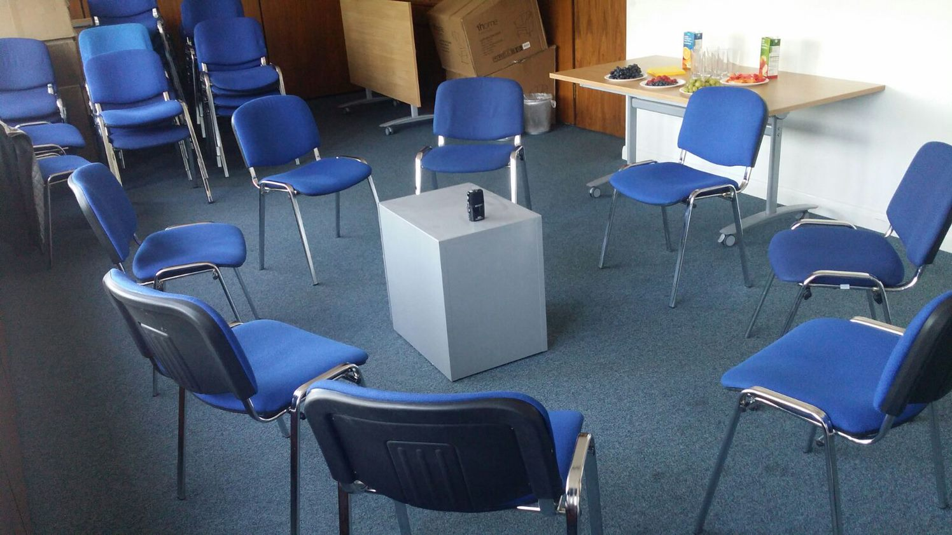
Method
Design
Qualitative approach - 3 focus groups, each lasting 1 hour;
Semi-structured interview questions/card sort procedure were used; 2 psychology lecturers facilitated the focus groups;
Analysed using experiential inductive method of Thematic Analysis as outlined by Braun and Clarke (2013);
Participants
  23 psychology undergraduates (Level 5/6); Age Range: 20 – 46 years; 19 females (M: 24.3 years), 4 males: (M: 21.5 years)
  The students’ grade average ranged from low second class (2:2) to first class. The mode grade of the participants was a high second class (2:1)
Notes:
23 psychology undergraduates level 5 and 6. 19 female, mean age: 24.3 years, 4 male, mean age: 21.5 years, 3 grade average 1st, 12 grade average 2:1, 8 grade average 2:2. 18 home students, 2 EU, 3 International students. 15 English as a first language
Recruited via advertisement on Blackboard and via Psychology notice board, SONA- research participation scheme
Inclusion criteria - Full time year 2 or 3 psychology students, proficient in spoken English

Slide 5
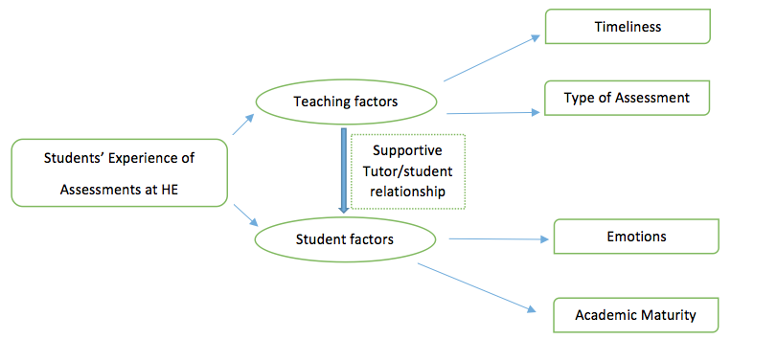
Analysis: Themes & Subthemes

Slide 6
Supporting tutor/student relationship
Balanced support valued by students
Consistent, good quality instruction and feedback
‘I know a couple of people who have one seminar tutor and they are not too fond of them so they were not really learning much so they just moved group. I can’t work in that class. You have to move to a tutor where you understand them better.’ (Sam)
‘I was forced to change my whole assignment a week before the deadline just because I got different opinions from different lecturers ... So it was quite rushed for me to change everything. So it was quite stressful.’ ( Jess)
Notes:
Teaching factors:
Timing of assessments effects student preparation. There is also a knock-on learning effect with one assignment advancing the next
Support for assignments needs to be balanced: too little causes feelings of abandonment; excess reduces academic independence and learning
Predictability of assignments effects preparation: too much can adversely affects learning; too little causes student stress; cue-seeking reduces workload but increases grade success

Slide 7
Teaching factors: Timeliness
Timeliness of Assessments
Timeliness of Guidance
‘I found that the H&C essay helped me to write the Individual Differences essay and because of that it helped me a lot in the exam because it was a similar method we had to use..’ (Alex)
‘The feedback for the Cognitive Poster was also excellent because of the fact that it felt like they took you, almost step-by-step into saying this is what you should have done here to improve the poster and it felt like they actually knew what they were looking for …’ ( Jane)
Notes:
Teaching factors:
Timing of assessments effects student preparation. There is also a knock-on learning effect with one assignment advancing the next
Support for assignments needs to be balanced: too little causes feelings of abandonment; excess reduces academic independence and learning
Predictability of assignments effects preparation: too much can adversely affects learning; too little causes student stress; cue-seeking reduces workload but increases grade success

Slide 8
Teaching factors: Type of Assessment
Predictability (high/low)
Cue seeking
Student focussed: Choice/
Creativity/Relevance/Workload
‘…you have to learn every single lecture slide, because it all comes up. Whereas with the other ones they tell you, oh yeah, there’s only two questions but if you learn 3 lectures to be on the safe side’ (Marie)
‘I’m reminded why … this is like gonna be the real world one day for us ..and that’s what I enjoyed the most out of the Poster, that it was just … it felt real, somehow and actually seeing how that skill was gonna be advantageous later’ (Sally)
Notes:
Teaching factors:
Timing of assessments effects student preparation. There is also a knock-on learning effect with one assignment advancing the next
Support for assignments needs to be balanced: too little causes feelings of abandonment; excess reduces academic independence and learning
Predictability of assignments effects preparation: too much can adversely affects learning; too little causes student stress; cue-seeking reduces workload but increases grade success

Slide 9
Student factors: Emotions
  Positive emotions:
  Excitement; Pride
Negative emotions:
Fear; Anxiety
‘I think that’s why you’re so proud though, because it was so hard and we all did so well.’ (Sarah)
‘I still have that moment where I walk into an exam and everything just goes and I’m like, oh I can’t do this, can’t do that. What am I doing here? But that’s like every exam that I’ve done in my life, so I don’t really know’ (Haiza)
Notes:
Teaching factors:
Timing of assessments effects student preparation. There is also a knock-on learning effect with one assignment advancing the next
Support for assignments needs to be balanced: too little causes feelings of abandonment; excess reduces academic independence and learning
Predictability of assignments effects preparation: too much can adversely affects learning; too little causes student stress; cue-seeking reduces workload but increases grade success

Slide 10
Student factors: Academic Maturity
  Self-evaluation
  Academic Perceptiveness
Academic Motivation
‘But if you have just memorised it you don’t actually know it, you have just memorised it. You just forget it the next day.’ (Chris)
‘ (in year 3) you keep saying applied, applied, applied, applied and that makes a difference, so then you do go away and think right this is the theory, this is how it applies to everyday life, and it just seems to come together more.’ (Sarah)
Notes:
Teaching factors:
Timing of assessments effects student preparation. There is also a knock-on learning effect with one assignment advancing the next
Support for assignments needs to be balanced: too little causes feelings of abandonment; excess reduces academic independence and learning
Predictability of assignments effects preparation: too much can adversely affects learning; too little causes student stress; cue-seeking reduces workload but increases grade success

Slide 11
Academic Maturity
Self-evaluation | Academic Perceptiveness | Academic Motivation
Awareness of their learning style | Value independent learning | Intrinsic motivation
Desire to develop study skills | Engage with formative feedback | Desire to develop transferable skills
Awareness of academic ability | Understand value of balanced support | Link learning to career ambition

Slide 12
Implications
Strategies to promote academic maturity, reduce stress and maintain a balanced workload could foster a more constructive approach to learning:
    Consolidated approach to setting assignments
    Time management training
    Stress management
    Strategies to promote intrinsic motivation
Appropriate assignments are a cost-effective way of improving student engagement and satisfaction
Implications for module and course leaders, exam and timetabling administrators and student support services

Slide 13
Assignment changes based on study outcome
Level 6 module: Psychology in the workplace
  Previous: assessment types were: Assessment 1 – Essay; Assessment 2 – exam (2 long essays)
  Current: Essay has been replaced by a business report: more applied (Topics: Training / Recruitment / Factors affecting Job Performance)
  Current: Exam has been replaced by a Case Study of an acquisition and merger of two organisations, which occurred in practice

Slide 14
Evaluation of Assessment changes
Teaching factors | Student factors
Timeliness Feedforward sessions: Going through the assessment guidelines; assessment criteria; past student submissions | Emotion Less stress experienced, leading to higher on-time submission rates; Positive response from students
Type of Assessment Predictability (high) Cue-seeking: feedforward sessions provide the space to ask questions | Academic maturity Students felt empowered to develop transferable skills (analytical skills; problem-solving; report writing)

Slide 15
Future research
Follow up with studies targeting other subject areas, and less successful students
What effect does study skills training ( e.g. time management) have on student satisfaction and learning?
What factors determine insight into the role of assessments and how this insight effects learning?
How can academics foster personal development in terms of academic maturity and intrinsic motivation?

Slide 16
Thank you
Any questions or comments?
Lynam, S., & Cachia, M. (2018). 'Students’ perceptions of the role of assessments at higher education.' Assessment and Evaluation in Higher Education, 43(2), 223-234. doi.org/10.1080/02602938.2017.1329928.

