Slide 1
UWL FESTIVAL OF TEACHING AND LEARNING
The academic library’s contribution to creating employable graduates
Dr Janice Fernandes
Subject librarian - LCM
&
Anna Lazarczyk
Subject librarian - SHSS

Slide 2
INTRODUCTION
Employability – “set of skills, understandings and personal attributes that makes graduates more likely to gain employment and be successful in their chosen occupations…” (Yorke, 2006)
“Education must build skills needed in 21st century workplaces, taking into account the changing nature of work …” (UNESCO, 2021)

Slide 3
OBJECTIVES OF THE STUDY
Reflection on skillsets needed by university graduates
How libraries strengthen employability skillsets
A model of embedded information literacy sessions across various levels
Adding value to the profession of academic librarianship

Slide 4
LITERATURE REVIEW
“Work readiness should form a key part of the education system” (Grimes, 2019)
“44% of young people leaving school, college or university were not work ready” (Grimes, 2018)
65% of children will ultimately end up working in completely new job types that don’t yet exist (World Economic Forum, 2016)
Research and using information stated as a necessary skill for gainful employment (CBI Framework, 2018)

Slide 5
How do we know what employers need?
Job descriptions
Careers fairs
Commercial awareness
News
Relevant work experience
Networking
Voluntary work
Government or professional bodies reports
National Careers Service
Skills Bootcamps

Slide 6
What skills do employers want?
Active learning skills and strategies
Interpersonal skills
Digital fluency
Research and using information
Critical thinking
Adaptability, flexibility, creativity
Notes:
Top 10 skills, creativity

Slide 7
How do libraries provide employability skills?
Institutional repository
Information literacy sessions
Digital collections; Blended learning
Open access publishing
Academic writing
Adaptability through collaborative spaces and remote environments

Slide 8
“Information literacy is the ability to think critically and make balanced judgements about any information we find and use. It empowers us to reach and express informed views and to engage fully with society” (CILIP, 2018)
Introduction sessions at the beginning of students’ journey
Embedded IL sessions across all levels
Group Workshops/
Interactive sessions
Focussed information
One-to-one appointments
Joint workshops
Drop-ins

Slide 9
Digital skills are “a range of abilities to use digital devices, communication applications, and networks to access and manage information” (UNESCO, 2018)
Use of library databases
Use of LibSearch (discovery tool) and website
Use of Refworks (referencing management software)
Library apps
24/7 Libchat
Self issue machines
PollEverywhere
Blackboard online appointment and drop-ins

Slide 10
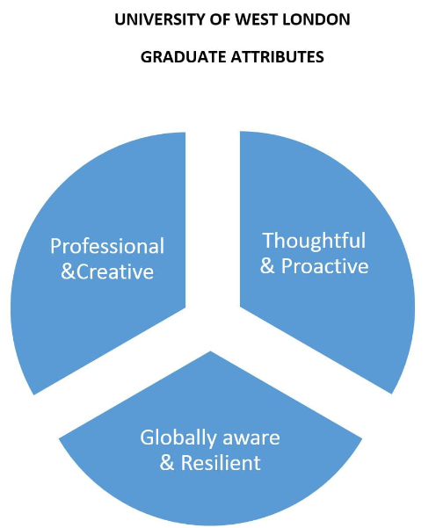
“Employability skills development is most effective when embedded within the degree programme” (Wakeham, 2017)

Slide 11
SCENARIO 1 Academic Writing and Digital Skills course (L3)
Learning Outcomes | strengthens academic language skills and employability skills
Duration | one semester/one academic year
Course Team | English language lecturers, Library, Study skills, Careers, Expert Academy, I.T.
Skills taught and learned | academic writing, critical reading and thinking, research and using information, referencing, Use of Blackboard and library databases, Microsoft Suite, presentation and communication skills

Slide 12
SCENARIO 2 Library led projects and job placements (L5)
Learning Outcomes | builds work readiness, customer service skills, creativity, data entry and analysis skills
Duration | Four weeks/summer jobs
Course Team | Academics, Library, Careers, I.T.
Skills taught and learned | Academic writing, Note taking, project management, mentoring, Information Literacy, Team work, Leadership, Networking, Confidence, Communication skills, Presentation skills, Problem solving, mock interviews
Project examples | User satisfaction surveys archive exhibitions institutional repository co-create project inclusive reading list stock inventory

Slide 13
SCENARIO 3 Employability and Personal Branding course (L6)
Learning Outcomes | strengthens employability skills , showcases personal branding, and builds career skills
Duration | one semester/one academic year
Course Team | Academics, Industries, English language lecturers, Library, Study skills, Careers, Expert Academy, I.T.
Skills taught and learned | Adaptability, flexible learning, CV writing, presentation and communication skills, mock interviews, group discussion, information research, using information effectively and ethically, knowledge of media and new technologies, soft skills

Slide 14
ROLE OF THE ACADEMIC LIBRARIAN
INDUCTION PROGRAMME
RESEARCH SUPPORT
INFORMATION LITERACY
DIGITAL SKILLS TRAINING
LIFE-LONG LEARNING
EMPLOYABILITY SKILLS
HOLISTIC ROLE
LIBRARIAN ROLE
Academic integrity - Creating honest citizens

Slide 15
CHANGING ROLE OF LIBRARY PROFESSIONALS
Constant upskilling and reskilling
Gaining teaching qualifications
Adapting to new technologies and marketing techniques
Flexibility, confidence and resilience

Slide 16
CONCLUDING REMARKS
Librarians today stand at par with academicians in creating employable graduates and they should recognize their significance in the employability framework.
More university led embedded Information Literacy programmes are necessary in this information age. They will provide transferrable skills for lifelong learning.

Slide 17
REFERENCES
CBI (2018) CBI Skills Framework. Available at: https://www.cbi.org.uk/media/1914/cbi-skills-framework.pdf (Accessed: 3 May 2022).
CILIP (2018) CILIP Definition of Information Literacy 2018. Available at: https://www.cilip.org.uk/page/InformationLiteracydefinition (Accessed: 5 June 2022).
Grimes, A. (2019) Getting young people ‘work ready’. Available at: cbi_work-readiness.pdf (Accessed: 2 June 2022).
Yorke, M. (2006) Employability in higher education: what it is – what it is not, The Higher Education Academy/ESECT. Available at: https://www.ed.ac.uk/files/atoms/files/hea-learning-employability_series_one.pdf (Accessed: 15 May 2022).
UNESCO (2018) Digital skills critical for jobs and social inclusion. Available at: https://en.unesco.org/news/digital-skills-critical-jobs-and-social-inclusion (Accessed: 20 May 2022).

Slide 18
REFERENCES
UNESCO (2021) Reimagining our futures together: A new social contract for education. Available at: https://unesdoc.unesco.org/ark:/48223/pf0000379707 (Accessed: 7 June 2022).
Wakeham, W. (2017, February) ’Employability: Integral to the curriculum or an add-on?’ Keynote paper presented at the Higher Education Academy STEM Conference, Manchester, United Kingdom.
World Economic Forum (2016) The future of jobs: Employment, skills and workforce strategy for the Fourth Industrial Revolution. Available at: https://www3.weforum.org/docs/WEF_FOJ_Executive_Summary_Jobs.pdf (Accessed: 25 May 2022).

