Slide 1
UWL FESTIVAL OF TEACHING AND LEARNING
Navigating the AI literacy landscape: A study of select academic libraries in the UK
Dr. Janice Fernandes
Academic Support Manager
Subject librarian - LCM

Slide 2
INTRODUCTION
Information Literacy - “ … the discovery of information, how information is produced and valued, the use of information in creating new knowledge and participating ethically in communities of learning” (ACRL, 2015)
AI Literacy - … competencies we will all need as a foundation in a world that is enhanced with AI technologies (includes recognising, critically evaluating, ethically using and making informed decisions about AI)

Slide 3
NEED OF THE STUDY
AI tools are varied and multiplying at a fast rate
AI in Higher Education - Academic integrity and plagiarism
Current drift to seeing AI through a different lens
Commitment of libraries to support students with respect to academic writing
Changing roles of the information professional

Slide 4
OBJECTIVES OF THE STUDY
A perception that the library webpage is the face of the library - virtual library
What is the current status with regard to AI guidance ?
Where is this information located? Is it easy to access, understand and use?
Do libraries play a major role in supporting students with respect to AI guidance?
Is there a move for today’s ‘university librarian’ to identify as ‘AI champion’?

Slide 5
RESEARCH METHODOLOGY
An analysis of university websites for Higher Education, list taken from UCAS (131)
Five parameters – Information on library webpage, Ease of understanding, Tutorial, Quiz, Videos
Various search strategies used; data collection through simple Excel sheet
Interesting information by following embedded links (saved to review later)

Slide 6
DATA ANALYSIS

Slide 7
DATA ANALYSIS

Slide 8
KEY INTERPRETATIONS
No uniformity about where this information is located – Libguides, study support, student union, academic policies
Guidance through pdf files, systematically evolving information, videos, checklist and acknowledgement
Separate guidance for staff and students
Links to outside sources – other universities, official organizations, blogs, interviews, reports etc.
Facility to book a 1-2-1 session with a librarian

Slide 9
KEY CHALLENGES
Updated information in a constantly evolving AI landscape
Guidance – too much or too little
Tone and choice of words - Warning, distanced, friendly
Tools for neurodiversity, translation etc.
AI sometimes just linked to referencing guidance
Concepts like Prompt engineering, critical thinking, use of images etc. needed more emphasis

Slide 10
SOME EXAMPLES
Videos showing students perspective of AI
A Reading list of AI resources (like us !)
Detailed guidance created using other IT tools like Sway and Flipsnack
Read about AI anxiety and AI audit for the first time
Funding for a number of AI related projects – greater awareness

Slide 11
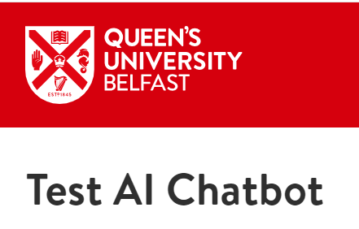
A lot of collaborative projects funding secured etc queen mary – links to videos showing students perspective of AI saw different IT tools like Flipsnack and sway being used some information about AI only comes inside referencing

Slide 13
You can use chatgpt to create a quiz
One uni says – using AI to support assignments
Not much information about how to critically evaluate information although most show a mention about this
Detailed prompt engineering with examples https://libguides.bcu.ac.uk/generativeAI/prompt-engineering
Very detailed information but under guidance for staff
The university will not be utilising any generative AI detection tools

Slide 14
file:///C:/Users/janic/Downloads/The-Prospects-of-Generative-AI-in-Higher-Education.pdf

Slide 15
https://www.oneusefulthing.org/p/my-class-required-ai-heres-what-ive?utm_source=%2Fsearch%2Fstudents&utm_medium=reader2

Slide 16
https://themarkup.org/machine-learning/2023/08/14/ai-detection-tools-falsely-accuse-international-students-of-cheating

Slide 17
According to Hashmi and Bal (2024) , one of the primary skills required in an AI-driven future is prompt engineering
https://www.sciencedirect.com/science/article/pii/S000768132400065X?via=ihub
the future work landscape will require a mix of technical and soft skills, underpinned by an understanding of AI's capabilities, limitations, and ethical implications.

Slide 18
Create opportunities for faculty, staff, students, and other stakeholders to discuss the impact of ChatGPT on the HEI and co-construct strategies to adapt and adopt to AI.
The section below on conducting an AI audit offers one
route for this type of engagement.
Introduce clear guidance for students and instructors
about how and when ChatGPT can be used (and when
it cannot). Such guidance should be negotiated with
students and teachers, not imposed on them.
Connect the use of ChatGPT to course learning
outcomes. This helps students understand how ChatGPT
can support their learning and what expectations there
are for them.
Review all forms of assessment and evaluation to
ensure that each element is fit for purpose. This reviewhttps://www.iesalc.unesco.org/wp-content/uploads/2023/04/ChatGPT-and-Artificial-Intelligence-in-higher-education-Quick-Start-guide_EN_FINAL.pdf
may lead to replacing exams or other assessments with
in-person assessments or altering the types of questions
or exam formats that are used.
Review and update policies relating to academic
integrity/honesty in relation to ChatGPT and other AI
tools.17
Train teachers, researchers, and students to improve
the queries they pose to ChatGPT. As researchers have
noted, ChatGPT is most useful when the inputs provided
to it are carefully created.18
https://www.iesalc.unesco.org/wp-content/uploads/2023/04/ChatGPT-and-Artificial-Intelligence-in-higher-education-Quick-Start-guide_EN_FINAL.pdf

Slide 19
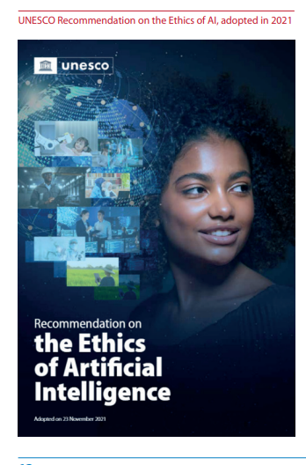
https://www.iesalc.unesco.org/wp-content/uploads/2023/04/ChatGPT-and-Artificial-Intelligence-in-higher-education-Quick-Start-guide_EN_FINAL.pdf
AI audit

Slide 20
LIBRARIAN AND STUDENT INTERACTION
Induction – university requirement
Classroom – curriculum requirement
Personalised – student requirement
There is evidence of strong, positive connections between student use of the library and impact on student learning and success (ACRL, 2016).

Slide 21
ROLE OF THE ACADEMIC LIBRARIAN
INDUCTION PROGRAMME
RESEARCH SUPPORT
INFORMATION LITERACY
DIGITAL SKILLS TRAINING
LIFE-LONG LEARNING
EMPLOYABILITY SKILLS
HOLISTIC ROLE
LIBRARIAN ROLE
Academic Integrity - Creating honest citizens
Notes:
This slide is just a showcase of everything else we do as subject librarians.
Information Literacy is just one of them.

Slide 22
SUMMING UP
An understanding of the subject librarian’s role in creating information literate graduates in the Higher Education framework will encourage more collaboration.
Quantitative as well as qualitative research related to library instruction at UWL will pave the way for embedding information literacy into the curriculum at all levels and schools in a more meaningful way.
Notes:
Hopefully more collaboration with the academics and the school and further assessment. But doing this research has given me the idea that I now need to get better evidence after each session … come September.

Slide 23
CONCLUSION
I will end with a lovely quote from the Head of Subject at LCM
“It is important to integrate information literacy into a performing arts curriculum, even though some students may resist it in favour of the practical aspect of the course.
Nevertheless, combining theory with practice is crucial for comprehending the practice and discovering innovative techniques.
Collaborating with the LCM subject librarian has helped us establish a solid connection between theory and practice”.
Dr. Gavin Baker
Notes:
Hopefully more collaboration with the academics and the school and further assessment. But doing this research has given me the idea that I now need to get better evidence after each session … come September.
And I will end with a lovely quote from the head of subject at LCM Dr. Gavin Baker
“It is important to integrate information literacy into a performing arts curriculum, even though some students may resist it in favour of the practical aspect of the course.
Nevertheless, combining theory with practice is crucial for comprehending the practice and discovering innovative techniques.
Collaborating with the LCM subject librarian has helped us establish a solid connection between theory and practice”.

Slide 24
REFERENCES
Bravender, P., McClure, H. and Schaub, G. (eds) (2015) Teaching information literacy threshold concepts: lesson plans for librarians. Available at : https://discovery.ebsco.com/linkprocessor/plink?id=2f152ba5-1c9b-355b-9adf-80ea7b4c077d (Accessed: 12 June 2023).
Lloyd, A. (2021) The qualitative landscape of information literacy research. Available at: https://www.perlego.com/book/3259709/the-qualitative-landscape-of-information-literacy-research-perspectives-methods-and-techniques-pdf (Accessed: 18 May 2023).
Mackey, T. and Jacobson, T. (2010) Collaborative information literacy assessments. Strategies for evaluating teaching and learning. London: Neal-Schuman Publishers, Inc.
McAdoo, M. (2012) Fundamentals of library instruction. Available at: https://www.perlego.com/book/1637222/fundamentals-of-library-instruction-pdf (Accessed: 17 May 2023).
SCONUL (2023) The value of academic libraries. Available at: The value of academic libraries | SCONUL (Accessed: 18 June 2023).
Zhu, S. et al. (2020) ‘Conceptual assessment framework of students' information literacy: An evidence-centered design approach’, International Symposium on Educational Technology (ISET), Bangkok, Thailand pp. 238-242. Available at: 10.1109/ISET49818.2020.00059 (Accessed: 17 June 2023).

