Slide 1

Artificial Intelligence Tools :
Keeping pace or staying ahead
An AI generated image from www.freepik.com
Dr. Janice Fernandes
Academic Support Manager
University of West London – U.K.
2nd July 2024

Slide 2

What we will discuss
Introduction to information
Basics of AI
ChatGPT
Quillbot
Humata
Goblin tools
Other AI tools
Librarians and AI – learn, teach, develop
Some thoughts

Slide 3
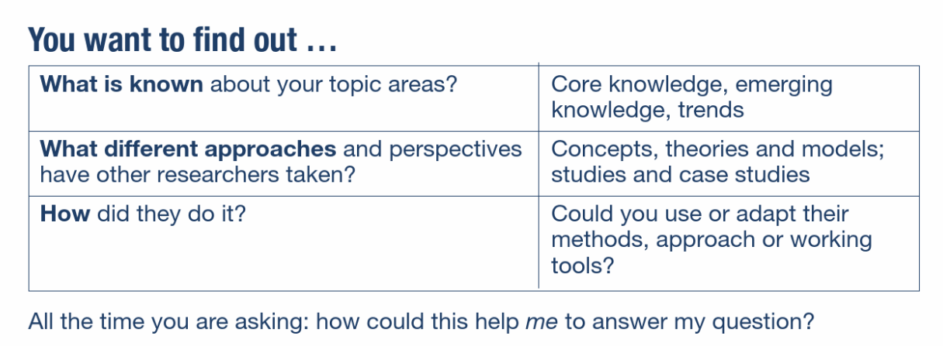
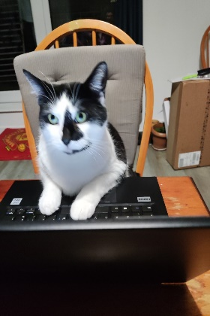
WHAT IS INFORMATION?
A viewpoint?
An opinion?
An answer?
A fact?

Slide 4

POTENTIAL SOURCES OF INFORMATION
Journal articles
Publisher databases
Government papers
Contracts
Conference papers
Letters and e-mails
Standards
Newspapers
Technical reports
Patents
Statistics
Books
Primary sources
Market reports
Theses
Blogs
VLogs
Videos
Open letters

Slide 5
POLL EVERYWHERE
https://pollev.com/janicefernandes764
What is the first word that come to mind when you think “Artificial Intelligence” ?
On a scale of 1-5 how confident are you about the knowledge and use of AI tools ?
What is your gut feeling about AI ? (Fake, Amazing, Necessary, Not necessary)

Slide 6
What is Artificial Intelligence
ARTIFICIAL
That which is made by human beings rather than occurring naturally
INTELLIGENCE
The ability to acquire and use knowledge and skills
Artificial intelligence is -
the science of making machines that can think like humans.
the development of computer systems capable of performing tasks that typically require human-like cognitive abilities.
Notes:
Differences between a Reference List and a Bibliography
The reference list is an alphabetical list of all the sources that you cited in the text of your assignment.
A bibliography is a separate list, presented in the same format as a reference list, however, it includes all the sources you consulted in the preparation of your assignment, not just those you cited.
Reference to the source of information used in your research. When you directly quote, paraphrase or summarize the essential elements of someone else's idea in your work, it is followed by an in-text citation.

Slide 7

How did artificial intelligence originate?
1950 : Alan Turing published “Computer Machinery and Intelligence” which proposed a test of machine intelligence called The Imitation Game.
1952 : Arthur Samuel a computer scientist developed a program to play checkers, which is the first to ever learn the game independently.
1955 : John McCarthy held a workshop at Dartmouth on “artificial intelligence” which is the first use of the word, and how it came into popular usage.

Slide 8
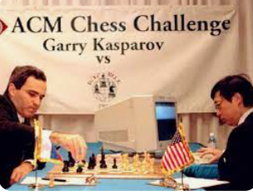
What was the name of the IBM supercomputer that defeated world chess champion Garry Kasparov?
Deep Blue was a chess-playing computer developed by IBM that defeated the world champion, Garry Kasparov, in 1997.
It was a unique purpose-built IBM supercomputer that used heuristic search algorithms to evaluate 200 million chess positions per second and select the best one.
Deep Blue’s victory is considered a milestone in the history of artificial intelligence .

Slide 9

Why is artificial intelligence important?
Too much information ,Too little time
Language complexities ,
Access and accessibility issues
Right information at the right time is the key
Complex analytical and decision-making skills
Computers (trained by humans) can (often) do things quickly and more efficiently than humans
Artificial intelligence forms the basis for all
computer learning and is the future of all
complex decision making.

Slide 10

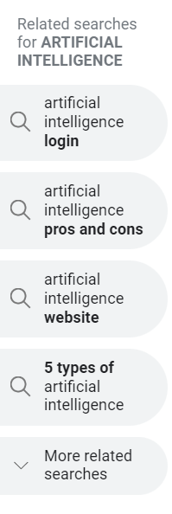


Do you recognise any of these terms ?
Generative AI
Essayservice.ai
Craiyon
Tabnine
SOPHIA
Machine Learning
Large Language Models
Natural language processing
Chatbots
Hallucinations
OpenAI
DeepbrainAI
Quillbot
Deep Learning
Otter.ai
BARD
DALL-E

Slide 11
Some of the many AI tools used in education today
Adobe Firefly
AmazonBedrock
AutoCrit
Caffe
ChatGPT
ClickUp AI
Copy.ai
Descript
Elink.io
Explainpaper
Goblin Tool
Grammarly
Humata
Infosys Niais
Jasper AI
JenniAI
Leonardo
Midjourney
OpenAIgym
Originality.ai
Play.ht
Quillbot
Reword
Rewritetool.net
Rytr
Scholarcy
Scispace
SlidesAI
Synthesia
Tensorflow
TimeHero
TutorAI
Wisdom.ai
Wordtune
Writely
WriteSonic

Slide 12
Quick use of AI among university students today
TutorAI
your personal tutor allowing you to select modules and learn at your own pace
Scispace/
Explainpaper
helps you understand research papers better by explaining main points
Jasper/
GoogleBardAI
generate text and script rewrite, paraphrase , summarise videos etc.
Quillbot
Has an AI powered thesaurus and uses a synonym slider to paraphrase text you want
Grammarly/
Spellbound
Reviews spelling grammar, punctuation, clarity, engagement and suggest replacements
Originality.ai
Accurate AI detection and plagiarism checker and fact checker
SUBMIT to Blackboard

Slide 13
What is ChatGPT ?
Conversational - Designed to generate human-like conversational text, understand context, answer questions and provides explanations.
Generative - Generates new and original content , creation and innovation is the key, can perform a variety of language-related tasks
Pre-trained - Exposed to a vast amount of text data from the internet, which allows it to learn grammar, language structure, and various patterns
Transformer - captures more context and improves performance on natural language processing (NLP) tasks.

Slide 14
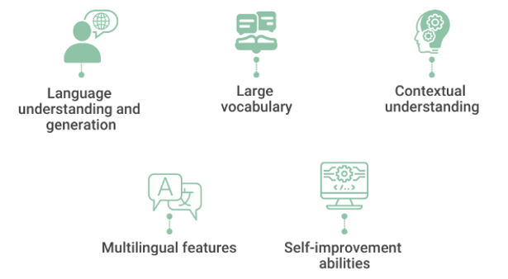
Characteristics of ChatGPT ?
Natural Language Processing
Multiple languages (80)
Learnt from the Internet
Learns, adapts, improves
Understands the context
Quick response time
Personalised experience
https://www.spiceworks.com/tech/artificial-intelligence/articles/what-is-chatgpt/

Slide 15
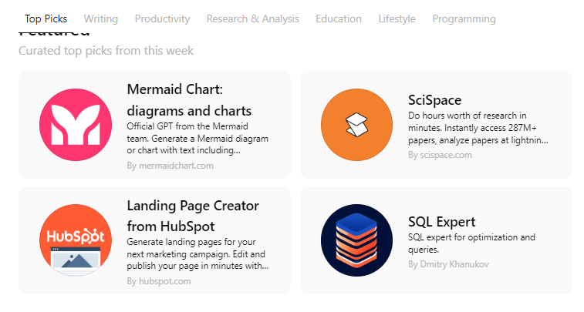
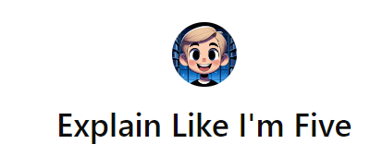
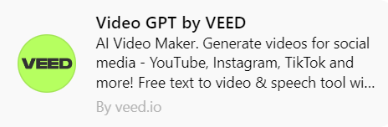

Other features through ChatGPT ?

Slide 16
ASSIGNMENT 1 – Experimenting with ChatGPT
Log into ChatGPT using this link www.chatgpt.com
Put these questions successively in ChatGPT and see the results.
List the soft skills required by university teachers today.
List the skills with regard to critical thinking required by university teachers today.
List the ethical decision-making skills with regard to critical thinking required by university teachers today.
3. Now try these queries and see the results
List 2 decision making skills required by university teachers in the 21st century giving an example of each relevant to the Indian scenario.
List 2 instances of university teachers having used their decision-making skills in a critical way in the last 5 years in India.
List an instance of a university teacher in Mumbai using their decision-making skills in a critical way in 2019 / 2022/1920 etc.

Slide 17
What is Quillbot ?
An online writing platform with AI tools embedded in it
It rewrites summarizes, checks for grammar and plagiarism , translates, outlines and creates citations.
Quillbot has the following tools -
The paraphrasing tool
A grammar checker
A plagiarism checker
The co-writer, which brings all of the other tools together
The summarizer
A citation generator

Slide 18
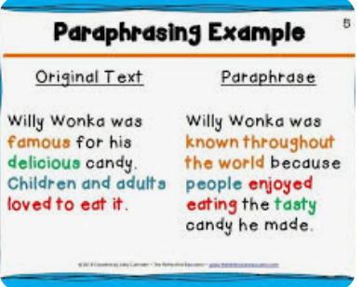
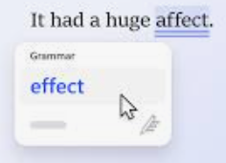

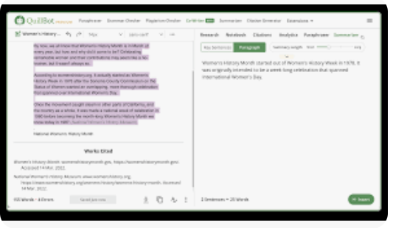
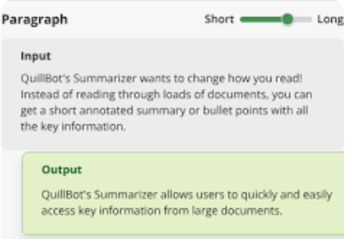
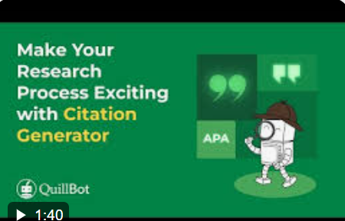
Characteristics of Quillbot
Paraphrasing Tool
Grammar Checker
Plagiarism checker
Co-writer – brings it all together
Summarizer – focus on the essence
Citation generator

Slide 19
ASSIGNMENT 2 – Experimenting with Quillbot
Log into Quillbot using this link https://quillbot.com/
Put the text below in Quillbot and see the results.
Try rephrasing various parts of the sentence to see the results.
Look at the number of words. How can you increase /decrease the word count.
Try other texts, languages, tools etc . in Quillbot and see the results.
India has not inculcated an awareness of plagiarism in children from their school days. At an early age, Indian children are not allowed to think independently. Schools even provide students with notes and answers: students are expected to write the same response during examinations. Most teachers do not like it if the students deviate from the notes provided and write answers in their own words, often deducting marks for doing so. Students are therefore taught to follow the trodden path and are not encouraged to think (Handa & Power, 2005) 86 words
https://doi.org/10.26529/cepsj.1494

Slide 20
Watch this video

Slide 21
What is Humata ?
Developed by AI experts Cyrus Khajvandi and Dan Rasmuson
An innovative AI intelligence tool for text-based files
Helps users quickly analyze, understand, and extract insights from complex documents, also cites it for you
It has page limits for the premium plans
The free version is limited to 60 journal article pages and 100 questions each month.
After the limit is exceeded, you need to pay for each page
https://www.humata.ai/

Slide 22
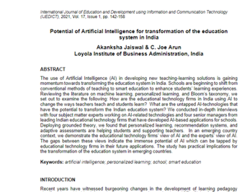
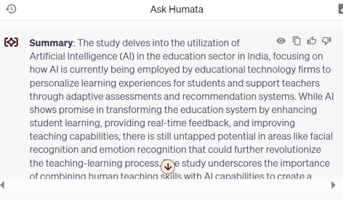
Experimenting with Humata
17 pages
400 words

Slide 23

What are Goblin Tools ?
Created by Bram De Buyser, a freelance software engineer
Collection of small, simple, single-task tools
Designed to help neurodiverse people (anxiety) with tasks they find overwhelming or difficult.
Most of the tools use AI technologies to achieve their goals.
Currently this includes OpenAI's models. As the tools improve, the intent is to move to an open source alternative.
Goblin tools are free to use and it will stay free, without advertisements or paywalls.

Slide 24
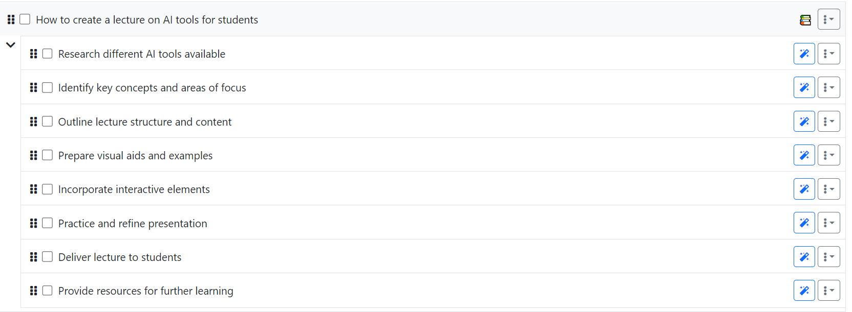
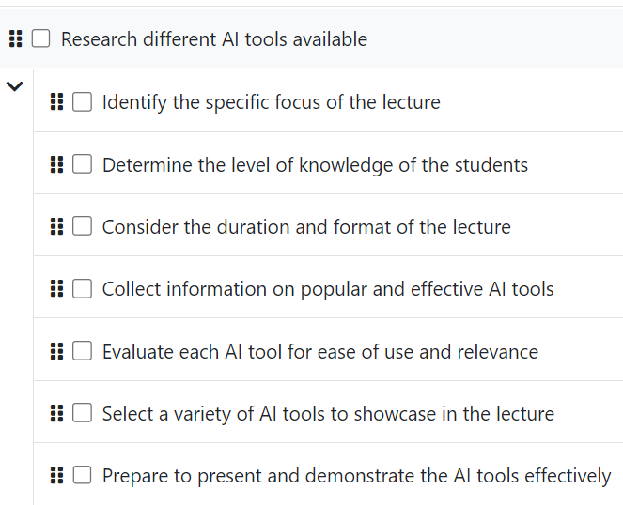
Goblin Tools – MagicToDo

Slide 25
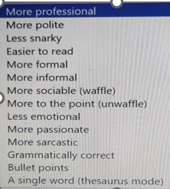

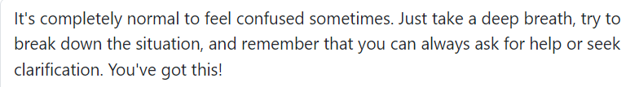
Goblin Tools – Other features
Breaking things down so you don't
Turn the spicy thoughts into classy ones
Am I misreading the tone of this?
Give me the crash course
How long will this take
Compile a list of tasks
What am I having for lunch ?

Slide 26
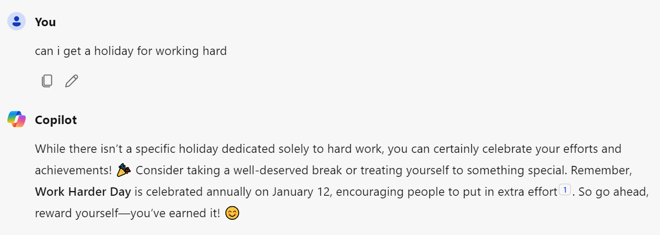
Microsoft Copilot
A product of Microsoft Corporation – was earlier called ‘Bing Chat’
Allows you to search for specific information, generate text, summarises content and create images based on text prompts
Can write code in popular programming languages
Integrates seamlessly with other Microsoft products

Slide 27

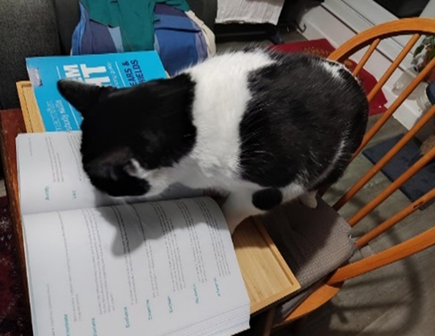

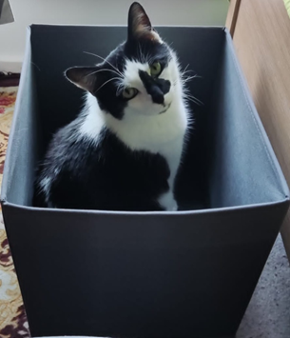
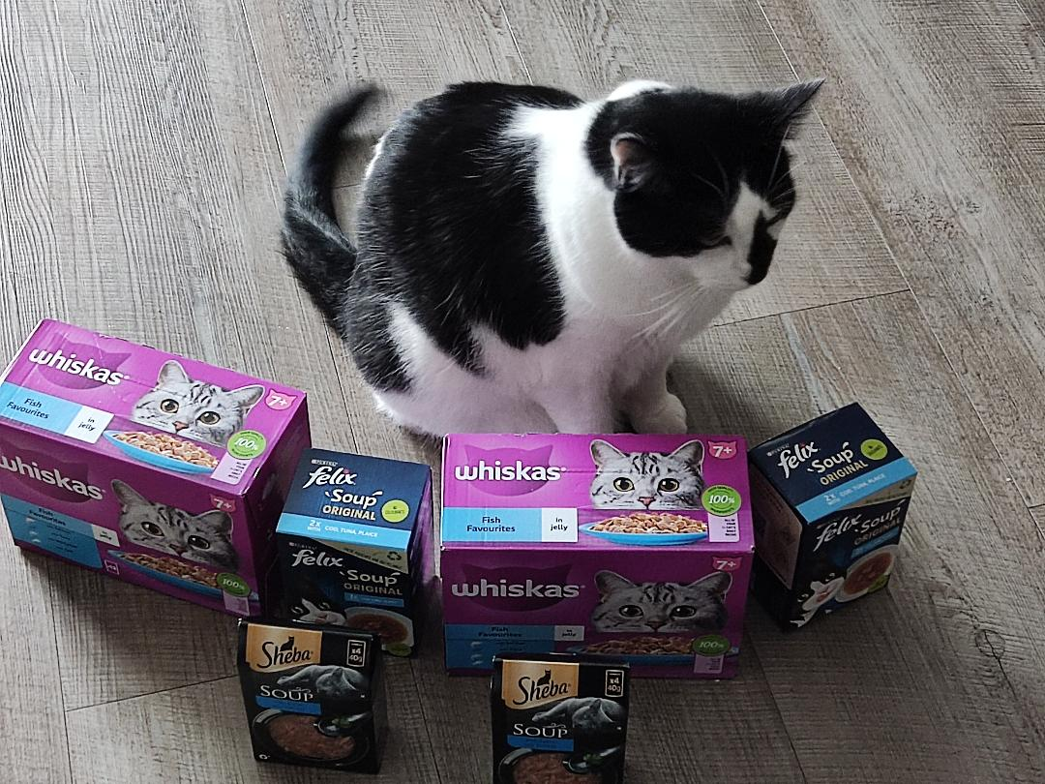
Are these images all created by Leonardo ?
Midjourney and Dall-e are the leaders in image creation

Slide 28
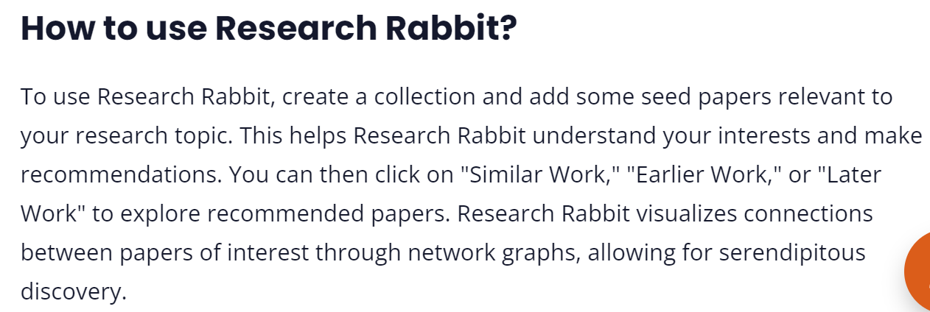
What is Scisummary and Research Rabbit?
Summarize 30k words (1M words per month after your trial ends).
Chat with papers and get inline citations and figures
Analyze figures from papers and ask questions directly about them
AI Powered research paper search, with no limit on searches
Bulk summarize papers, combine papers into a single summary, and compare papers using AI

Slide 29
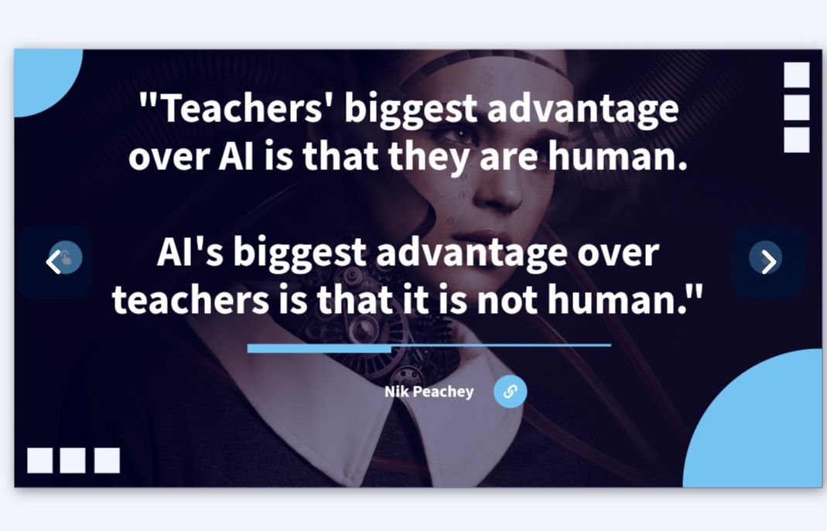
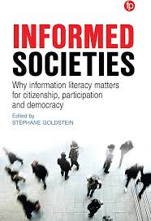
Time for reflection …
Informed societies (cilip.org.uk)

Slide 30
Librarians and Artificial Intelligence
LEARN
Why students use them and how they use them
Talk to students
Talk to colleagues
Attend webinars and workshops - LILAC
AI Coffee morning
Myspace library
TEACH
Students to use them effectively and ethically
AI Literacy
Referencing it correctly
Fake News
Workshops / Role play
Demonstrate AI tools
DEVELOP
Guidelines, raise awareness and collaborate with others
Continuous assessments
Redevelop questions and marking rubrics
Practical/group test
lived experiences
Similarity detector

Slide 31
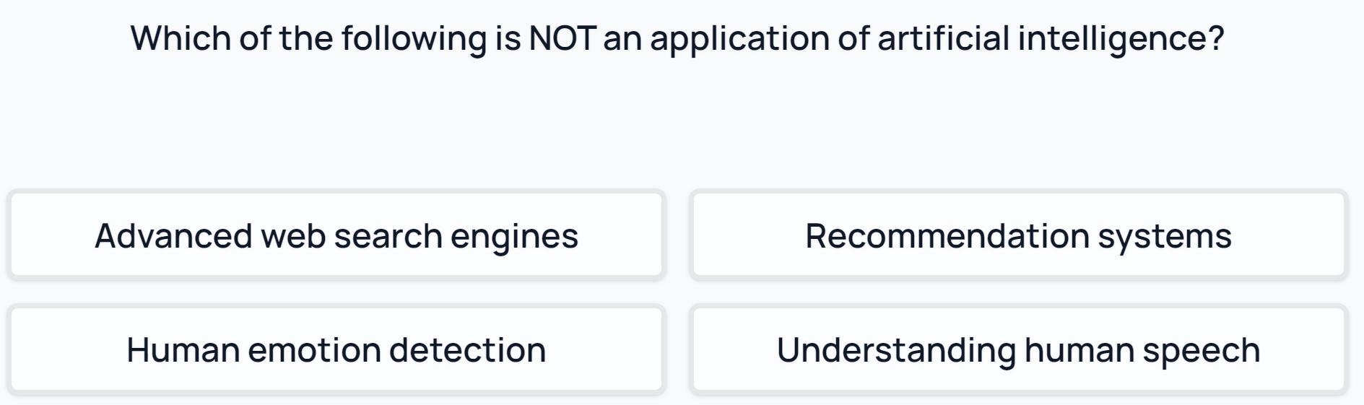
AI Literacy in the information era
AI literacy is defined as a set of competencies that enables individuals to critically evaluate AI technologies; communicate and collaborate effectively with AI; and use AI as a tool online, at home, and in the workplace.

Slide 32
How do AI tools “help/not help” students ?
Engage in conversational chats
Answer questions and give explanations
Programming and coding assistance
Content ideas for creative projects
Writing assistance and proofreading
Educational support
Game interactions(text-based games)
Language translation
Study tips and strategies
General knowledge
Career guidance
Accuracy and reliability – citations incorrect, references may not exist
Using old information
Inability to ask clarifying questions
Potential for misinformation – what goes in comes out
Bias – ethnic, geographic, race, gender
Limited subject expertise unlike search engine
Lack of emotional understanding
No critical thinking or context understanding
Potential for off-topic responses
Privacy concerns

Slide 33
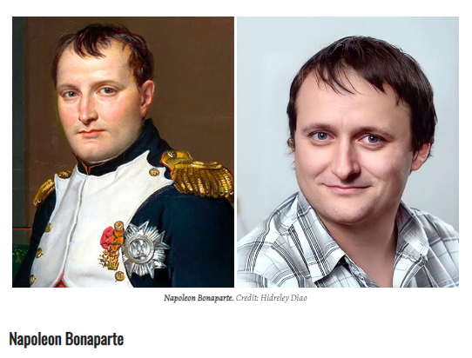
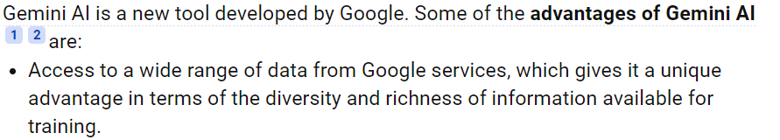
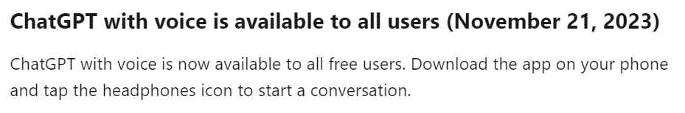
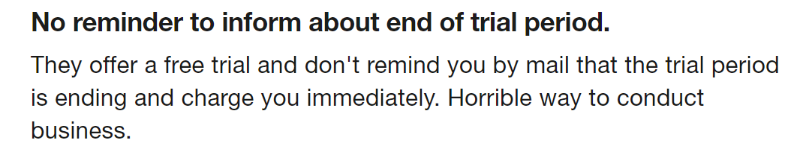
AI tools - some insights
Notes:
Here are some AI-powered tools that can assist you in selecting a research topic:
Texta.ai: This student-focused article generator uses cutting-edge AI and natural language technology to find and create relevant research for your topic in seconds. It’s a great way to say goodbye to endless hours of research¹.
Gemini: An AI chatbot from Google AI that can be used for various research tasks, including finding information, summarizing texts, and generating creative content².
Consensus: An AI-powered research tool designed to help you find and understand scientific research papers².
Scite.AI: A platform that provides context-aware citation analysis for scientific articles².
GPT4All: Leverage the power of GPT-4 language models for generating text, answering questions, and more².
AsReview: An AI tool for systematic literature reviews that helps you efficiently screen and select relevant research articles².
DeepL: While primarily known for translation, DeepL’s language models can also assist in generating content and understanding complex texts².
Humata: An AI tool that can summarize various types of content, making it useful for research purposes².
Gemini is an AI chatbot from Google AI that can be used for a variety of research tasks, including finding information, summarizing texts, and generating creative text formats. It can be used for both primary and secondary research and it is great for creating content.

Slide 34
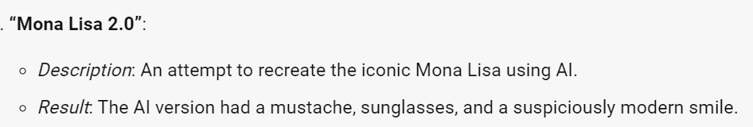
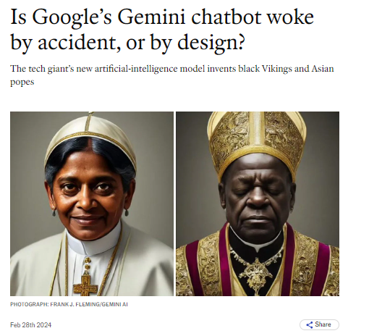
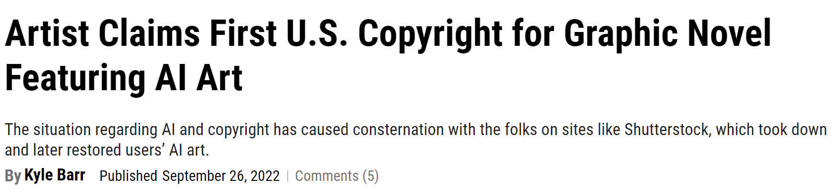

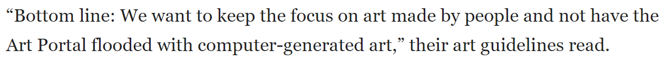
AI tools – some insights
https://www.economist.com/united-states/2024/02/28/is-googles-gemini-chatbot-woke-by-accident-or-design

Slide 35
Evaluating information sources – thinking critically
C
CURRENCY
Timeliness
Date published Date updated
Links functional
R
RELEVANCE
Relate to the topic
Intended audience
Appropriate level
Basic or advanced
A
AUTHORITY
Who is the author
Is the writer qualified
Contact details
A
ACCURACY
Evidence
Verified by anther source
Unbiased
P
PURPOSE
Inform, Sell, entertain, persuade?
Fake news
Notes:
Magazines
Magazines publish articles on topics of popular interest and current events. The articles are written by journalists and are for the general public.
Magazines, like journals and newspapers, are called "periodicals" because they are published at regular intervals throughout the year. You can find print magazines at newsstands and in libraries. Some are now available on the Web as electronic magazines.

Slide 36
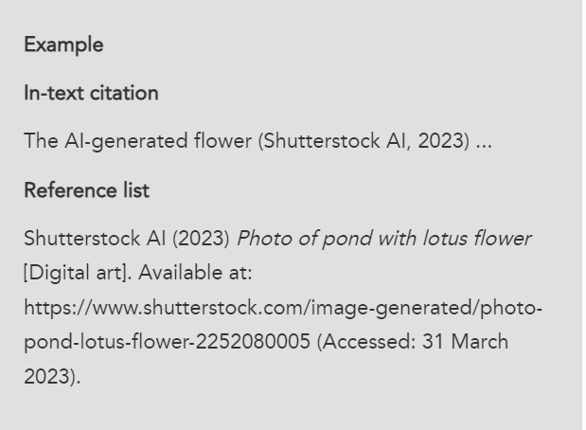
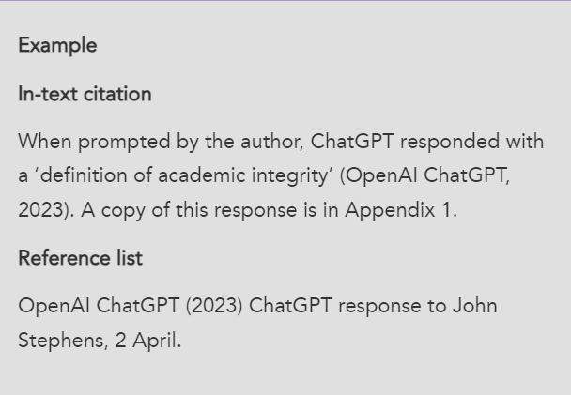
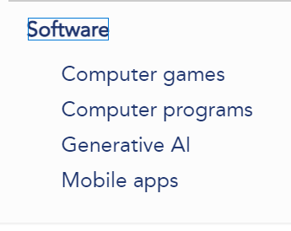
References and Citations - Cite them right online
Cite Them Right - Generative AI (citethemrightonline.com)

Slide 37

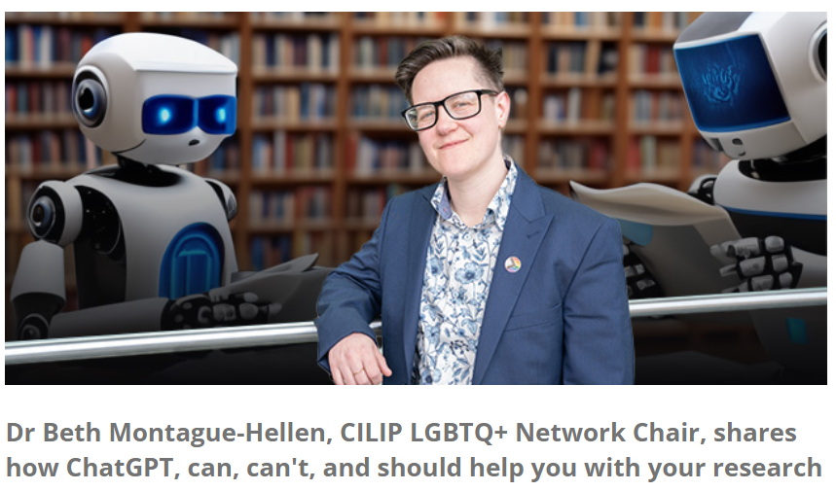
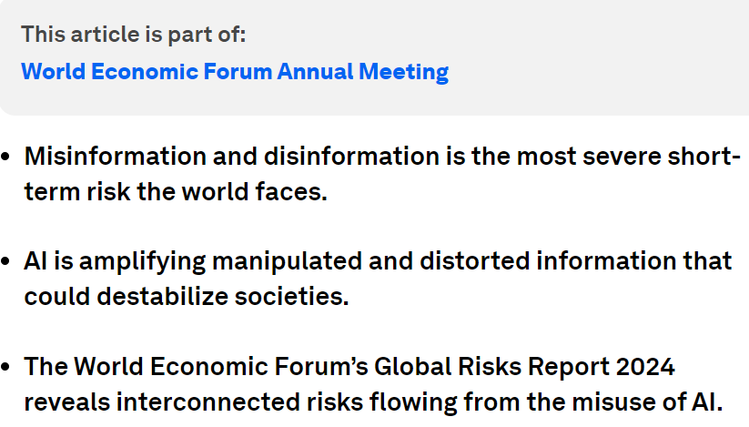
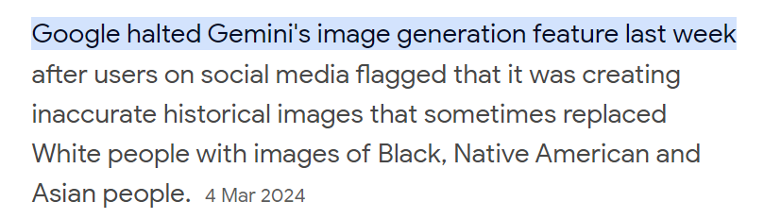

AI tools – looking at AI through a critical lens
https://www.cilip.org.uk/news/661388/Can-AI-do-your-reading-for-you--should-it.htm
https://academia.stackexchange.com
Notes:
Gemini is an AI chatbot from Google AI that can be used for a variety of research tasks, including finding information, summarizing texts, and generating creative text formats. It can be used for both primary and secondary research and it is great for creating content.

Slide 38

AI – Teach students about the limitations
AI prompts – telling AI what exactly you want - generating content, interpreting data, or simulating a customer response. “Ask and it shall be given”.
AI Bias– favouring data, people, ideas – gender, occupation or culture
Hallucinations– Incorrect or misleading responses, creating information which does not exist- authors, titles, quotations, research results etc.
Data Privacy– Check the privacy policy – what data are you sharing – name, age, geographical location, religion, information preferences etc. Do not share any sensitive or private data with a generative AI tool.

Slide 39

BA40103E - Employability Skills
The graduate employment market and emerging trends
Written assignment report - 1000 words , 30% weightage, 40% pass mark
RESULTS FROM CHATGPT
Remote work and flexibility
Technology and digital skills
Soft skills emphasis
Focus on diversity and inclusion
Continued learning and adaptability
Green jobs and sustainability
Healthcare and biotechnology
Entrepreneurship and startups
Globalization and cross-cultural competence
Gig economy and freelancing
Good set of points ; very vague , repetitive , old thoughts and probably everyone in the class has the same flow

Slide 40
BA40103E - Employability Skills
The graduate employment market and emerging trends
Written assignment report - 1000 words , 30% weightage, 40% pass mark
BEFORE YOU GET RESULTS FROM CHATGPT -
Look at the learning outcomes in the module study guide
Look at the assessment criteria
Look at the marking scheme
Think of the required flow of the document
Consider the statistical information required
Remember you will be submitting through Turnitin
Teach students that you don’t need AI for this - to think critically, to distinguish fake news and understand what is expected of you !

Slide 41
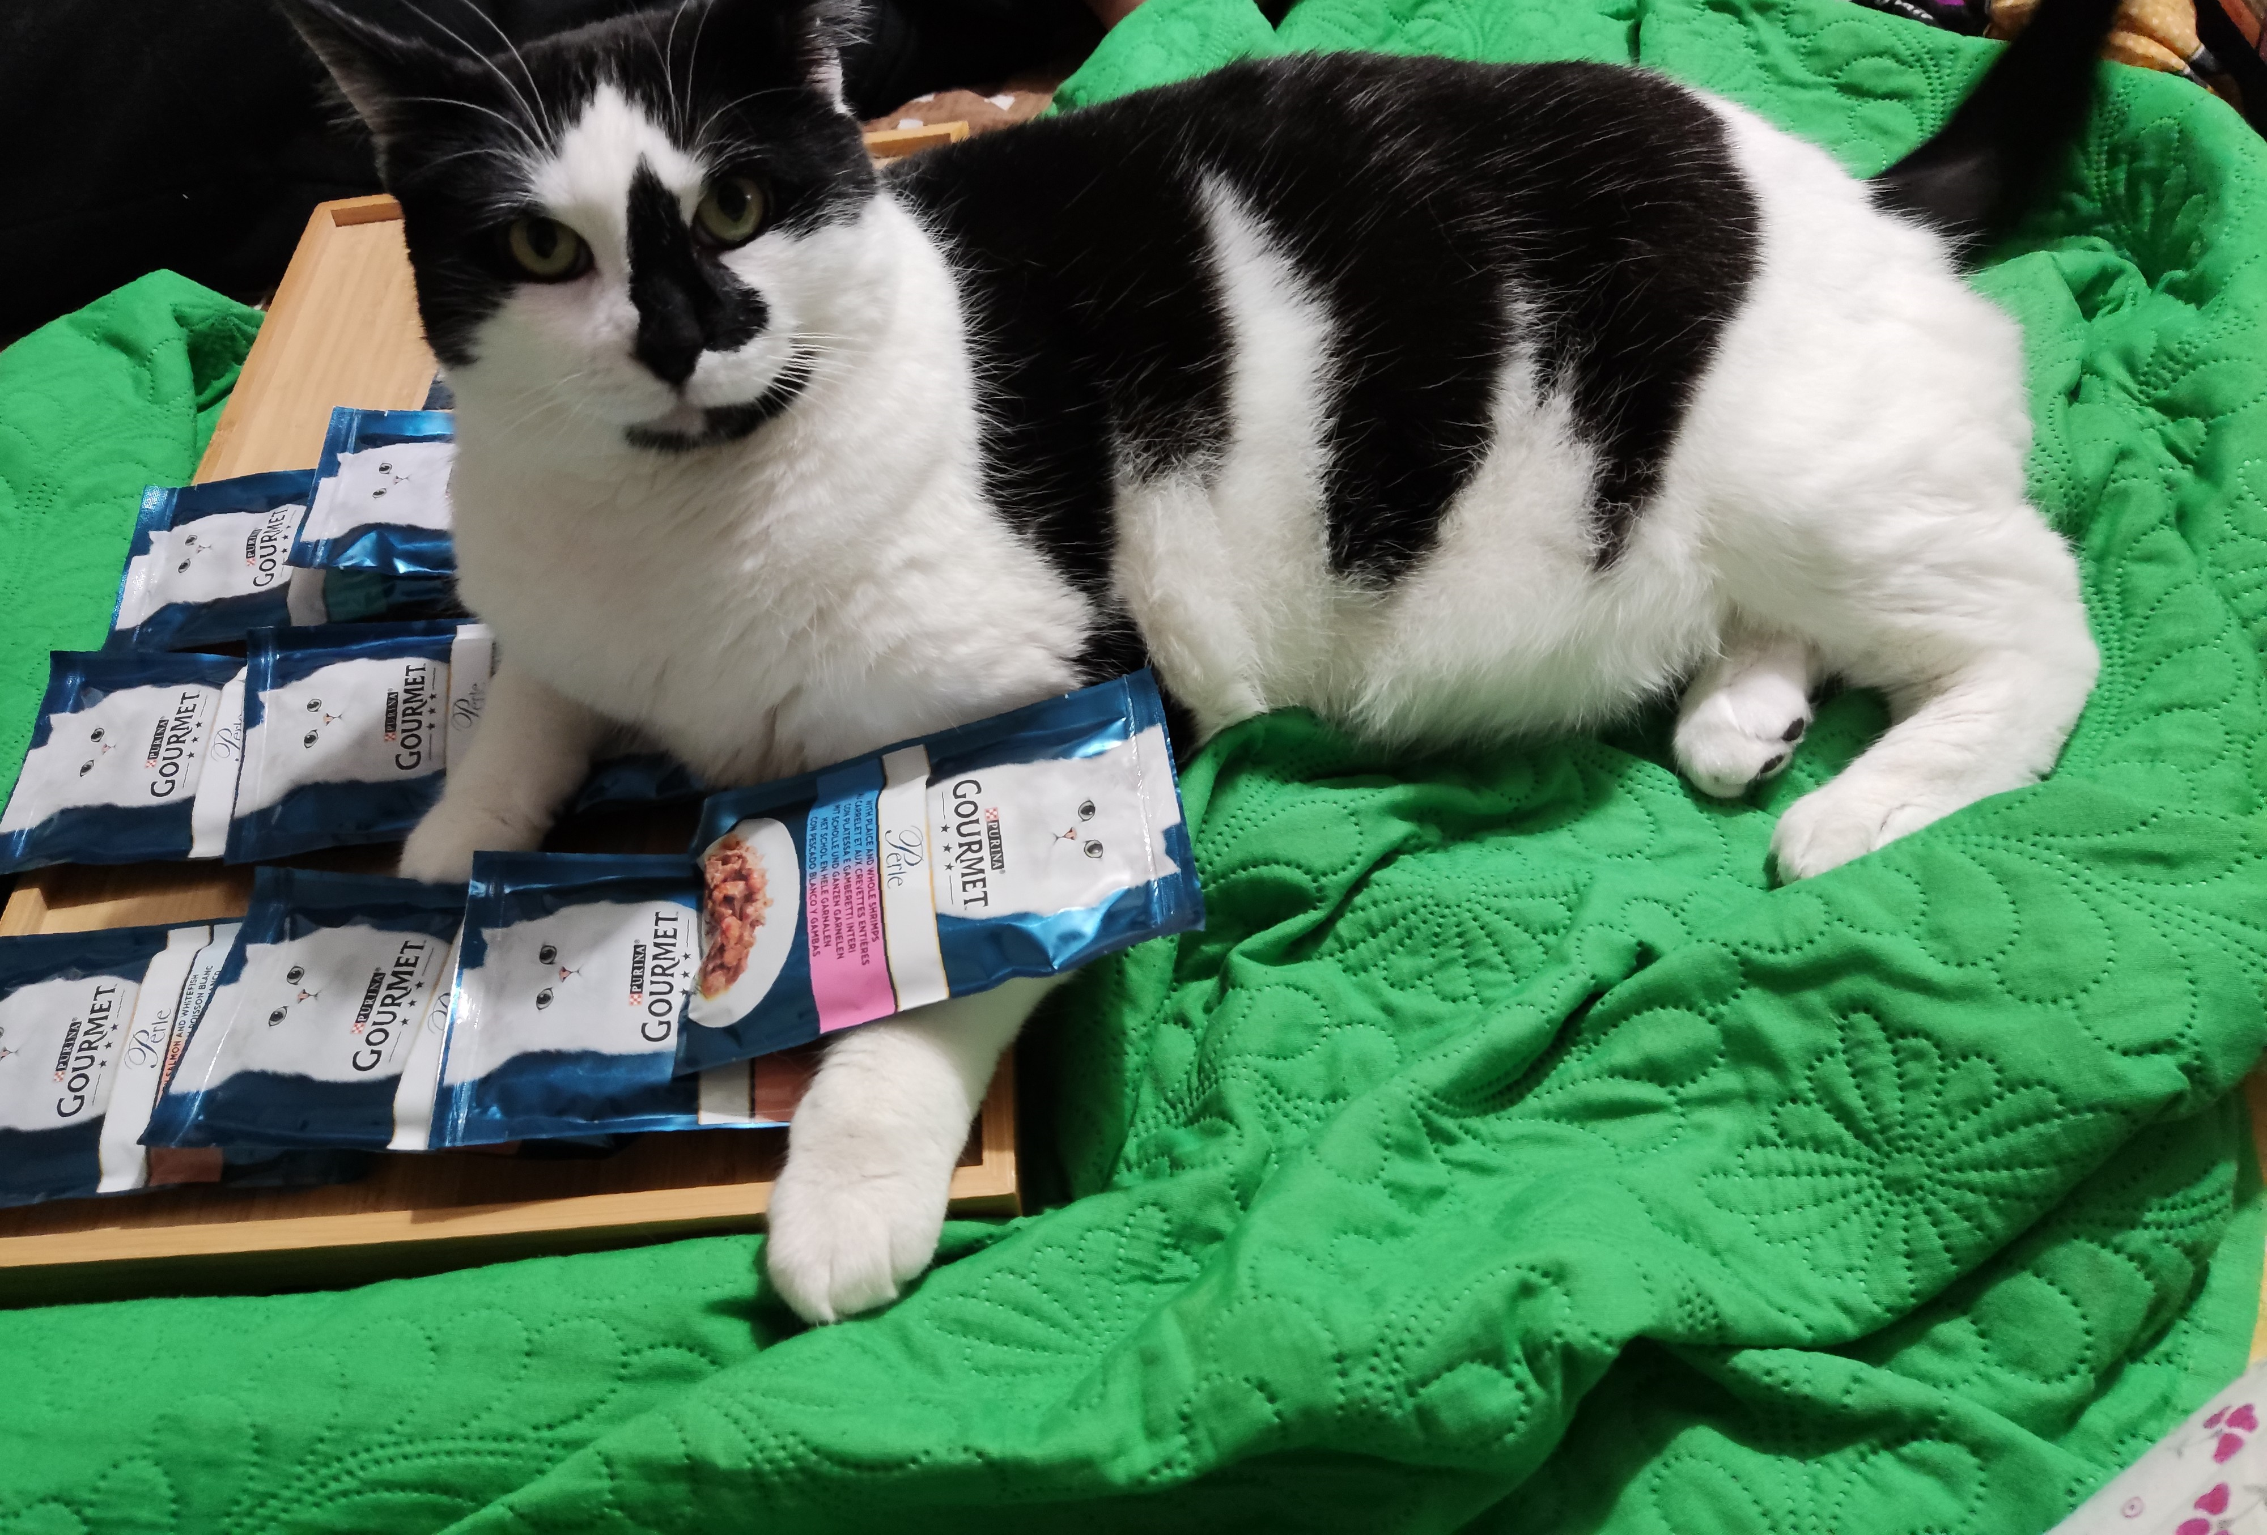
MW40010W - Foundations of Midwifery Practice.
Discuss a midwifery skill in a 3500 word essay.
RESULTS FROM CHATGPT - Blood Pressure Monitoring and Hypertension Management in Pregnancy
Importance and regular monitoring
Education and counselling
Recognizing hypertensive disorders
Risk assessment
Collaboration with healthcare team
Patient monitoring and follow-up
Emergency response
Postpartum care
Communication
Continuing education
Good set of points ; nothing exciting or explaining why you wanted to study the subject !

Slide 42
MW40010W - Foundations of Midwifery Practice.
Discuss a midwifery skill in a 3500 word essay.
BEFORE YOU GET RESULTS FROM CHATGPT -
Look at your Reading list/library resources to help you decide which skill to choose (your interest, global attention)
Look at the criteria for references needed to support your essay (last 5 years ?)
You need to search databases for latest advances in the field
You will need to adhere to word count for individual subtopics
You have to sign a declaration that this is your own work

Slide 43

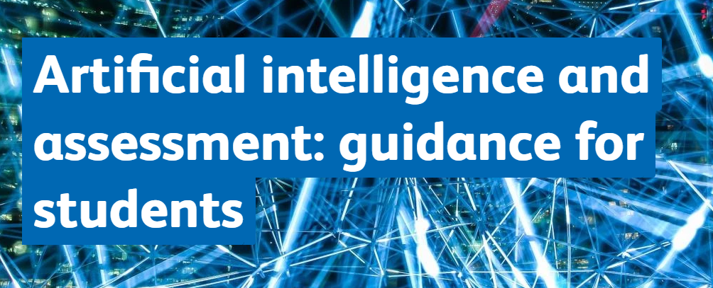
Develop guidelines for students
Passing off AI-created content as your own work is treated as academic misconduct and has serious consequences
There are ways of using AI ethically. Check with your supervisor
If AI is acceptable, check your subject guide for contact details of your subject librarian who can guide you further: uwl.ac.uk/current-students/library/finding-and-using-information/library-subject-guides
uwl.ac.uk/current-students/support-current-students/study-support/artificial-intelligence

Slide 44
University guidance for students on AI
Academic Misconduct – Using an AI tool to gain an unfair academic advantage by misrepresenting its work as your own (i.e. using ghost writers including AI).
The University is committed to equipping our students with the ethical and critical skills they will need to use AI tools responsibly in their future careers.
Students should make use of formative assessments, subject librarians, the Study Support Team, and the academic experts at their school or college to develop Academic Integrity skills (including referencing and citation).
Artificial intelligence and assessment: guidance for students | University of West London (uwl.ac.uk)

Slide 45
More AI tools
Consensus - search engine that uses AI to find insights in the form of summarized conclusions from research studies
Scispace - understand research papers better, ask questions , extract data and paraphrase, useful for science
Semantic scholar - scientific literature, highlights important elements of the paper
Iris AI - Smart search, data extraction and summaries
HyperWrite’s AI Literature Review Generator - creation of literature reviews.
Asreview.nl - Systematic reviews
Microsoft Power BI - a collection of software services, apps, and connectors
Akkio - aimed at beginners, a business analytics and forecasting tool for users to analyze their data and predict potential outcomes.
Monkeylearn - no-coding platform that uses AI data analysis features to help users visualize and rearrange their data.
Notes:
Here are some AI-powered tools that can assist you in selecting a research topic:
Texta.ai: This student-focused article generator uses cutting-edge AI and natural language technology to find and create relevant research for your topic in seconds. It’s a great way to say goodbye to endless hours of research¹.
Gemini: An AI chatbot from Google AI that can be used for various research tasks, including finding information, summarizing texts, and generating creative content².
Consensus: An AI-powered research tool designed to help you find and understand scientific research papers².
Scite.AI: A platform that provides context-aware citation analysis for scientific articles².
GPT4All: Leverage the power of GPT-4 language models for generating text, answering questions, and more².
AsReview: An AI tool for systematic literature reviews that helps you efficiently screen and select relevant research articles².
DeepL: While primarily known for translation, DeepL’s language models can also assist in generating content and understanding complex texts².
Humata: An AI tool that can summarize various types of content, making it useful for research purposes².
Gemini is an AI chatbot from Google AI that can be used for a variety of research tasks, including finding information, summarizing texts, and generating creative text formats. It can be used for both primary and secondary research and it is great for creating content.

Slide 46
Still more AI tools
AI Image generator – visualises your description, turns text into images, includes image extender and voice changer
Videoleap – Use video editing tools to turn AI generated images as videos for a project
Fotor – Free AI image generator, includes background remover, enlarger, photo enhancer and photo effects
Design AI - graphic design platform to create logos, videos, banners, and mockups by filling a questionnaire
Autoenhance AI – provides sky replacement, perspective correction and image relighting
Khroma - learns your color preference and create your own color palette., learns your colour choices by asking you to select 50 colours you like
Uizard AI design automation – design websites in minutes
DeepL/Google translate - AI translator preserving meaning and context
Notes:
Gemini is an AI chatbot from Google AI that can be used for a variety of research tasks, including finding information, summarizing texts, and generating creative text formats. It can be used for both primary and secondary research and it is great for creating content.

Slide 47
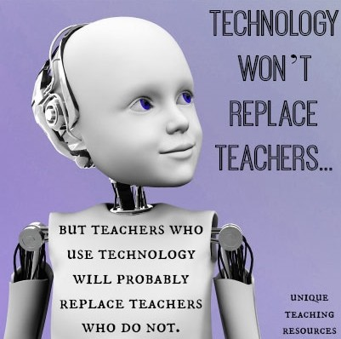
AI – What can I do v/s What I can do !
Newer Job descriptions
Teaching future citizens to think critically
Students adapting to AI faster than academics
Overcoming language skills and barriers
Time management and goal setting
Embedding ethics
Embracing diversity
Open dialogue Sharing AI knowledge
Source: www.createacademyonline.com
https://journals.cilip.org.uk/jil/article/view/14/519

Slide 48
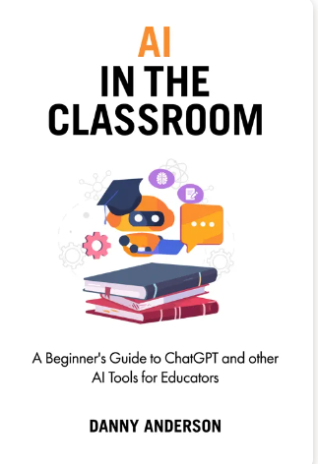
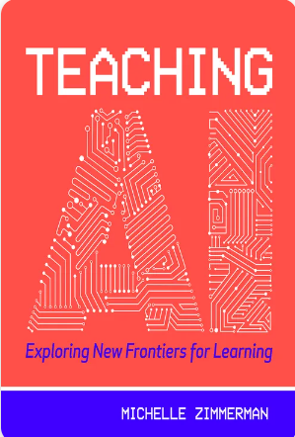
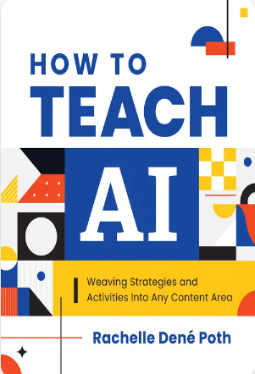

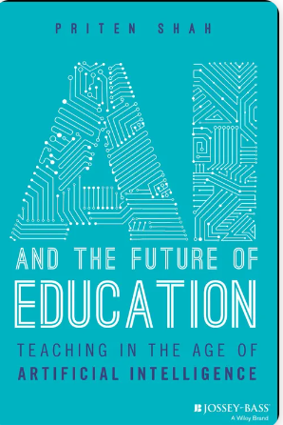
Artificial Intelligence in the classroom

Slide 49

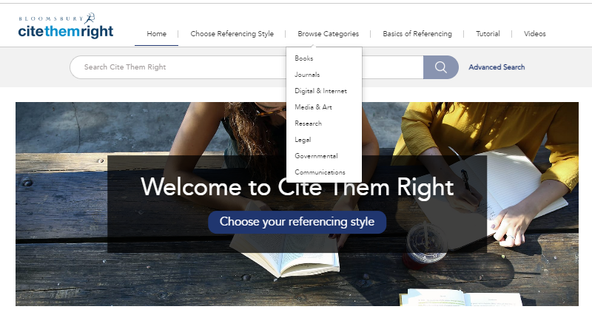


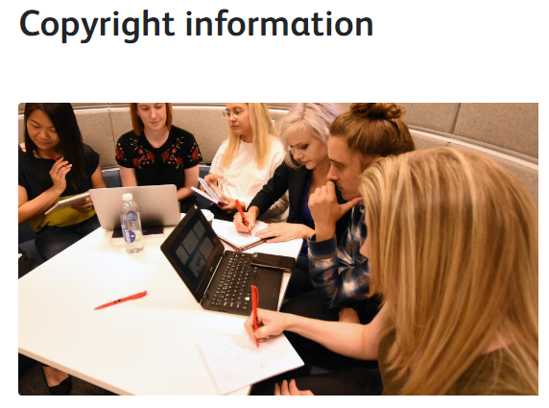



Slide 50
HOME WORK FOR TEACHERS
https://www.cilip.org.uk/news/661388/Can-AI-do-your-reading-for-you--should-it.htm
https://www.timeshighereducation.com/campus/confronting-generative-ai-fastchanging-higher-education-sector
https://www.hepi.ac.uk/2023/10/11/how-can-we-utilise-ai-in-higher-education
https://www.linkedin.com/pulse/role-ai-education-inspiroz
https://www.jisc.ac.uk/reports/artificial-intelligence-in-tertiary-education
https://wonkhe.com/blogs/caution-is-needed-around-generative-ai-especially-when-work-based-learning-is-involved
https://wonkhe.com/blogs/caution-is-needed-around-generative-ai-especially-when-work-based-learning-is-involved
https://www.unesco.org/en/digital-education/artificial-intelligence
https://repository.jisc.ac.uk/9232/1/ai-in-tertiary-education-a-summary-of-the-current-state-of-play-september-2023.pdf
Defining artificial intelligence for librarians - Andrew M. Cox, Suvodeep Mazumdar, 2022 (sagepub.com)
AI & Libraries (youtube.com
https://library.soton.ac.uk/sash/what-is-academic-integrity
https://manchester-uk.libanswers.com/teaching-and-learning/faq/264824
https://libguides.cam.ac.uk/AI

Slide 51

Thank you
for giving me the opportunity
to delve into
the amazing world of Artificial Intelligence
and to add value
to the profession of Librarianship !
BEST WISHES

