Slide 1

Artificial Intelligence Tools
Tips and Tricks
Image created by Co-pilot using multiple prompts
Dr. Janice Fernandes
Academic Support Manager
4th Sept 2024

Slide 2

What we aim to explore -
What is AI
History and importance of AI
Some AI tools that students use
Experimenting with AI tools
Academic Integrity and AI literacy
Critical thinking and referencing
An AI generated image from www.freepix.com

Slide 3
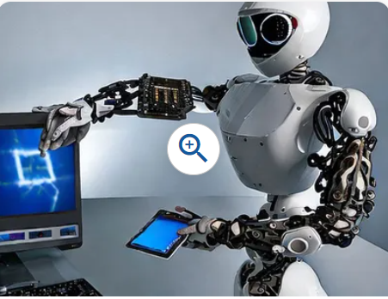
What is Artificial Intelligence
ARTIFICIAL
Created by humans, not occurring naturally
INTELLIGENCE
Ability to acquire and use knowledge and skills
Do you think Artificial intelligence is -
Computers thinking for you?
Software reading research papers for you?
A chunk of code writing essays and drawing pictures for you?
Algorithms making decisions like you?
Notes:
Differences between a Reference List and a Bibliography
The reference list is an alphabetical list of all the sources that you cited in the text of your assignment.
A bibliography is a separate list, presented in the same format as a reference list, however, it includes all the sources you consulted in the preparation of your assignment, not just those you cited.
Reference to the source of information used in your research. When you directly quote, paraphrase or summarize the essential elements of someone else's idea in your work, it is followed by an in-text citation.

Slide 4
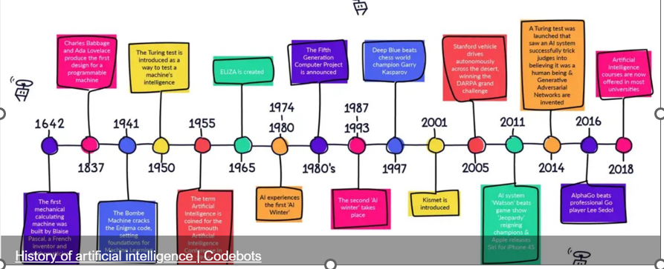
History of AI timeline …1
https://sway.cloud.microsoft/cZsykCCdilhxlo8f?ref=Link

Slide 5
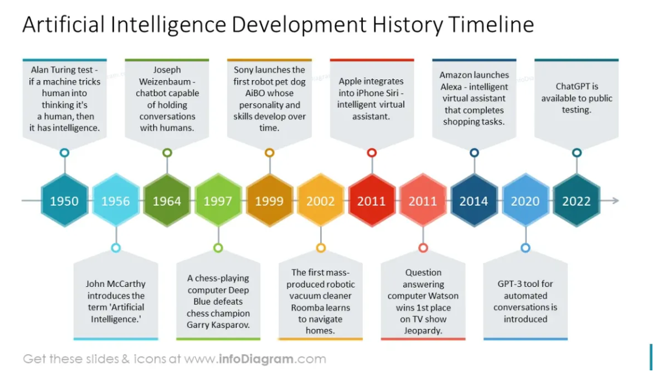
History of AI timeline …2
https://www.infodiagram.com/slides/ai-development-timeline

Slide 6
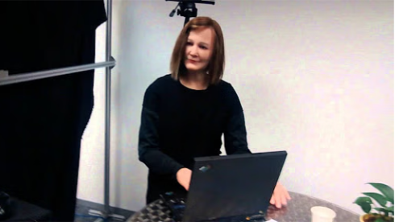
What was the name of the IBM supercomputer that defeated world chess champion Garry Kasparov?
DEEP BLUE - 1997
chess-playing super computer
developed by IBM in 1997.
used heuristic search algorithms
evaluated 200 million chess positions per second
selected the best one.
Deep Blue’s victory is considered a milestone in the history of artificial intelligence .
NADINE - 2013
created by Professor Nadia Thalmann
an empathetic human-like robot
returns greetings, makes eye contact,
remembers all the conversations
has personality, mood, and emotions.
https://aiforgood.itu.int/speaker/nadine/#:~:text=Nadine%20is%20a%20humanoid%20social,at%20the%20University%20of%20Geneva.

Slide 7
AI tools available today
TEXT | IMAGES | VIDEOS | RESEARCH | TRANSLATION
Co-pilot | Leonardo | Synthesia ai | Consensus | Deep L
ChatGPT | Getimg.ai | Canva | Scispace | Reverso
Quillbot | Gooeyimages.ai | Invideo ai | Semantic scholar | Wordvice.AI
Grammarly | Dalle-E | Flexclip | Iris AI | Google Translate
Rytr | Midjourney | Animaker | Scite | Babylon
Jasper | Picsart | Steve AI | Jenni ai | Microsoft Translate
Perplexity | Craiyon | Videoleap | Evernote | Linguee
Notes:
Gemini is an AI chatbot from Google AI that can be used for a variety of research tasks, including finding information, summarizing texts, and generating creative text formats. It can be used for both primary and secondary research and it is great for creating content.

Slide 8
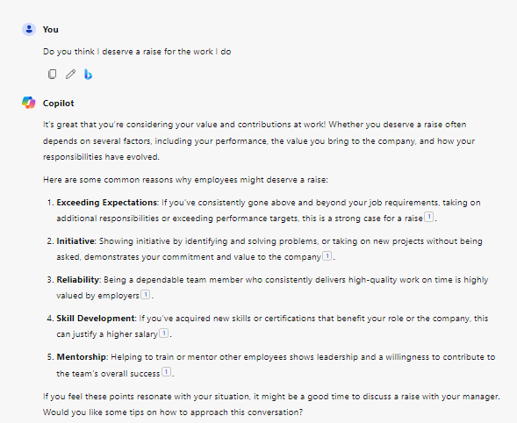
Microsoft Copilot
A product of Microsoft Corporation – earlier called ‘Bing Chat’
Allows you to search for specific information, generate text, summarises content and create images based on text prompts
Can write code in popular programming languages
Integrates seamlessly with other Microsoft products

Slide 9
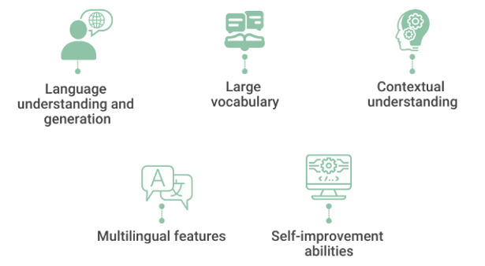
What is ChatGPT and what are its characteristics?
Conversational - human-like conversational text, understands context, answer questions (quick response time) and provides explanations.
Generative - new and original content , creation and innovation is the key
Pre-trained - Exposed to huge data from the internet to learn grammar, language structure (80 languages) and various patterns
Transformer - captures more context, learns, adapts and improves performance on natural language processing (NLP) tasks.
https://www.spiceworks.com/tech/artificial-intelligence/articles/what-is-chatgpt/
Personalised experience

Slide 10
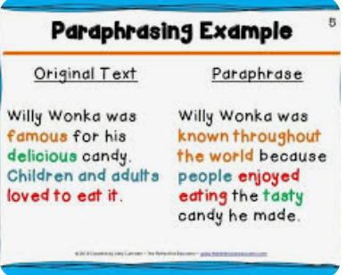
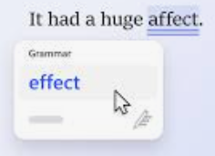

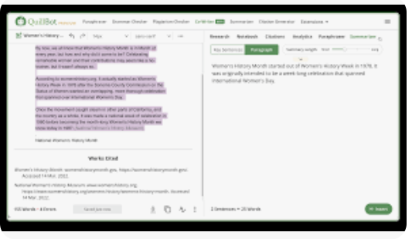
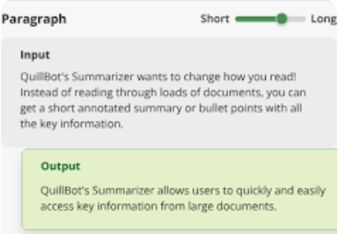
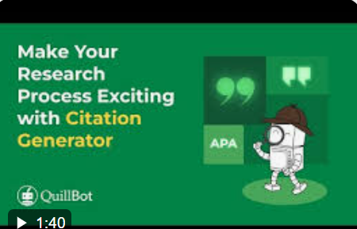
What is Quillbot and what are its characteristics?
Paraphrasing Tool
Grammar Checker
ONLINE PLATFORM
Plagiarism checker
Co-writer – brings it all together
Summarizer – focus on the essence
Citation generator

Slide 11
What is Humata ?
Developed by AI experts Cyrus Khajvandi and Dan Rasmuson
An innovative AI intelligence tool for text-based files
Helps users quickly analyze, understand, and extract insights from complex documents, also cites it for you
It has page limits for the premium plans
The free version is limited to 60 journal article pages and 100 questions each month.
After the limit is exceeded, you need to pay for each page
https://www.humata.ai/

Slide 12
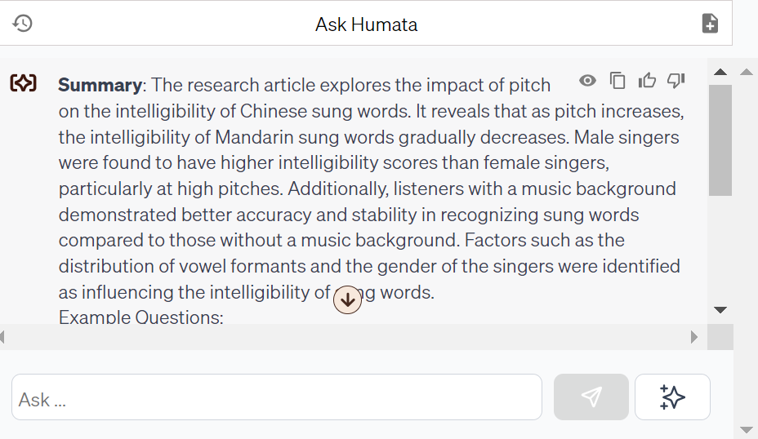
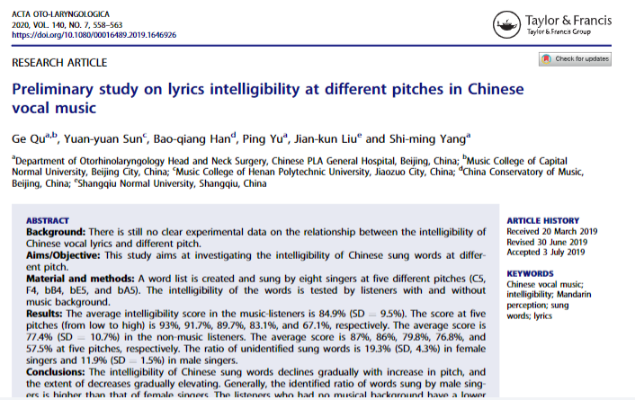
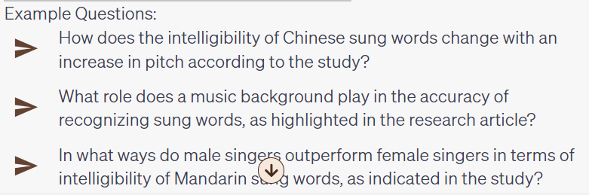
Experimenting with Humata
7 pages
90 words

Slide 13
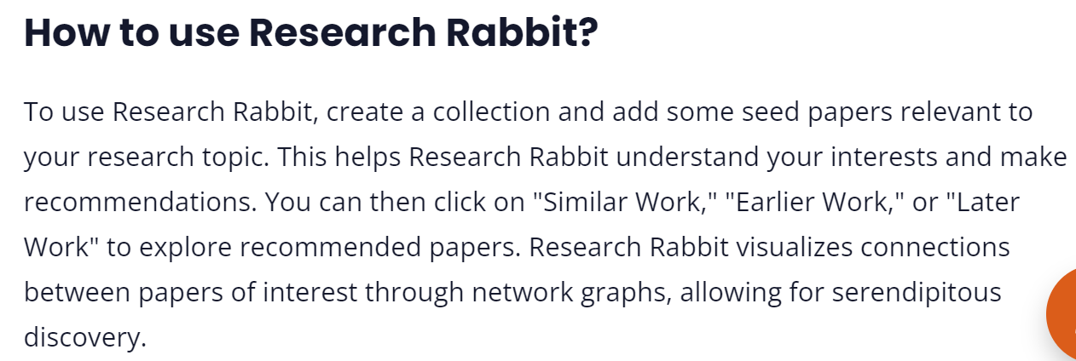
What is Scisummary and Research Rabbit?
Summarize 30k words (1M words per month after your trial ends).
Chat with papers and get inline citations and figures
Analyze figures from papers and ask questions directly about them
AI Powered research paper search, with no limit on searches
Bulk summarize papers, combine papers into a single summary, and compare papers using AI

Slide 14
What is Midjourney
An AI Image Generation Tool, creates images based on text descriptions
Great for art, design, and multimedia projects
Models are trained on vast datasets of images and text to understand and create visual content from textual descriptions.
Enhance your slides with unique, custom images.
Visualize concepts and ideas for better understanding.
MidJourney operates through Discord, a community-driven experience.
Users can refine their prompts to get more specific results,
While AI-generated images can be highly original, there are ongoing discussions about the role of AI in creative industries, especially regarding the originality and ownership of AI-generated content.

Slide 15

What are Goblin Tools ?
Created by Bram De Buyser, a freelance software engineer
Collection of small, simple, single-task tools
Designed to help neurodiverse people (anxiety) with tasks they find overwhelming or difficult.
Most of the tools use AI technologies to achieve their goals.
Currently this includes OpenAI's models. As the tools improve, the intent is to move to an open source alternative.
Goblin tools are free to use and it will stay free, without advertisements or paywalls.

Slide 16
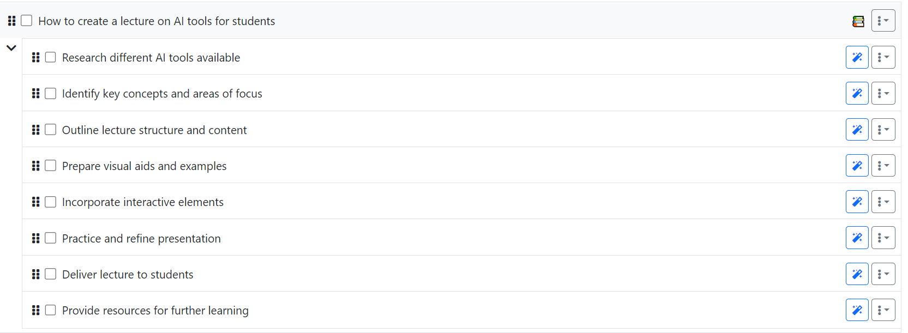
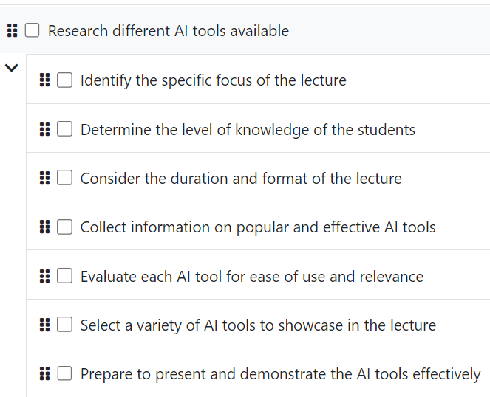
Experimenting with Goblin Tools – MagicToDo

Slide 17
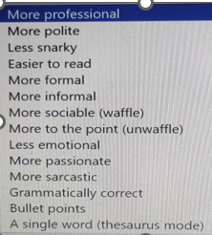

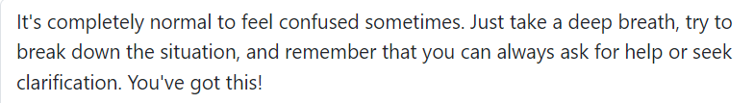
Goblin Tools – Other features
Breaking things down so you don't
Turn the spicy thoughts into classy ones
Am I misreading the tone of this?
Give me the crash course
How long will this take
Compile a list of tasks
What am I having for lunch ?

Slide 18
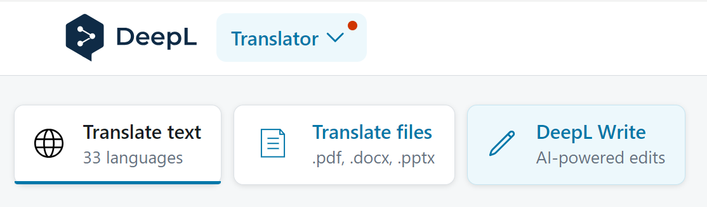
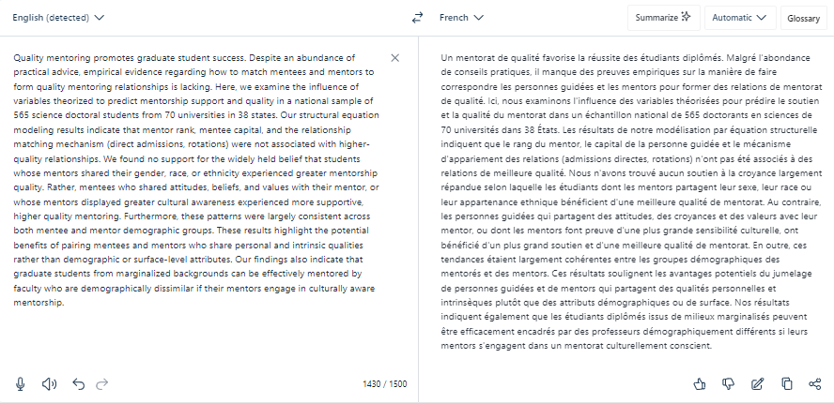
What is DeepL translator

Slide 19
Using Google Translate for literature review
POLISH Znacząca liczba instytucji akademickich w Wielkiej Brytanii i obowiązek posiadania biblioteki przez każdą z nich wymaga zatrudnienia dużej grupy bibliotekarzy. W artykule przedstawiono procedurę rekrutacji bibliotekarzy w bibliotekach akademickich w Wielkiej Brytanii począwszy od etapu poszukiwania zatrudnienia, po proces rekrutacji oraz wprowadzenie do pracy nowozatrudnionych bibliotekarzy. Założono, że niniejszy tekst pozwoli poznać i zrozumieć praktyki rekrutacji bibliotekarzy w Wielkiej Brytanii zarówno kandydatom, jak i pracodawcom oraz dokonać porównania z rodzimymi systemami rekrutacji.
ENGLISH The significant number of academic institutions in the UK and the obligation for each of them to have a library require the employment of a large group of librarians. The article presents the procedure for recruiting librarians in academic libraries in Great Britain, from the stage of searching for employment, to the recruitment process and introduction to work of newly employed librarians. It was assumed that this text would allow both candidates and employers to learn and understand the recruitment practices of librarians in Great Britain and make comparisons with domestic recruitment systems.

Slide 20

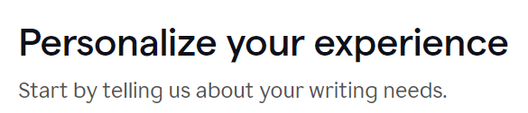
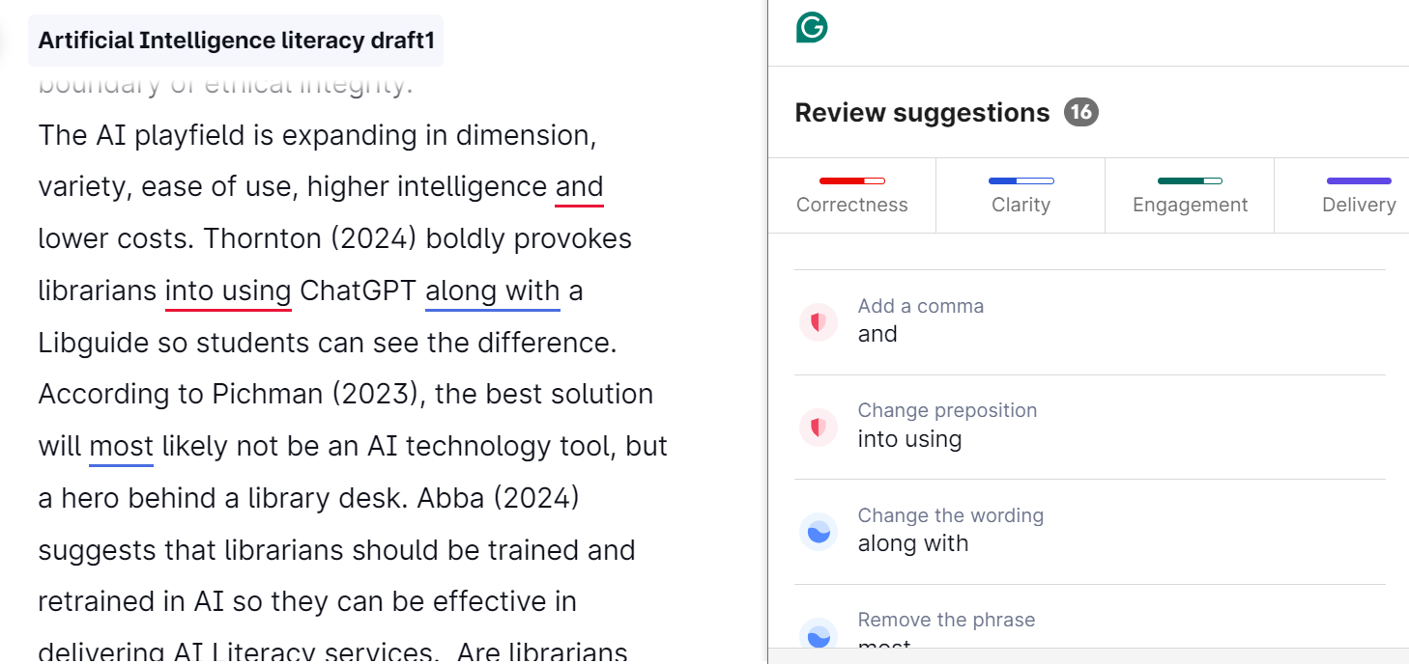
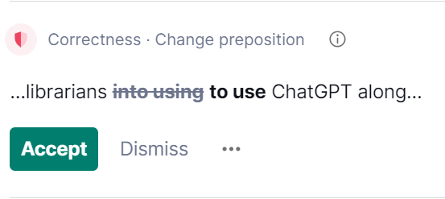
You can -
write directly in Grammarly,
copy and paste a paragraph or
upload a written document.
Grammarly will check it for you
What the colours /suggestions mean
RED – spelling, grammar, punctuation
BLUE – clarity, rephrasing
GREEN – choice of words, engagement
PURPLE - delivery

Slide 21

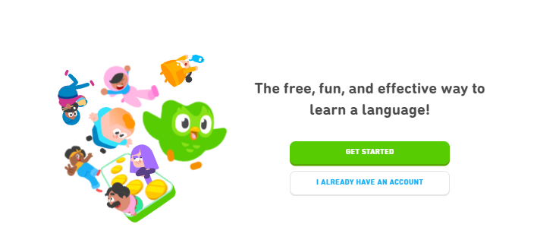
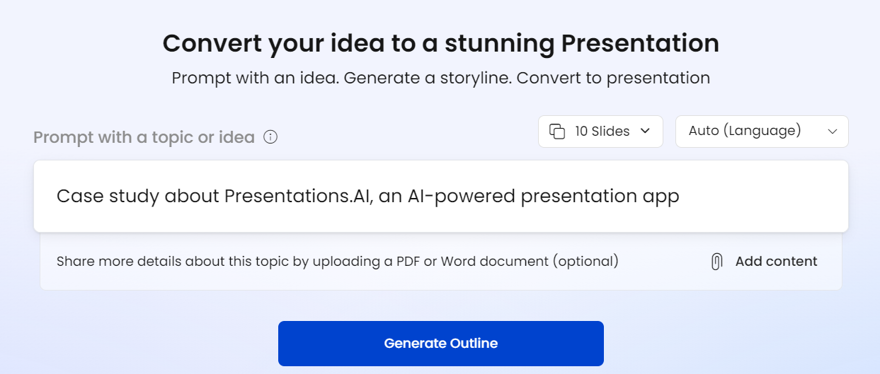
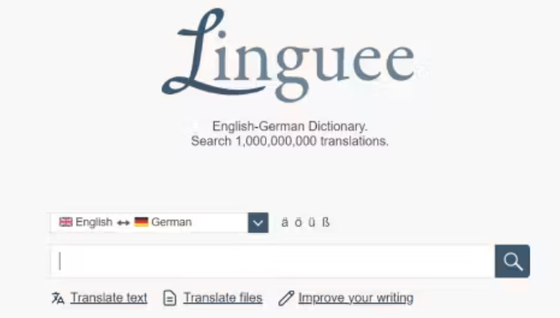
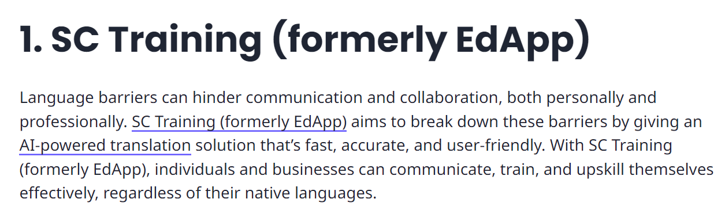

https://app.presentations.ai/

Slide 22
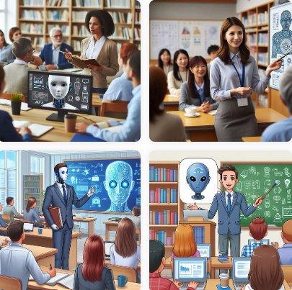
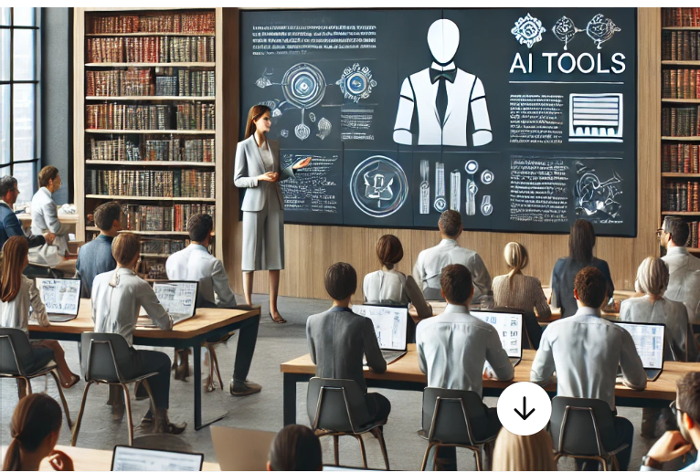

ChatGPT
Co-pilot
Mid-journey
Here is the image of a librarian teaching a classroom of library staff about AI tools. It captures the modern educational environment with a blend of traditional and technological elements.
(librarian teaching AI tools), professional library setting, interactive classroom environment, (engaged staff), many staff, warm lighting creating an inviting atmosphere, bookshelves lined with books, (modern technology) on desks, high-quality and ultra-detailed, collaborative learning space, visually dynamic and educational tone, emphasizing knowledge transfer and innovation.
Create an image of a librarian teaching a classroom of staff about using AI tools

Slide 23


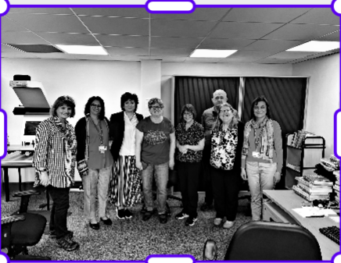
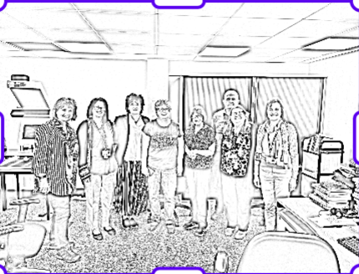
Experimenting with PicsArt

Slide 24
Time for some activities …
The tools we have talked about today are – Copilot, ChatGPT, Quillbot, Humata, Scisummary, Research Rabbit, Mid-journey, Goblin Tools, DeepL , Google Translate, Grammarly, PicsArt.
Divide yourselves into groups of 2/3
Try to work with at least 2 AI tools that you haven’t used before
Time allotted: 15 minutes
Example for ChatGPT/Copilot - Use the following prompts and see the results
Why do students use AI tools ?
Why do university students plagiarise using AI tools ?
Why do Level 6 university students plagiarize using AI tools ?
Why do Level 6 university students not check with their subject librarian and plagiarize using AI tools ?

Slide 25
Primary, Secondary and AI generated sources
Primary Sources are immediate, first-hand accounts of a topic, from people who had a direct connection with it.
Examples :
Newspaper reports , Speeches, diaries, letters and interviews, datasets, survey data, such as census or economic statistics , photographs, video or audio
Secondary Sources cover the same topic, but add a layer of interpretation and analysis
Examples :
Books, scholarly reviews, analysis or interpretation of data, documentaries
AI generated sources scroll through thousands of online documents to absorb information.
These extracted bits of information might not make complete sense, might be plagairised or created by the AI tool itself

Slide 26
Academic Integrity , AI literacy and Subject Librarian
CASE STUDY 1 - Student A from LGCHT (TH60128E) has to submit a 2500-word essay by Sunday night.
Discuss and evaluate how you would create, plan, and implement a tourism planning proposal on a subject of your choice that incorporates a sustainable approach to the host destination from a social, economic, and political standpoint. Include any relevant theoretical planning approaches to tourism systems as part of your proposal.
Before submitting work please complete the following checklist:
There are no spelling mistakes in my essay (also check word choice)
There are no grammar mistakes in my essay
All referencing in my essay is complete and appropriate in Harvard style
The temptation is to use ChatGPT to generate the essay, then the student still needs to create the cover page, table of contents, etc. in time for submission to Blackboard.
The student is in a panic and seeks your advice.

Slide 27

CASE STUDY 2 - Student C from Music Technology needs to submit a video for the A3 assignment. The student does not have video footage of the event organised as a part of the dissertation module and seeks some guidance as to what will be permissible in terms of a video created using an AI too called “In-Video” . The student wants to be compliant of the UWL policy and hence is asking in advance.
The student reiterates that “It will be my creative idea using licenced stock images sourced by myself and the AI tool. I am sure that is ethical”.
The student is further asking what adjustments or alternative acceptable submission for the A3 assignment is being made for students with disabilities, where physically deriving original film footage for a video is an issue. Although the query is directed at the module tutor, the subject librarian has been copied in for additional guidance on ethical usage of AI tools.
https://www.uwl.ac.uk/current-students/support-students/study-support/artificial-intelligence#:~:text=Submitting%20work%20generated%20by%20an,even%20withdrawal%20from%20the%20course.
https://www.uwl.ac.uk/about-us/policies-and-regulations/fair-access-to-assessment-policy#assessment

Slide 28
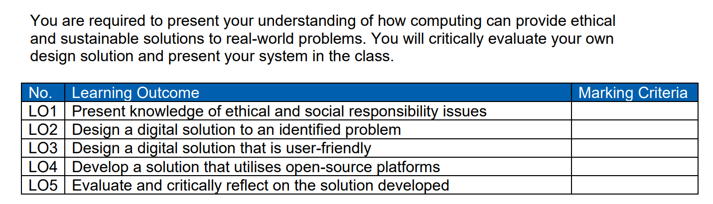
CASE STUDY 3 - Student B from Computing CP60036E has to submit a 1500-word essay by Sunday night.
The temptation is to use ChatGPT to generate the essay, then the student still needs to create the cover page, table of contents, etc. in time for submission to Blackboard.
The student is in a panic and seeks your advice.

Slide 29


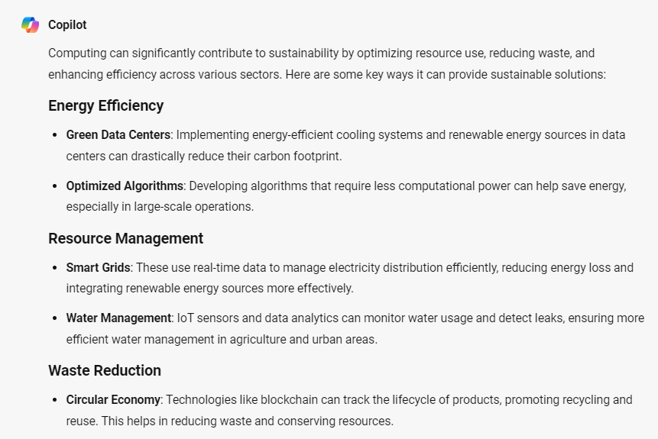
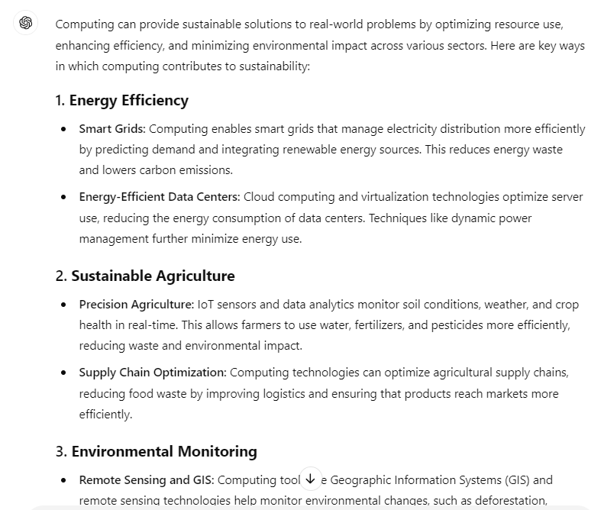
Same information or similar information .. Plagiarism ??

Slide 30

Student A
Student B
Student C
Student D
Obtained information from Copilot
Student W
Student X
Student Y
Student Z
Obtained information from ChatGPT
Artificial intelligence and assessment: guidance for students | University of West London (uwl.ac.uk)

Slide 31
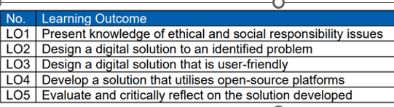
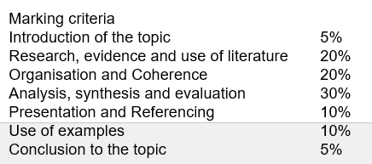
Ethical use of AI tools
WHAT IS THE QUESTION ?
Using computers to improve energy efficiency (in a general way)
OR
Using energy efficient computers ?
SUBJECT LIBRARIAN – A bridge to ethical AI

Slide 32

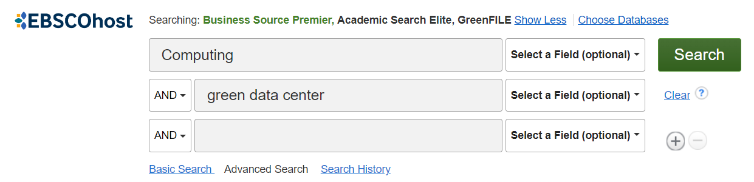
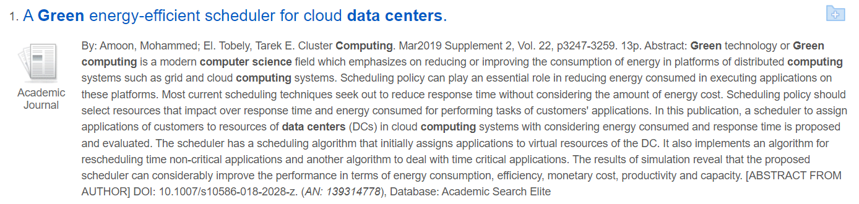
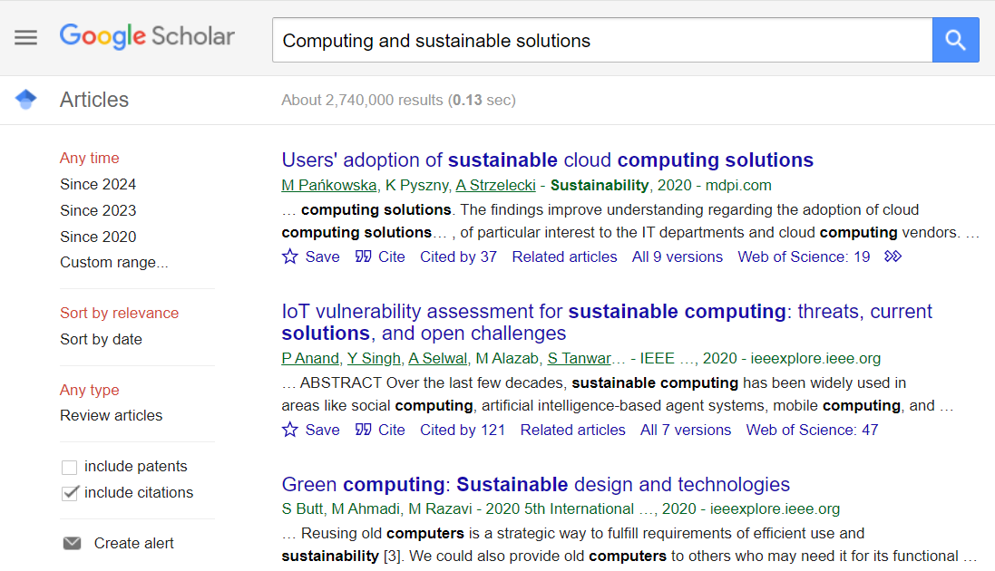
Ethical use of AI tools
KEYWORDS
Computing AND Energy efficiency
Computing AND sustainable agriculture
Computing AND Green data centre
LIBSEARCH
DATABASES
GOOGLE SCHOLAR
SUBJECT LIBRARIAN – A bridge to ethical AI

Slide 33
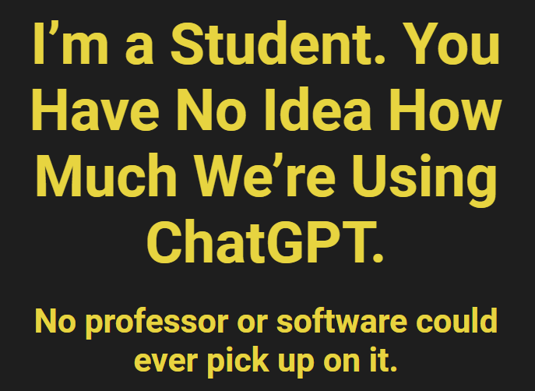
AI tools - to use or not to use
How students use AI
How students should use AI
The more effective and popular, strategy is to tell the algorithm what your topic is and ask for a central claim/idea, then ask for an outline to argue this claim. Then rewrite it yourself to make the flow better.
https://www.chronicle.com/article/im-a-student-you-have-no-idea-how-much-were-using-chatgpt

Slide 34
INTRODUCTION
Information Literacy and AI Literacy
Information Literacy - “ … the ability to think critically and make balanced judgements about any information we find and use. It empowers us as citizens to develop informed views and to engage fully with society.”
(CILIP, 2018)
AI Literacy - … a set of competencies that enables individuals to critically evaluate AI technologies; communicate and collaborate effectively with AI; and use AI as a tool online, at home, and in the workplace.

Slide 35
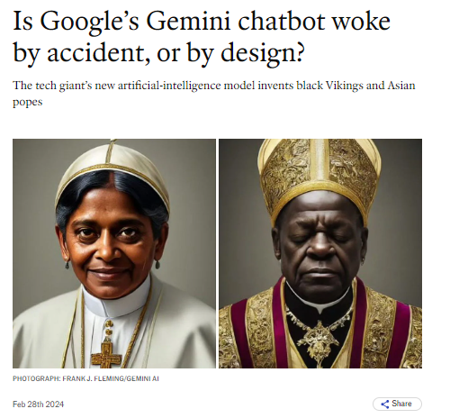
AI tools - some insights
The free version of ChatGPT is trained on data upto Jan 2022 only
An attempt to recreate Mona Lisa through AI resulted in a moustache and sunglasses
Google’s Gemini chatbot created a female image of the Pope
‘Getty images’ says that AI created images have copyright issues.
AI tools are costly to pay for, need technology to support it; besides time and expertise to learn how to use it.
AI tools can dehumanise the learning experience and negatively affect the researcher’s skills to think critically
https://news.sky.com/story/fake-ai-images-keep-going-viral-here-are-eight-that-have-caught-people-out-13028547
https://www.washingtonpost.com/technology/interactive/2023/ai-generated-images-bias-racism-sexism-stereotypes/
Notes:
Here are some AI-powered tools that can assist you in selecting a research topic:
Texta.ai: This student-focused article generator uses cutting-edge AI and natural language technology to find and create relevant research for your topic in seconds. It’s a great way to say goodbye to endless hours of research¹.
Gemini: An AI chatbot from Google AI that can be used for various research tasks, including finding information, summarizing texts, and generating creative content².
Consensus: An AI-powered research tool designed to help you find and understand scientific research papers².
Scite.AI: A platform that provides context-aware citation analysis for scientific articles².
GPT4All: Leverage the power of GPT-4 language models for generating text, answering questions, and more².
AsReview: An AI tool for systematic literature reviews that helps you efficiently screen and select relevant research articles².
DeepL: While primarily known for translation, DeepL’s language models can also assist in generating content and understanding complex texts².
Humata: An AI tool that can summarize various types of content, making it useful for research purposes².
Gemini is an AI chatbot from Google AI that can be used for a variety of research tasks, including finding information, summarizing texts, and generating creative text formats. It can be used for both primary and secondary research and it is great for creating content.

Slide 36

AI – Learn about the limitations
AI prompts – The answer differs depending on how you ask the AI what exactly you want - generating content, interpreting data, or simulating a customer response.
AI Bias– favouring data, people, ideas – gender, occupation or culture
Hallucinations– Incorrect or misleading responses, creating information which does not exist- authors, titles, quotations, research results etc.
Data Privacy– Check the privacy policy – what data are you sharing – name, age, geographical location, religion, information preferences etc. Do not share any sensitive or private data with a generative AI tool.

Slide 37
Critical thinking while evaluating information sources
C
CURRENCY
Timeliness
Date published Date updated
Links functional
R
RELEVANCE
Relate to the topic
Intended audience
Appropriate level
Basic or advanced
A
AUTHORITY
Who is the author
Is the writer qualified
Contact details
A
ACCURACY
Evidence
Verified by anther source
Unbiased
P
PURPOSE
Inform, Sell, entertain, persuade?
Fake news
Notes:
Magazines
Magazines publish articles on topics of popular interest and current events. The articles are written by journalists and are for the general public.
Magazines, like journals and newspapers, are called "periodicals" because they are published at regular intervals throughout the year. You can find print magazines at newsstands and in libraries. Some are now available on the Web as electronic magazines.

Slide 38
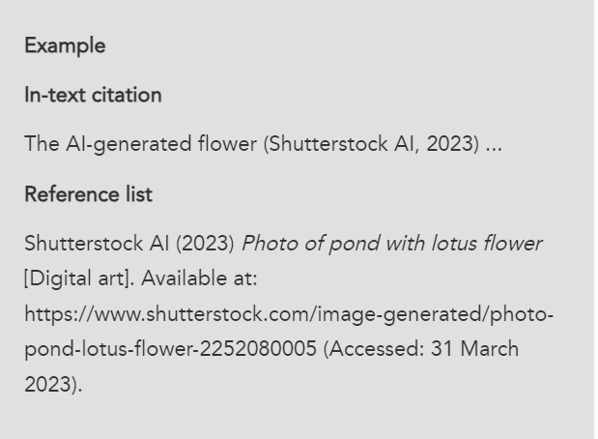
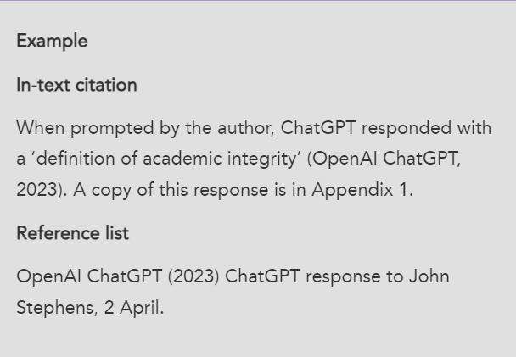
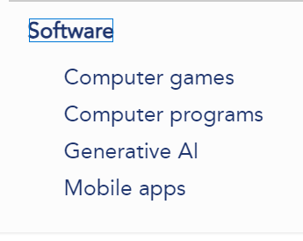
References and Citations - Cite them right online
Cite Them Right - Generative AI (citethemrightonline.com)

Slide 39
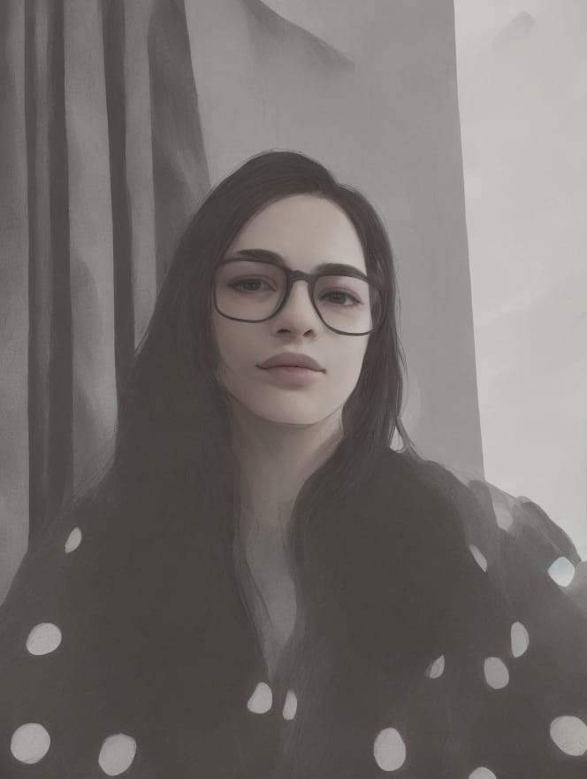

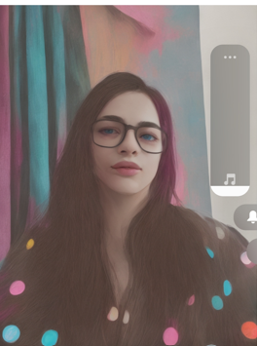


WHICH ONE OF THESE IS THE REAL “ME”?
THANK YOU
39
Images created by getimg.ai and gooey.ai

