Slide 1

How to know what I don’t know
Librarians,
Artificial Intelligence and ChatGPT
Dr. Janice Fernandes
Created Jan 2024

Slide 2
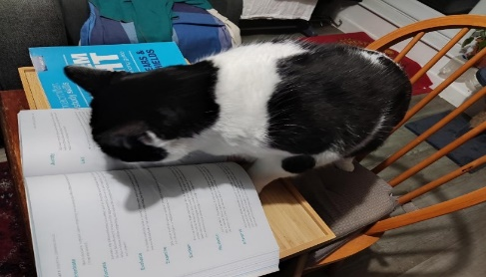
How confident do you feel in knowing and understanding about Artificial Intelligence in relation to academic libraries ?

Slide 3
What is Artificial Intelligence
ARTIFICIAL
That which is made by human beings rather than occurring naturally
INTELLIGENCE
The ability to acquire and use knowledge and skills
Artificial intelligence is -
the science of making machines that can think like humans.
the development of computer systems capable of performing tasks that typically require human-like cognitive abilities.
Notes:
Differences between a Reference List and a Bibliography
The reference list is an alphabetical list of all the sources that you cited in the text of your assignment.
A bibliography is a separate list, presented in the same format as a reference list, however, it includes all the sources you consulted in the preparation of your assignment, not just those you cited.
Reference to the source of information used in your research. When you directly quote, paraphrase or summarize the essential elements of someone else's idea in your work, it is followed by an in-text citation.

Slide 4

How did artificial intelligence originate?
1950 : Alan Turing published “Computer Machinery and Intelligence” which proposed a test of machine intelligence called The Imitation Game.
1952 : Arthur Samuel a computer scientist developed a program to play checkers, which is the first to ever learn the game independently.
1955 : John McCarthy held a workshop at Dartmouth on “artificial intelligence” which is the first use of the word, and how it came into popular usage.

Slide 5

Why is artificial intelligence important?
Too much information ,Too little time
Language complexities , access and accessibility issues
Is the information correct ?
Does this information answer my question ?
Right information at the right time is the key
Complex analytical and decision making skills
Computers (trained by humans) can (often) do things quickly and more efficiently than humans
Artificial intelligence forms the basis for all
computer learning and is the future of all
complex decision making.

Slide 6
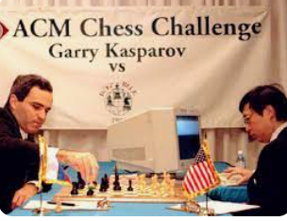
What was the name of the IBM supercomputer that defeated world chess champion Garry Kasparov?
Deep Blue was a chess-playing computer developed by IBM that defeated the world champion, Garry Kasparov, in 1997.
It was a unique purpose-built IBM supercomputer that used heuristic search algorithms to evaluate 200 million chess positions per second and select the best one.
Deep Blue’s victory is considered a milestone in the history of artificial intelligence .

Slide 7
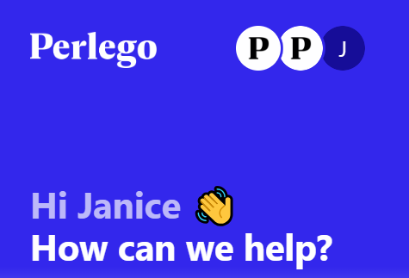
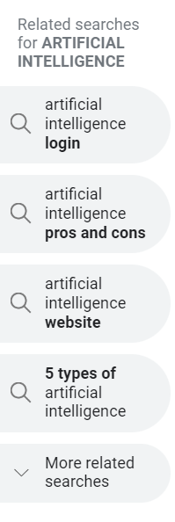


Do you recognise any of these terms ?
Generative AI
Essayservice.ai
Craiyon
Tabnine
SOPHIA
Machine Learning
Large Language Models
Natural language processing
Chatbots
Hallucinations
OpenAI
DeepbrainAI
Quillbot
Deep Learning
Otter.ai
BARD
DALL-E

Slide 8

List of AI tools used in Higher education today
Grammarly
Quillbot
Originality.ai
Midjourney
Copy.ai
Wordtune
ChatGPT
ClickUp AI
Rewritetool.net
AutoCrit
Adobe Firefly
Jasper AI
WriteSonic
Descript
Play.ht
Rytr
Reword
Scispace
JenniAI
TutorAI
Scholarcy
Explainpaper
Writely
SlidesAI

Slide 9
Quick use of AI among university students today
TutorAI
your personal tutor allowing you to select modules and learn at your own pace
Scispace/
Explainpaper
helps you understand research papers better by explaining main points
Jasper/
GoogleBardAI
generate text and script rewrite, paraphrase , summarise videos etc.
Quillbot
Has an AI powered thesaurus and uses a synonym slider to paraphrase text you want
Grammarly/
Spellbound
Reviews spelling grammar, punctuation, clarity, engagement and suggest replacements
Originality.ai
Accurate AI detection and plagiarism checker and fact checker
SUBMIT to UWL Blackboard

Slide 10
What is ChatGPT ?
Conversational Generative Pre-trained Transformer
Conversational Designed to generate human-like conversational text, understands context, answer questions and provides explanations.
Generative generates new and original content , creation and innovation is the key, can perform a variety of language-related tasks
Pre-trained exposed to a vast amount of text data from the internet, which allows it to learn grammar, language structure, and various patterns
Transformer captures more context and improves performance on natural language processing (NLP) tasks.

Slide 11


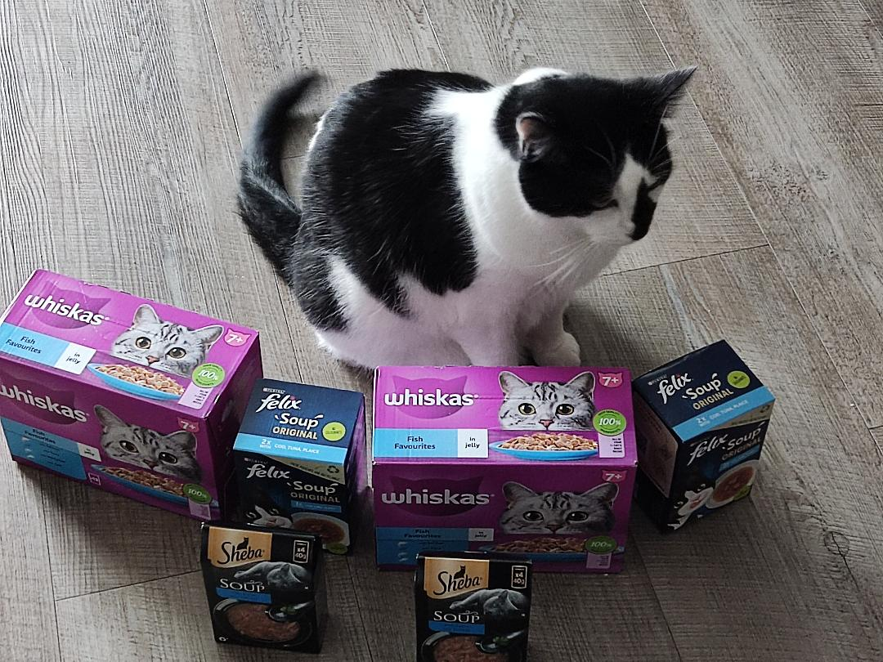
How does ChatGPT “help” students ?
Engage in conversational chats
Answer questions and provide explanations
Programming and coding assistance
Content ideas for creative projects
Writing assistance and proofreading
Educational support (definitions/examples)
Game interactions(text-based games)
Language translation
Study tips and strategies
General knowledge
Career guidance

Slide 12
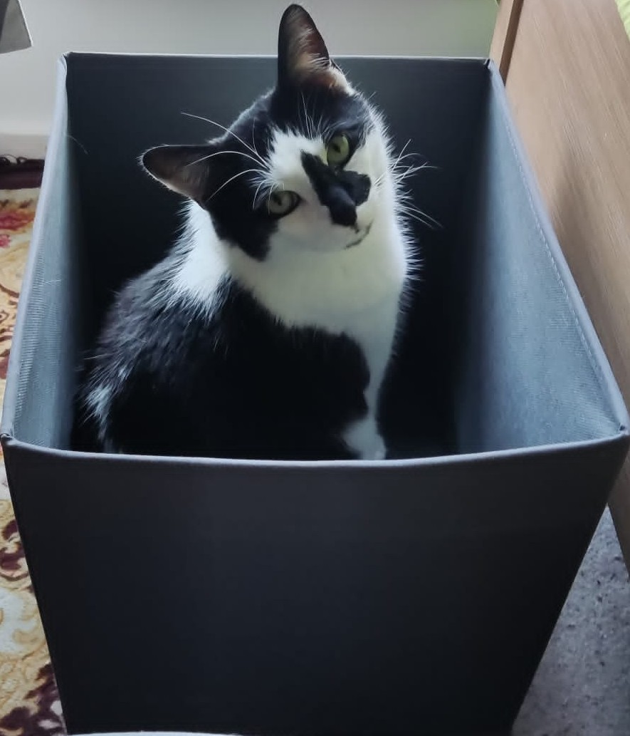
How does ChatGPT “NOT help” students ?
Accuracy and reliability – citations incorrect, references may not exist
Using old information – information of 2022 in 2024
Inability to ask clarifying questions
Potential for misinformation – what goes in comes out
Potential for bias – ethnic, geographic, race, gender
Limited subject expertise unlike a search engine
Lack of emotional understanding
No critical thinking or context understanding
Potential for off-topic responses
Privacy concerns

Slide 13
UWL guidance for students on AI
Academic Misconduct – Using an AI tool to gain an unfair academic advantage by misrepresenting its work as your own (i.e. using ghost writers including AI).
The University is committed to equipping our students with the ethical and critical skills they will need to use AI tools responsibly in their future careers.
Students should make use of formative assessments, subject librarians, the Study Support Team, and the academic experts at their school or college to develop Academic Integrity skills (including referencing and citation).
Artificial intelligence and assessment: guidance for students | University of West London (uwl.ac.uk)

Slide 14
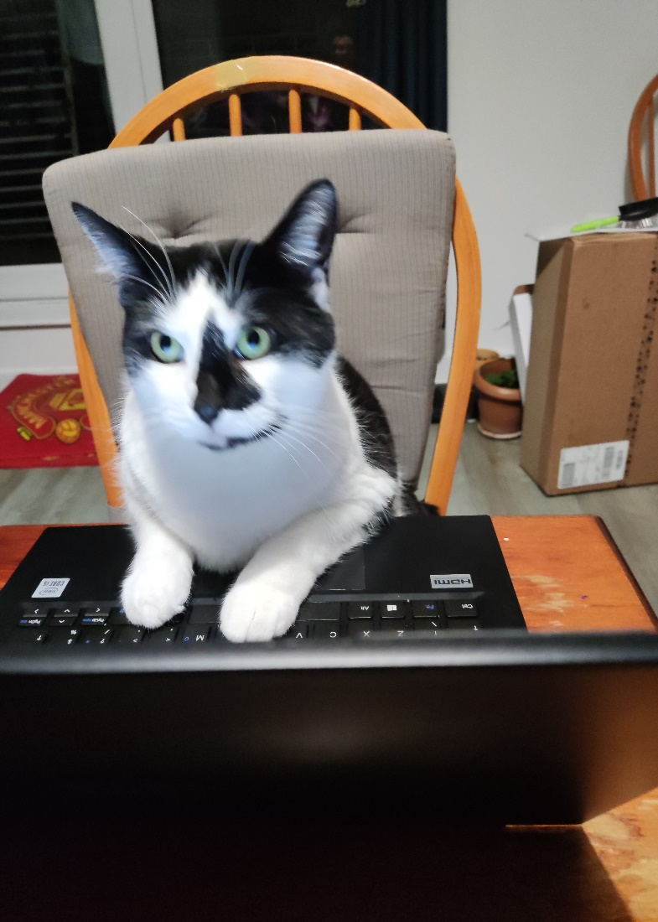
BA40103E - Employability Skills
The graduate employment market and emerging trends
Written assignment report - 1000 words , 30% weightage, 40% pass mark
RESULTS FROM CHATGPT
Remote work and flexibility
Technology and digital skills
Soft skills emphasis
Focus on diversity and inclusion
Continued learning and adaptability
Green jobs and sustainability
Healthcare and biotechnology
Entrepreneurship and startups
Globalization and cross-cultural competence
Gig economy and freelancing
Good set of points ; very vague , repetitive , old thoughts and probably everyone in the class has the same flow

Slide 15
BA40103E - Employability Skills
The graduate employment market and emerging trends
Written assignment report - 1000 words , 30% weightage, 40% pass mark
BEFORE YOU GET RESULTS FROM CHATGPT -
Look at the learning outcomes in the module study guide
Look at the assessment criteria
Look at the marking scheme
Think of the required flow of the document
Consider the statistical information required
Remember you will be submitting through Turnitin

Slide 16
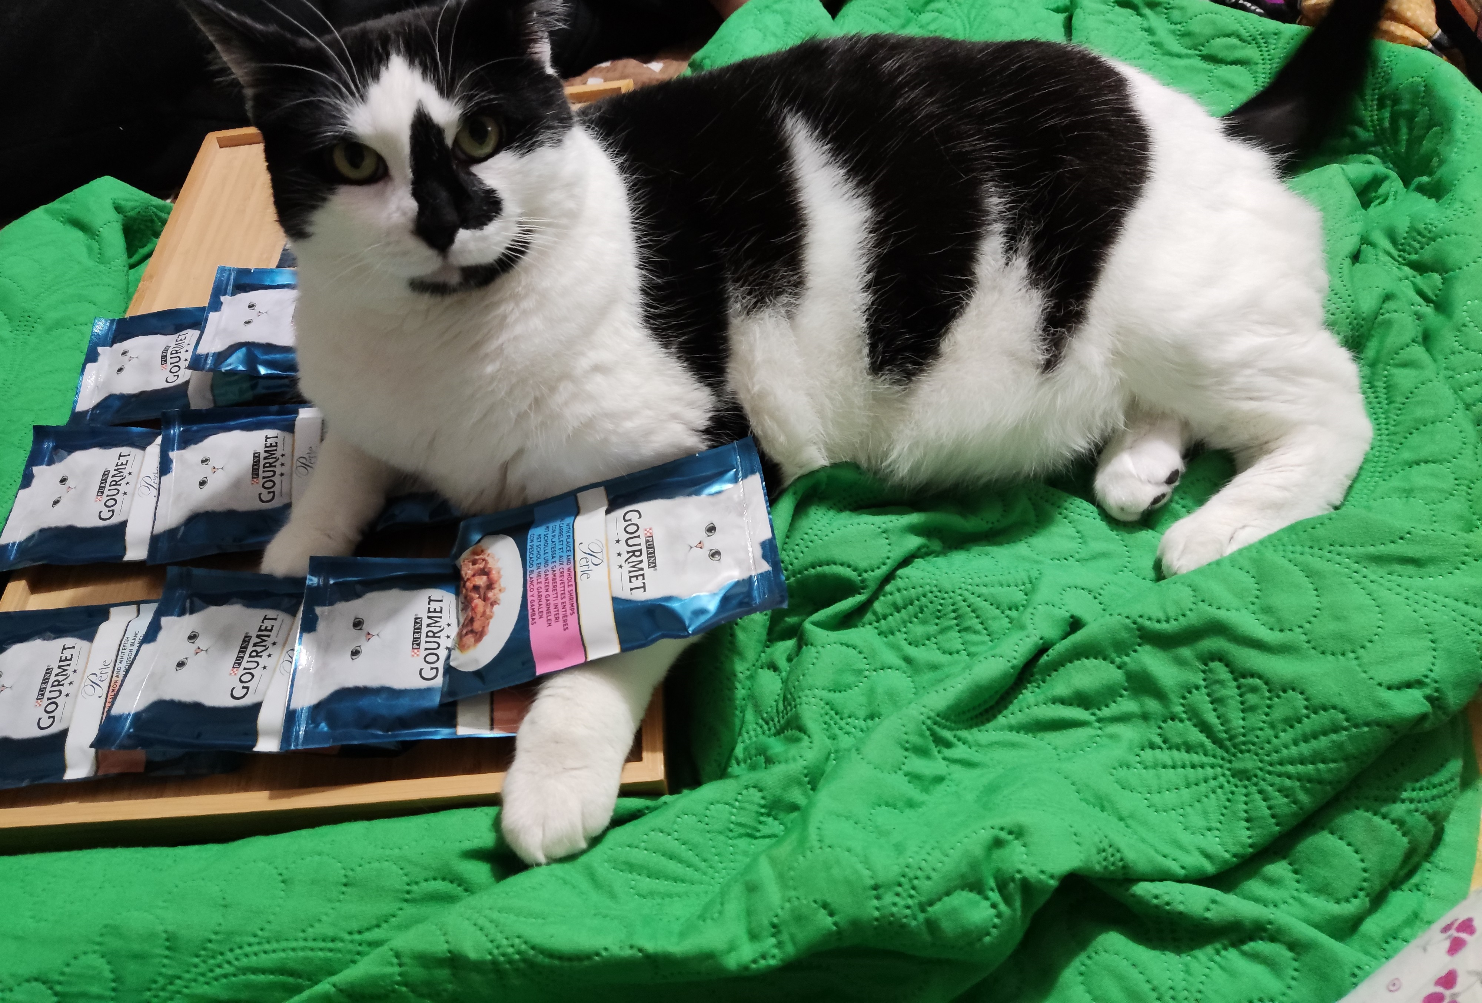
MW40010W - Foundations of Midwifery Practice.
Discuss a midwifery skill in a 3500 word essay.
RESULTS FROM CHATGPT - Blood Pressure Monitoring and Hypertension Management in Pregnancy
Importance and regular monitoring
Education and counselling
Recognizing hypertensive disorders
Risk assessment
Collaboration with healthcare team
Patient monitoring and follow-up
Emergency response
Postpartum care
Communication
Continuing education
Good set of points ; probably everyone in the class has the same flow

Slide 17
MW40010W - Foundations of Midwifery Practice.
Discuss a midwifery skill in a 3500 word essay.
BEFORE YOU GET RESULTS FROM CHATGPT -
Look at your Reading list to help you decide which skill to choose (your interest, global attention)
Look at the criteria for references needed to support your essay (last 5 years ?)
You need to search databases for latest advances in the field
You will need to adhere to word count for individual subtopics
You have to sign a declaration that this is your own work

Slide 18
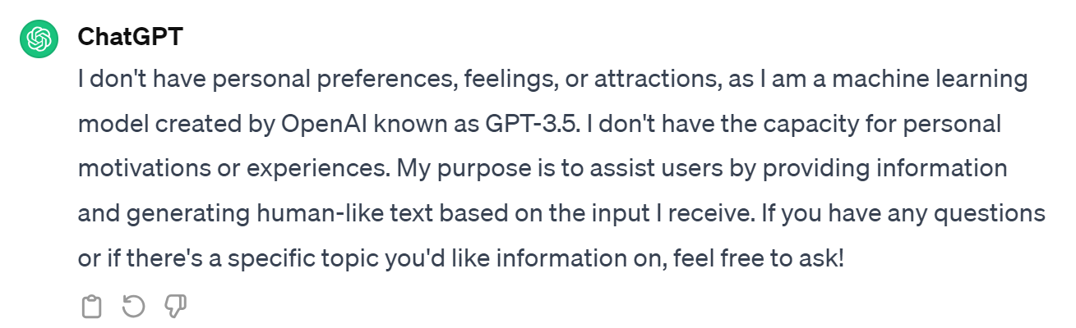
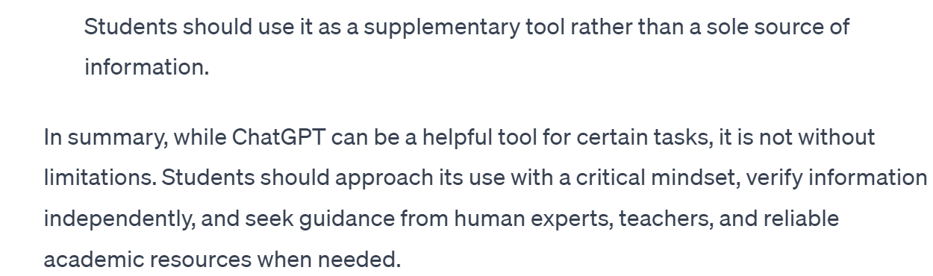
SS40013W – Psychology in the real World
The second part of the assignment (750 words) consists of personal statement for an employer, explaining what attracts you to the profession, highlighting your skills that suit the chosen area and evidence them using competency based statements.

Slide 19
LCM - Search results through CHATGPT
Do you think there is a gender bias in music production?
As an AI language model, I don't have personal opinions. The music industry, like many other creative fields, has faced challenges related to gender representation, opportunities, and recognition for women.
Can you cite the sources for these claims?
I recommend referring to academic research papers, industry reports, and reputable media sources that delve into topics related to gender bias in the music industry.

Slide 20

LCM - Search results through Libsearch
Gender bias in music production
March 2018, …David Byrne released an album American Utopia on which he proudly presented collaborations with 25 musicians (Beaumont-Thomas 2018). …all 25 collaborators (including Byrne himself, of course) were male. …We know now, firmly and without argument, that the music industry is overwhelmingly male. In the UK … festival line-ups (Sherlock & Bradshaw 2017), earning disparity (Jones 2018), live venue bookings (BBC News 2017) ….
Citing the sources for these claims
Raine, S. and Strong, C. ed. (2019) Towards gender equality in the music industry : education, practice and strategies for change. Bloomsbury Academic. Available at: https://discovery.ebsco.com/linkprocessor/plink?id=444172bf-d359-36e1-9546-692253fa4f6a (Accessed: 19 Jan 2024).

Slide 21

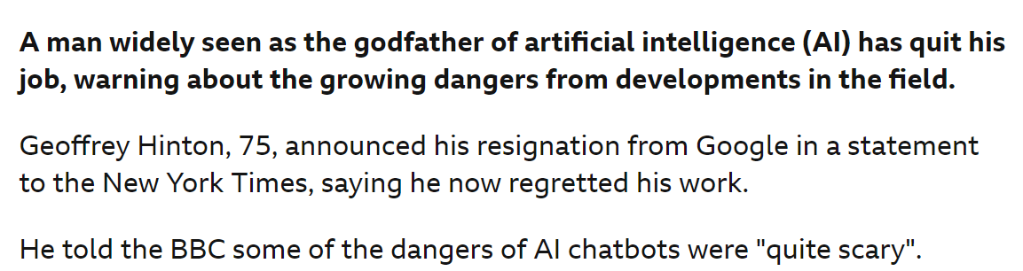
GEOFFREY HINTON

Slide 22
AI and the UWL library
TEACH
Students how to use them effectively and ethically
Information Literacy
Cite them right
Role play
Demonstrate ChatGPT
DEVELOP
Detailed guidelines, raise awareness and collaborate with others
Assignments and assessments focussed sessions
Similarity detector
LEARN
Why students use them and how they use them
Talk to students
Talk to academics
Talk to colleagues
Discuss in meetings

Slide 23
Evaluating sources critically
C
CURRENCY
Timeliness
Date published Date updated
Links functional
R
RELEVANCE
Relate to the topic
Intended audience
Appropriate level
Basic or advanced
A
AUTHORITY
Who is the author
Is the writer qualified
Contact details
A
ACCURACY
Evidence
Verified by anther source
Unbiased
P
PURPOSE
Inform, Sell, entertain, persuade?
Fake news
Notes:
Magazines
Magazines publish articles on topics of popular interest and current events. The articles are written by journalists and are for the general public.
Magazines, like journals and newspapers, are called "periodicals" because they are published at regular intervals throughout the year. You can find print magazines at newsstands and in libraries. Some are now available on the Web as electronic magazines.

Slide 24
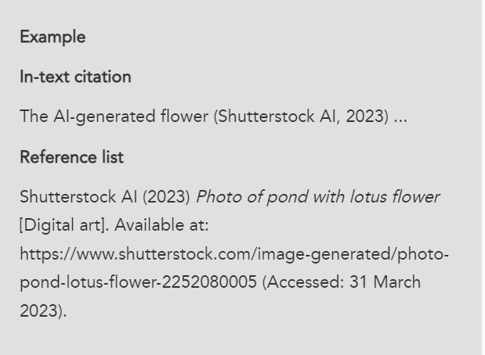
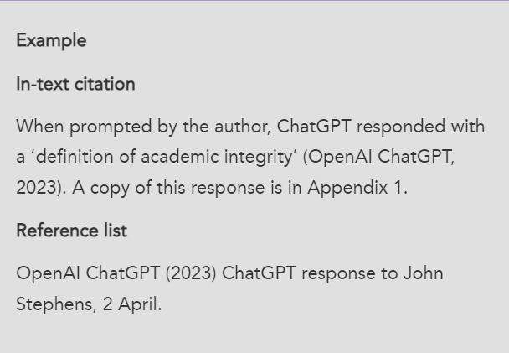
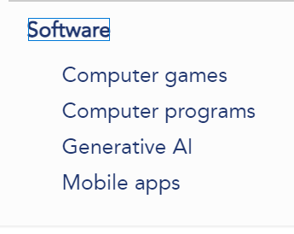
Cite them right online -
Cite Them Right - Generative AI (citethemrightonline.com)

Slide 25
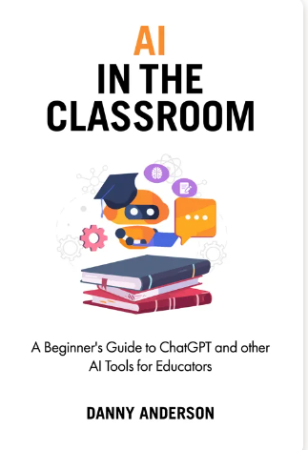
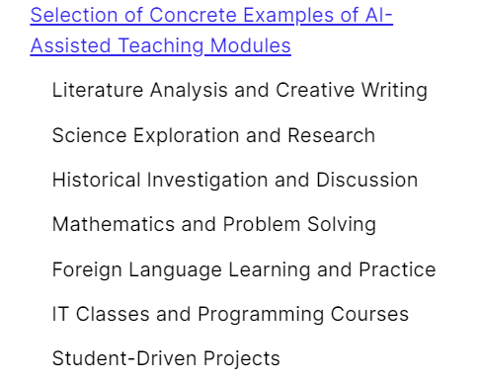
Artificial Intelligence in the classroom
ereader.perlego.com/1/book/4140955

Slide 26
Some references – worth a read
https://www.cilip.org.uk/news/661388/Can-AI-do-your-reading-for-you--should-it.htm
https://www.timeshighereducation.com/campus/confronting-generative-ai-fastchanging-higher-education-sector
https://www.hepi.ac.uk/2023/10/11/how-can-we-utilise-ai-in-higher-education
https://www.linkedin.com/pulse/role-ai-education-inspiroz
https://www.jisc.ac.uk/reports/artificial-intelligence-in-tertiary-education
https://wonkhe.com/blogs/caution-is-needed-around-generative-ai-especially-when-work-based-learning-is-involved
https://wonkhe.com/blogs/caution-is-needed-around-generative-ai-especially-when-work-based-learning-is-involved
https://www.unesco.org/en/digital-education/artificial-intelligence
https://repository.jisc.ac.uk/9232/1/ai-in-tertiary-education-a-summary-of-the-current-state-of-play-september-2023.pdf
Defining artificial intelligence for librarians - Andrew M. Cox, Suvodeep Mazumdar, 2022 (sagepub.com)
AI & Libraries (youtube.com

Slide 27
How confident do you NOW feel in knowing and understanding about Artificial Intelligence in relation to academic libraries ?

