Slide 1

Reading and storytelling
for academics and leisure
The U.K. experience
Dr. Janice Fernandes
Academic Support Manager
University of West London
Write to me at –
janicefernandes@yahoo.com
5th October 2024

Slide 2
Sit comfortably, close your eyes, regulate your breathing
Which is your favourite childhood book ?
Did you own/read a lot of books ?
Do you still have any of those books ?
Did you receive books as gifts ?
Can you picture yourself reading as a child?
Can you recreate that experience and
recapture that joy ?

Slide 3
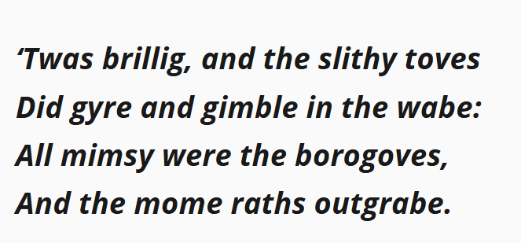
Can you read this ?
Can you understand it ?

Slide 4
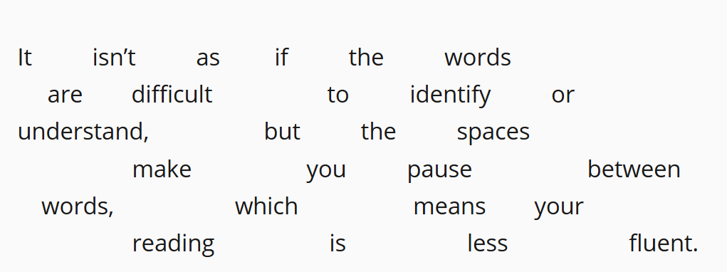
Can you read this ?
Can you understand it ?

Slide 5
What is Reading
Making meaning from print
Identifying alphabets, words and sentences
Constructing an understanding
Making meaning to achieve fluency
Reading in different languages and scripts
Understanding phonetics and vocabulary

Slide 6
What do we read
Story books, Text books, Novels
Religious texts
Newspapers and magazines
Handouts, pamphlets, posters, leaflets
Information in electronic formats
Books made into films

Slide 7
Advantages of reading
Mastery over the language, quote well
Gain knowledge ; increase confidence
Improve communication skills
Improve memory, focus and concentration
Reduce stress; mental well-being; better sleep
Reading as a hobby on your CV
Read well, write well, speak well

Slide 8
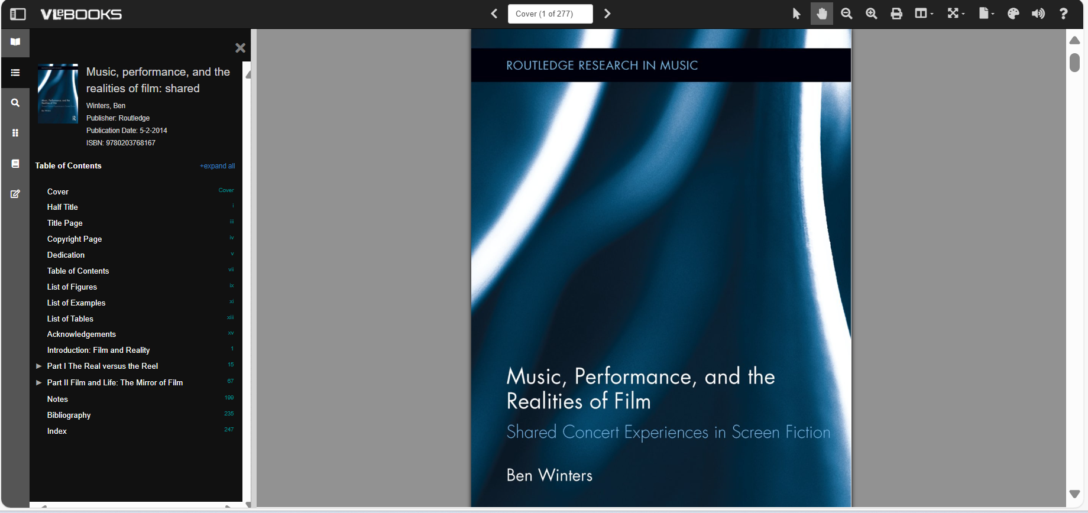
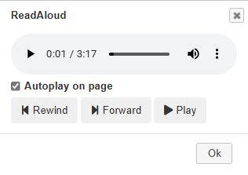
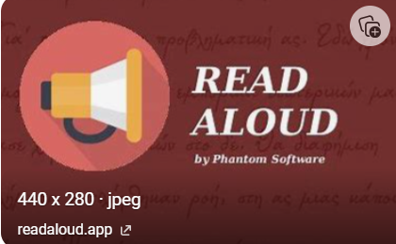
Various elements of an e-book
Zoom in/Out
Background colours
Table of Contents
Search within the book
Dictionary

Slide 9
Why should you read effectively?
Awareness of the main resources in your subject ​
To indicate to your tutor, your knowledge and understanding of the relevant resources ​
To manage your time​ well
To enable you to use the resources appropriately in your writing

Slide 10
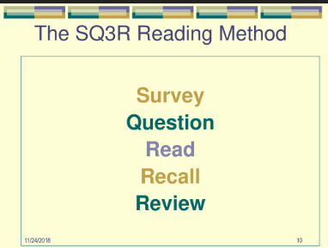
How you should read effectively?
Survey - Question - Read - Recall - Review ​
Evaluate the source- author – reason – authenticity-relevance
Reading and understanding; asking questions in your mind
Finding the evidence for what you agree with or disagree with

Slide 11
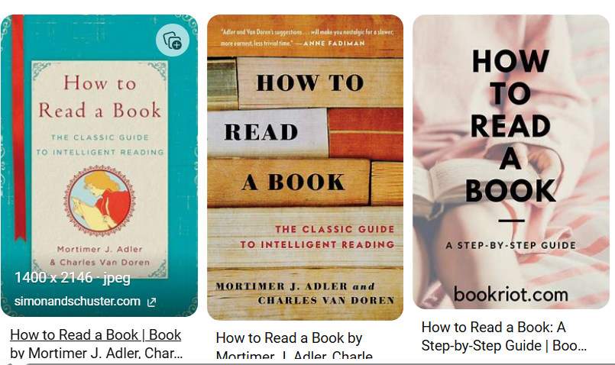

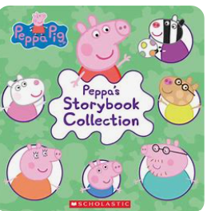

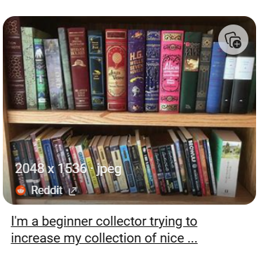
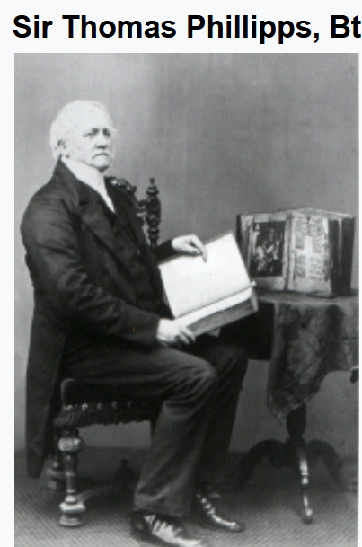
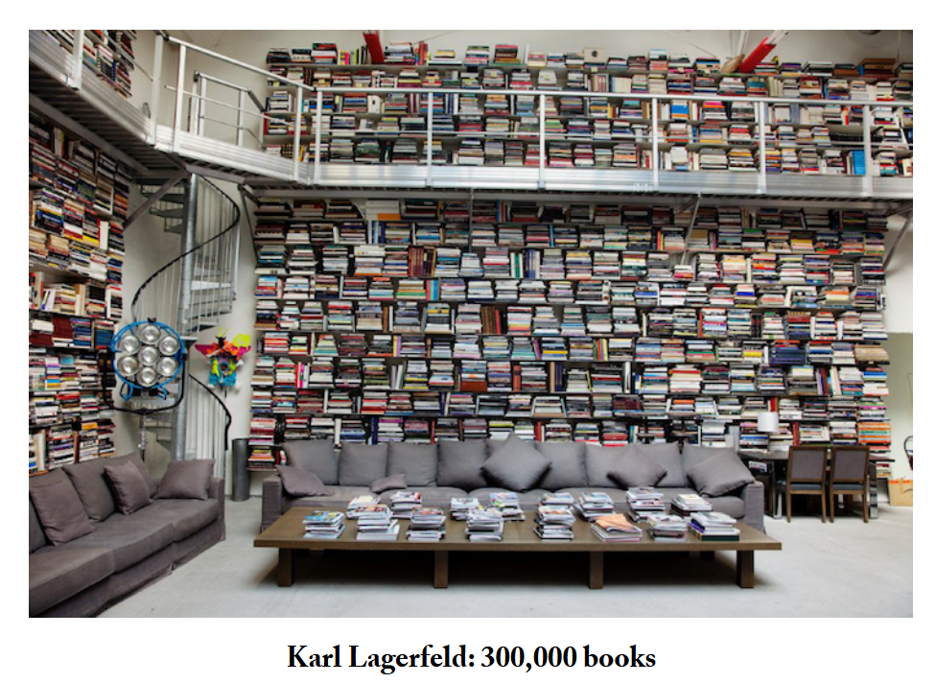
Book collections
40,000 printed books and 60,000 manuscripts

Slide 12

Common excuses and how to overcome them
No time
No money
No space
No motivation
No company
No future prospects

Slide 13
Sit comfortably, close your eyes, regulate your breathing
Who was the best storyteller in your childhood?
Which story did you enjoy the most and why ?
Did you tell stories to others as a child ?
Do you remember any of those stories ?
Can you picture yourself listening to a story as a child?
Can you recreate that experience and
recapture that joy ?

Slide 14
What is Storytelling
The art of conveying narratives through words, visuals, or experiences
Used to engage, inform, or entertain an audience, multilingual
Sharing experiences
Enables us to connect with others, convey messages effectively,
Can communicate, persuade and inspire action.

Slide 15
The purpose of Story telling
Making abstract concepts understandable
Can nurture and shape ideas
Can build moral values
Can create a sense of unity
Acts as a catalyst for positive change

Slide 16
The process of Story telling
KNOW YOUR AUDIENCE
SELECT YOUR THEME
CHOOSE YOUR STORY
START
MIDDLE
END
WRITE THE SCRIPT paper/mind
ADD YOUR FLAVOUR
DELIVER YOUR STORY

Slide 17
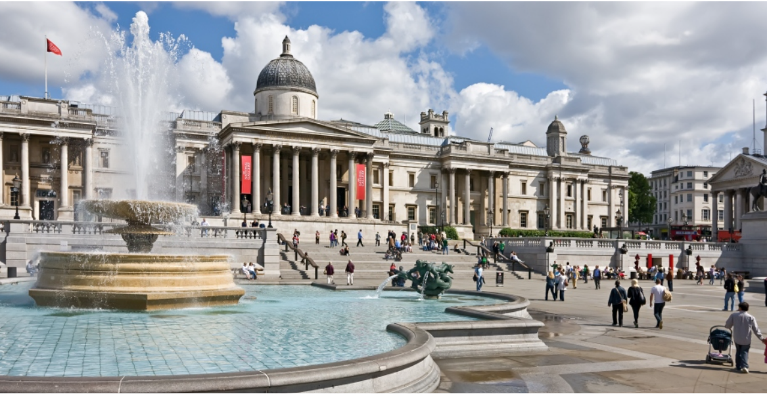
Trafalgar Square London

Slide 18
The 5 Ps Storytelling
People - creating characters and human connection
Places - where the story happens, diverse, memories
Pictures - photo in the mind, imagination, visuals
Platforms - live audience, video, social media
Personal – connect on a 1-2-1 level, questions, humour

Slide 19
Some aspects of storytelling …1
Changing the character
Changing the scenario
Changing the ending
Changing the names, location, dress, food etc.
Changing the focus of the narrative

Slide 20
Other aspects of story telling …2
Evaluation through observation
Evaluation through interaction
Evaluation through feedback
Evaluation through statistics
Evaluation through impact
How do you know if you are making a difference ?

Slide 21
How do you tell a good story
When to begin … and begin well
Add details – Names, places, dialogues
Connect with the audience
Emphasise through pauses, tone, pitch
Dramatise or use props if necessary
Use body language, gestures, hands

Slide 22
How do you know you are telling a good story
A new story for the audience
Enthralled audience
Minor interruptions don’t change the connection
Display of emotions at the end
You are talking to your audience , not at your audience

Slide 23
The U.K scenario
Public libraries in the U.K.
A means of inclusive, social and cultural activity
A medium for education, entertainment, and cultural preservation.
A means of reaching out and healing,
Story telling events across the country

Slide 24
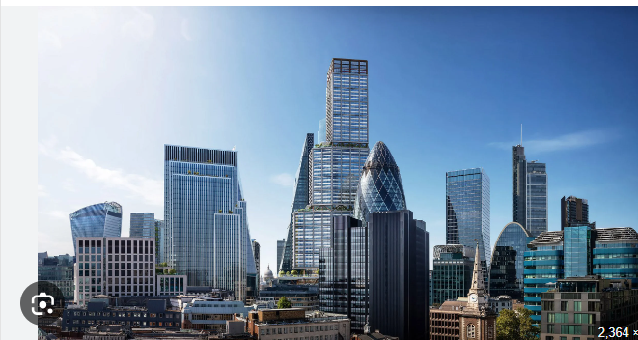

Slide 25


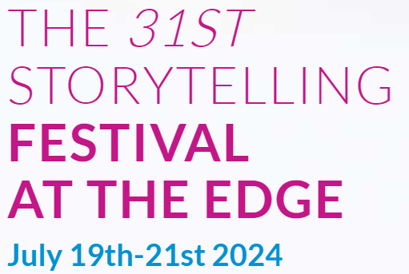


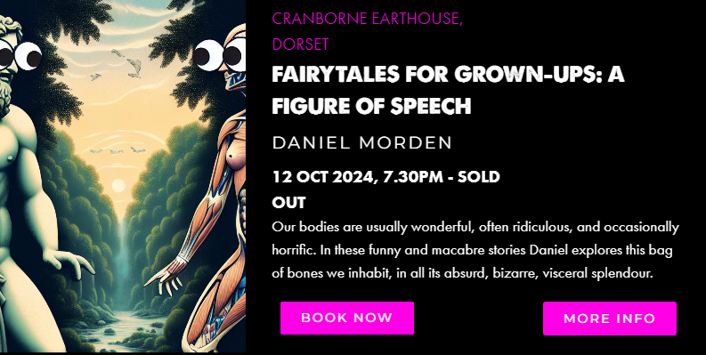




Slide 26
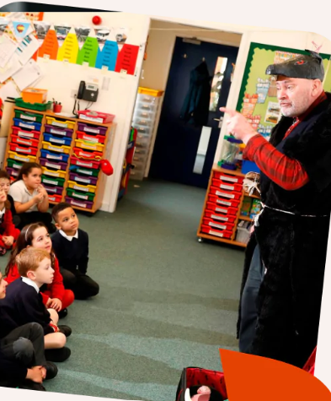
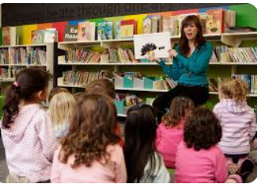
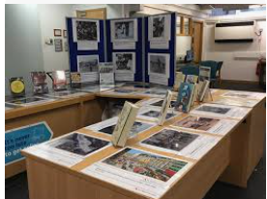
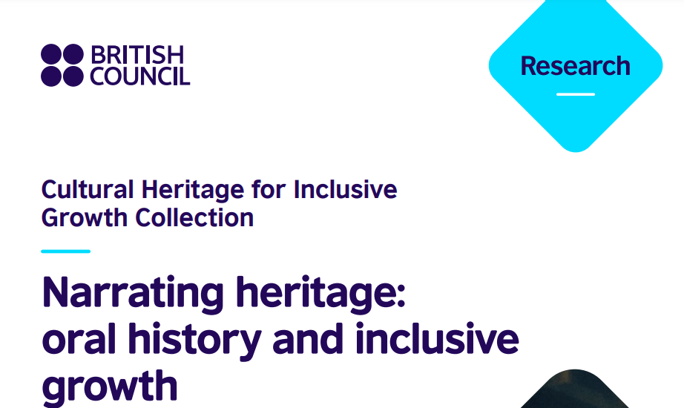
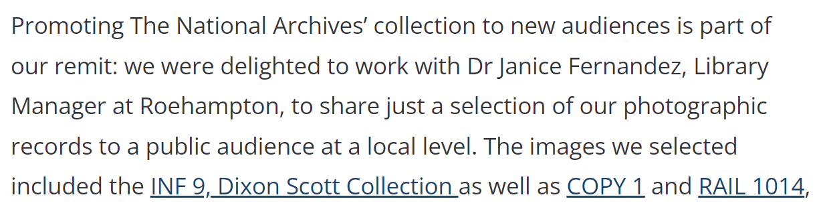

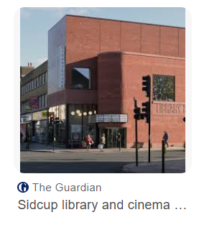
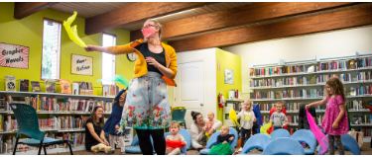
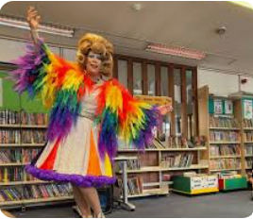
https://youtu.be/uACzO6Bo0Z0

Slide 27
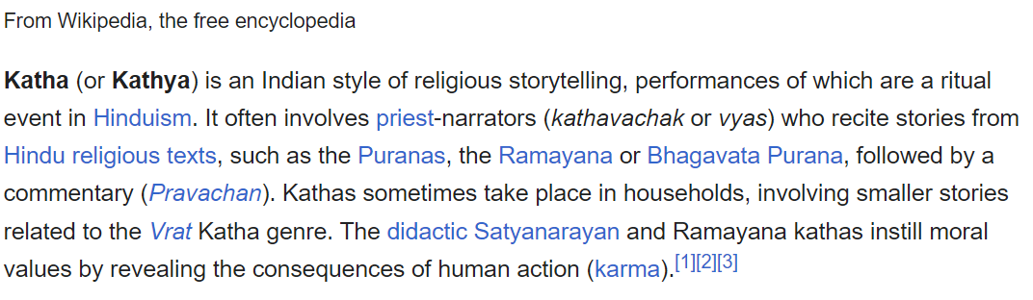
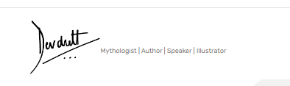
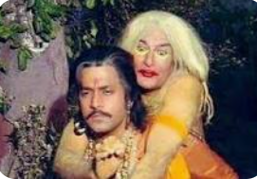
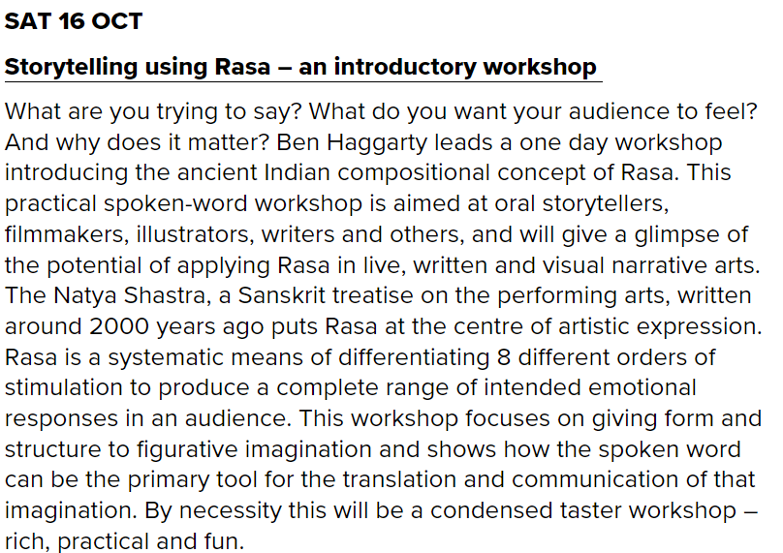
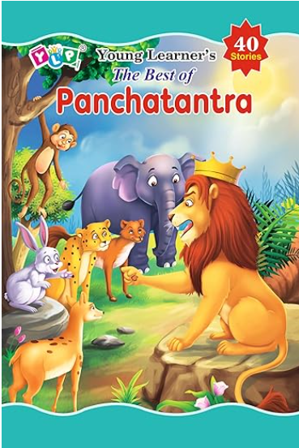
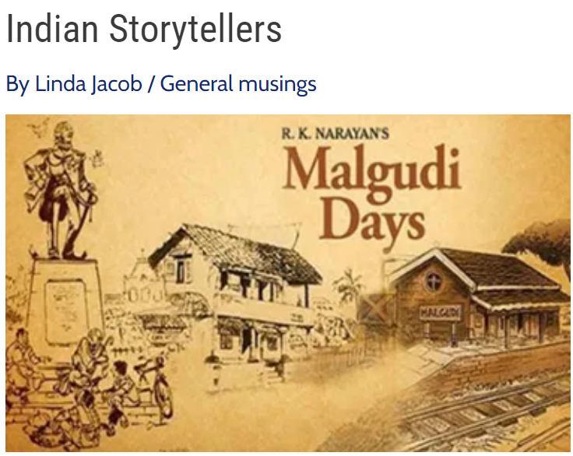

Slide 28
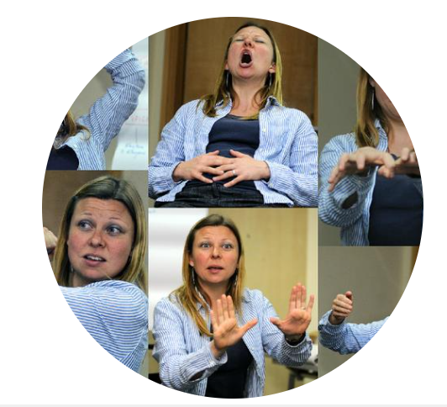
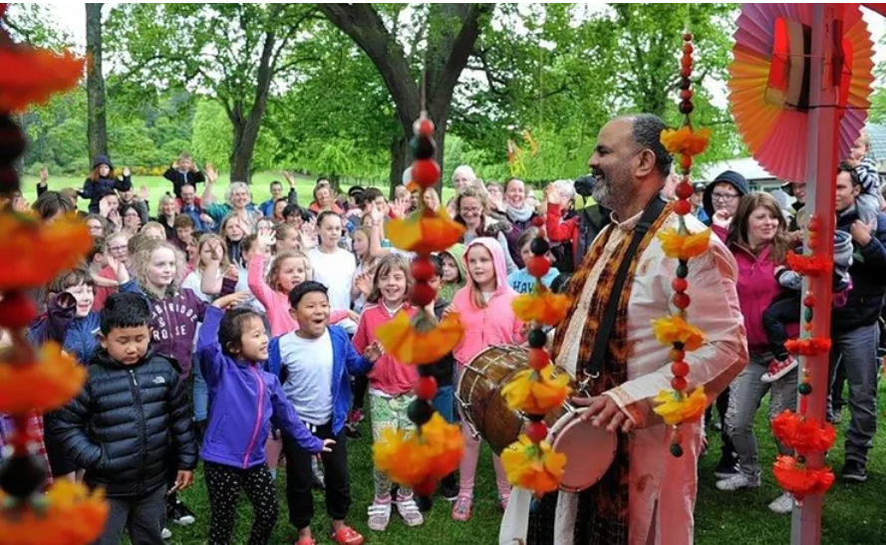
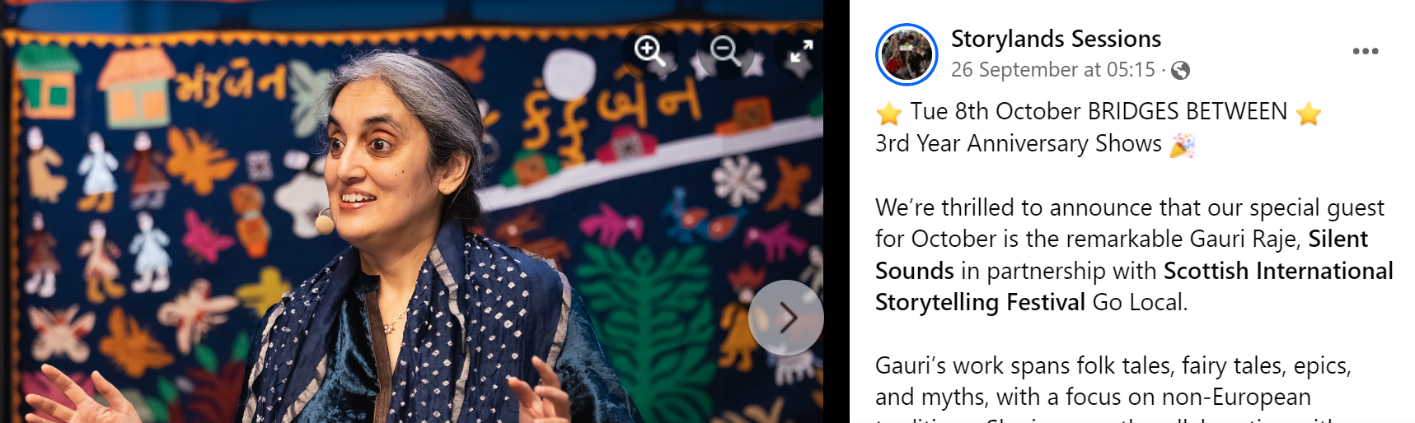
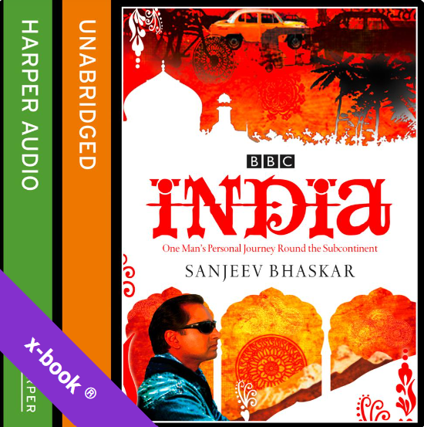
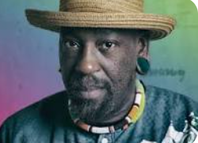
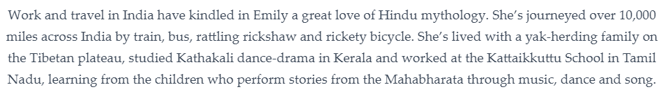
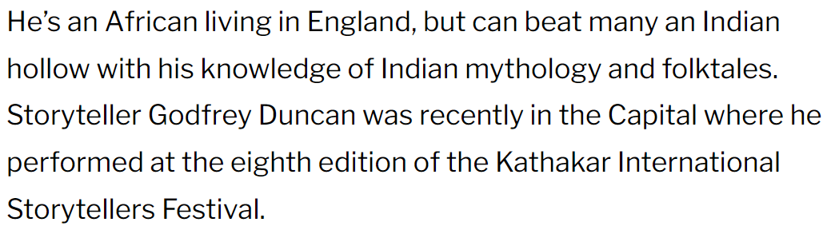
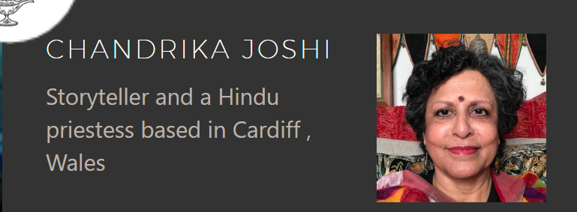
Indian storytellers in the U.K.
Peter Chand

Slide 29
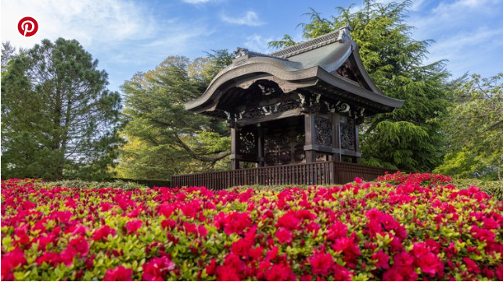
Kew Gardens London

Slide 30
Storytelling in Academics and Research
Oral histories – preservation of information
Archives
Documenting experiences
Case studies in management
Theses and Dissertations
Research studies

Slide 31
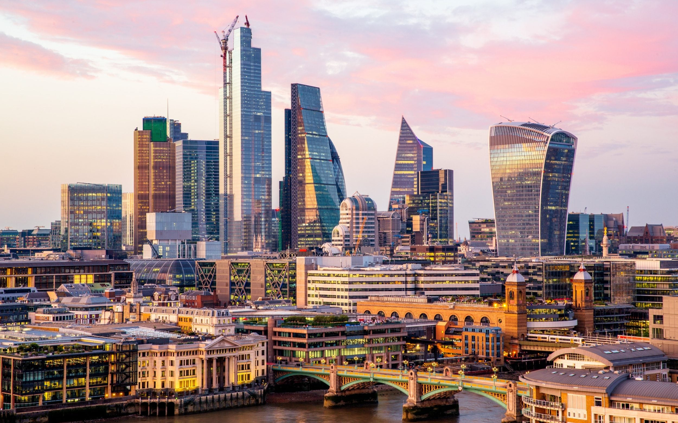

Slide 32
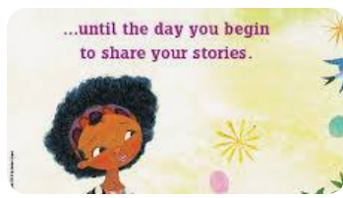



Slide 33

THANK YOU
For giving me the opportunity
to present here today and
to add value to academics.
Best wishes
for a successful career
and an amazing future !

