Slide 1
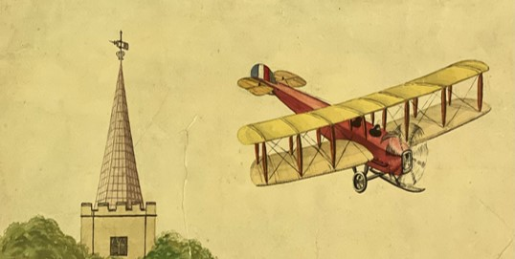


Seeing the Whole Picture
Mary Brown
Archivist
University West London
Ruskin College
Mary.Brown@uwl.ac.uk
The Sustainability Project
Our Journey
Our Harrow
Funded by a grant from The National Archives

Slide 2
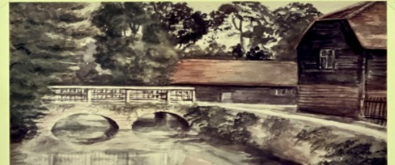
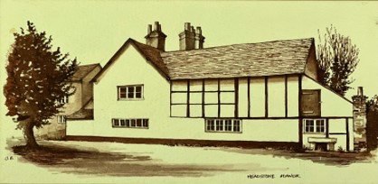
Harrow Local History Collection and Archive
Repository for Harrow Council
Holds a combination of local authority records and records from the community
Over 100,000 items make up HLHCA
Community members from diverse backgrounds send in enquiries to the archive and come to the museum to explore Harrow’s history
Collections themselves contain little about the diverse people and communities that make up Harrow
Collections have lacked appropriate care and storage to ensure long term preservation

Slide 3
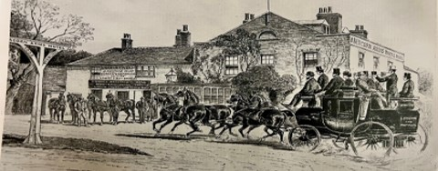
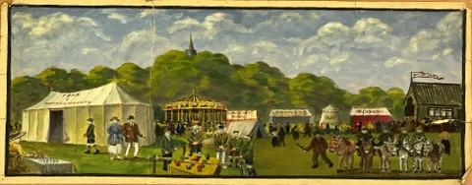
Our Goal
Our Plan
the co-creation of sustainability-themed public outreach and community events while addressing the sustainability of the collections themselves.
Catalogue and Rehouse the Art and Print Collection
Collaborative Workshops with the Afghan Community
Afghan Community Volunteers Skill Building
New Material to be Accessioned into the Collections
Co-curated Exhibition

Slide 4
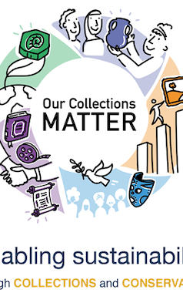
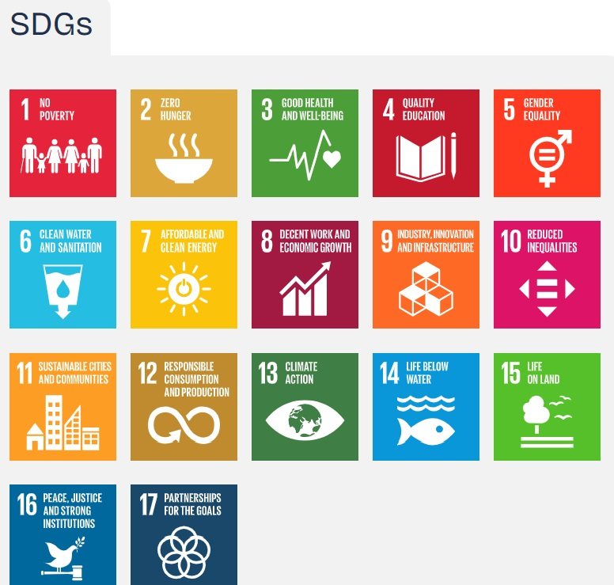
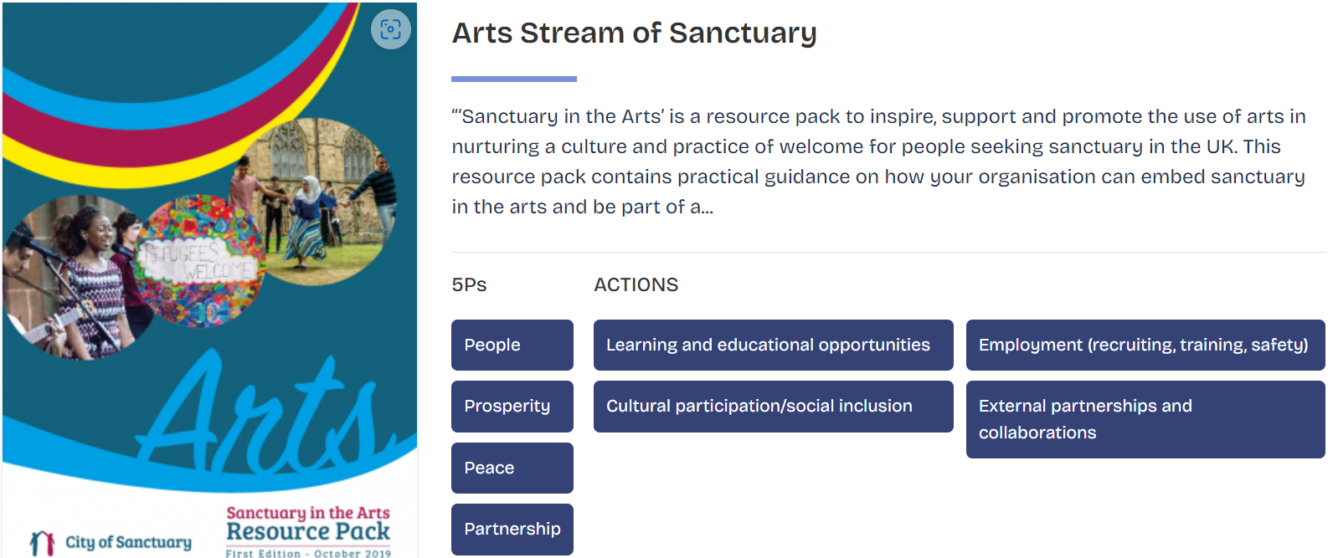
International Centre for the Study of the Preservation and Restoration of Cultural Property (ICCROM) and Our Collections Matter (OCM)
Good Practices and Methods for Co-creation
Arts Streams of Sanctuary – City of Sanctuary Arts Resource Pack
Intergenerational Toolkit for Museum Collections
ASTC Equity and Diversity Toolkit
Arts and Equity Toolkit
Audience Development Toolkit
Arts and Culture Digital Roadmap
OCM Website: https://ocm.iccrom.org/
UN Sustainable Development Goals: https://sdgs.un.org/goals

Slide 5
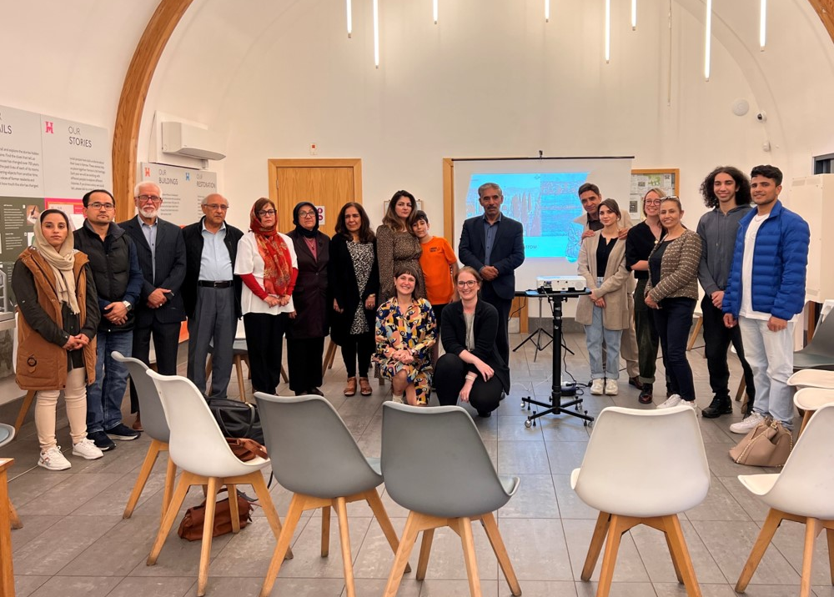
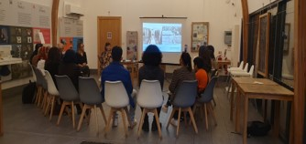
Welcome Workshop
  Used the session to build a rapport with participants
  Discussed the co-productive element of the grant
  Gauged the participants’ needs, skills and interests.
  Setup a WhatsApp group to communicate

Slide 6
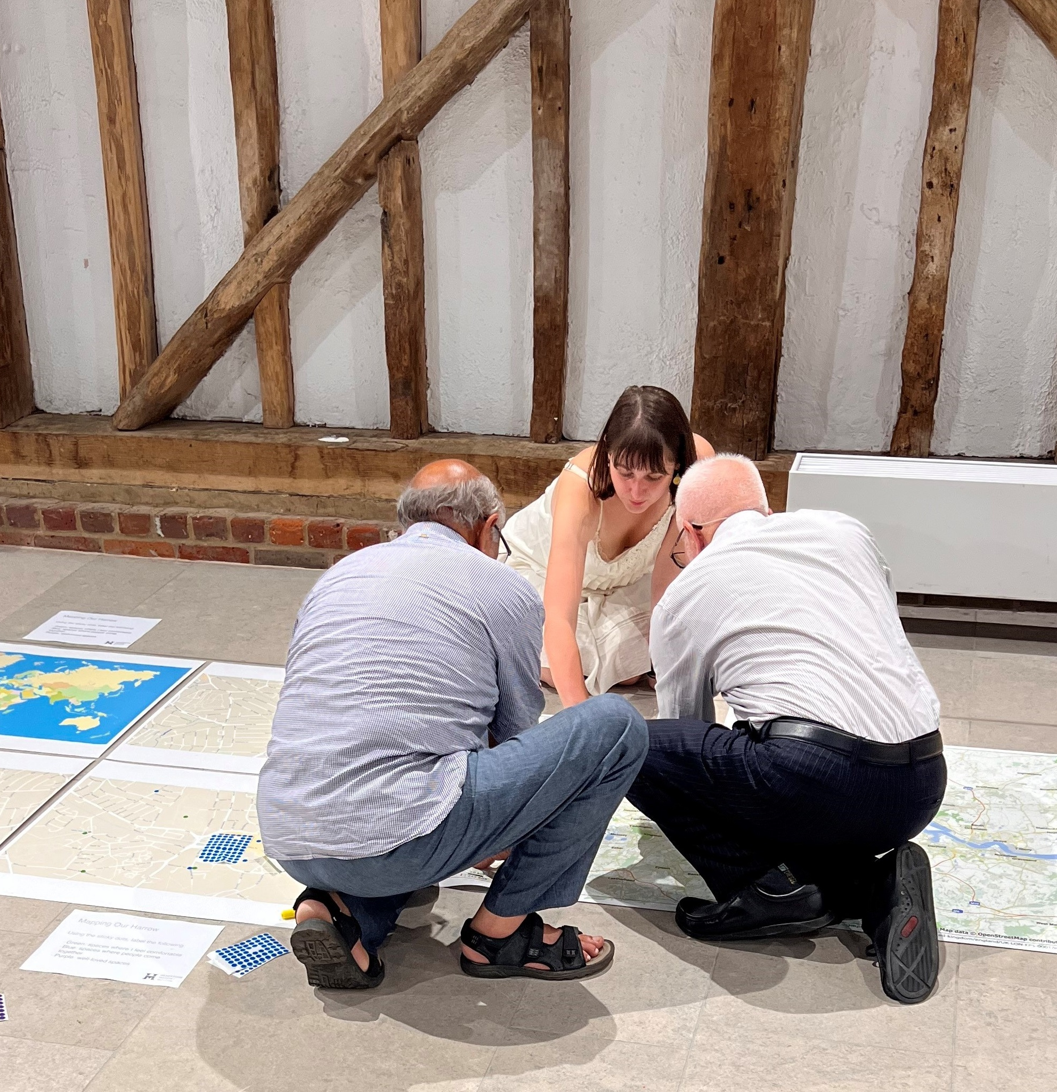
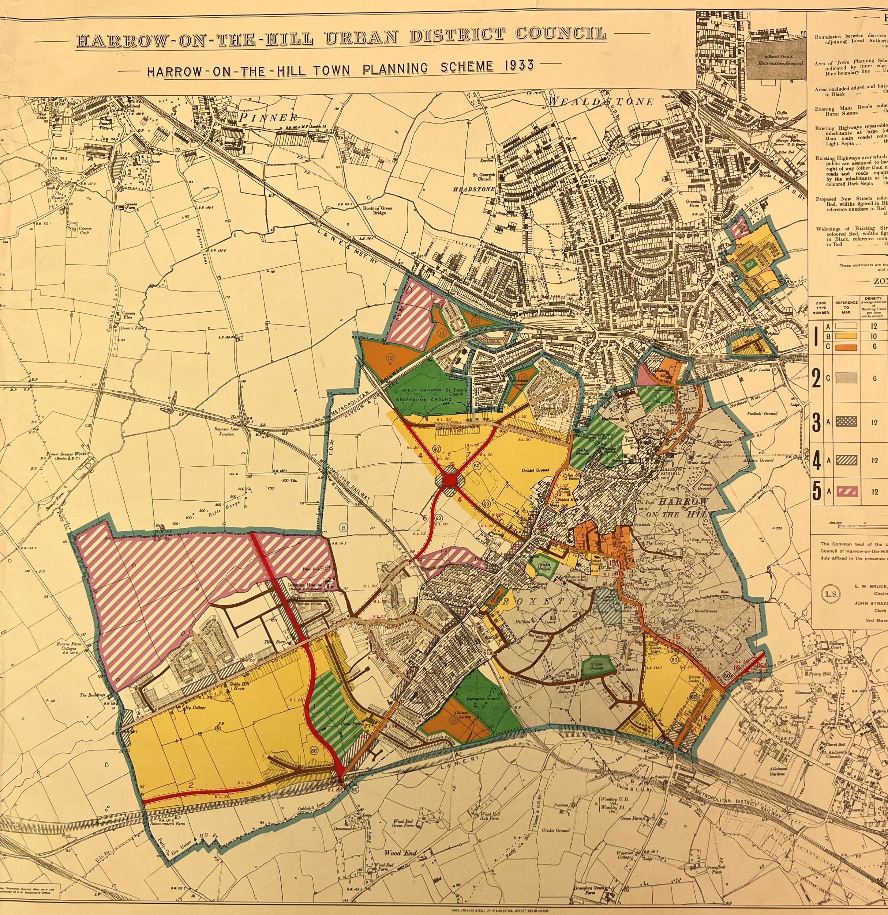
Your Harrow : Participatory Mapping Workshop
  Explored ideas of sanctuary and identify spaces of sanctuary in the borough
  Participants labelled spaces and places in the borough that foster connections, highlighting well-loved places and places people come together in the borough

Slide 7
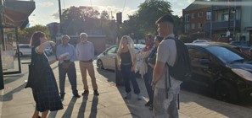
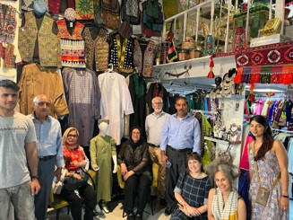
  Self-led tour of Harrow and Wealdstone
  Tasks:
  To take photos of things, people, or places that remind them of home and
  To take photos of things, signs, or infrastructure that connect them to others
  Generated new photos that celebrate sanctuary, home and belonging, producing new items for accession
Photo Crawl Family Workshop

Slide 8
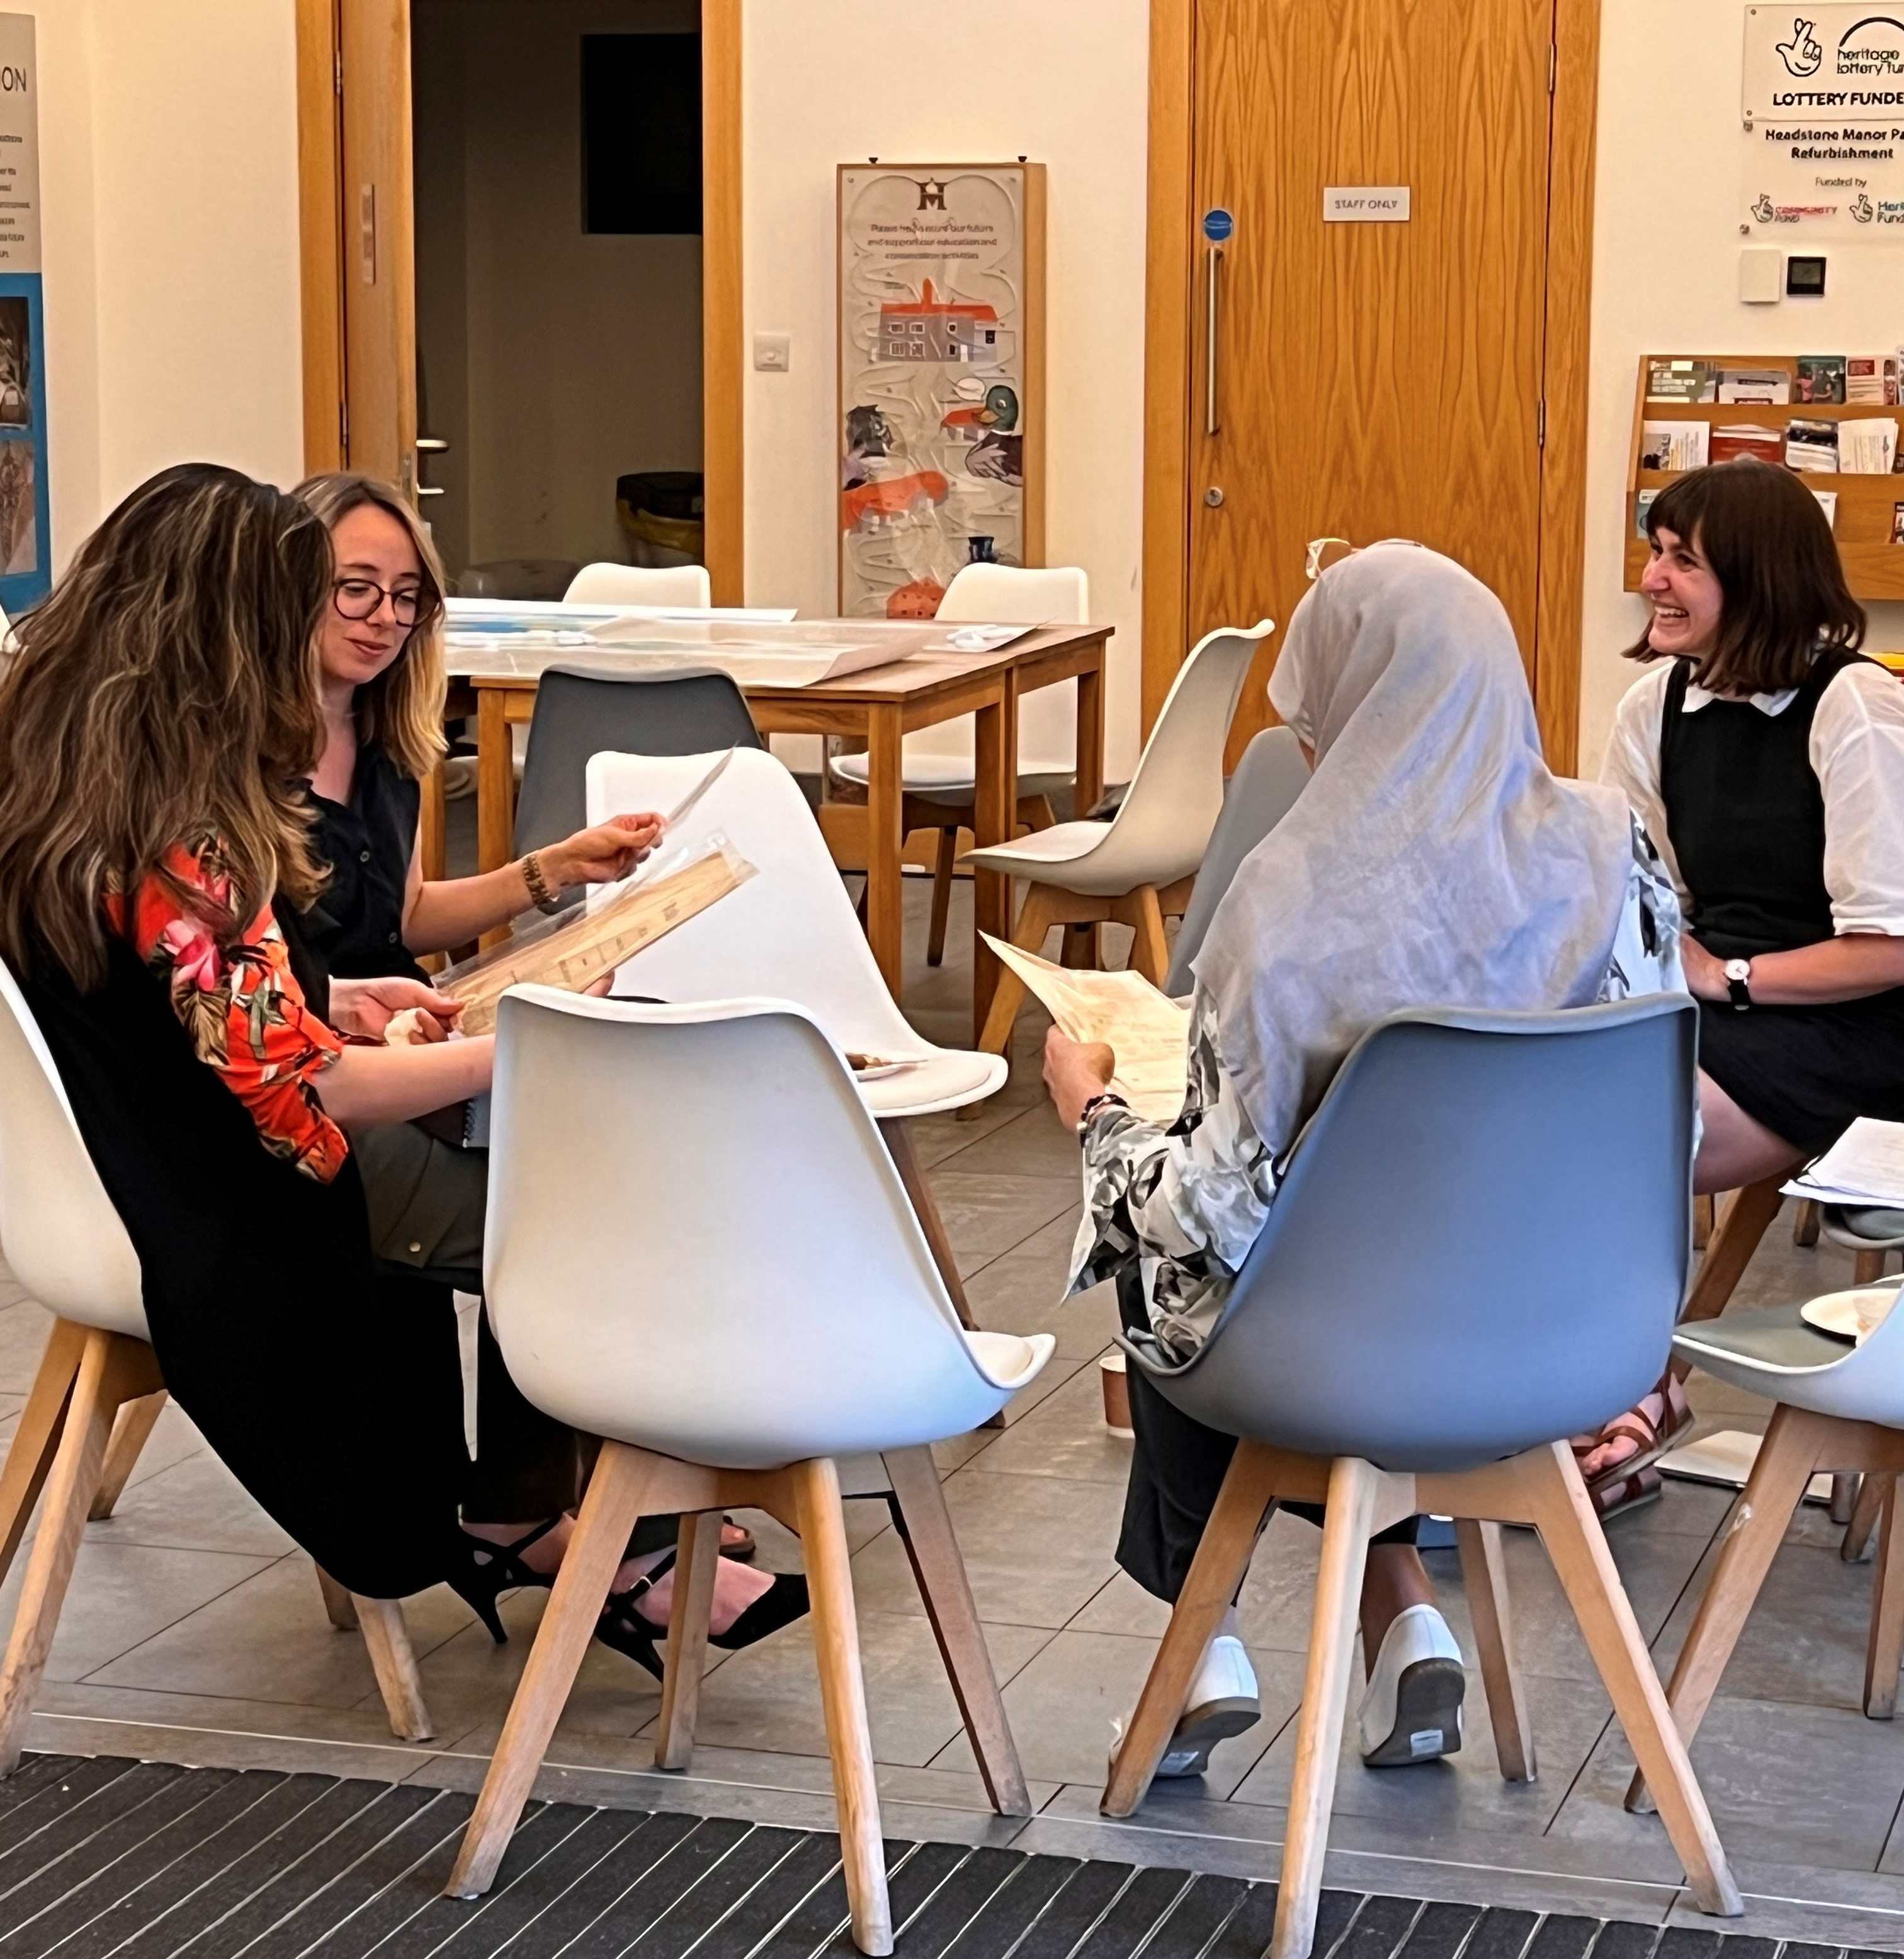
Make Your Own Archive Workshop
Activities
  Participants described a treasured object and then drew or wrote about their object
  Participants explored three archive boxes, discussing their contents, why the items may have been accessioned and what they represent.
  Participants were then asked to describe what they would like the archives to accession.
  Participants grouped the photos from the photo crawl into themes and identified items for accession
Goals
showcase Harrow’s diversity and global connections as well as provide new insight into how materials are accessioned by archives
Receive insight and feedback from participants on how they could be better represented

Slide 9
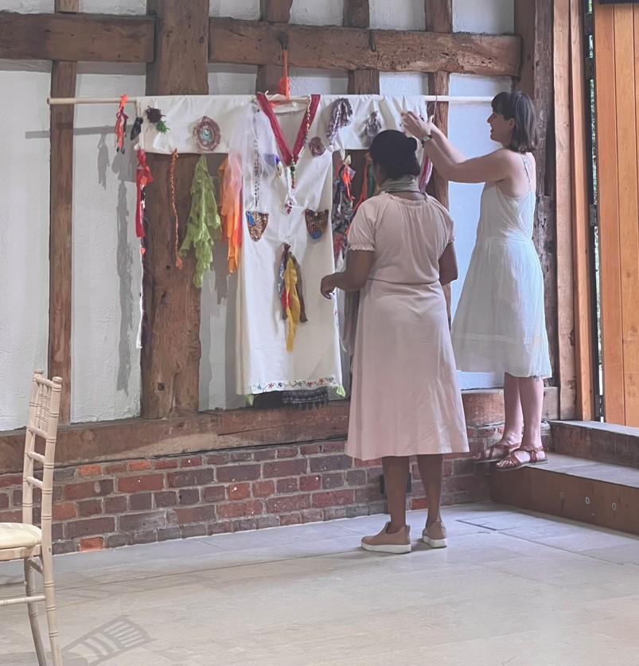
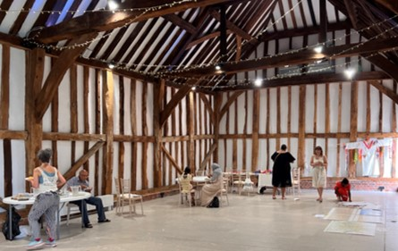
Family Art Workshop
  Public drop-in arts workshop
  Explored ideas of home in the borough and connection to place.
  Focused on what brings us together, what inspires hope and what makes us feel at home
  Participated in weaving, embroidery, and textile collage
  Created an Afghan style co-created dress that was exhibited and later, accessioned
Workshop scheduled to coincide with Heritage Open Day activities
Headstone Manor and Museum new children’s activities launched the same day pulling in more people

Slide 10
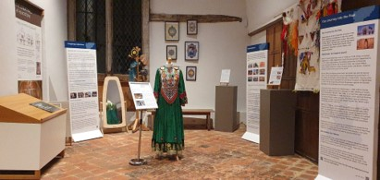
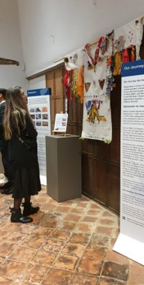
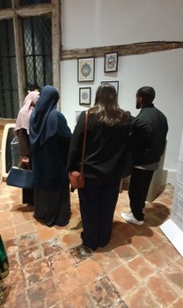
Outcomes
Connections to Afghan Refugee Communities
Relationships with Paiwand and the Afghan Association of London
5 successful well attended workshops
Maps, photographs, and art to be accessioned into the collections
Art collections catalogued and rehoused
Exhibition in Headstone Manor and Museum displaying creations from the workshops as well as objects, recipes, and stories from the community

Slide 11
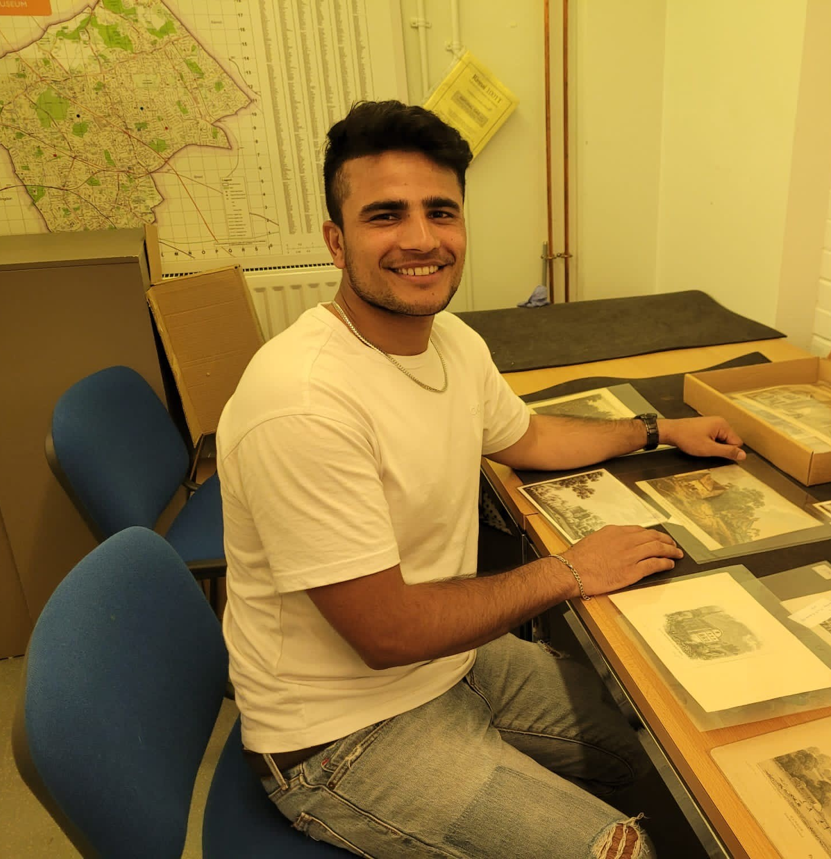
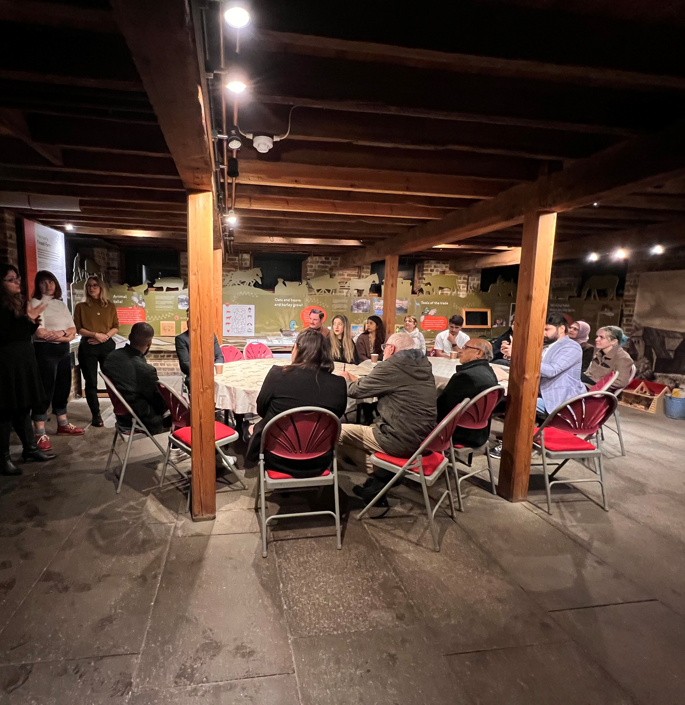


Impact
“I never thought this old bill of sale would make me think of the diaries I kept on scrap paper from my dad’s work as a teenager and left behind in Kabul 27 years ago” – Fahima
“What about second generation Afghans in London? What about my experience?” - Baktash
About 3,000 people visited Headstone Manor and Museum in October with the exhibition in the Great Hall
Many thanks for the hard work, dedication and creativity of Project Outreach Archivist Dr. Edanur Yazici and Project Archivist Dr. Holly Winter
With funding and support from The National Archives and ICCROM Our Collections Matter

