Slide 1

THE DOCTORAL RESEARCH JOURNEY– Challenges & Opportunities
Dr. Janice Fernandes
Academic Support Manager
University of West London, U.K.
janicefernandes@yahoo.com
29th Dec 2024

Slide 2




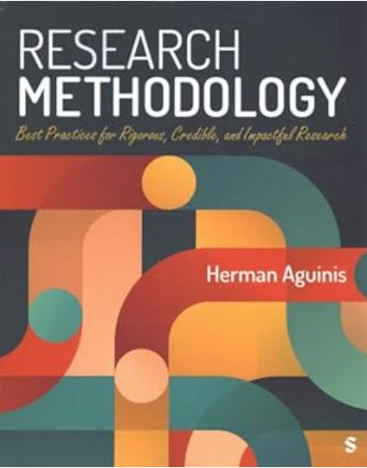
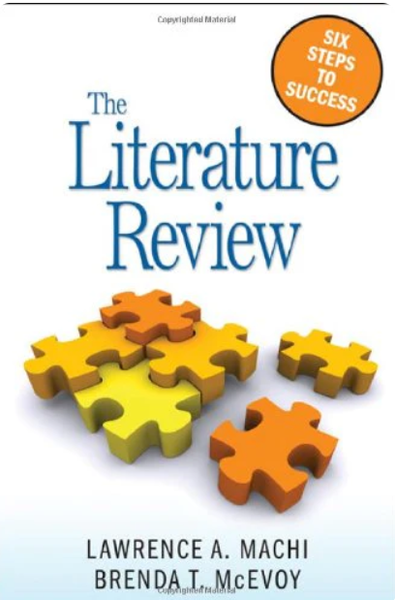
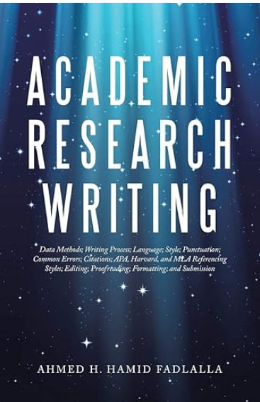


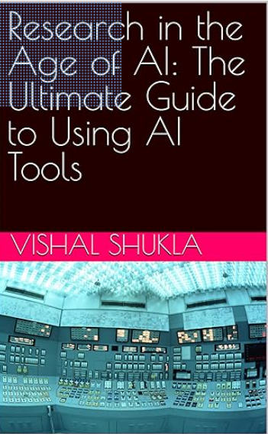

Charting your research journey through books

Slide 3
Selection of a Research Topic
What excites me about my research topic?
What was my motivation in selecting this topic for my doctoral study?
Does my topic address a current gap in my area of study?
Is my topic too broad or too narrow?
Is my topic original and impactful?
Does my title tell the story? Will it be found via Google Scholar ?
Is my research area manageable in terms of timeline and resources?
Does my topic align with my long-term career goals?
Am I replicating existing studies without providing new insights?

Slide 4

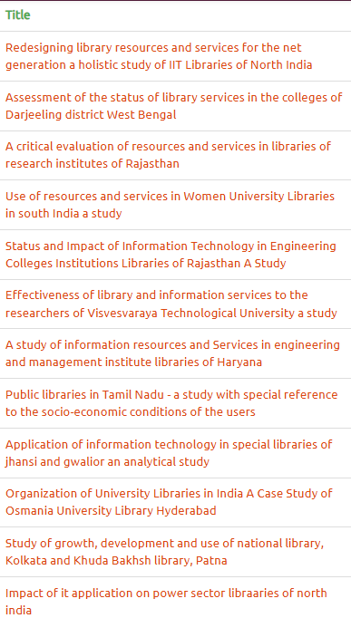
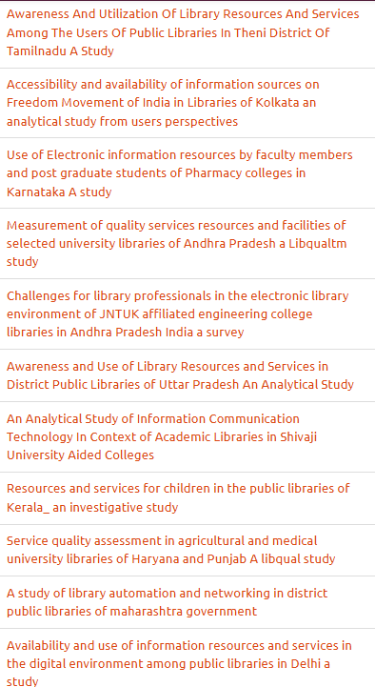
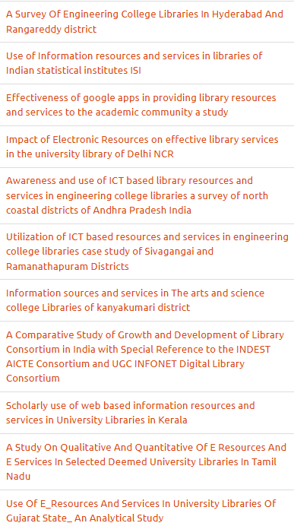

Slide 5











Slide 6

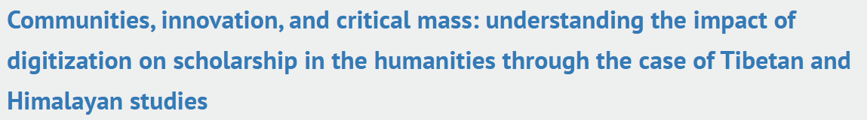





Some examples

Slide 7

Various Sources of information
Journal articles
Publisher databases
Government white papers
Contracts
Conference papers
Letters and e-mails
Standards
Newspapers
Technical reports
Patents
Statistics
Books
Market reports
Theses
Blogs
VLogs
Videos
Institutional Repositories
Interviews
Artificial Intelligence
Magazines

Slide 8
What does my Literature Review tell me ?
A comprehensive understanding of the topic, its importance and its validity
Critical insights into what has been researched and what needs to be done
A clear understanding of the gap in the research
A showcase of various research methodologies
An understanding of various factors and parameters, geographical boundaries, sample size, and other differences
A fair judgment of the time frame and other resources needed
An overall vision of your research project through the lens of past experiences

Slide 9
What a Literature Review should not be ?
Not having sufficient quantity and quality of reviews to cover the breadth and depth of the research topic
Not being well structured or organised , not arranging them in a logical sequence
A copy of the abstracts from various research articles
Not being critical or analytical enough
Blindly typing in the findings of other researchers
Use of too many quotations
Not using paraphrasing/summarising/synthesizing
Not taking care of citations and referencing
Not finding that gap in the research

Slide 10

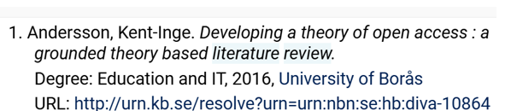
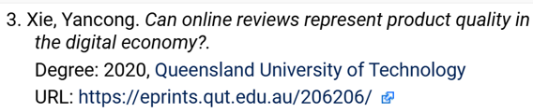
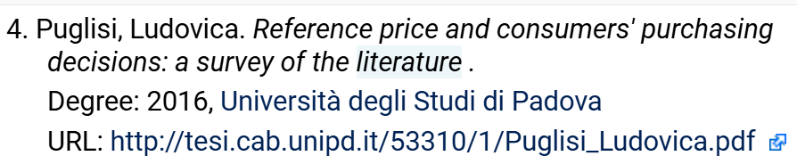
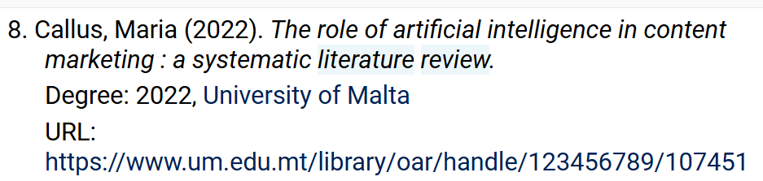
Some examples

Slide 11
How to write a literature review
Step 1 :
Select a topic
Step 2 :
Define the
search terms
Step 3 :
Search and evaluate resources
Step 4 :
Survey the literature
Step 5 :
Write down each analysis
Step 6 :
Write the review
Literature Review Process

Slide 12
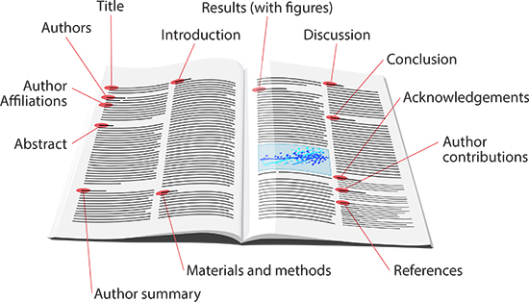
The typical structure of a journal article
Title and authors
Abstract and keywords
Introduction
Literature Review
Research methodology
Findings
Discussion
References

Slide 13
Difference between
Paraphrasing, Summarising and Quoting
Paraphrasing
When you paraphrase, you express someone else's writing in your own words. This is an alternative way of referring to an author's ideas or arguments without using direct quotations from their text.
It fits in more neatly into your own style of writing and shows that you really do understand what the author is saying.
You must not change the original meaning and you must still cite and reference your source of information.
Summarising
When you summarise, you provide a brief statement of the main points of an article, web page, chapter or book, known as a summary.
This differs from paraphrasing as it only lists the main topics or headings, with most of the detailed information being left out.
Quoting
Quotations should be relevant to your arguments be enclosed in quotation marks . Too many will prevent you from demonstrating your understanding and analysis.
Your tutor will prefer to read your own interpretation of the evidence.
Give the author, date and page number(s)/URL that the quotation was taken from.
Quotations are also counted in your assignment's total word count.

Slide 14
How do I decide my Research Methodology?
Qualitative - Ethnography, Autoethnography, Narrative research, Oral Histories
Quantitative – Experimental, Descriptive, Survey
Mixed methods – Exploratory, Explanatory, Convergent
Action research
Historical research
Evaluation research
Systematic review, Citation analysis, Content analysis, Delphi method, Meta analysis

Slide 15

Some varied methodologies
Ethnographic research - qualitative - involves studying people in their natural environment to understand how they live
Autoethnography - researcher writing about a topic of great personal relevance - their experiences within the social context.
Citation analysis - measuring the relative impact of an author or publication by counting the number of times that author or publication has been cited by other people.
Systematic review – assessment of the evidence on a clearly formulated question - uses structured methods to identify, select and critically appraise relevant primary research.

Slide 16

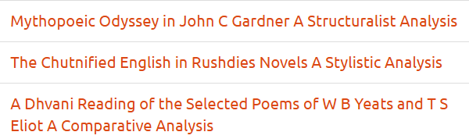
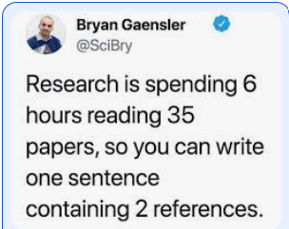


Some examples

Slide 17
What should my Data Collection method be?
Survey – Questionnaire – Sample size – Pilot study
Check for spellings/grammar/ selection and tone of words
Interviews – Recording – face to-face – online
Check for choice of questions – open-ended
Focus groups
Check for group size – questions in advance; supporting and opposing arguments
Trade reports / White paper / Grey literature
Attended a Workshop conducted by SCONUL cpd25 Task Group Understanding libraries with qualitative techniques – using observations

Slide 18
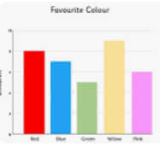

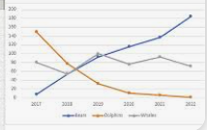
Data Analysis and Interpretation
Descriptive Analysis – Utilizing measures of central tendency (mean, median, mode) and dispersion (range, variance, standard deviation) to describe datasets.
Predictive Analysis – Using statistical algorithms to identify the likelihood of future outcomes
Regression analysis – the relationship between the dependent and independent variables
Factor analysis ; Cohort analysis; Cluster analysis; Time series analysis

Slide 19
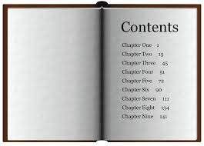
How to write chapters
Chapter 1 | Introduction (includes statement of the problem, need, objectives, hypothesis, scope and limitations, research methodology, definition of terms)
Chapter 2 | Review of literature with citations
Chapter 3 | Research Methodology
Chapter 4 | Analysis and Interpretation
Chapter 5 | Findings, Conclusions and Suggestions Bibliography and Appendices
Notes:
The ability to develop a good research topic is an important skill. An instructor may assign you a specific topic, but most often instructors require you to select your own topic of interest. When deciding on a topic, there are a few things that you will need to do:
Be aware that selecting a good topic may not be easy. It must be narrow and focused enough to be interesting, yet broad enough to find adequate information. Before selecting your topic, make sure you know what your final project should look like. Each class or instructor will likely require a different format or style of research project.

Slide 20
Some points to keep in mind
Hypothesis – don’t forget about it
Do not duplicate information to fill up the pages
Put your graphs in the middle; remember you will need to bind the thesis so you might lose information
Create /Update the Table of Contents as you go along
Go back and re-look at the objectives of your study
Findings / Recommendations/ Conclusion/ Future Research / Bibliography

Slide 21
How to write and publish a research paper
Select the appropriate topic and title
Set the flow from introduction to conclusion
Don’t forget font, line spacing, referencing style, abstract, keywords etc.
Decide the publication, predatory journals, peer review etc.
Improve visibility – Institutional Repository, Google Scholar, ORCID, LinkedIn, Resume etc.

Slide 22
How to make a good presentation
Select the appropriate title and sub-title
Remember the rule 6 * 6 ; less is more
Make it visually appealing yet easy to understand
Do not read from your slide ; summarise it
Practice – pitch, tone, language, humour
Create your own style
SIX WORDS PER LINE
SIX LINES PER SLIDE

Slide 23

What is Artificial Intelligence
Current AI is neither Artificial nor Intelligent
ARTIFICIAL
Made by human beings, not occurring naturally
INTELLIGENCE
Ability to acquire and use knowledge and skills
Application of statistical analysis tools
Growing set of machine learning techniques
ChatGPT - Probably the best software program for impersonating humans ever released to the public
The Guardian, Dec 2022
Notes:
Reference to the source of information used in your research. When you directly quote, paraphrase or summarize the essential elements of someone else's idea in your work, it is followed by an in-text citation.

Slide 24
AI tools available today
TEXT | IMAGES | VIDEOS | RESEARCH | TRANSLATION
ChatGPT | Leonardo | Synthesia ai | Consensus | Deep L
Quillbot | Getimg.ai | Canva | Scispace | Reverso
Perplexity | Gooeyimages.ai | Invideo ai | Semantic scholar | Wordvice.AI
Grammarly | Dalle-E | Flexclip | Iris AI | Google translate
Rytr | Midjourney | Animaker | Scite | Babylon
Jasper | Picsart | Steve AI | Jenni ai | Microsoft translate
Copilot | Craiyon | Videoleap | Evernote | Linguee
Notes:
Gemini is an AI chatbot from Google AI that can be used for a variety of research tasks, including finding information, summarizing texts, and generating creative text formats. It can be used for both primary and secondary research and it is great for creating content.

Slide 25
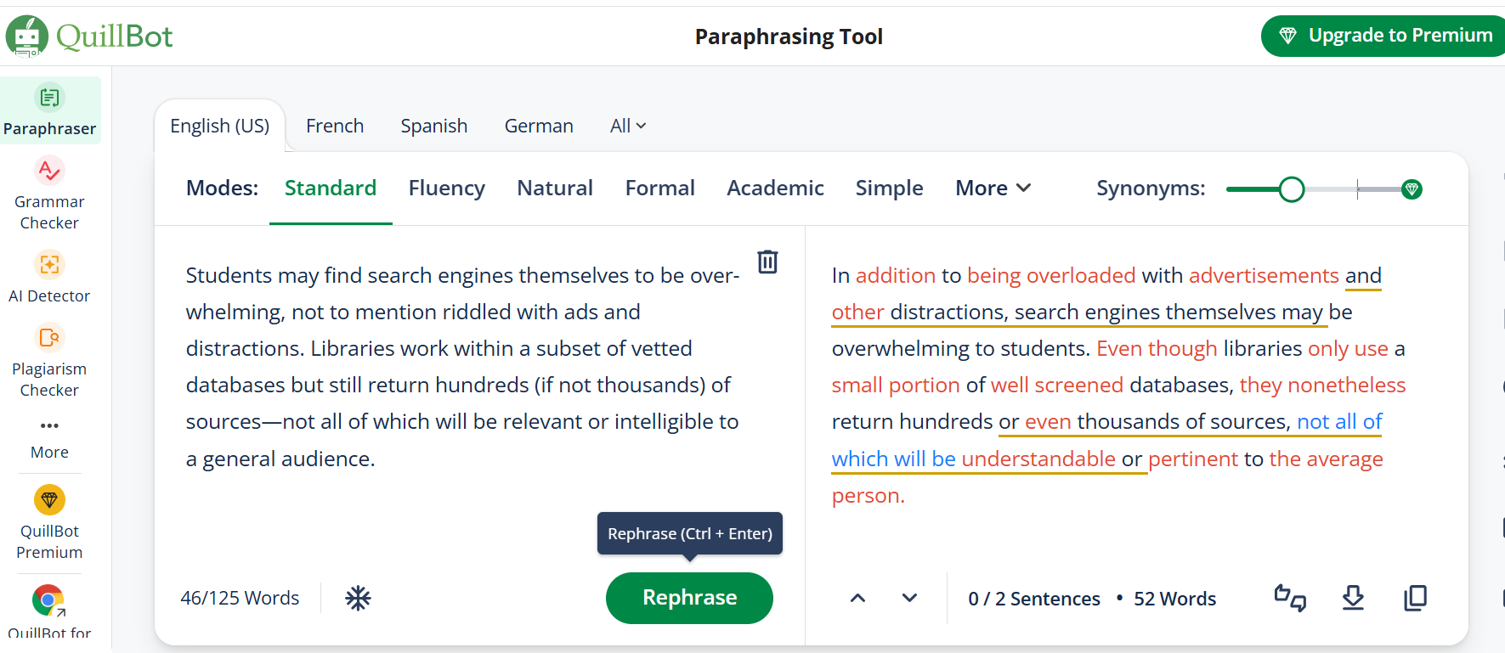
Experimenting with Quillbot Paraphrasing Tool

Slide 26

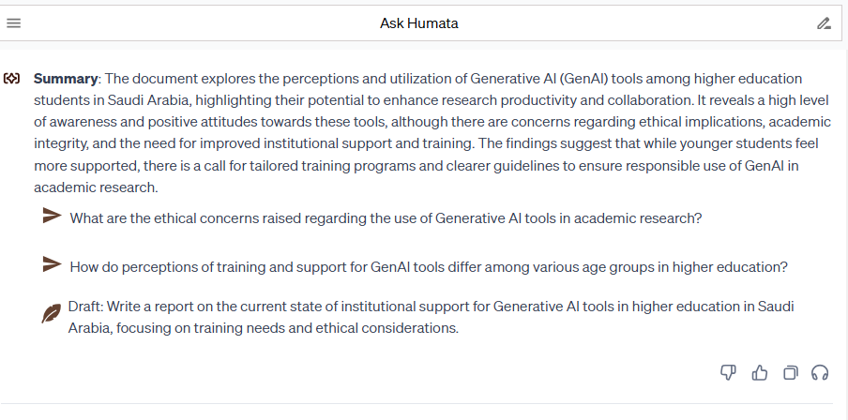


Experimenting with Humata

Slide 27
Experimenting with Goblin Tools
What are the Pros and Cons?
What am I having for lunch ?
Using AI for my doctoral research
Increased efficiency in literature review
Ability to process and analyze large datasets quickly
Improved accuracy in identifying patterns and trends
Support for predictive modeling and simulations
Facilitated automation of repetitive tasks
Potential bias in AI algorithms could skew results
Risk of over-reliance on AI leading to oversight of important qualitative data
Possible difficulties in replicating AI-generated results or methodologies
Limited availability of support or resources specific to AI applications
Fear of academic integrity issues

Slide 28
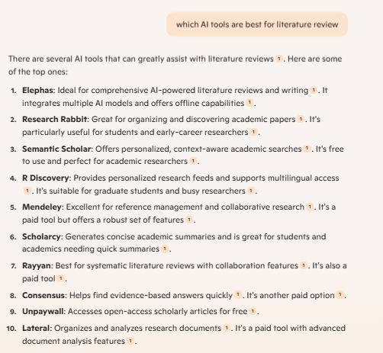
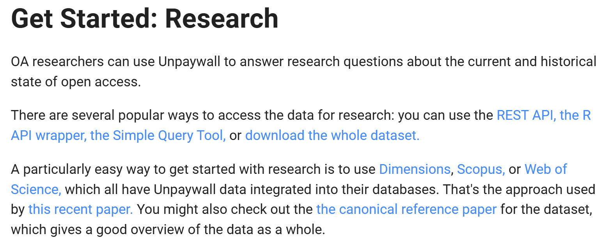
Experimenting with Microsoft Copilot
www.unpaywall.org An open database of 51,730,253 free scholarly articles.

Slide 29


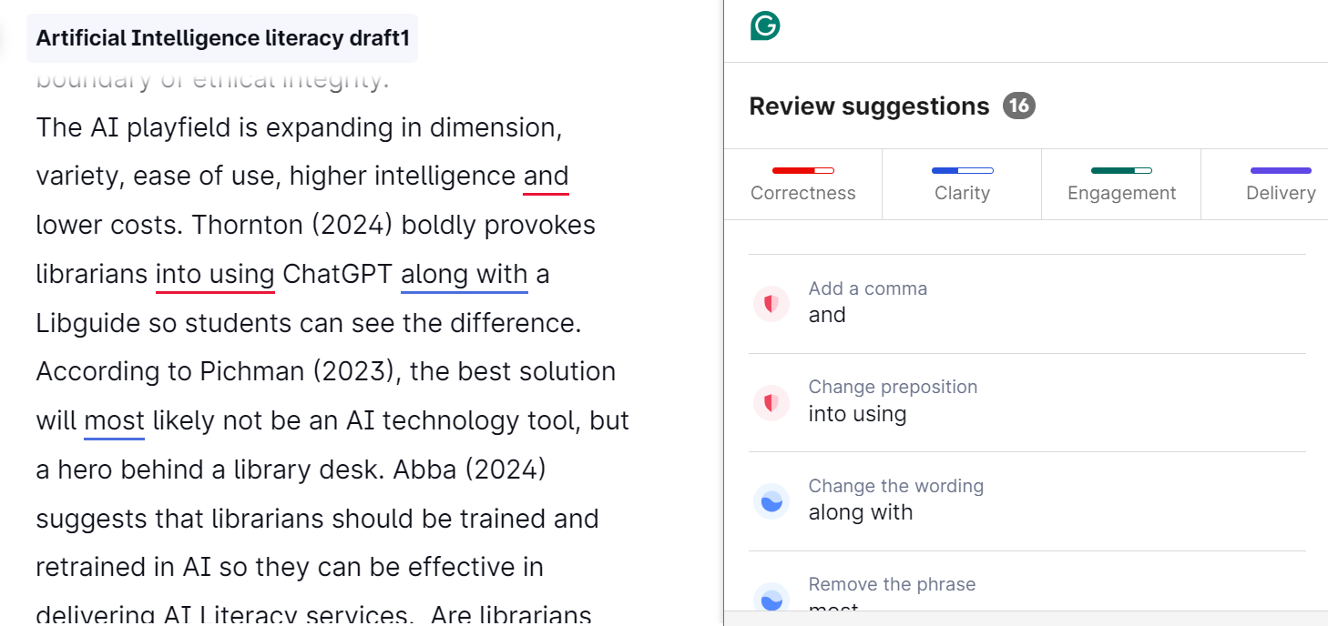
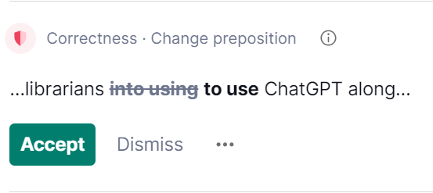
You can -
write directly in Grammarly,
copy and paste a paragraph or
upload a written document.
Grammarly will check it for you
What the colours /suggestions mean
RED – spelling, grammar, punctuation
BLUE – clarity, rephrasing
GREEN – choice of words, engagement
PURPLE - delivery

Slide 30

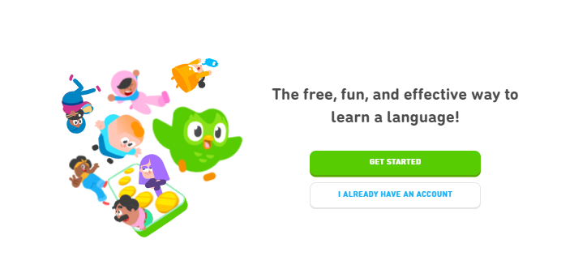
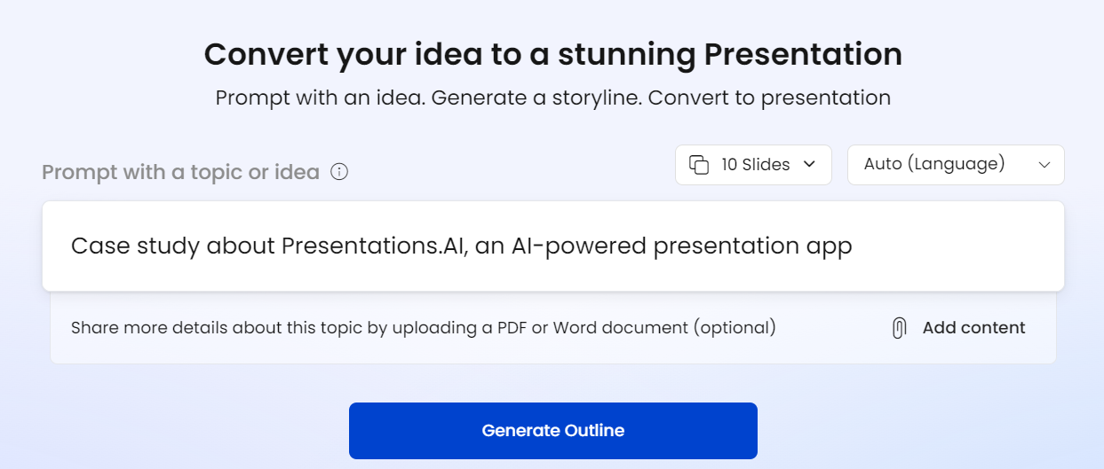

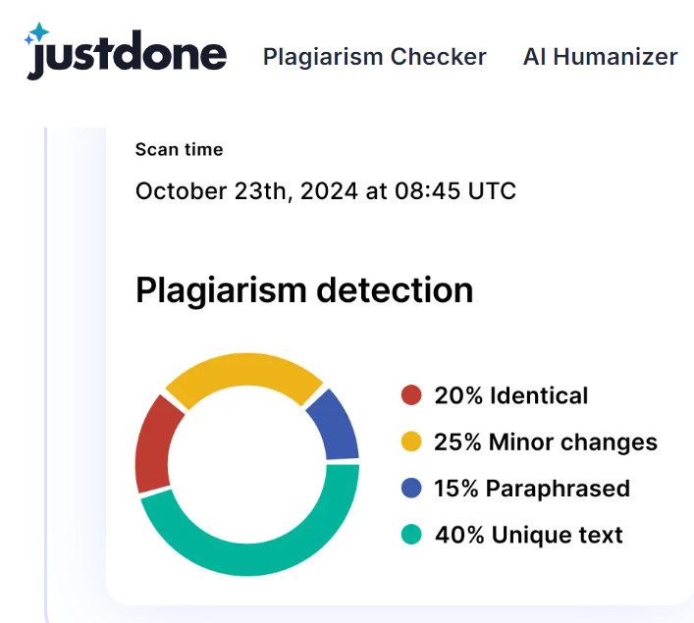
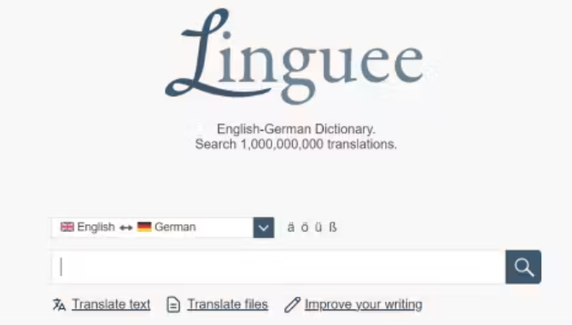
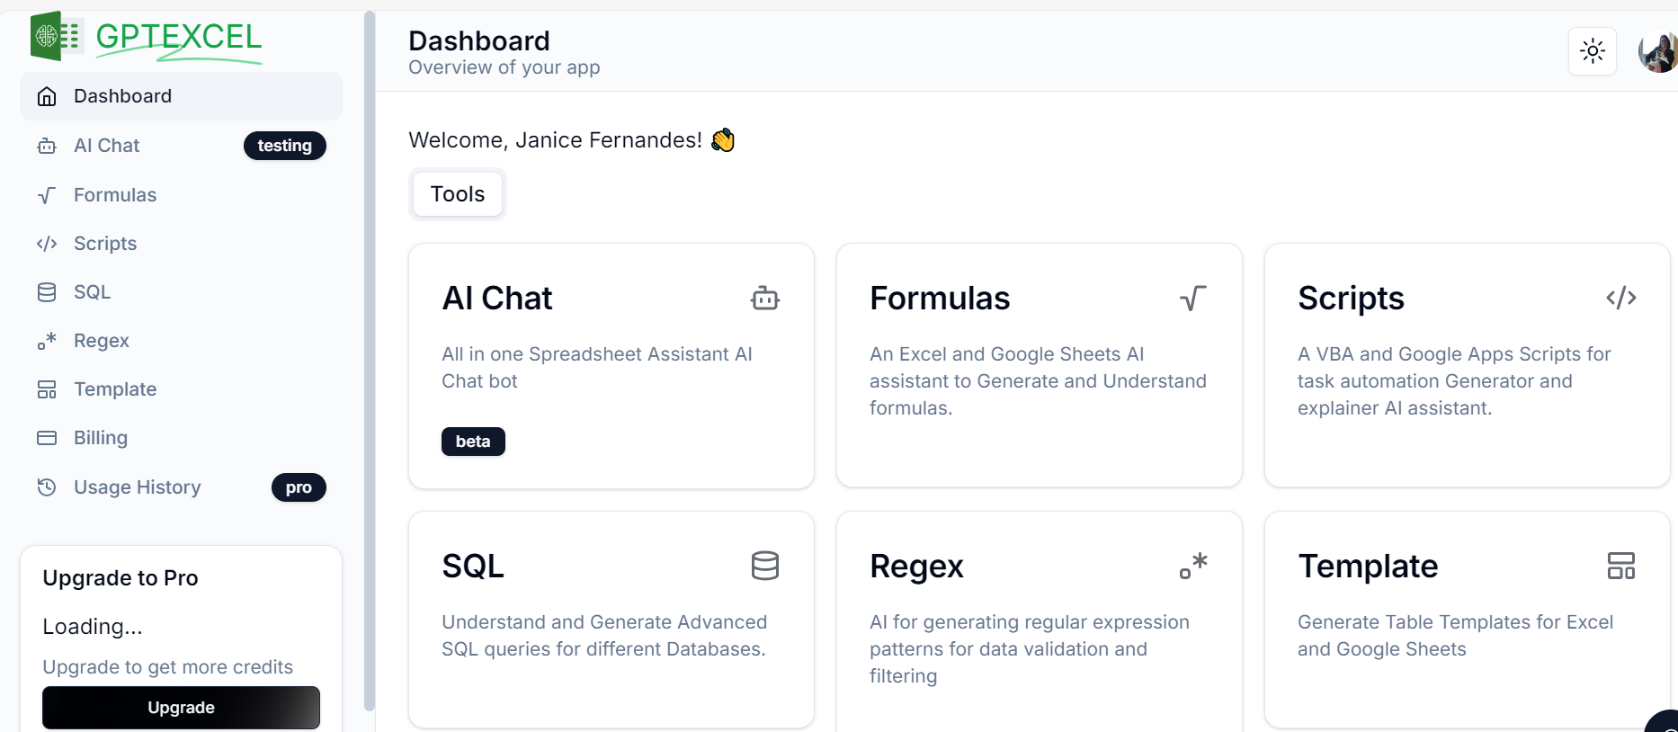

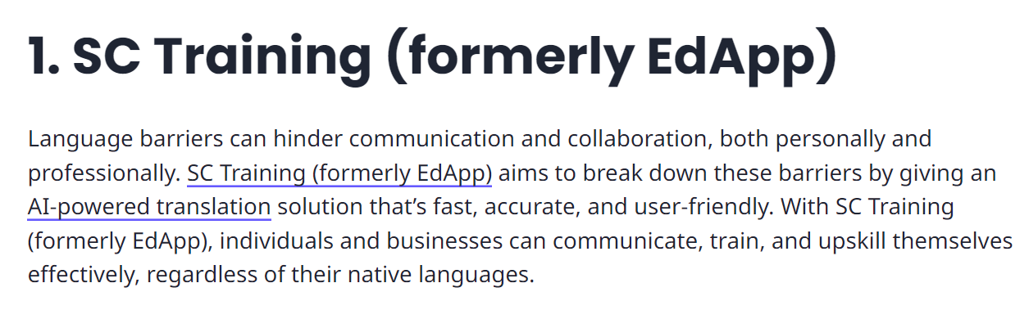
https://app.presentations.ai/

Slide 31
Challenges of doing Doctoral Research
  Selection of topic – should be personal, exciting yet related
  Information is not available; what is available is not free
  Literature review – time-consuming, bias in selection of articles; sometimes details unavailable
  Evaluation of resources – current, accurate, relevant
  Co-operation of respondents, societal concerns, anonymity
  Lack of direction, guidance and understanding
  Lack of time ; waste of time?
  Copyright and IPR

Slide 32
Opportunities while doing Doctoral Research
  Preliminary work has already been done ; standing on the shoulders of giants
  Building connections, information bridges and networks
  Sharpen critical analysis and lateral thinking skills
  Better academic writing skills, more presentations and publications
  Building skill sets - Focused, determined, clear, systematic
  Makes you more knowledgeable ; an expert in the field

Slide 33
Quotes to motivate you
Research is what I am doing when I don’t know what I am doing !
Research is to see what everybody else has seen, and to think what nobody else has thought !
Research is the distance between an idea and its realization !
Research always seems impossible… until it’s done !
Research is a little progress each day adding up to big results !
Doctoral research … GO FOR IT !!!

Slide 34





Your supervisor is constantly searching for the real “you”?
THANK YOU
34
Images created by getimg.ai and gooey.ai

Slide 35

Thank you for giving me
the opportunity
to delve into
the amazing world of research
and to add
value to the profession !

