Slide 1
Enjoying your job
SOFT SKILLS
IN THE
WORK PLACE
Dr Janice Fernandes
13th June 2021

Slide 2
I am very unhappy here
I try my level best to complete the tasks given to me
Will you let me speak or do I just have to listen ?
They never listen to any of my suggestions
They will always make me stay late so I come late every day
Why do I have to do everything ?
I have no option but to work here
I am grateful that I have a job
I am very happy working here
The pay is too little for all the work that I have to do
What’s your problem ?
I don’t speak English so I can’t understand anything of what they say !
This job is so boring
There is nothing new to learn here

Slide 3
SOFT SKILLS IN THE WORK PLACE
Change Management
Communication skills
Team Building
Positive Thinking
Time management
Innovation & Creative Visualization
Self motivation
Pro-active attitude
Happiness & Peace of mind

Slide 4
CHANGE MANAGEMENT
Personal
Professional
What is change – different, altered, replaced
Examples of change – NAAC, new courses, furniture, timings
Types of change – global, environmental, technological, location, responsibility
Why does change happen – financial, people, thinking, necessity
How does change help – adjustment, innovation, growth, survival
What is change management ?
PDCA - Plan – Do – Study – Act
An ongoing process
Thinking – Doing – Thinking again
Thinking – Doing – Thinking again

Slide 5
CHANGE MANAGEMENT IN COLLEGE LIBRARIES
Technology | Instagram, Twitter, Telegram, Wechat, Linkedin, Snapchat, Reddit, Pinterest
Online resources | Proquest, EBSCO, Sciencedirect, SAGE
Free to use | DOAJ, DOAR, NDLI, N-LIST, NPTEL
Rules | Collaborative learning, use of mobiles, coffee time, a snooze ?
Communication | What do you think ? Will it work ? Let’s try it ?
Adding Value | Institution, Profession, Self
Personal Satisfaction | Adaptability, Victory, Self motivation

Slide 6
CHANGE MANAGEMENT … contd
How do “YOU” manage change ?
Attitude – be open to change,
grow through what you go through
Analyse – be informed, communicate, question
Acquire – knowledge, practice, skills
Adaptability – the only thing that is consistent is change
My idea of change -
Advt for Ambuja Cement –
benefits everyone in the end

Slide 7
SCENARIOS FOR CHANGE MANAGEMENT
Covid-19 pandemic – Lockdown – online teaching – library professionals expected to provide information resources
Transferred from another department or another college ; new people, new tasks, new priorities
All communication with college, government, GP, teachers, is now online e.g. U.K.
Trialling a two shift work pattern, multi-location libraries and rotating staff e.g. Richmond libraries
Using a different entry-exit point, Low sound area, Author talks, Suggestions register
Understand - Analyse - Solution – Benefits - Vision

Slide 8
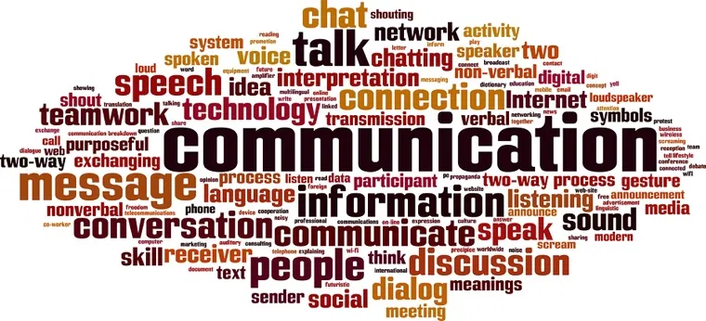
COMMUNICATION SKILLS
WHAT - Ability to share thoughts, ideas and feelings
WHICH - Communication with superiors, peers, subordinates, customers /users
WHY - Better understanding, building trust and respect, sharing creativity, solving problems
TYPES - Verbal & non-verbal , Tone, Language, Pitch, Gestures, Body language

Slide 9
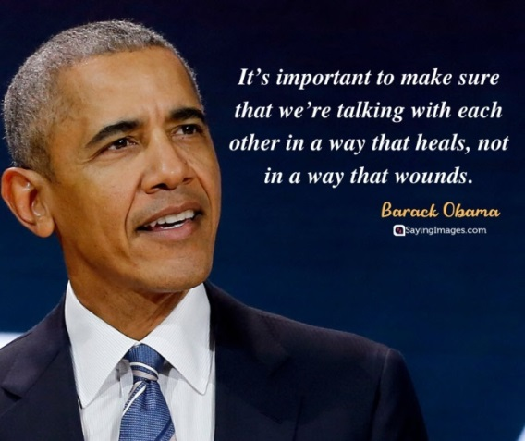
SECRETS OF EFFECTIVE COMMUNICATION
Key to any good relationship
Can be mastered
Needs effort, practice and a willingness to learn from mistakes
Avoid distractions and stay focussed
Allow the other person to speak
Learn to listen
Keep your emotions under control
Be open to suggestions and positive criticism
Respect the person even if you don’t like the idea

Slide 10
SCENARIOS FOR EFFECTIVE COMMUNICATION
The Librarian tells you that you now have to take on additional responsibilities
The Principal says you can work in two departments since you do not have much work to do
Your colleague always asks you to cover their job when they go on their annual two month holiday
Students are always asking you the same questions at the desk, expecting different answers and suggesting vague ideas
You want to tell the resource person that you liked the presentation
Listen - Analyse - Solution - Communicate - Feedback

Slide 11
REFRESHING YOUR MIND
Move three toothpicks to form three squares
That was easy

Slide 12
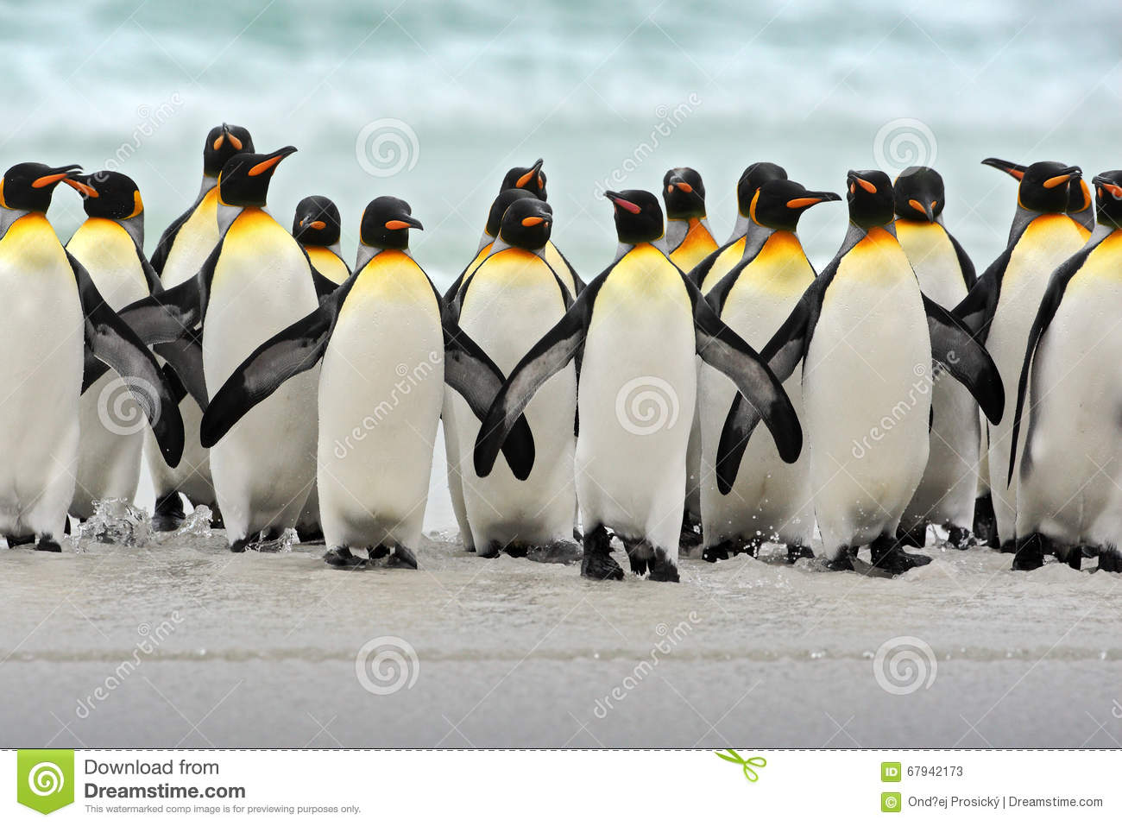
TEAM BUILDING
Elements of an effective team
Shared goal - objective - vision
Mutual trust and respect - feelings, ideas, ways
Taking responsibility - Volunteering instead of being told
Motivated team - Willing to work together
Understand each others weaknesses, develop strengths
Grow together - Collaboration rather than competition
A team is a group of people bound together in a relationship by a common goal
Who does your team consist of ?
We are in this together !
(but on different icebergs)

Slide 13
POSITIVE THINKING
Look back at your selected statements from the second slide
What did you select ? Why?
Struggling ? Unbearable ? Difficult times ? Is life unfair ?
Understand - Positive thinking impacts physical and mental health
Past experiences – Don’t let it muddle your present judgement
Step back from the situation – how would you advise another person
Try reverse engineering - What do I want ? How do I get it ?
Step out of your comfort zone – it is very difficult
Practice Gratitude
Family - Faith – Friendship – Feelings - Fun

Slide 14
AFFIRMATIONS FOR POSITIVE THINKING
It’s not my job !
I don’t understand English
I don’t know how to do it - I can’t do it - I won’t do it !
Somebody else can do it !
Its time to go home !!!!!
When I get up I decide how my day is going to be
I have been given this job for a reason
This place/post/person will help me grow if I allow it
I am willing to learn new things even if they seem
difficult at first
I am the “brand ambassador” for the library
It’s your decision – your choice – your loss or gain !

Slide 15
TIME MANAGEMENT
Plan your day – Well begun is half done
Write down your tasks – It is not silly
Minimise distractions – is it candy crush or solitaire ?
Prioritise your jobs – See what is urgent
Communicate your intentions - Let others know
Review the list as you go through the day
Kitna Kaam Tha Aaj !!!!!!!!

Slide 16
SCENARIOS FOR TIME MANAGEMENT
The main desk of your college library at 9.00 a.m.
Four students waiting at the main desk
Your colleague is late again
The phone constantly ringing
The librarian calling you
The computer at the main desk is not working
There is noise in the library and outside the main door
You have been called to the General Office
The cup of tea in your hand is getting cold !!!

Slide 17
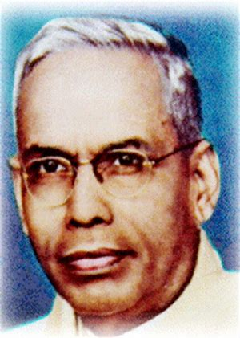
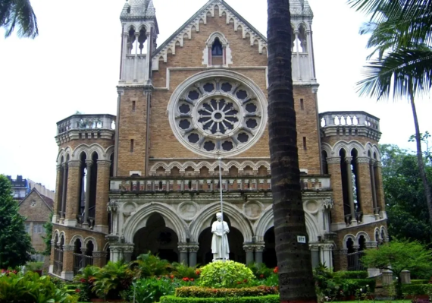
RANGANATHAN’S 5 LAWS OF LIBRARY SCIENCE
Books are for use
Every Reader his/her Book
Every Book its Reader
Save the time of the Reader
The library is a growing organism

Slide 18
I am very unhappy here
I try my level best to complete the tasks given to me
Will you let me speak or do I just have to listen ?
They never listen to any of my suggestions
They will always make me stay late so I come late every day
Why do I have to do everything ?
I have no option but to work here
I am grateful that I have a job
I am very happy working here
The pay is too little for all the work that I have to do
What’s your problem ?
I don’t speak English so I can’t understand anything of what they say !
This job is so boring
There is nothing new to learn here

Slide 19
Dream Big but make sure you Work Hard !
There are No Short cuts to Hard Work !
When you feel like stopping, think about why you started !
Nothing worthwhile is ever easy. Remember that !
It is the things we work hardest for, that will reward us the most !
Your limitation is only your imagination !
Working hard for something we care about is called Passion !
Don’t stop when you are tired. Stop when you are done !

Slide 20
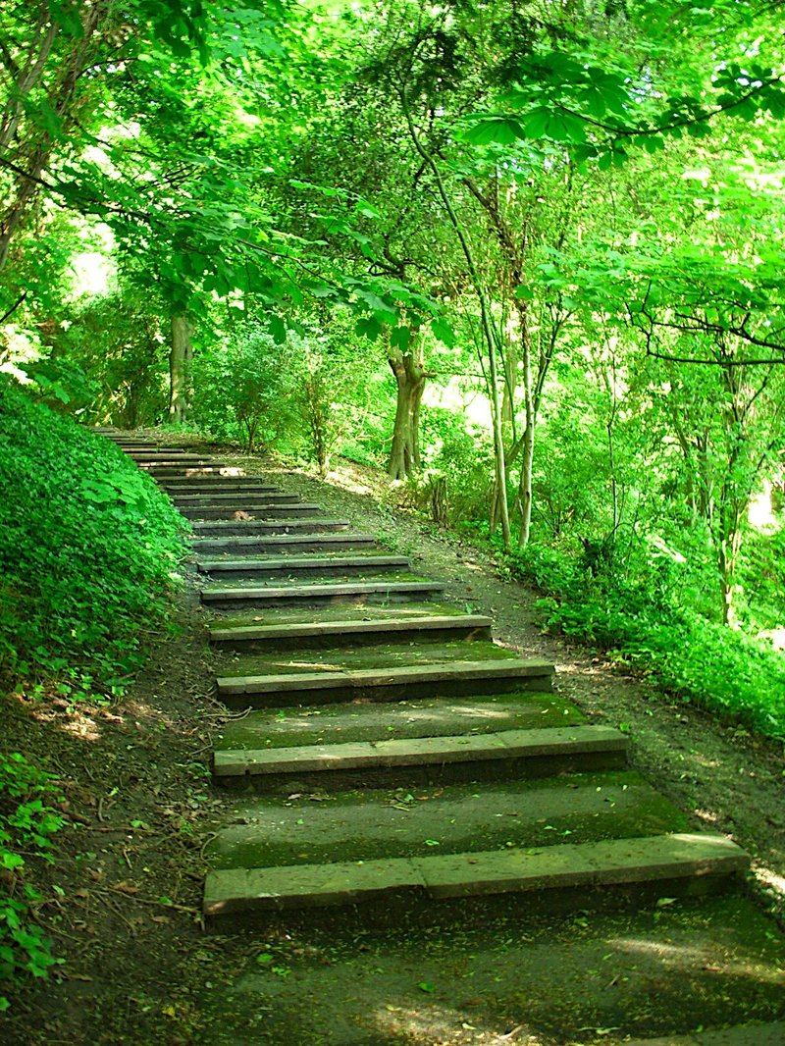
Thank you
for giving me the opportunity
to delve into
the amazing world of human behaviours and skill sets and to add value
to the profession of Librarianship !

