Slide 1
Impact of National Education Policy 2020 on Global Research in Higher Education :
Challenges and Opportunities for Ph.D. students
https://www.linkedin.com/pulse/national-education-policy-nep-2020-game-changer-indias-upadhyay-wcv8c/
Dr. Janice Fernandes
Academic Support Manager
University of West London – U.K.
31st August 2024

Slide 2
The National Education Policy 2020 lays particular emphasis on the development of the creative potential of each individual. It is based on the principle that education must develop not only cognitive capacities - both the ‘foundational capacities ’of literacy and numeracy and ‘higher-order’ cognitive capacities, such as critical thinking and problem solving – but also social, ethical, and emotional capacities and dispositions.

Slide 3
Salient points relevant to Higher Education
Less emphasis on learning outcomes
Language barriers and learning in the local language
Less emphasis on the true meaning of research
Adapting to changes in technology
Global standards of quality
Multi-disciplinary approach to Higher education
Lack of competitive peer-reviewed research funding
Distance learning and online education
Professional, academic, and career counselling
Continuous Professional Development
Learning Transferable skills/ Skills for life

Slide 4
Learning Outcomes … 1
On successful completion of a research degree programme, students should demonstrate :
the creation and interpretation of new knowledge, through original research, of a quality to satisfy peer review, extend the forefront of the discipline, and merit publication
a systematic acquisition and understanding of a substantial body of knowledge of an academic discipline or area of professional practice
the general ability to conceptualise, design and implement a project for the generation of new knowledge,
a detailed understanding of applicable techniques for research and advanced academic enquiry.
https://www.yorksj.ac.uk/media/content-assets/registry/research-degrees/reference-documents/Learning-Outcomes-for-the-award-of-research-degrees.docx

Slide 5
Learning Outcomes … 2
On successful completion of a research degree programme, students should demonstrate transferrable skills :
the skills necessary for a career as a researcher and employment in a senior capacity in a relevant area of professional practice;
evaluating their own achievement and that of others;
self-direction and effective decision-making in complex situations
independent learning and the ability to work in a way that ensures continuing professional development
https://www.yorksj.ac.uk/media/content-assets/registry/research-degrees/reference-documents/Learning-Outcomes-for-the-award-of-research-degrees.docx

Slide 6
Learning Outcomes … 3
On successful completion of a research degree programme, students should demonstrate a learning context comprising of the following :
This will include the critical analysis and decision-making in complex situations.
The structure of the programme will provide research and professional training, breadth and depth of study, and opportunities for drawing upon appropriate resources and techniques
Students should develop to a high level their capacity for communication skills and informed opinions, the design and management of their learning activities
https://www.yorksj.ac.uk/media/content-assets/registry/research-degrees/reference-documents/Learning-Outcomes-for-the-award-of-research-degrees.docx

Slide 7
Focussing on the “R” of Research
RESEARCH RE+SEARCH = SEARCH AGAIN
Read – and understand
Relevant – to your topic of research
Reflect – on the need and importance
Realise – the importance of citations
Recognise – fake news, misinformation and disinformation
Raise – the quality of your research
Realign – your methodology or objectives if necessary
Re–do – some parts if need be
Reward – yourself and celebrate small successes

Slide 8
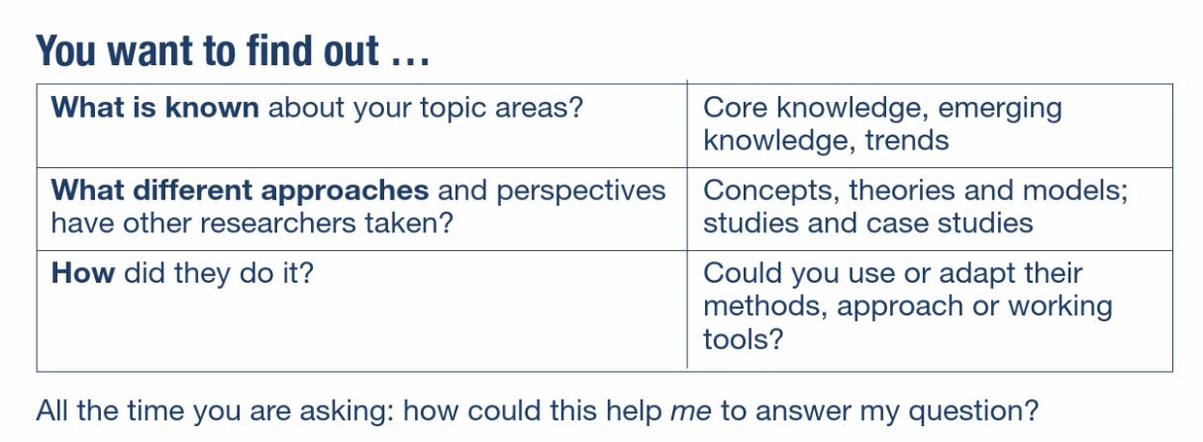
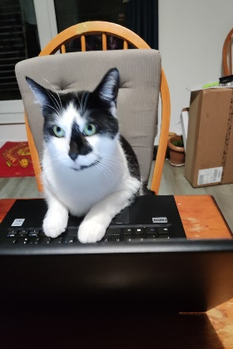
WHAT IS INFORMATION?
A viewpoint?
An opinion?
An answer?
A fact?

Slide 9
POTENTIAL SOURCES OF INFORMATION
Journal articles
Publisher databases
Government papers
Contracts
Conference papers
Letters and e-mails
Standards
Newspapers
Technical reports
Patents
Statistics
Books
Primary sources
Market reports
Theses
Blogs
VLogs
Videos
Open letters

Slide 10
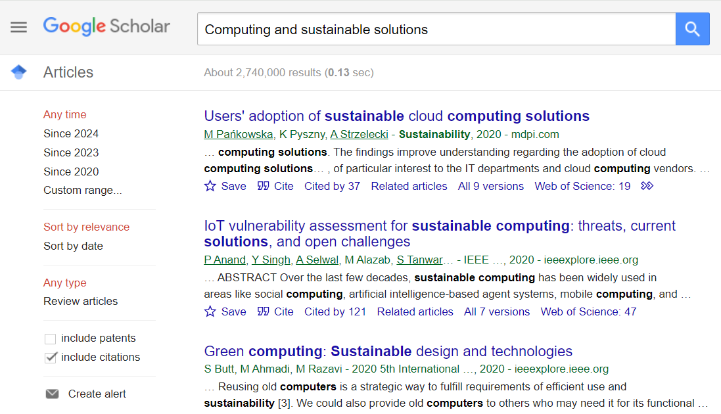
KEYWORDS
Computing AND Energy efficiency
Computing AND sustainable agriculture
Computing AND Green data centre
LIBRARY CATALOGUE
DATABASES
GOOGLE SCHOLAR
SUBJECT LIBRARIAN

Slide 11
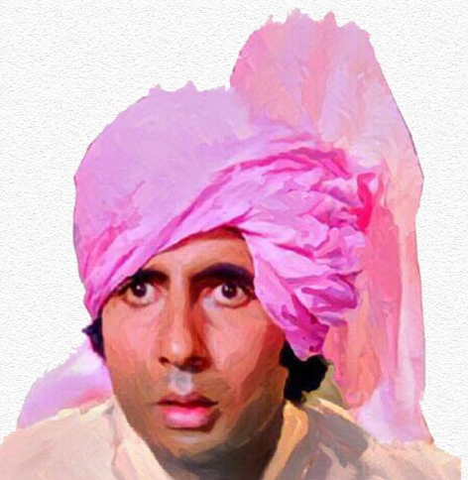
English is a funny language !
Language-learning software programs; online course
English newspapers, TV shows, songs, books, films, videos, audiobooks, podcasts, recipes, apps
Learn correct pronunciations; use a bilingual dictionary and the Read Aloud option in e-books
Find a conversation partner ; subscribe to podcasts
Record yourself as you speak
Practice is the best teacher

Slide 12
Using Google Translate for literature review
POLISH Znacząca liczba instytucji akademickich w Wielkiej Brytanii i obowiązek posiadania biblioteki przez każdą z nich wymaga zatrudnienia dużej grupy bibliotekarzy. W artykule przedstawiono procedurę rekrutacji bibliotekarzy w bibliotekach akademickich w Wielkiej Brytanii począwszy od etapu poszukiwania zatrudnienia, po proces rekrutacji oraz wprowadzenie do pracy nowozatrudnionych bibliotekarzy. Założono, że niniejszy tekst pozwoli poznać i zrozumieć praktyki rekrutacji bibliotekarzy w Wielkiej Brytanii zarówno kandydatom, jak i pracodawcom oraz dokonać porównania z rodzimymi systemami rekrutacji.
ENGLISH The significant number of academic institutions in the UK and the obligation for each of them to have a library require the employment of a large group of librarians. The article presents the procedure for recruiting librarians in academic libraries in Great Britain, from the stage of searching for employment, to the recruitment process and introduction to work of newly employed librarians. It was assumed that this text would allow both candidates and employers to learn and understand the recruitment practices of librarians in Great Britain and make comparisons with domestic recruitment systems.

Slide 13
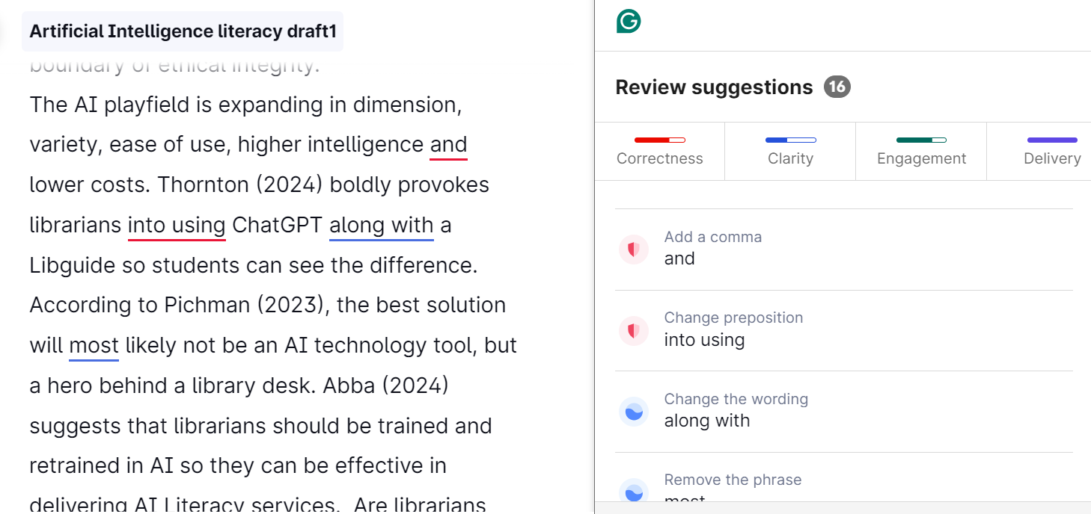
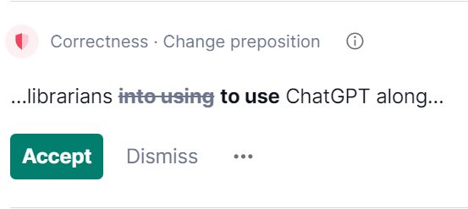
You can -
write directly in Grammarly,
copy and paste a paragraph or
upload a written document.
Grammarly will check it for you
What the colours /suggestions mean
RED – spelling, grammar, punctuation
BLUE – clarity, rephrasing
GREEN – choice of words, engagement
PURPLE - delivery

Slide 14
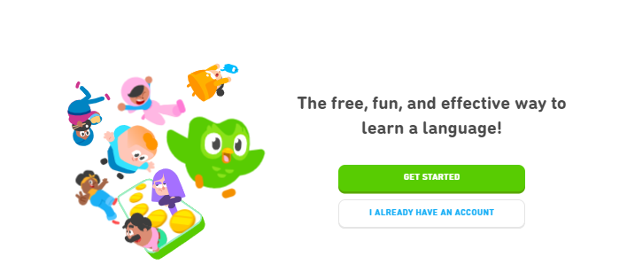
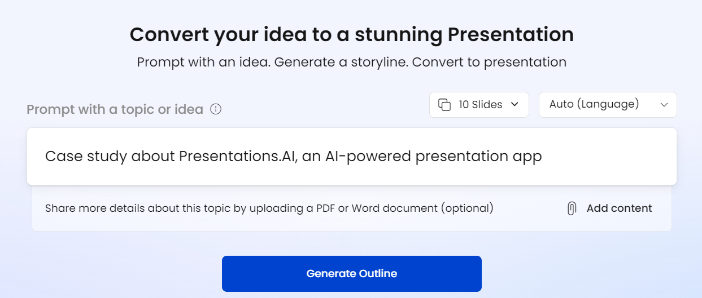
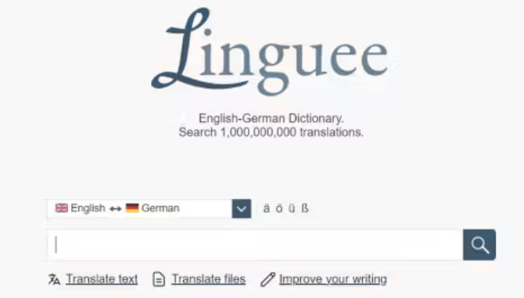
https://app.presentations.ai/

Slide 15
Adapting to changes in technology
Learn and create powerful presentations
Learn and use Artificial Tools ethically
Learn and understand about e-books
Learn to adapt to changes – self-learn

Slide 16
Research and Critical Thinking
A self-guided, self-disciplined thinking process
The ability to identify credible data sources,
The ability to gather and evaluate information, following a methodology and based upon objectives,
The ability to analyse results
The ability to present an argument and insights based on this analysis.
https://www.criticalthinking.org/pages/defining-critical-thinking/766

Slide 17
Research and Critical Thinking
Give us an example of the most difficult situation you have handled at work?
How do you approach problems that have no clear solution or path forward?
How do you approach new ideas or processes?
If you have five projects and only have time to complete two, how do you choose the projects to prioritise?
How do you handle a situation where your manager makes a mistake?
How do you resolve disagreements between team members?
https://www.criticalthinking.org/pages/defining-critical-thinking/766

Slide 18
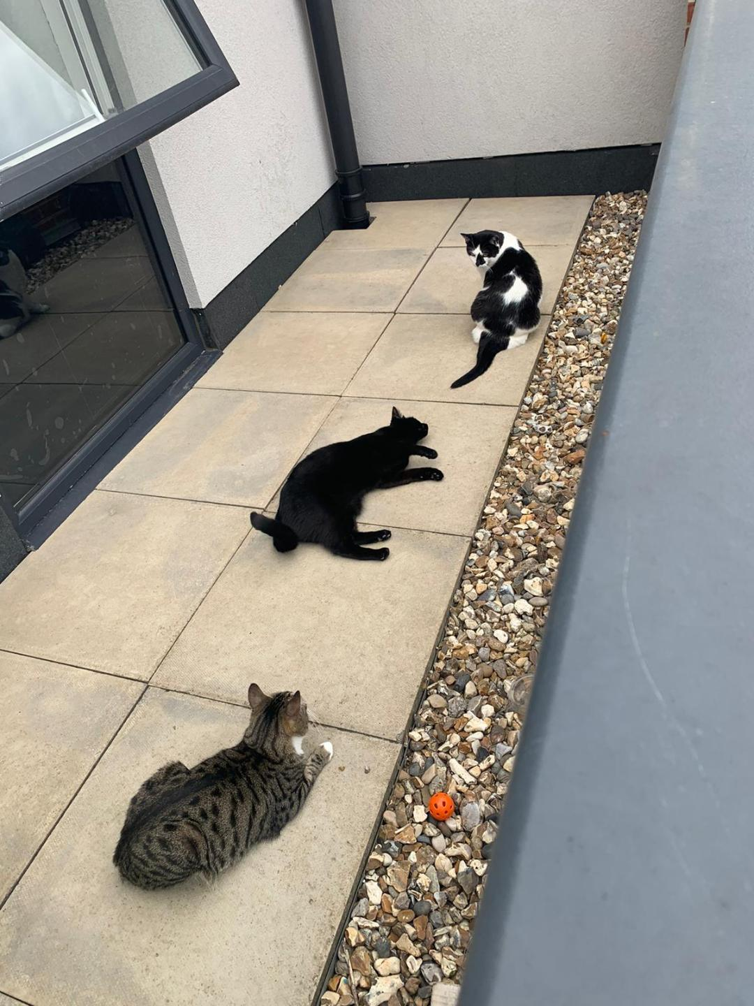
Reading and critically evaluating literature
Look at the title. Who is the author ?
Go through the preview/abstract/table of contents. Does it agree or disagree with what you already know ?
Read the discussion/ results/evidence ? Are there any gaps/debates/inconsistencies?
Don’t read passively; Separate facts from opinion; No bias
Read a second time; Think critically; How is this resource relevant to your research?
Write down the arguments/facts – summarise, synthesise, paraphrase
Reference as you cite ( don’t forget page numbers and links)

Slide 19
How to find other resources
Google Scholar - WHY
Scholarly literature but not verified; needs evaluation
Many subjects and sources: articles, theses, books, abstract
Explore related works, citations, authors, and publications
Will not contain everything that is in the library's databases.
Google - WHY NOT
Too many results ; too little information
Authority often unverified
Lists websites not databases; dead links
Contains much unpublished material

Slide 20
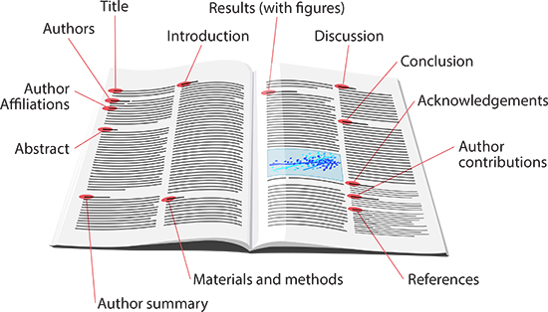
The typical structure of a journal article
Title and authors
Abstract and keywords
Introduction
Literature Review
Research methodology
Findings
Discussion
References

Slide 21
What is Humata ?
Developed by AI experts Cyrus Khajvandi and Dan Rasmuson
An innovative AI intelligence tool for text-based files
Helps users quickly analyze, understand, and extract insights from complex documents, also cites it for you
It has page limits for the premium plans
The free version is limited to 60 journal article pages and 100 questions each month.
After the limit is exceeded, you need to pay for each page
https://www.humata.ai/

Slide 22
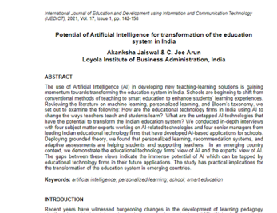
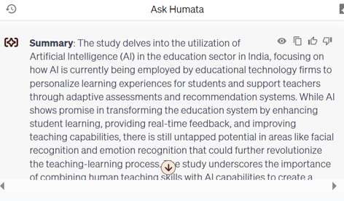
Experimenting with Humata
17 pages
400 words

Slide 23
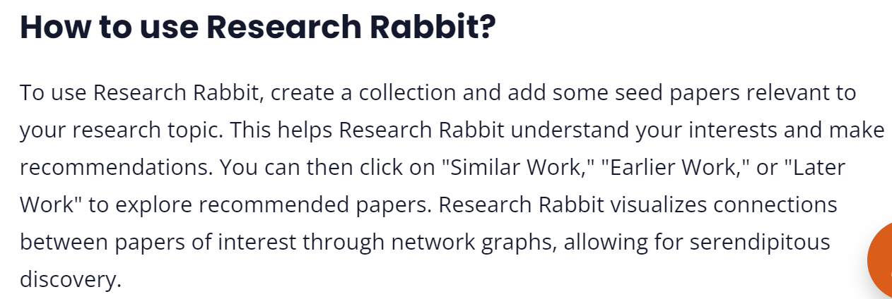
What is Scisummary and Research Rabbit?
Summarize 30k words (1M words per month after your trial ends).
Chat with papers and get inline citations and figures
Analyze figures from papers and ask questions directly about them
AI Powered research paper search, with no limit on searches
Bulk summarize papers, combine papers into a single summary, and compare papers using AI

Slide 24
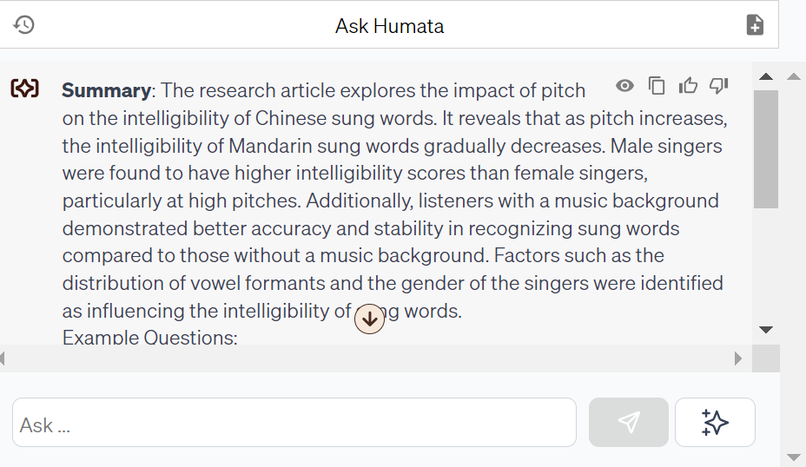
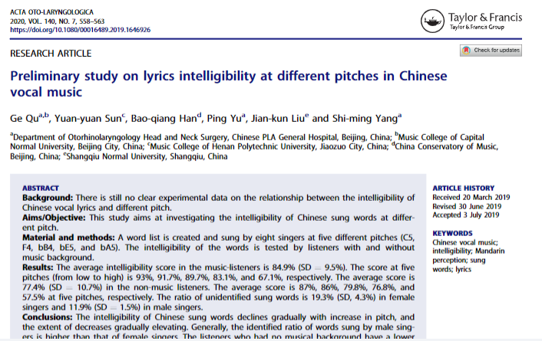
Experimenting with Humata
7 pages
90 words

Slide 25
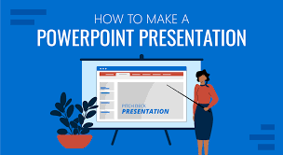
How to create a good presentation ?
Six words per line, six lines per slide
Visuals for effect
Font size, colours, background, readability, accessibility
What you say and how you say it
Feedback and evaluation
Up your game with presentation tips | LinkedIn Learning
Create and Deliver Engaging Presentations | LinkedIn Learning
Great speaking skills are a must-have | LinkedIn Learning

Slide 26
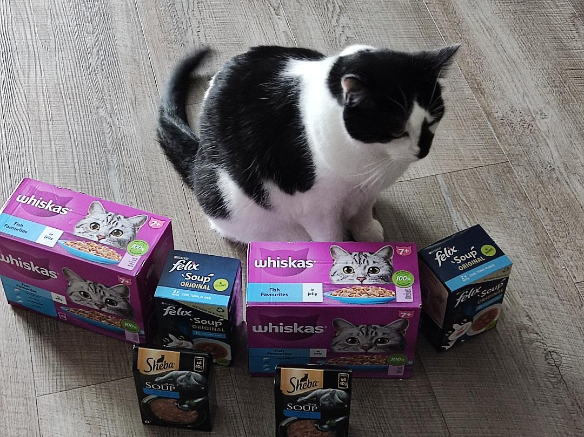
HOW TO MANAGE YOUR TIME
The process of deciding on the order in which you will do tasks, and making sure that they are done on schedule.
(Collins English Dictionary)
The analysis of how working hours are spent
The prioritization of tasks
The planning of various tasks on a timeline
The organizing of time between different activities

Slide 27
WHY GET INTO RESEARCH
An opportunity to gain more knowledge on an interesting topic
Disseminate the results of research to society
Learn valuable skills – reading, writing, interpreting, analysing, decision making, communicating
Build a scientific thought process
Create a base for lifelong learning

Slide 28
WHAT IS PLAGIARISM
Copying another person’s work, (with or without their consent), and claiming or pretending it is your own
Presenting arguments that use a blend of your own and copied words of the original author without acknowledging the source
Poor paraphrasing and summarizing
Paying someone to write your essay
Plagiarism may be intentional or unintentional
Plagiarism is a breach of academic integrity and a disciplinary offence
Neville, C. (2016) The complete guide to referencing and avoiding plagiarism. 3rd edn. Maidenhead: Open University Press

Slide 29
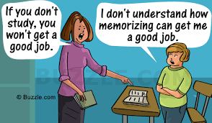
Source: www.Opinionfront.com

Slide 30
AI tools available today
TEXT | IMAGES | VIDEOS | RESEARCH | TRANSLATION
Co-pilot | Leonardo | Synthesia ai | Consensus | Deep L
ChatGPT | Getimg.ai | Canva | Scispace | Reverso
Quillbot | Gooeyimages.ai | Invideo ai | Semantic scholar | Wordvice.AI
Grammarly | Dalle-E | Flexclip | Iris AI | Google Translate
Rytr | Midjourney | Animaker | Scite | Babylon
Jasper | Picsart | Steve AI | Jenni ai | Microsoft Translate
Perplexity | Craiyon | Videoleap | Evernote | Linguee
Notes:
Gemini is an AI chatbot from Google AI that can be used for a variety of research tasks, including finding information, summarizing texts, and generating creative text formats. It can be used for both primary and secondary research and it is great for creating content.

Slide 31
What are Goblin Tools ?
Created by Bram De Buyser, a freelance software engineer
Collection of small, simple, single-task tools
Designed to help neurodiverse people (anxiety) with tasks they find overwhelming or difficult.
Most of the tools use AI technologies to achieve their goals.
Currently this includes OpenAI's models. As the tools improve, the intent is to move to an open source alternative.
Goblin tools are free to use and it will stay free, without advertisements or paywalls.

Slide 32
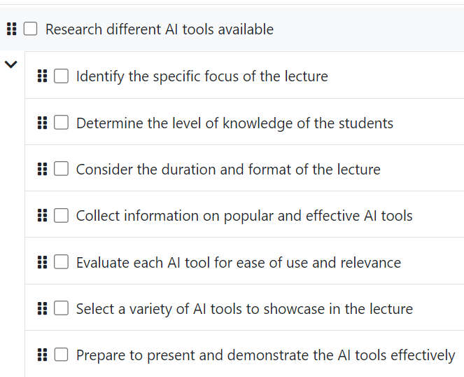
Goblin Tools – MagicToDo

Slide 33
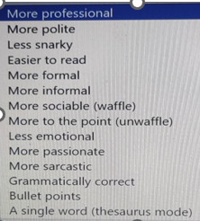
Goblin Tools – Other features
Breaking things down so you don't
Turn the spicy thoughts into classy ones
Am I misreading the tone of this?
Give me the crash course
How long will this take
Compile a list of tasks
What am I having for lunch ?

Slide 34
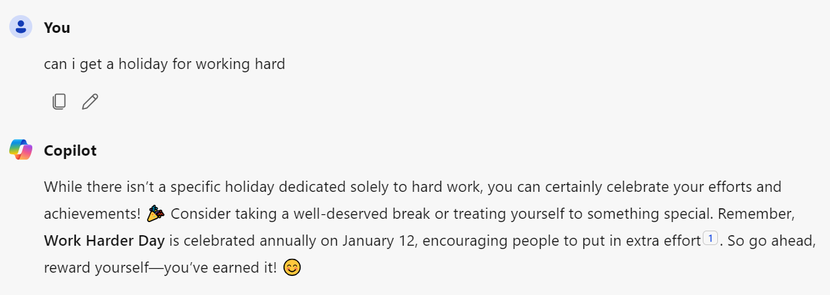
Microsoft Copilot
A product of Microsoft Corporation – was earlier called ‘Bing Chat’
Allows you to search for specific information, generate text, summarises content and create images based on text prompts
Can write code in popular programming languages
Integrates seamlessly with other Microsoft products

Slide 35
Evaluating information sources – thinking critically
C
CURRENCY
Timeliness
Date published Date updated
Links functional
R
RELEVANCE
Relate to the topic
Intended audience
Appropriate level
Basic or advanced
A
AUTHORITY
Who is the author
Is the writer qualified
Contact details
A
ACCURACY
Evidence
Verified by anther source
Unbiased
P
PURPOSE
Inform, Sell, entertain, persuade?
Fake news
Notes:
Magazines
Magazines publish articles on topics of popular interest and current events. The articles are written by journalists and are for the general public.
Magazines, like journals and newspapers, are called "periodicals" because they are published at regular intervals throughout the year. You can find print magazines at newsstands and in libraries. Some are now available on the Web as electronic magazines.

Slide 36
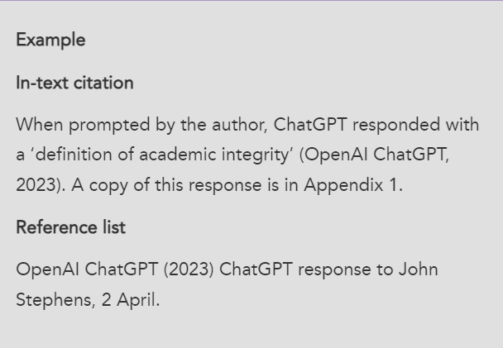
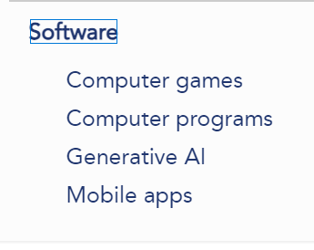
References and Citations - Cite them right online
Cite Them Right - Generative AI (citethemrightonline.com)

Slide 37
AI – Learn about the limitations
AI prompts – telling AI what exactly you want - generating content, interpreting data, or simulating a customer response. “Ask and it shall be given”.
AI Bias– favouring data, people, ideas – gender, occupation or culture
Hallucinations– Incorrect or misleading responses, creating information which does not exist- authors, titles, quotations, research results etc.
Data Privacy– Check the privacy policy – what data are you sharing – name, age, geographical location, religion, information preferences etc. Do not share any sensitive or private data with a generative AI tool.

Slide 38
Publications on NEP2020

Slide 39
Thank you
for giving me the opportunity
to delve into
the amazing world of Information and Education
and to add value
to the profession of Librarianship !
BEST WISHES

