Slide 1
How will Tourism and Hospitality Education have to change in 5, 10 and 15 years’ time for the global citizen student? Zabin Visram, Senior Lecturer, University of West London Ingrid Kanuga, Senior Lecturer, University of West London

Slide 2
Our Research
Increase in international student numbers
Longitudinal study of four years indicated challenges in adapting to our education system, developing employability skills and integrating within the community

Slide 3
Our Research
To address these challenges we created a conceptual framework named The Learning, Assessment, Pastoral (LAP) conceptual Framework.
This provides for a theoretical model perpetuating the concepts of incremental learning, critical thinking; volunteering, competitive spirit and mentoring

Slide 4
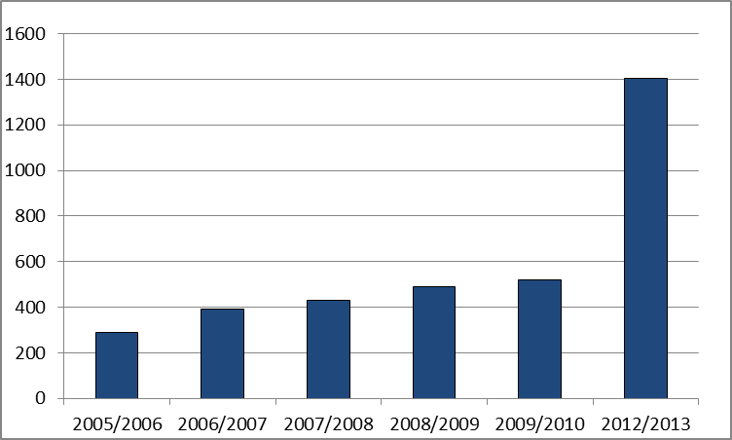
Background
Depicting the trend in rising international student numbers studying at UWL.

Slide 5
Background
According to the HESA, there were 124,545 non-UK domiciled postgraduate students who studied in British universities in 2005/2006. And in 2012/2013 this figure has increased to 195, 755 (57% increase).
In addition Universities have started to provide the same education at campuses in host countries, taking the home country academic team into new environments where they have to be ready to provide suitable learning teaching and assessment strategies.

Slide 6
The Question
How can universities adapt their programmes to help the international students get accustomed to the UK teaching delivery and assessment structures?
How can universities develop their curriculums to build in appropriate employability skills to enable them to build a career in their respective industries?

Slide 7
Influence
One significant stakeholder influencing university programmes is the employer. They have identified key specific graduate attributes that need to be developed by universities, namely development of soft skills involving communication, change management, self and other leadership, presentation, flexibility and application.
The Leitch report into review of skills (2006:p3) further identified that there is a direct correlation between skills and employment and indicated that it is the universities that need to make reforms to address this correlation better.

Slide 8
The Study
4 year qualitative study involving students in focus groups.
Students on Graduate Diploma course with placement element.

Slide 9
Findings
The international student learning was impacted by:
the different delivery and teaching methods;
the different forms of assessment strategies;
concepts of independent learning;
and by pastoral issues.

Slide 10
The solution
From the findings of this research the lecturing team created a conceptual framework named :
The Learning, Assessment, Pastoral (LAP) conceptual Framework
informed by industry experts, student cohort and institute of hospitality.
allows for global graduate attributes to be developed and supports integration within the learning and assessment environment.

Slide 12
Pastoral Model..
Mentorship Scheme
Field Trips
Vteam
Competitions

Slide 14
The Mentorship Scheme
Benefit for mentees :
Extended inductions : Making students feel wanted / valued by the institution and local community
Extended inductions : orientation
Encourage friendship and belonging
Educate cultures and traditions
Encourage integration
Understanding about the hospitality industry from a student perspective
Understanding about the assessment structures
Educating about the teaching methods
Learning about independent study approaches

Slide 15
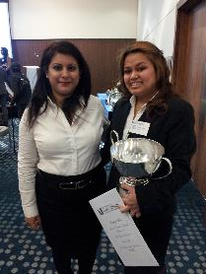
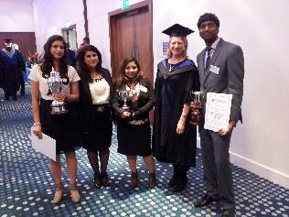
Competitions

Slide 16
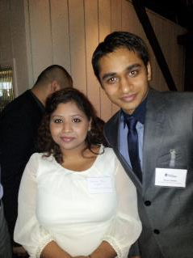
Field Trips

Slide 17
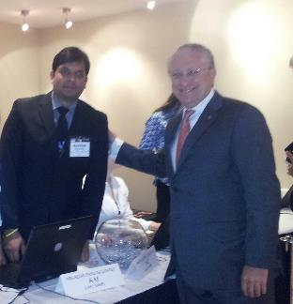
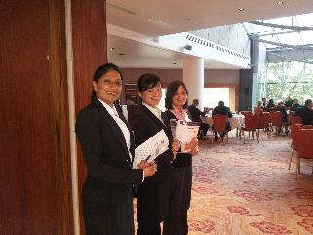
Vteam: HOT E

Slide 18
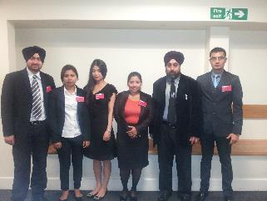
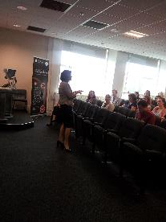
Students organised, and delivered the mentoring conference 25 universities attended the event

Slide 20
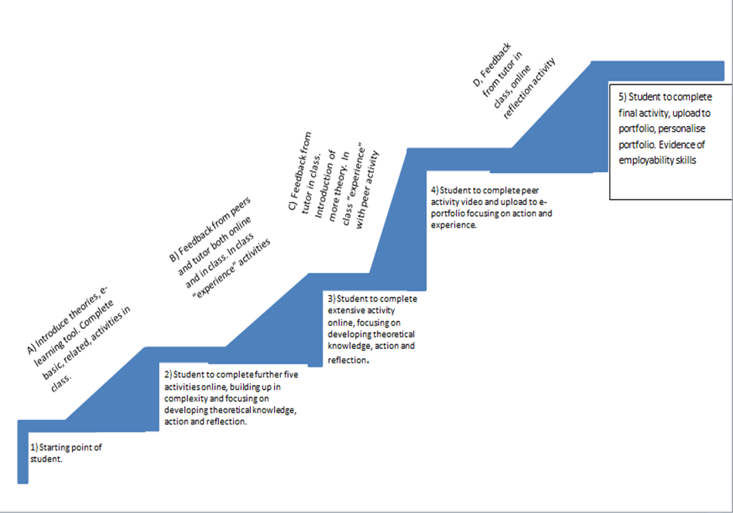

Slide 21
Blended Learning Phased Assessment Strategy
https://v3.pebblepad.co.uk/v3portfolio/uwl/Asset/View/k8c6y9HZ98jrs4mZq65t6pM4bh

Slide 22
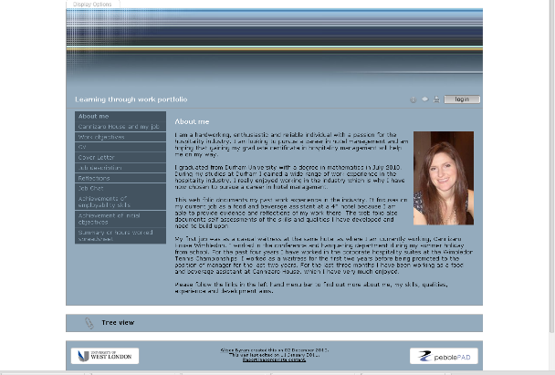
Example: http://www.pebblepad.co.uk/uwl/viewasset.aspx?oid=70765&type=webfolio

Slide 23
Results
Highly improved academic results and progression
14 industry awards
High profile placements
95% employment upon graduation
Students feel confident, happy and settled.

Slide 24
How will Tourism and Hospitality Education have to change in 5, 10 and 15 years’ time for the global citizen student? Zabin Visram, Senior Lecturer, University of West London Ingrid Kanuga, Senior Lecturer, University of West London

