Slide 1
Evaluating staff and student partnerships to provide opportunities for students to engage within the community and develop their confidence
The Graduate Diploma Programme
Zabin Visram : Ingrid Kanuga

Slide 2
Evolution of the programme : - from Certificate to Diploma
The student profile :
International : mainly Indian subcontinent.
A first degree in an unrelated subject
No experience in hospitality
The Graduate Certificate programme
6 months taught
12 weeks placement
Then it was validated in 2013
The Graduate Diploma programme
One year taught
24 weeks placement
Successful completion leads to a PASS award

Slide 3
The Graduate Certificate programme
What were the problems and concerns when I Inherited it ?

Slide 4
The problems with the Graduate Diploma programme
Concerns
Plagiarism
Cultural differences : Mixing in community
Unfamiliar with the teaching style and Assessment structures
High Failure rate
Concept of independent learning was new
Came from a background not in hospitality
Had to acquire employability skills in hospitality exceptionally quickly
Needed to learn practical concepts related to hospitality so can put into practice in placement element
Lecturers unfamiliar with the students backgrounds both academic and social and cultural – learning curve for them

Slide 5
The New Graduate Diploma Programme

Slide 6
How were the challenges addressed?
Before validation and the redesign of the programme – who were the stakeholders that were consulted ?
Aim : to improve ‘graduateness’
Help settle in new cultural environment
Develop familiarity with the Hospitality industry
Improve the pass rate
Better learning experience :
A series of Focus Groups were conducted with student groups
To identify their needs and suggestions for improvement
STUDENT ENGAGEMENT
Employers
Were interviewed and their views of the skills base required
EMPLOYER
ENGAGEMENT
The lecturing team course reviews identified their concerns
After discussions – the redesign of the programme took place

Slide 7
Partnership: Building Trust and Confidence
Voice
concerns
Articulate
ambitions
Design
Strategies
Staff
Students
Student Led

Slide 8
How did we do it?
Focus groups
Course committee meetings/student reps
Mentor feedback

Slide 9
Strategies Employed
Inremental learning / Phased Assessment
Extended inductions
Mentor scheme employed
Share experiences twice a week – scheduled sessions
Field trips /
Visits to industry and institute of hospitality
VTEAM
Min 5 events
One year taught
24 weeks placement
Validation
Outcome and new programme

Slide 10
How were the problems addressed ?
Concerns | strategies
Had to acquire employability skills in hospitality exceptionally quickly Community | Field trips and industry visits / guest lecturers / careers office and placement office and VTEAM
Needed to learn practical concepts related to hospitality so can put into practice in placement element | New practical elements brought into the taught part – in pillars and feast training sessions and H & S and MICROS training
Lecturers unfamiliar with the students backgrounds both academic and social and cultural – learning curve for them | Visits to India and disseminated information on the teaching and learning styles and assessment methods the students are use to
European competitions

Slide 11
Students said … we did …
They asked : said they need practical skills hence we introduced practical sessions with the lectures suggestions - in pillars and feast with Adam designing the module elements.
Students suggestions for developing team work skills : initiated the following strategies : role play activities and participation VTEAM .
Students request for understanding the industry initiated me designing field trips and guest lectures and attendance in competitions.
Students requested help in accustoming to independent learning. I developed the mentor scheme.
Unfamiliarity with teaching and assessment strategies and plagiarism - I introduced extended induction and mentor scheme.
Exposure to industry and learning about director development and strategies was requested by students - to address this I got them involved in HOT E conference

Slide 12
OUTCOMES
No plagiarism issues
Pass rate improved : External said to have a distinction and merit award
Settled better into the community and better cultural awareness
One student won 14 awards for university : West London Football and Basket ball
Awards won for institute of hospitality
EU Cup finalists
Students securing placements in prestigious hotels : Landmark etc

Slide 13
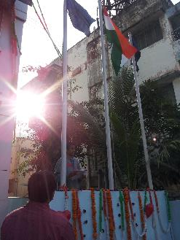
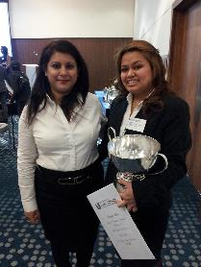
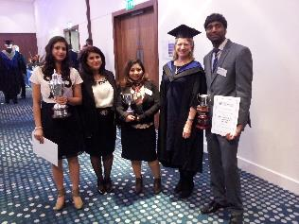
Awards and visiting India to understand the students culture and teaching environments

Slide 14

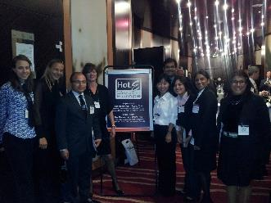
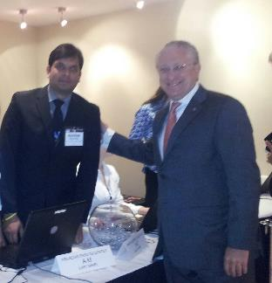
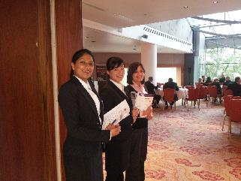
HOT E Our students success is UWL success

Slide 15
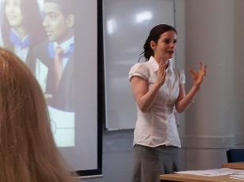
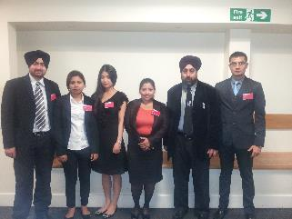
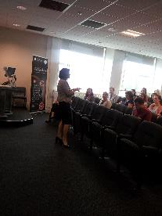
Presenting our research at conferences.
Students orgainsed, and delivered the mentoring conference 25 universities attended the event

Slide 16
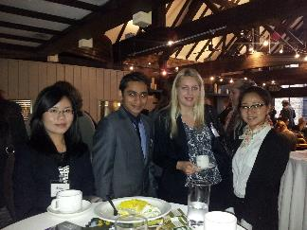
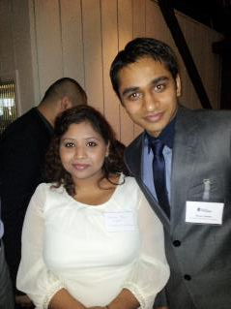
Students participate at the institute of hospitality competition

Slide 17
Our Graduates!
We now attract a variety of international student s: Brazil, USA, Malaysia, Vietnam, India etc

