Slide 1

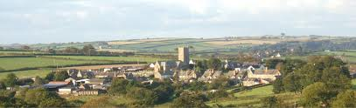
Blended Learning Phased Assessment Employability Strategy

Slide 2

Blended Learning Phased Assessment Employability Strategy (BLPASES) Framework
          Brief paper = Brief presentation ☺
          Our student Profiles & Needs
          Previous Research
          The Framework
          The Framework in Practice
          Student Feedback
          What is next

Slide 3


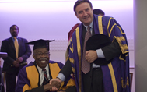
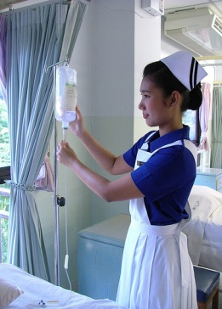

Student profiles & needs
120 Nationalities
Ages between 17-63
Living with parents – Single parent with 4 children
Focused career change – “had to do something”
Full UK education - “I dropped out of high school but I am a senior manager”

Slide 4
Student profiles & needs
Most common question asked at open days: “Will I get a job after this?”
Most common question from industry: “How do your courses prepare students for work?”

Slide 5
Previous Research
  Vgotsky (Social Constructivism) (1978)
  Kolb’s Learning Strategies (19840
  Lave and Wenger (1991)
  Maslow Hierarchy of Needs (1987)
  Salmon E-moderation 5-stage model (2003)
  Laurillard conversational framework (2002)
  We interviewed lecturers, students and industry professionals on their experiences
  and needs. We then used this research to pilot a phased assessment strategy.

Slide 6
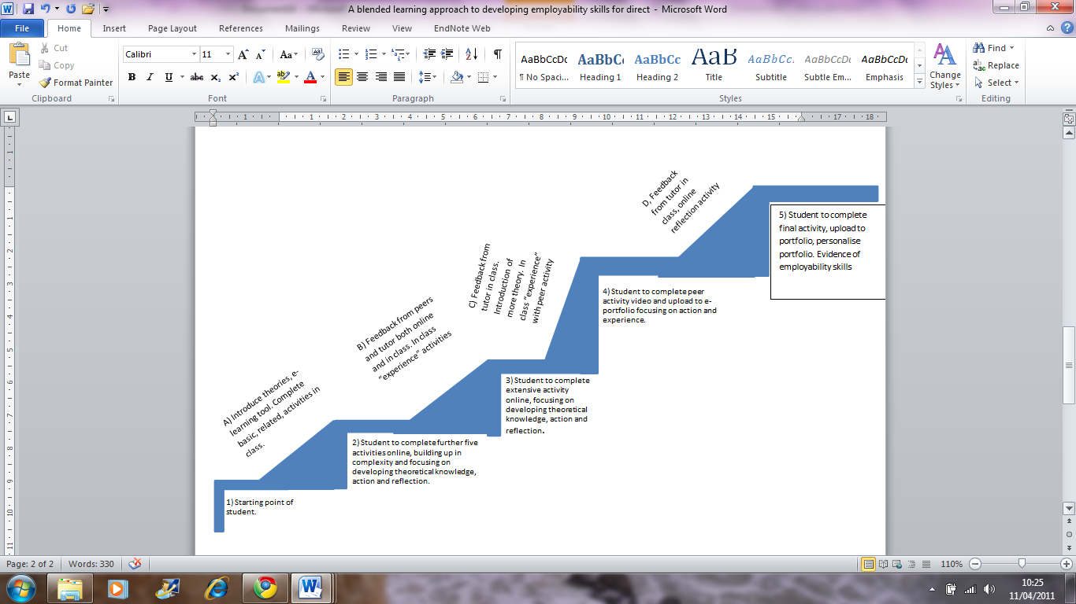
BLPASES Framework

Slide 7
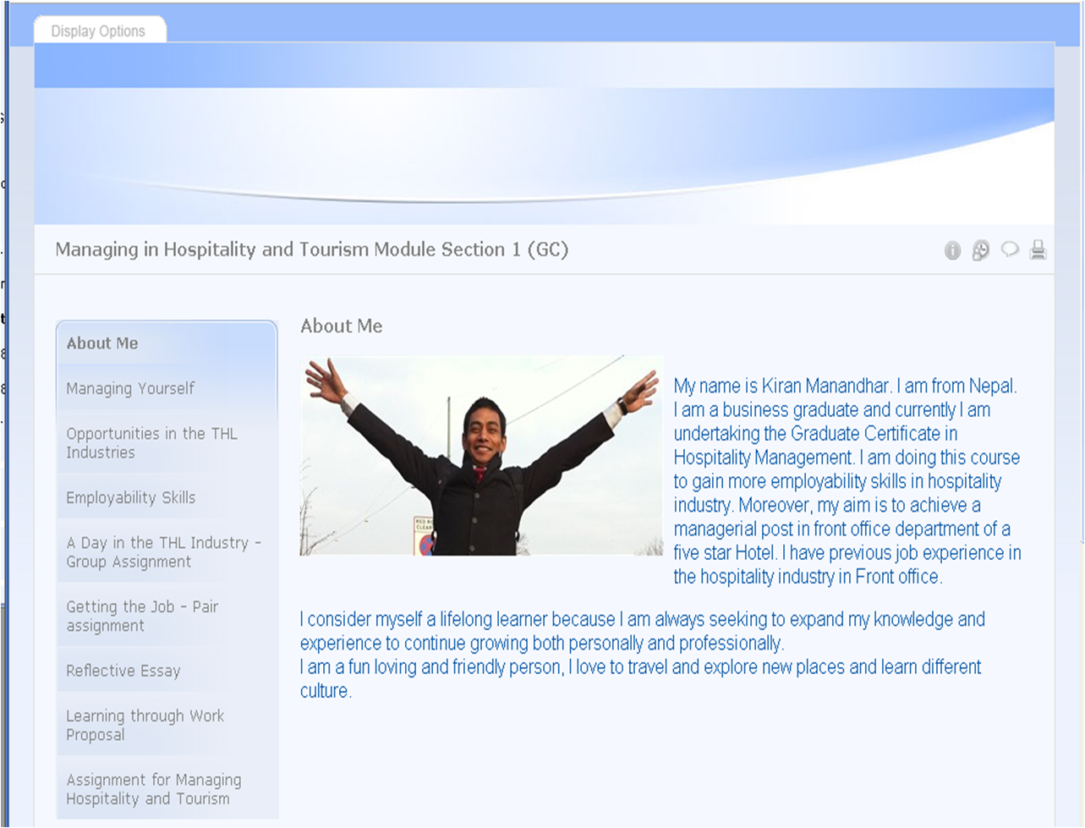

Slide 8
Student Feedback
I really enjoyed this module. Building the portfolio with activities from class, my own video’s and research was the best mixture of learning/.
The module has enabled me to analytically observe and decide on my career path in the hospitality industry over the next few years to come.
The activities/ homework made me do my research on time and I enjoyed it.
The group and peer work helped me reflect on my own skills, from attitude to technical.

Slide 9
What is next?
Further develop the online learning
Marking Matrix
Role out to 350 students on business module across 7 programmes.

Slide 10
For more information
For further information on the assessment pilot, to see student views and reflections on
this strategy or to obtain a full copy of the bibliography contact:
Ingrid.Kanuga@UWL.ac.uk
Or connect on LinkedIn
Visit this link for a demonstration video:
http://www.youtube.com/watch?v=ienjw4X86v0

Slide 11

Thank you ☺

