Slide 1
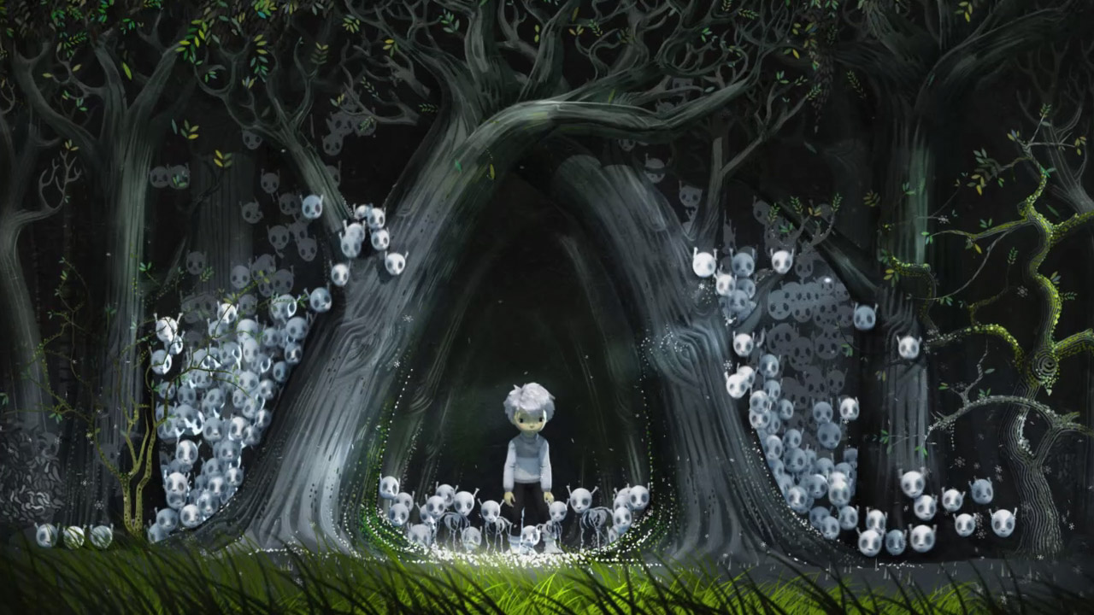

The Winter of the Summer Child

Slide 2

Questions..
1) Will it make a difference to my sons overall academic achievements if he enters formal education at a time where he will have just turned four in comparison to five, six or even seven years?
2) Will it make a difference to my son’s emotional well-being if he enters formal education being the youngest child in comparison to being the oldest?
3)Should it be the parents, the local authority or the schools decision on when to enter their summer born child to reception?

Slide 3

Statistics

Slide 4
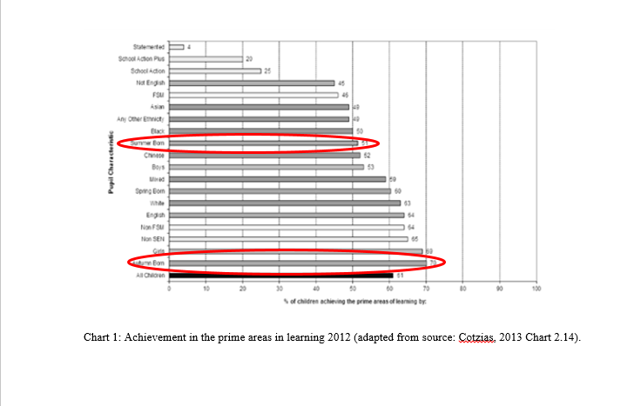

Slide 5
