Slide 1
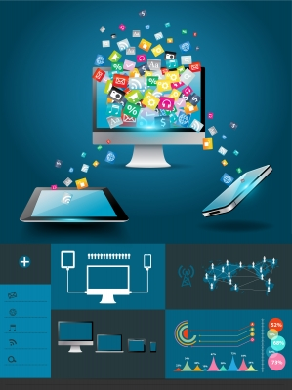
What Library and Information Sciences can learn from Improvement Science : Emerging Paradigms, Future Directions and Practitioners’ Empowerment
Syed Adnan Adil
Library Systems Manager University of West London

Slide 2
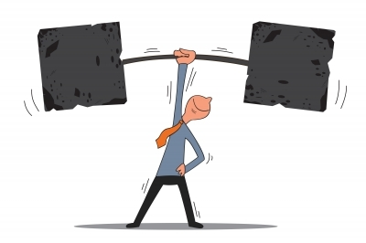
Objectives
What is improvement sciences ?
Quality assurance movements
Subjective domains of improvement
Leadership theories
Pulse check of LIS literature
Possible future trends
Conclusion

Slide 3

What is improvement sciences
An emerging discipline, who aims to:
Reduce gap between theory and practice
Provides facilitation among stakeholders
Achieves projects in agreed yet time bound projects
Deals with sustainability of change
Connects macro level objectives to service planning
Up-skill “reflective practitioner”
Enabling ‘change management’

Slide 4
Quality assurance movements
Quality improvement 1920s (Shewart, Deming and Juran)
TQM from 1940s to 1980s (Japnese and American gurus)
Lean thinking (1990s)
Six sigma
Improvement and implementation disciplines

Slide 5
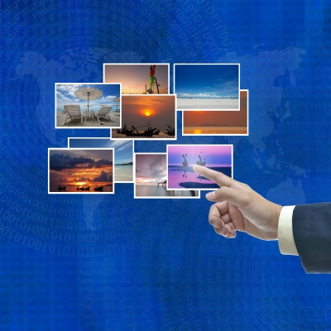
Topical domains of improvement
Quality improvement
Change management
Leadership styles
Alignment between policy and practices
Operational planning
Engagement
Reflective assessment
Project management

Slide 6

Improvement tools
Action effect diagram (AED)
Brainstorming
Change readiness matrix
Return on Investment calculator
Process mapping
Plan, Do, Study, Act (PDSA)
Stakeholder analysis
Responsibility charting

Slide 7
Models of Leadership
1980s (US)
  Heroic model of leadership
1990s
  Inspirational leadership
  Acknowledgement of the dark side of charisma (arrogance, narcissism, manipulation)
Present
  More focus on follower-leader relationships
  Concept of shared leadership

Slide 8

LIS literature pulse check
Fragmented
Trend influenced
Deals with single phenomenon
Johanssen (1992) and Khan M M (2015)
Time lag for research translation (17 years)
Second translational gap
More practitioner-led research

Slide 9
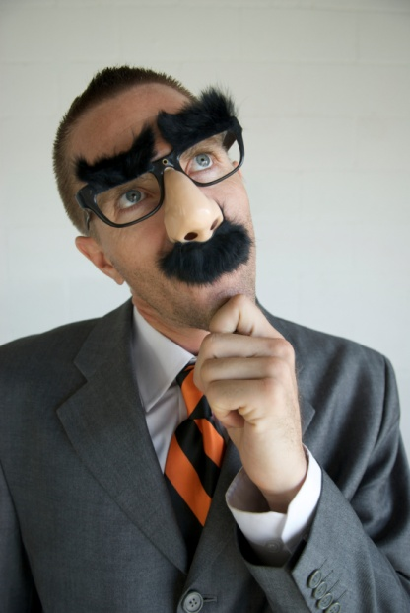
Considerations
Knowledge translation of research into practice
More attention to diverse contexts
Project and operations management skills
Measurement of value and impact
Partnerships
Grey Vs Scholastic literature
Inter disciplinary approach

Slide 10
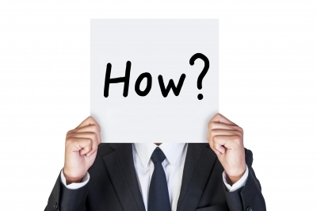
Thank you
Questions

Slide 11
References
Khan, M. M., & Kamal, M. (2015). Total Quality Management (TQM) for Improving Quality Service in University Libraries: A Conceptual View.
Johannsen, C. G. (1992). Danish experiences of TQM in the library world. New library world, 93(6).
Morris, Z. S., Wooding, S., & Grant, J. (2011). The answer is 17 years, what is the question: understanding time lags in translational research. Journal of the Royal Society of Medicine, 104(12), 510-520.
Note: Images in presentation have been taken from Copyright cleared sources from the internet.

