Slide 1
Hold a mirror up to nature
Kristin Brewe – Advertising Lecturer – University of West London
Students as Partners in Learning: Teaching & Learning Conference 2016

Slide 2
Students & “happy families”

Slide 3
Still more “happy families”

Slide 4
A distorted cultural mirror

Slide 5
Industry challenge & response
2011
9 out of 10 people in advertising are white
Lack of women in leadership roles
2011 through 2015
Numerous industry initiatives
2015
9 out of 10 people in advertising are white
Lack of women in leadership roles
Sources: Institute for Practitioners in Advertising industry census data – 2011 & 2015

Slide 6
The medium is the message
Exposure to dominant forms + traditional “authority” delivery =
Dominant forms continue (Janks, 2000)
Collaborative task +
Peer-led conversations =
Critical literacy fostered (Sampson & Cohen, 2001; Bruffee, 1981)

Slide 7
Goals of learning activity
See whether a student-led approach better teaches critical literacy
Enhance engagement with class discussions, particularly for sensitive issues
Increase awareness and engagement with the topic of diversity in advertising
Develop understanding of why advertising does not reflect our society
Foster a sense of responsibility and ownership in students
Build confidence that change is possible

Slide 8
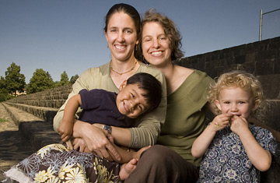
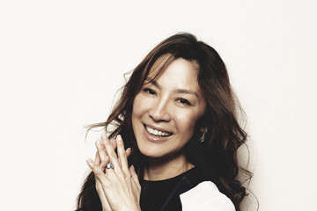
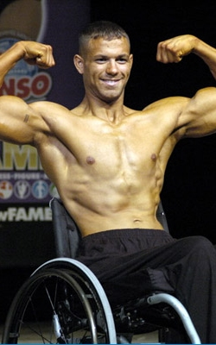
Peer learning diversity exercise
→Divided into small groups
→Provided with 5 scenarios
→Given a choice of specific images for each
→Had to choose 1 image unanimously for each
An advertising agency showcasing a creative director on its website who is the “ultimate decision-maker”
A high street bank ad featuring a “happy, healthy family”
A cosmetics company illustrating its tagline “Be Beautiful” in outdoor advertising
A male grooming brand’s print campaign illustrating the tagline “You’re the man.”
A leadership training course’s website showing a Chief Executive Officer, “the head of a company.”

Slide 9
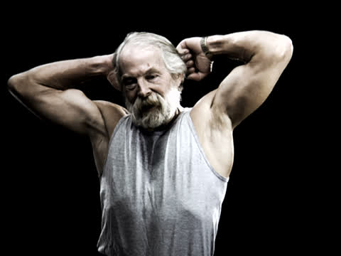
Key aspects of student discussion
Thoughtful about their decisions and sensitive in their rationale
“The wheelchair adds a new dimension.”
“Even if you don’t have legs, you can still be a man.”
Coaching one another about tact & inclusion
Student A: “Some of us thought we should pick the old man…is he the man? It’s funny.” Student B: “But we didn’t pick that because we decided it’s making a joke we weren’t sure was necessary.”
Surprised by their own bias
“She’s the creative director?!”
“There’s no way she’s old enough to be a CEO! I guess I shouldn’t think that way.”

Slide 10
Enhanced engagement with class
Pre-activity
Post-activity
Q5: In class, I enjoy discussion a lot of topics with my classmates– including controversial ones.
Sources: Pre and post activity classroom surveys March and April 2016; 12 respondents in pre, 16 in post. Rounding may cause slight shifts in percentages.

Slide 11
More engagement with diversity
Pre-activity
Post-activity
Q6: In class, I wish we would discuss issues like diversity in advertising more.
Sources: Pre and post activity classroom surveys March and April 2016; 12 respondents in pre, 16 in post. Rounding may cause slight shifts in percentages.

Slide 12
More aware of ads’ non-reflection
Pre-activity
Post-activity
Q11: I notice people who look like my friends in advertising.
Sources: Pre and post activity classroom surveys March and April 2016; 12 respondents in pre, 16 in post. Rounding may cause slight shifts in percentages.

Slide 13
Less certain we’re in the picture
Pre-activity
Post-activity
Q12: I see people who look like my family and me in advertising.
Sources: Pre and post activity classroom surveys March and April 2016; 12 respondents in pre, 16 in post. Rounding may cause slight shifts in percentages.

Slide 14
More interest in how
Pre-activity
Post-activity
Q7: I am interested in how advertising and public relations influences our culture.
Sources: Pre and post activity classroom surveys March and April 2016; 12 respondents in pre, 16 in post. Rounding may cause slight shifts in percentages.

Slide 15
Stronger sense of responsibility
Pre-activity
Post-activity
Q10: Advertisers have a responsibility to create messages that have positive social effects.
Sources: Pre and post activity classroom surveys March and April 2016; 12 respondents in pre, 16 in post. Rounding may cause slight shifts in percentages.

Slide 16
Deeper interest in career
Pre-activity
Post-activity
Q2: I want to have a career in marketing, advertising, and/or public relations.
Sources: Pre and post activity classroom surveys March and April 2016; 12 respondents in pre, 16 in post. Rounding may cause slight shifts in percentages.

Slide 17
Confidence somewhat shaken
Pre-activity
Post-activity
Q2: I am confident that I will someday be a leader in the creative communications field.
Sources: Pre and post activity classroom surveys March and April 2016; 12 respondents in pre, 16 in post. Rounding may cause slight shifts in percentages.

Slide 18
In my partners’ words…
Change the world with ads in the future.
It’s a good idea to show diversity in advertising. Advertising should reflect reality. We have a stereotypical view of certain people.
Many companies are very white-washed. It is our job to change advertising.
Diversity is still an issue in the advertising sector.
I learned that people will sway towards easy, non-controversial options, especially in advertising.
My responsibility is to stay true to myself and my own beliefs and express them regardless of consequences.
Change in the ad/PR world will happen soon.
Advertising needs to be more diverse.
Some answers provided in a free form comment box asking, “What did you learn?”

Slide 19
What did I learn?
Peer learning seems to better develop critical literacy and diversity awareness
Diversity-related peer exercises enhance overall class engagement
Students understand the issue of diversity faster and more deeply in peer work
Understanding the social context of culture is easier in peer-led learning
Peer reinforcement of social norms inculcates a greater sense of responsibility
Student confidence can get shaken when confronting issues like diversity
Being self-reflective on my own classroom presence improves student learning

Slide 20
Next steps…
Hone exercise further based on findings from this trial run
Work with other educators to implement similar exercises and survey pre- and post
Develop similar critical literacy exercises that logically flow with curriculum for other modules
Work with industry bodies, like the IPA, to enhance their school outreach programmes’ content

Slide 21
Thank you! Any questions?

