Slide 1


Advertising Online in the Age of Reputation
Kristin Brewe,
Lecturer in Advertising - UWL

Slide 2
Agenda
Reinvention amidst chaos
Understated entertainers
The importance of being useful
Expect (& be) the unexpected

Slide 3
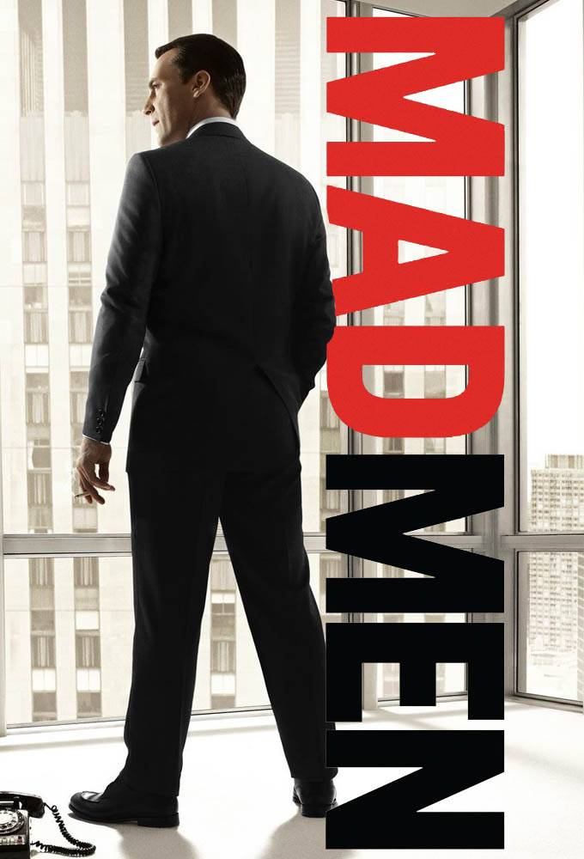

Notes:
We used to make marketing strategies and ads in a lone-wolf creative genius scenario, relatively isolated in our offices coming up with ideas that we broadcast out… like Don Draper in Mad Men. It was assumed that consumers were passive beasts, receptive to whatever sales messages we threw at them
Now, your office probably looks and feels like this and the world we’re talking to definitely looks like this– we are cross-functional, we are interconnected, not just with one another but with companies we do business with and politicians we elect. This, of course, is largely because of the internet, something we invented because human beings crave connection and information.

Slide 4
Product
Placement
Price
Promotion
Notes:
But our fall back is still this! The 4 Ps. The 5 Ps. While these may help get at the heart of the matter, I think we need to go back to the drawing board toward something much more fundamental…
CONTEXT

Slide 5
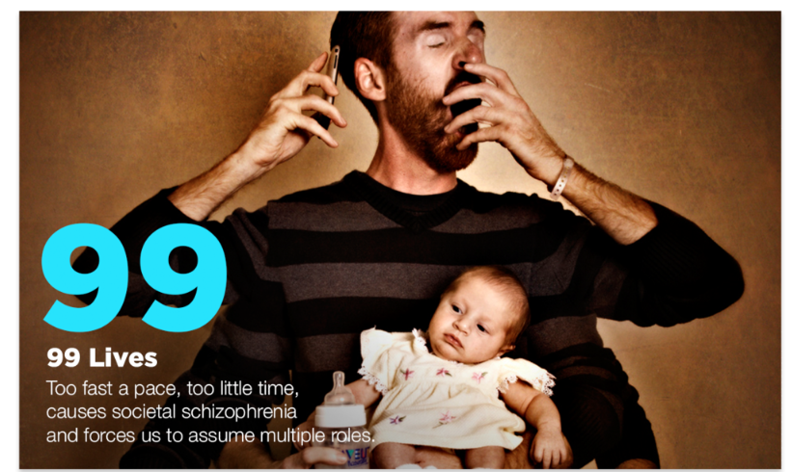
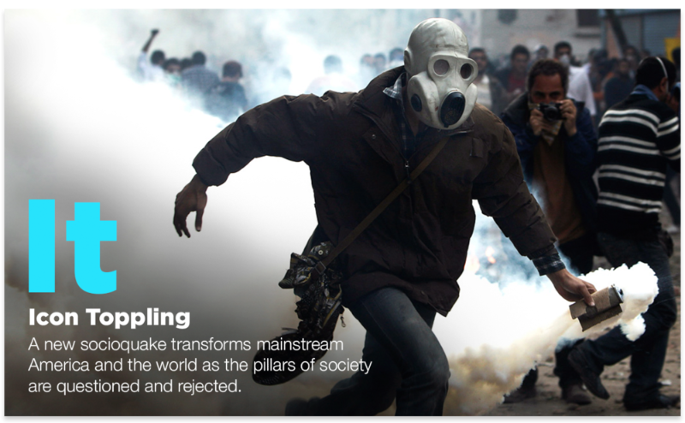
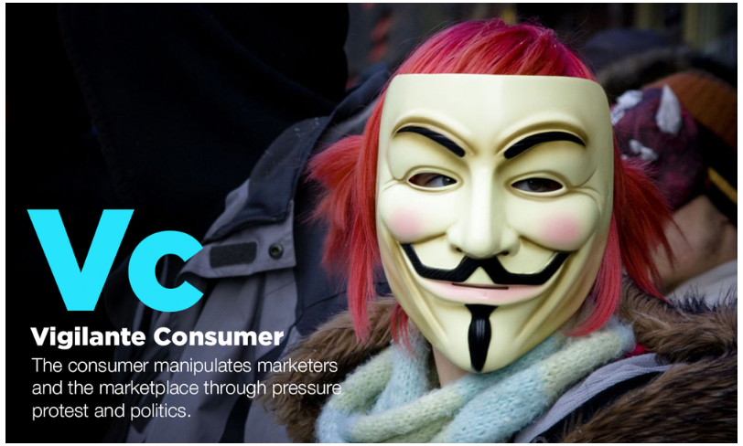
Today’s consumer context
Source: Faith Popcorn’s BrainReserve - Trendbank
Notes:
Because we need to put first things first – without understanding context --- all of our marketing and advertising strategies will fall on deaf ears or be subject to radical misinterpretation
Faith Popcorn, the Nostradamus of Marketing, highlights 17 trends that are characterising global consumers, and here are the three that I think change everything…
99 Lives – we have to wear so many hats, and technology has made it possible for us to take on even more. Everything’s moving far too fast to absorb them. “How will I do it?” We are weary.
We are also world weary – the news is bad, if not downright depressing. While we see groups like ISIS engage in literal icon toppling – The destruction of thousand year old temples, we also see the old order everywhere increasingly called into question– traditional expressions of authority, whether that’s from governments, companies, experts, etc. How many people believe that their favourite brands have their best interests at heart? VW, TalkTalk…. Brand we’ve relied on for quality or for communications services either cheat us outright or don’t protect things like our personal data
Which leads us to the vigilante consumer. I’m tired, I don’t trust things, but now, I have a way of fighting back: social media in particular. I saw one case where a disgruntled man on a British Airways flight took out Twitter ads to tell people about his rather bad experience. That was never before possible.

Slide 6
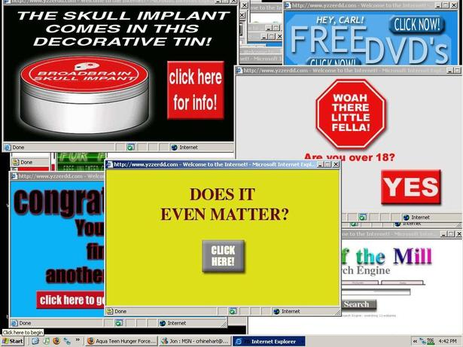
Notes:
But instead of taking these kinds of insights to heart, when we do online advertising, many of us do this.
We interrupt -- how many times have you wanted to see a news article but then had to keep closing a box that was begging you to subscribe?
We irritate – how many times have you been trying to look at your email only to have the page load slowly because of an ad?
We bait and switch – we use programmatic media – robots -- to do the dirty work of our display advertising – without understanding where ads are really going and what creative will appear before a prospective customer or someone who’s already bought from us (The Pants that Followed Me Around the Web)
What’s frightening is that programmatic advertising represents up to 50% of all display spend in some markets – we’re doubling down on this as an investment! Wow.
This is all the result of traditional thinking about consumers like a military battle: targets, positioning, attrition, guerrilla… BOMBARD.
But clearly, if you understand the wider context within which we now operate… that way of thinking doesn’t work any more…

Slide 7
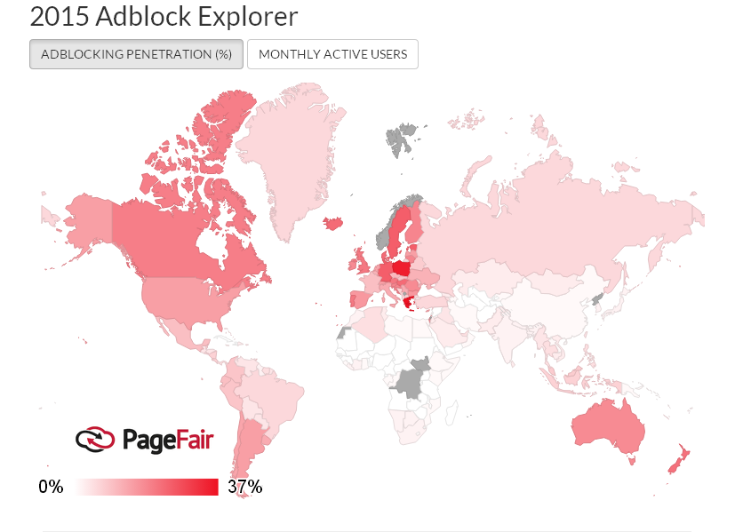
The world turns off digital display
Source: PageFair 2015 Adblocker Explorer Report, http://blog.pagefair.com/2015/adblock-explorer/
Notes:
And consumers are turning us off…even when quite a few of them know that this may mean an end to the free internet!
In Asia, adblocking technology is particularly prevalent on mobile phones
Online publishers believe this is an existential threat to their businesses – which means it’s a threat to yours! How will you reach people if they’ve blocked all the ways to speak to them?
Why did we want to get to this point in the first place?
This is such an urgent matter that the Internet Advertising Bureau – the trade body for digital advertising – has recently released new standards for display advertising: that they load quickly, that they’re not interruptive…
Which definitely means that this is a problem.

Slide 8
The age of reputation
Notes:
Welcome to what I’m calling the “age of reputation”
Rather than value, rather than competitive position, rather than all those Ps…an intense focus on what you do well through the lens of what consumers need to thrive in this chaotic context – that’s what should drive everything in your business– product development, customer service, not just your advertising
Perception is reality

Slide 9
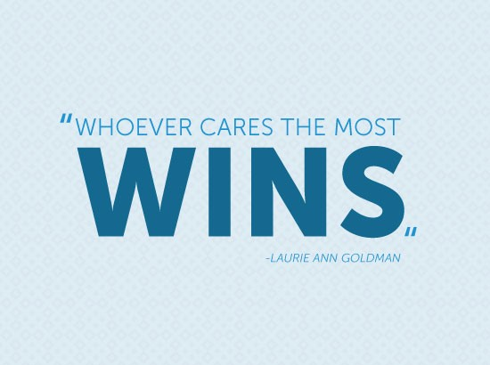
Notes:
Laurie Ann Goldman – one of Ad Age’s top CMOs – brands like Spanx, Macy’s, etc. famously coined this phrase
Think for a minute how different that is from a message about “who has the best P&L statement wins” which has defined most of my career and probably still defines quite a few folks’ experiences
Companies who will get this will win in today’s world

Slide 10
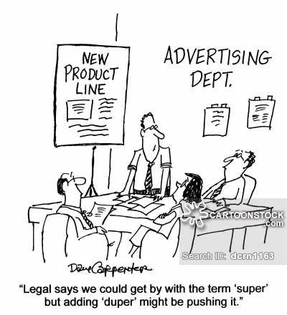
The brand as understated entertainer
Notes:
Legal may be your new best friend in this age of reputation
Hyperbole is over.
Giant logos are over.
Screaming tone of voice is over.
Understatement is in.
Entertainment wins – we are surrounded by it and expect it. 24/7

Slide 11
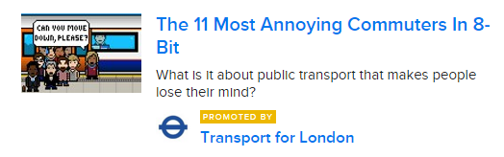
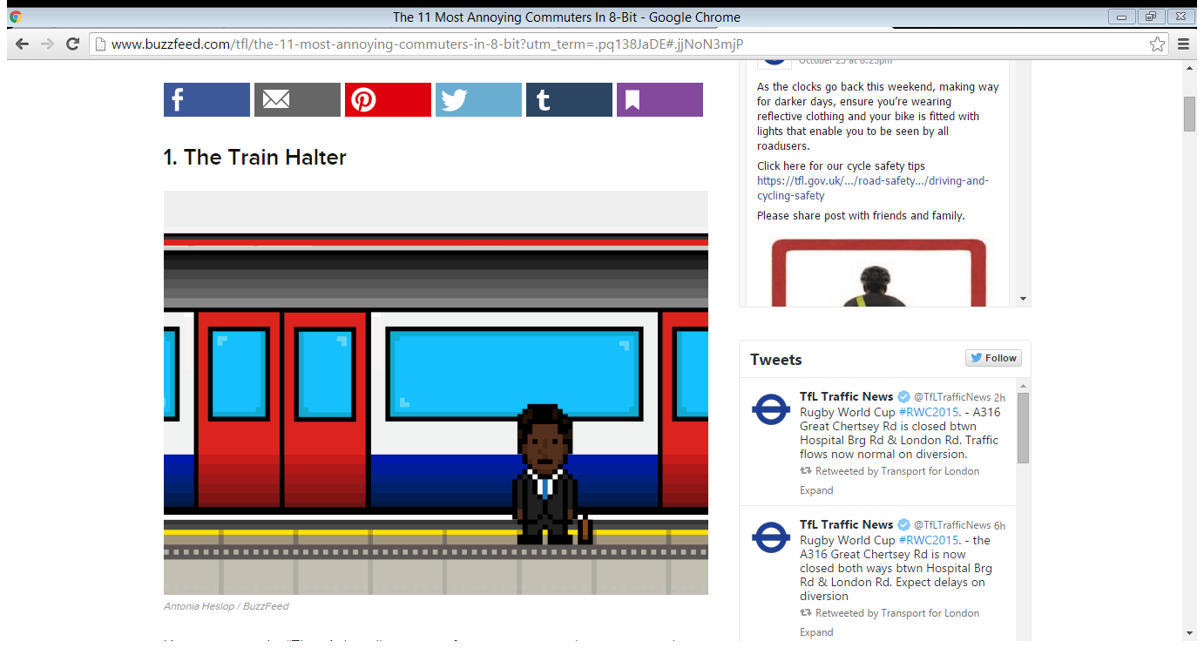
Notes:
Buzzfeed, whose own house style is far from understated, is doing interesting things in the “native advertising” sponsored content space
Promotion is very subtle – usually with a mere “promoted by” mention, and then gets right into some content that’s related to the brand’s goal
In this campaign, TfL engages very successfully in terms of promoting its safety message and also, highlighting how helpful it’s Twitter feed is
They’re not saying that explicitly but they’re showing it – even more powerful and effective

Slide 12

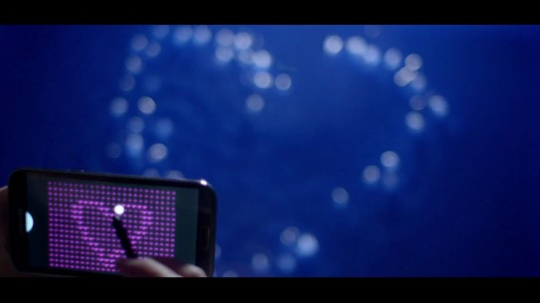
Beyond the Product Demo
Vloggers
e.g., any product placement with Zoella
Samsung Liquid Pixels – Galaxy Note II
Watch: https://www.youtube.com/watch?v=JUS-hHhbzxA
Notes:
Product demos used to be our staple as marketers and advertisers- BUY THESE AMAZING KNIVES NOW, LOOK THEY CUT CANS!
But now, when we need to be understated entertainers, something more subtle is required….
In the case of product placement – particularly pervasive with Vloggers like Zoella, it’s so subtle fans might not know they’re being advertised to
But the point here is that we’re connecting not be shouting, not by making product features take centre stage– but my making emotional benefits centre stage… subtly “brought to you by”… in this case…Samsung

Slide 13
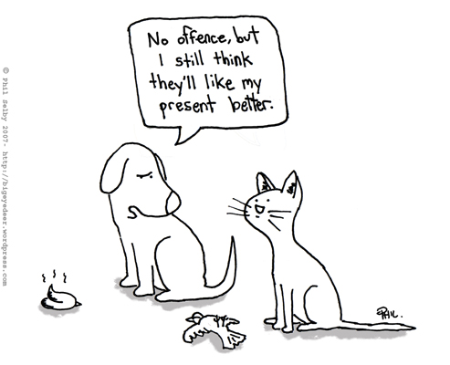
The importance of being useful
Notes:
Now, as we saw a bit with TFL, we need to be useful. But useful to whom?
The “presents” we bring to consumers (ads) aren’t what they’re expecting or, in some contexts, even welcome.
Make sure you’ve really thought about what it is that would make their lives easier and help. Really help.

Slide 14
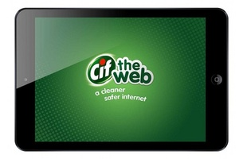
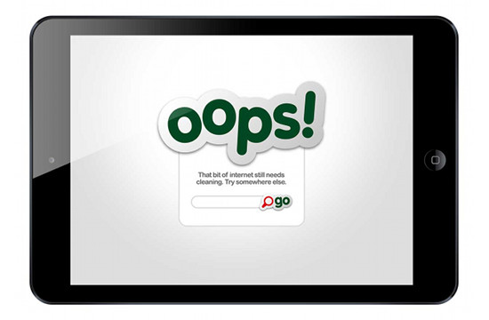
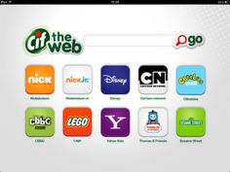
A true utility - Cleaning up the internet….
Notes:
Unilever’s amazing campaign…. 99 Lives parents. Afraid for their kids on the internet.

Slide 15
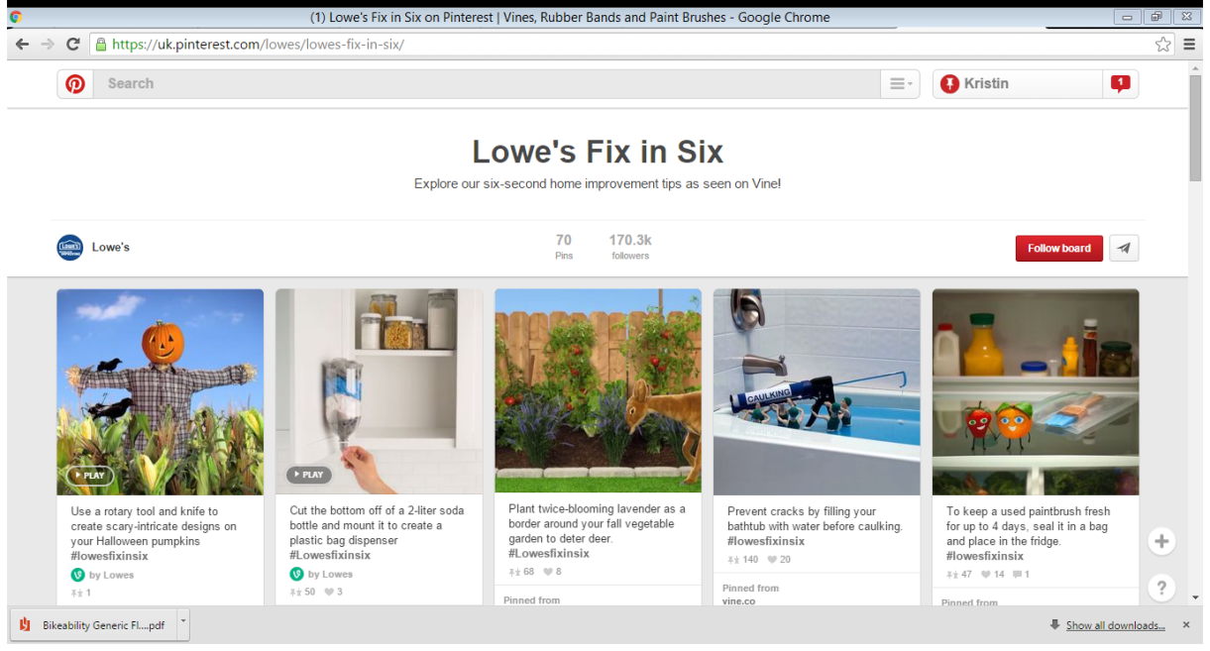
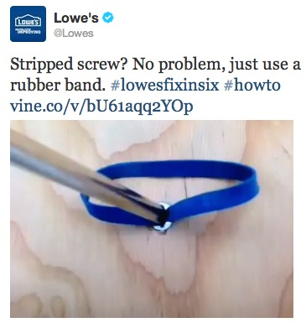
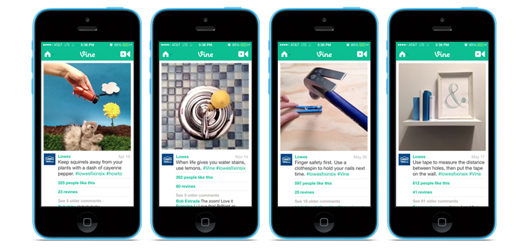
Essentials – Helping you fix things
Notes:
Lowe’s – helping everyone do quick fixes…. Using 6-second Vines. Genius.

Slide 16
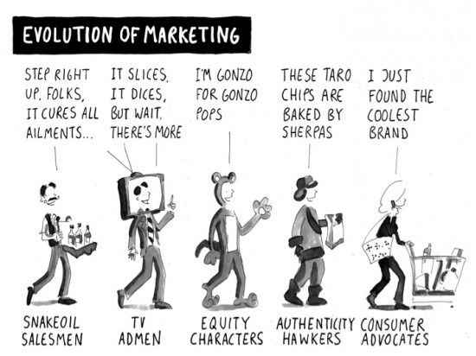
Expect (& be) the unexpected
Notes:
Now, we rightfully should be looking for advocates.
And even more old school brands can definitely be cool to their fans – regardless of how boring the product may seem.
We love to badge with brands that “get us”
And we love to be surprised.
But there are a lot of surprises around us? The key for a marketer is to stay at the top of the curve of innovation. But that doesn’t have to be expensive…

Slide 17
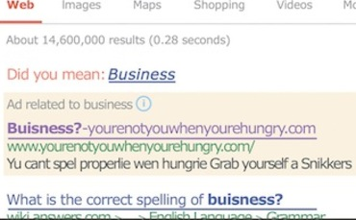
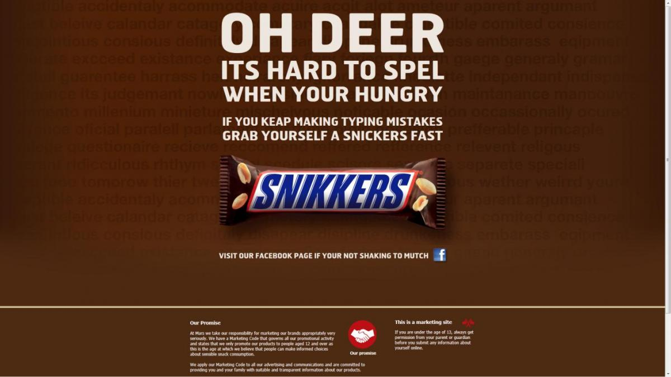
Brightening up a business day
Notes:
BBDO, MediaCom and Google strategists came up with this genius campaign for Snickers, using Adwords and a landing page

Slide 18
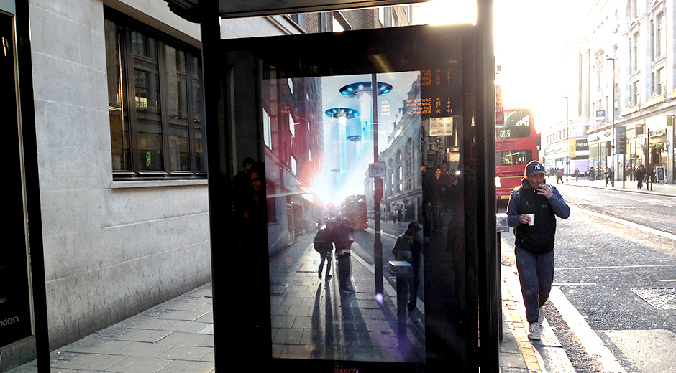
Delightful outdoor…digitally
Watch here: https://youtu.be/Go9rf9GmYpM
Notes:
Outdoor media is one of the places where brands are going digital, generally in the augmented reality direction
Here’s a great example of a Pepsi campaign that is definitely unexpected

Slide 19
Top tips for brands online
Never ignore the consumer
Don’t leave the ads to the robots
Delight, entertain & engage
Avoid “making the logo bigger”
Provide truly useful content
Solve folks’ problems
Surprise (& delight again)
Embed sharing at the heart
THE AGE OF REPUTATION

Slide 20

Any questions?
Thank you, & stay in touch!
Kristin Brewe, www.kristinbrewe.com

