Slide 1
COMPOSE YOUR FUTURE 2016
The UCAS Guide to getting into University and College 2011
There is also a very detailed web site that will tell you everything you need to know about the entire applicant journey.

Slide 2
COMPOSE YOUR FUTURE 2016
Types of Qualification / Award:
MA / M.Dram (4 Year course)
BA (Hons)
4 Year course with Foundation
2 Year Intensive BA
FdA
HND/HNC

Slide 3
COMPOSE YOUR FUTURE 2016
Career paths within the performing arts
Acting / Theatre / Dance / Drama / Theatre Studies / Dramatic Literature / Musical Theatre / Directing / Stage Management / Vocal Performance (sung/spoken) / Music / Drama Education / Music / Drama Therapy / Technical Theatre / Music Industry/Music Business/Music Administration/Events Management / Audio/Recording Technology / Composing / Music Producers / Journalists / Studio Technician / Teaching

Slide 4
COMPOSE YOUR FUTURE 2016
Be brave - after graduating from university you will also have a set of personal and technical skills for a huge range of alternative employment opportunities such as...............
Management / Local government / Arts organisations
Education institutions / Industry / National Health Service (NHS)
Leisure companies / Voluntary organisations
RESEARCH

Slide 5
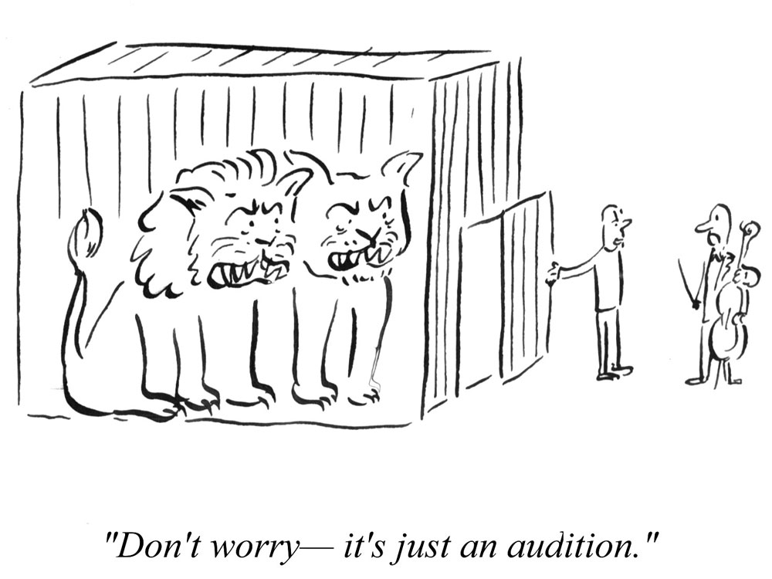
Where to begin…
Why are auditions and interviews important?
This is amongst the most important decisions to be made in your life.
In preparation go to concerts, theatre and live music gigs.
Have ambition and determination to fulfil your dreams.
Aim high!
Make decisions...........

Slide 6
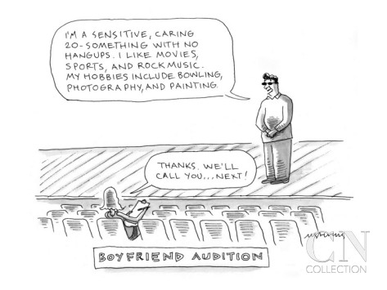
COMPOSE YOUR FUTURE 2016
Interviews / Auditions
What are they/you
looking for?
Have you got the ‘X’
factor?
Don’t rely on the back
story

Slide 7
Some important factors for Music Conservatoire applications. Deadline, just missed at 18:00 on 3rd October, 2016.
Don’t despair make an application to the conservatoire of your choice and they will respond to you on an individual basis.
For the record: You may need to have more than one audition/interview, depending on the conservatoire's audition policy, and the study type and course you choose:
Main specialism - one audition will be needed.
Joint main specialism - two auditions, one for each specialism, will be needed.
Secondary specialism - some conservatoires will audition on your main specialism only, whereas others will audition on both your main and secondary specialism.
Alternative main specialism - two auditions, one for each specialism, will be needed.

Slide 8
What an audition might involve
Music performers normally play two or more contrasting pieces in a live audition held at the conservatoire. In some cases you can send a recording or video instead.
Musicians/musicologists may be asked to play or sing scales, read or sing at sight, take an aural test or have an interview.
Composers are often asked to submit a portfolio or some other evidence of practical ability, or to have an interview.
Dance and drama applicants may be asked to prepare monologues, a performance piece, participate in a dance class, sing, sight-read text or improvise.
Drama production applicants may be given set tasks prior to the interview, where you will then discuss the tasks, your understanding of the course, and your career aspirations, amongst other things.

Slide 9
COMPOSE YOUR FUTURE 2016
Student Room:
“…i av so far put down University A (2nd in country for drama apparently), University B (one of best teaching quality), Drama School A, University C, and University D. now am not sure about University C and more cos 70% of students r mature! eeks. well i know that i am picking a drama course for both theory and practical, but i really love the idea of a production course (i.e. at Drama School A). so basically i'm also confused. does ???? have student accom? or is it just a day college and i hav to get my own private accom?...”

Slide 10
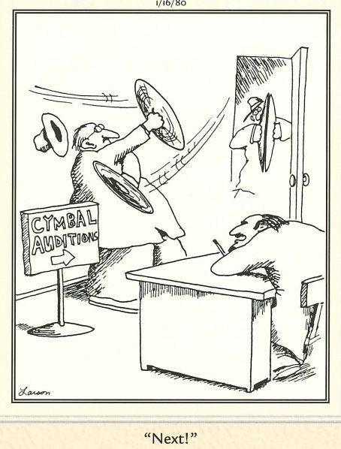
Before the audition ask yourself these questions:
What special gifts do you possess? Name them.
Are you aware of the competition?
Are you really prepared to work hard?
Do you always seek praise?
What plans do you have if you don’t succeed?

Slide 11
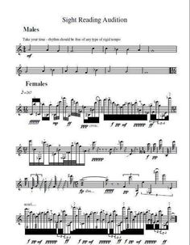
Before the audition you must do the following:
Prepare for the audition before you even hear from the institution. Be ready
Know why you have made your UCAS choices
Read Prospectus and any information relating to the course
Read audition guidelines for each university or conservatoire and work hard for this important occasion. Treat it as the entry to your career
Be aware of audition requirements such as sight reading

Slide 12
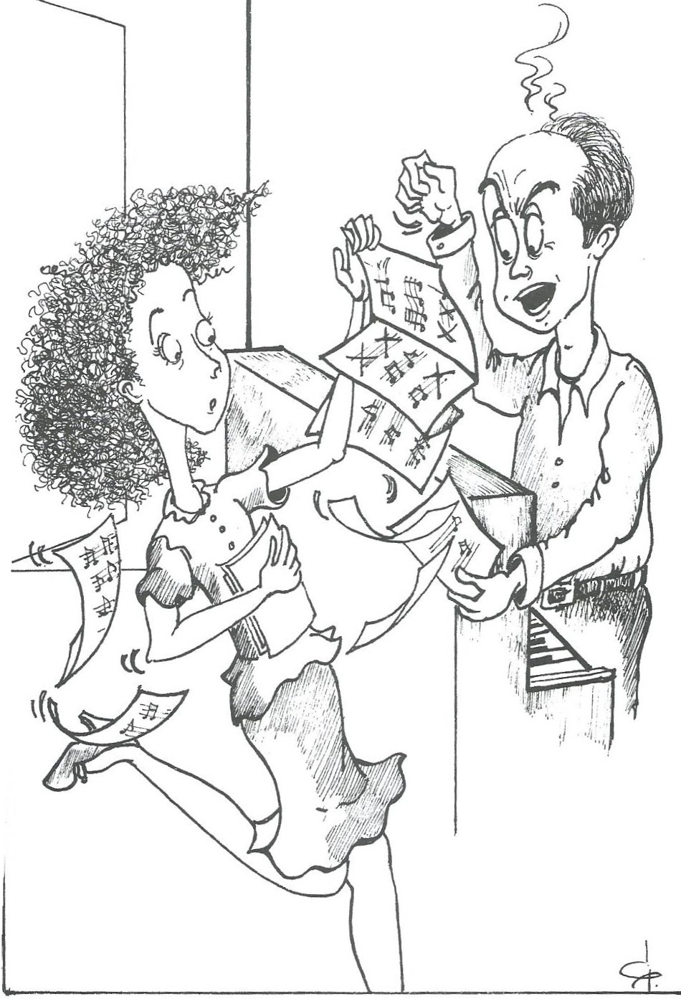
Audition Preparation
Know your subject and the reason for your choice of study.
Monologue – know the play and situation and be prepared to take direction.
Song or music performance. Work with an accompanist who isn’t your regular accompanist.
Dress suitably for the event
Have a tape of your audition pieces just in case you are sick.
Musicians always prepare your music for the accompanist!

Slide 13
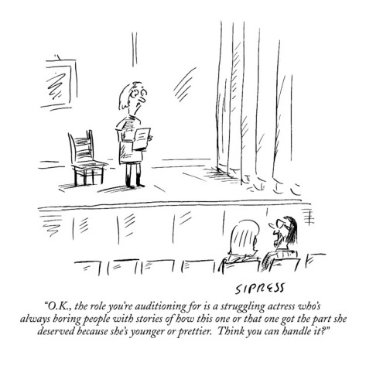
The audition itself
Most important. Know yourself!
Don’t try to impress and be smart.
Be amazing and charming.
The audition starts in the moment
you open your eyes that day.
This is your time to shine.
Have fun and enjoy yourself.
Aim to understand the narrative of
the performance – music, drama or
dance

Slide 14
COMPOSE YOUR FUTURE 2016
Always have questions to ask
How do you support students to find work?
What is the alumni network like?
What is the strongest element of the course?
How many performing opportunities are there?
Are there opportunities for students projects?

Slide 15
COMPOSE YOUR FUTURE 2016
Be careful what you ask for...........Depending on your needs and final ambition you might like to also consider what is going to be important in your professional and academic studies.
Core curriculum content – relevant modules – balanced curriculum
Structure and style of teaching delivery within the academic year
Hours contact time – ability to ‘earn and learn’
Work placement experience
Practice / written / final dissertations / performance projects

Slide 16
COMPOSE YOUR FUTURE 2016
After the audition
Do not write endless letters to the audition panel about
points you should have raised in audition/interview.
Make sure you have as much information about the course
so that you can make an informed decision at a later point
in the audition process.

Slide 17
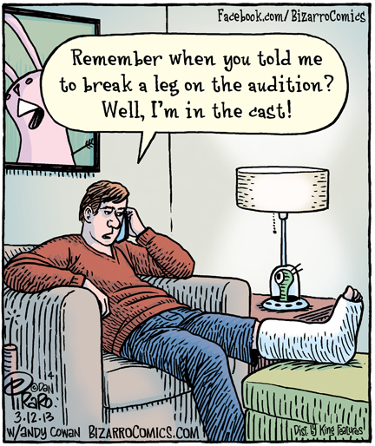
In preparing for other auditions work out why you were, or were not successful.
What did you wear?
What piece did you start with?
Did they ask for anything different in the
redirection? Why?
Did you like the panel?
Did the panel like you?
What were your first / final impressions
What did you love / hate about the
audition

Slide 18
COMPOSE YOUR FUTURE 2016
For Performing Arts students. A word of advice DON’T…
write your own monologue for an audition.
use a monologue that is not from a published play – on no account use internet sites or a monologue from a film.
sing Sondheim songs at an audition or try out new repertoire at an audition.
audition with props.
try to show a wide range of emotions (e.g can cry at will) simply for the sake of showing the panel.
Do not play or sing a musical number where there is a tricky bit you can’t perform well. This will always be the moment the panel is waiting for.
think that not being offered a place is a judgement of your self-worth.
carry the audition around with you emotionally or mentally; just let it go.

Slide 19
COMPOSE YOUR FUTURE 2016
For Performing Arts students. Most importantly DON’T…
think that not being offered a place is a judgement of your self-worth.
carry the audition around with you emotionally or mentally; just let it go.
This is difficult but you must find a way.
The audition and interview is a Time for Love!

Slide 20
COMPOSE YOUR FUTURE 2016
TIME
Technical presentation
Inner awareness
Mental preparation and muscle
Expressive freedom

Slide 21
COMPOSE YOUR FUTURE 2016
LOVE
Likeability
Originality
Versatility
Evenness

Slide 22
COMPOSE YOUR FUTURE 2016
Further Question about Auditions and Interviews
GOOD LUCK
for the future!

