Slide 1
Social Media – an information literacy approach
Davina Omar
Information Specialist
Library and Learning Services
Kingston University

Slide 2
What we aimed to do
Multiple voices
Interactive
Regular
Fun and serious
Aimed at all
Notes:
Starting Point was static. A traditional subject page. We were aware that it was very difficult to update the information and we weren’t able to include all the information we needed to. For example, if we had given some advice to a student on a computer science course about a piece of coursework, there was no way to easily provide this same info to other students who would need it. We also had no way of saying when new books were arriving or if we knew a book was in heavy demand, no way of reminding students we had an e-book copy.
We set up a working group in October 2010 with interested people from the subject teams and our e-team. We almost immediately settled on the idea of using blogs to replicate the material we wanted to keep from the current subject pages and to provide the interactive ingredient. We trialled some blogs for a couple of months to see whether we would have enough content for them – we agreed there needed to be a minimum of 2 posts per week per blog. Once we were happy to go ahead, the blogs launched in September 2011.
We originally had 22 blogs but we are now down to 11 as we have refined what we are doing with them.
All the subject team members contribute to their own blog as well as people from customer services and collections.

Slide 3
Notes:
The main blog I am responsible for is the SEC library blog. This covers the full faculty so needs to be relevant to students studying in 8 different schools.
We do categorize each blog post so students can just look at the posts relevant to their subjects.
We also tag all the posts. Originally we didn’t worry about the names of the tags and were very imaginative in the ones that we used. It meant we ended up with over 180 different tags which made the word cloud very difficult to use. We have now decided to be more like librarians and have a controlled vocabulary for the tags so that they are more meaningful to staff and students.
The blog is aimed at everyone in the faculty but also for fellow librarians. They are often used to answer questions that come to the help desks so have become a knowledgebase for library staff.
We try to include series of posts which we all contribute to. For example recently, we have had:
Summer visiting (looking at professional libraries to visit)
Going beyond google
Hidden gem (highlighting different shelfmarks in the library)
Tips for returning students
Smart Tuesday (educational apps)
We also have ‘something for the weekend’ where we highlight videos/events/programmes that students might want to watch which are related to their topics but have a fun element.

Slide 4
Notes:
One of our regular features to pull up items for students social life

Slide 5
Notes:
We try to have series that run at none busy time to keep content and interest in the blog so over the summer we did a series on professional libraries.
One of the original concerns had been the summer period and having enough content but that fear for us was ungrounded.

Slide 6
Notes:
Different features are run by different members of the team depending on their interests and knowledge.
We do though have one key member of staff (Maren Schroeder) who keeps a watching eye over the blog and develops a lot of our features

Slide 7
Notes:
We are often talking about digital material in the blog but we do make a special effort to highlight the print stock in different posts

Slide 8
Notes:
The blog is incredible useful for highlighting general changes to library services and buildings. There are often written by people outside the subject team which is great.
We all have our individual writing styles which I think is crucial for the blog as it makes the content more dynamic and simply more interesting to read.

Slide 9
CILIP (2014) Information Literacy – definition. Available at: http://www.cilip.org.uk/cilip/advocacy-campaigns-awards/advocacy-campaigns/information-literacy/information-literacy (Accessed: 10/11/14)
Notes:
We intended for the blogs to be a tool for providing teaching material to students but we have now formalised this and make sure that we cover all aspects of information literacy as set out by CILIP.
Most of this content has been included in the blog for years but we are now making a special effort to include more on less core topics like ethics and responsibility of use.
Our original aim was to have a minimum of 2 posts a week but we have more than exceeded this. We have had to implement a weekly update which brings together all of the posts from that week

Slide 10
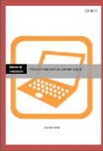
Notes:
There is still static content within the blog which is similar to the material we had in our original pages. These are guides for different levels of the subjects, information on dissertations, referencing etc.
One change we have made with the static content is to update this throughout the year and not think of it as a summer job.

Slide 11
Notes:
We have also recently created a library cloud which is attached to email signatures as well as the blog. This brings all the links to content into one place for the students

Slide 12
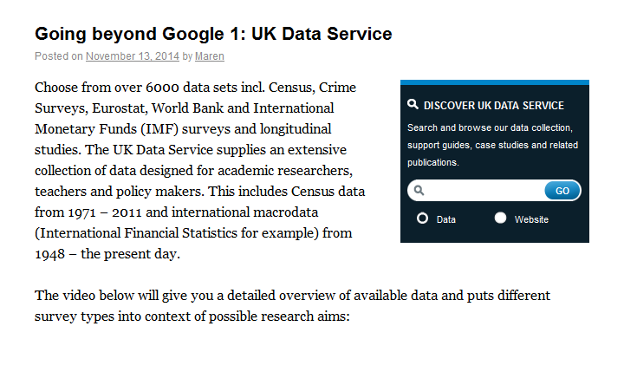
Notes:
Here is what it looks like now.
dIScover is our branding for our drop ins as well as our enquiry desk so we followed through with this name for the blog.
The static content is mainly from the top menu but the majority of the screen is taken up with posts.
The categories and tags can be found on the right-hand side.

Slide 13
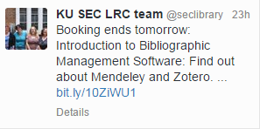
How do we drive traffic?
Twitter
Assignments
Bookings
Search engine compatible
Lots and lots of content
Notes:
All of our posts are automatically tweeted out so we need to be careful of the first 109 characters of the post as this is what will form the tweet (along with a link to get to the next bit of content)
We also have assignments for most of our first year modules and the guidebooks will be uploaded to the blog as well as the information to answer some of the questions.
We book tutorial sessions through the blog.
We originally made the blogs hidden from search engines but we have recently changed this policy. It does have one downside which means we get so much spam that it is no longer possible to see genuine student comments to the posts.
And mostly we add lots and lots of content to entice people in

Slide 14
Notes:
It is really helpful that the blog automatically links with our twitter account but we are increasing the number of tweets that we do separately to the blog ones for topics that are quick/simple and don’t require a full blog post

Slide 15
Notes:
Although the blog has now been running since 2011 in various different guises, we are still trying to develop it and see how we can get more usage.
We monitor page views and traffic to the blog so we know how much usage we are having and since we opened them up to search engines, we can see the types of searches that are bring people to the blog.
We need to do lots and lots more to increase the usage so that is what the rest of the session will be about. How do we as librarians use social media and how do we increase traffic to the things that we do?

