Slide 1
Challenging the Gendered Discourse of Domestic Violence
Dr Ben Hine
Senior Lecturer in Psychology
University of West London
Twitter : @drbahine
Email: Ben.Hine@uwl.ac.uk
W: https://www.uwl.ac.uk/users/ben-hine
http://www.menandboyscoalition.org.uk/
UCL – Gender Equity Network – 15.12.16

Slide 2
Structure
Definition and Statistics for Domestic Violence (DV) in the UK
Stereotypes regarding DV
Effects of Stereotypes on Perceptions
  Victim
  Peers
  Criminal Justice System
  General Public
Future Directions and Recommendations

Slide 3
What does Domestic Violence look like?

Slide 4
Definition
“Any incident or pattern of incidents of controlling, coercive or threatening behaviour, violence or abuse between those aged 16 or over who are or have been intimate partners or family members regardless of gender or sexuality. This can encompass but is not limited to the following types of abuse:
  Psychological
  Physical
  Sexual
  Financial
  Emotional”
Domestic Violence in England and Wales – House of Commons Briefing Paper 2016

Slide 5
Statistics (UK)
ONS CSEW Focus on Violent Crime and Sexual Offences 2014/15
  27.1% of women (4.5m) and 13.2% (2.2m) of men say they have been a victim of domestic abuse since they were 16
  1/4 women and 1/6 men will suffer from domestic abuse in their lifetime
  Year ending March 2015 1.3 million women (8.2%) and 600,000 men (4%) had experienced domestic abuse
  1.1m women and 500k men suffered partner abuse during this time period

Slide 6
Statistics (UK)
ONS CSEW Focus on Violent Crime and Sexual Offences 2014/15
  Of those who reported being a victim of domestic abuse once or more, 37% of men and 29% of women suffered forceful abuse
  This was 61% and 63% respectively for emotional and psychological abuse
  16.8% of separated women and 8.7% of separated men suffered partner abuse

Slide 7
Statistics (UK)
ONS CSEW Focus on Violent Crime and Sexual Offences 2014/15
  Of those abused, men suffered more severe bruising or bleeding (6%) and internal injuries or broken bones (2%) than women (4% and 1% respectively)
  30% of men and 47% of women have emotional or psychological problems related to abuse
  19 men and 81 women died at the hands of their partner

Slide 8
Statistics (UK)
ONS CSEW Focus on Violent Crime and Sexual Offences 2008/09
  6.2% of gay or bi-sexual men said they had suffered partner abuse (compared to 3.3% of heterosexual men)
  12.4% of lesbian women also suffered more partner abuse compared to heterosexual women (4.3%)
NSPCC (2009)
  18% of boys and 25% of girls had been victims of physical violence in a relationship

Slide 9
What does Domestic Violence look like?

Slide 10
Where do stereotypes regarding Domestic Violence come from?

Slide 11



Social Cognition
Heuristics: Rules of Thumb
  Availability
  Representativeness
Schemas: Representations of the world

Slide 12

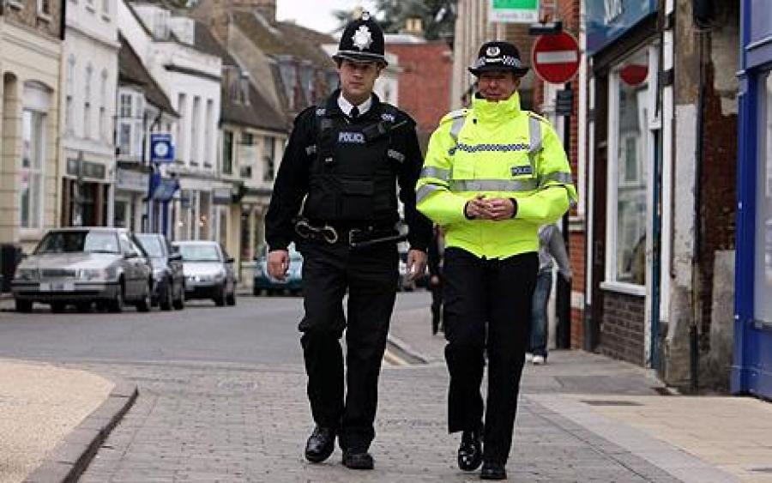

Schemas
Person schemas
  Best friend
Role schemas
  Police officer
Scripts
  Events
Self-schemas
  About yourself

Slide 13
Gender Schemas
Sandra Bem, 1981
  Networks of information regarding gender
  Own-sex and Other-sex schemas
  Information comes from a number of sources
Masculinity (Men) | Femininity (Women)
Aggressive Independent Strong Dominant Stoic & Unemotional Self-confident Sexually Dominant Perpetrators | Non-Aggressive Interdependent Weak Passive Emotional Caring/Nurturing Sexually Submissive Victims

Slide 14

Automatic thinking
Heuristics and schemas are there to cut down on the workload for you brain
Particularly useful to:
  Make sense of a situation based on limited information
  Fills gaps in memory and perception
  Guide us in uncertain situations

Slide 15
What does Domestic Violence look like?

Slide 16
Social Cognition can go wrong…
In certain scenarios, we can make inaccurate assumptions
This happens all the time
Some cases are more detrimental than others
We also evaluate ourselves against our interacting schemas...

Slide 17
What effect do our stereotypes and schemas regarding DV have on perceptions of the crime and those involved?

Slide 18
Victim Perceptions
Dr. Anna Shum-Pearce – Clinical Psychologist –University of Auckland, NZ (2015)
  Interviewed 9 male victims of domestic abuse
    Invisibility
    Not viewed as a serious issue
    Real men don’t seek help
    Risk as being labelled as the abuser
    Pretend to be OK
    Lack of social support
Presentation given at the Male Psychology Conference 2015

Slide 19
Statistics (UK)
ONS CSEW Focus on Violent Crime and Sexual Offences 2014/15
  Male victims (29%) are over twice as likely than women to not tell anyone about the partner abuse they suffer
  Only 10% of male victims will tell the police (26% women)
  Only 23% will tell a person in an official position (43% women)
  Only 11% will tell a health profession (23% women)
  80% of the men who call the ManKind Initiative helpline have never spoken to anyone before about the abuse they are suffering

Slide 20
Peer Perceptions
Dr. Anna Shum-Pearce – Clinical Psychologist –University of Auckland, NZ
  Focus Groups with 19 young adults
    Men as powerful
      In control of the situation
        Allowing it
        Can’t be manipulated
        Could leave easily
      Don’t need our help
    Women as incapable of harm
  Lack of support from social network and services (Tsui et al, 2010; Tsui, 2014)

Slide 21

Media example
https://www.youtube.com/watch?v=C7m5v8pLtog

Slide 22
Experiences within the CJS
Dr. Jessica McCarrick – Teeside University (2016)
  Guilty Until Proven Innocent
  Masculine Identity
  The Pressure Cooker: Negative Psychological Impact
  Light at the End of the Tunnel

Slide 23
Experiences within the CJS
Male victims report poor satisfaction with care from officers (Buzawa & Austin, 1993)
Female perpetrators are more likely to receive lower sentences or have their cases dismissed (Henning & Feder, 2005)
Male victims are more likely to be blamed for their victimization than female victims (Stewart & Maddren, 1997)
Male victims believe that officers won’t be able to help to a greater extent than female ones (Drijber, Reijnders, & Ceelen, 2013)

Slide 24
Experiences within the CJS
Prejudice against men is extreme, and has link to underreporting (George, 2007), and more men being put into the system if counter charges are made
The same actions are judged as actionable when performed by men as opposed to women (Sorenson & Taylor, 2005)
Male victims are sometimes completely ignore by police and other services (George & Yarwood, 2004)
Lack of funding for male services (Pizzey, 2000)

Slide 25
General Perceptions
Research by Harris & Cook (1994) & Seelau, Seelau & Poorman (2003 & 2005)
  Severity
  Resolution
  Action by Police
  Responsibility
  Sentencing

Slide 26
General Perceptions (2)
Letellier (1994), Brown & Groscup (2009), Renzetti & Miley (2014)
  Just as common in these relationships
  Chronically misunderstood
  Chronically under investigated (heterosexism)
  Influenced by Gendered Beliefs
  Perceived as less serious

Slide 27
General Perceptions (3)
Current research project by Hine and colleagues
Data collection scheduled for 2017
Preliminary pilot findings
  Severity
  Responsibility
  Even Humour!
  https://www.youtube.com/watch?v=7M0MW6ON484

Slide 28
How can we change this? And why should we want to?

Slide 29
Recommendations
Government and Political Narrative
  Gender Inclusive instead of Gender Exclusive Narrative
Police, Crown Prosecution Service, Other professional bodies
  Gender Inclusive Training and Policy
  VAWG Strategy
Academia
Media
  https://www.youtube.com/watch?v=yMBL9I5lzMk
  Hollyoaks – Ste and Brendan

Slide 30
Recommendations (2)
Domestic Violence is a crime that is deeply coloured by Gender
But it is not a ’Gendered Crime’

Slide 31
Thank you!
Any questions?
Dr Ben Hine
Senior Lecturer in Psychology
University of West London
Twitter : @drbahine
Email: Ben.Hine@uwl.ac.uk
W: https://www.uwl.ac.uk/users/ben-hine
http://www.menandboyscoalition.org.uk/

Slide 32
References
Bem, S. L. (1981). Gender schema theory: A cognitive account of sex typing. Psychological Review, 88, 354–364
Brown, M. J., & Groscup, J. (2009). Perceptions of same-sex domestic violence among crisis center staff. Journal of Family Violence, 24(2), 87-93.
Buzawa, E. S., & Austin, T. (1993). Determining Police Response to Domestic Violence Victims:" The Role of Victim Preference". The American Behavioral Scientist, 36(5), 610.
Drijber, B. C., Reijnders, U. J., & Ceelen, M. (2013). Male victims of domestic violence. Journal of Family Violence, 28(2), 173-178.
George, M. J. (2007). The" great taboo" and the role of patriarchy in husband and wife abuse. International Journal of Men's Health, 6(1), 7.
George, M. J., & Yarwood, D. J. (2004). Male Domestic Violence Victims Survey 2001: Main findings. www.dewar4research.org
Henning, K., & Feder, L. (2005). Criminal prosecution of domestic violence offenses an investigation of factors predictive of court outcomes. Criminal justice and behavior, 32(6), 612-642.
Harris, R. J., & Cook, C. A. (1994). Attributions about spouse abuse: It matters who the batterers and victims are. Sex Roles, 30(7-8), 553-565.
Letellier, P. (1994). Gay and bisexual male domestic violence victimization: Challenges to feminist theory and responses to violence. Violence and victims, 9(2), 95-106.
McCarrick, J., Davis-McCabe, C., & Hirst-Winthrop, S. (2016). Men’s Experiences of the Criminal Justice System Following Female Perpetrated Intimate Partner Violence. Journal of family violence, 31(2), 203-213.

Slide 33
References
Pizzey, E. (2000). From the personal to the political. In Pizzey, E., Shackleton, L. R., & Urwin, P. (Eds). Women or men – who are the victims? (pp. 23-35). London: Institute for the Study of Civil Society
Poorman, P. B., Seelau, E. P., & Seelau, S. M. (2003). Perceptions of domestic abuse in same-sex relationships and implications for criminal justice and mental health responses. Violence and Victims, 18(6), 659-669.
Renzetti, C. M., & Miley, C. H. (2014). Violence in gay and lesbian domestic partnerships. Routledge.
Seelau, S. M., & Seelau, E. P. (2005). Gender-role stereotypes and perceptions of heterosexual, gay and lesbian domestic violence. Journal of family violence, 20(6), 363-371.
Seelau, E. P., Seelau, S. M., & Poorman, P. B. (2003). Gender and role‐based perceptions of domestic abuse: does sexual orientation matter?. Behavioral Sciences & the Law, 21(2), 199-214.
Sorenson, S. B., & Taylor, C. A. (2005). Female aggression toward male intimate partners: An examination of social norms in a community‐based sample. Psychology of Women Quarterly, 29(1), 78-96.
Stewart, A., & Maddren, K. (1997). Police officers’ judgements of blame in family violence: The impact of gender and alcohol. Sex roles, 37(11-12), 921-933.
Tsui, V. (2014). Male victims of intimate partner abuse: Use and helpfulness of services. Social work, 59(2), 121-130.
Tsui, V., Cheung, M., & Leung, P. (2010). Help‐seeking among male victims of partner abuse: Men's hard times. Journal of Community Psychology, 38(6), 769-780.

