Slide 1
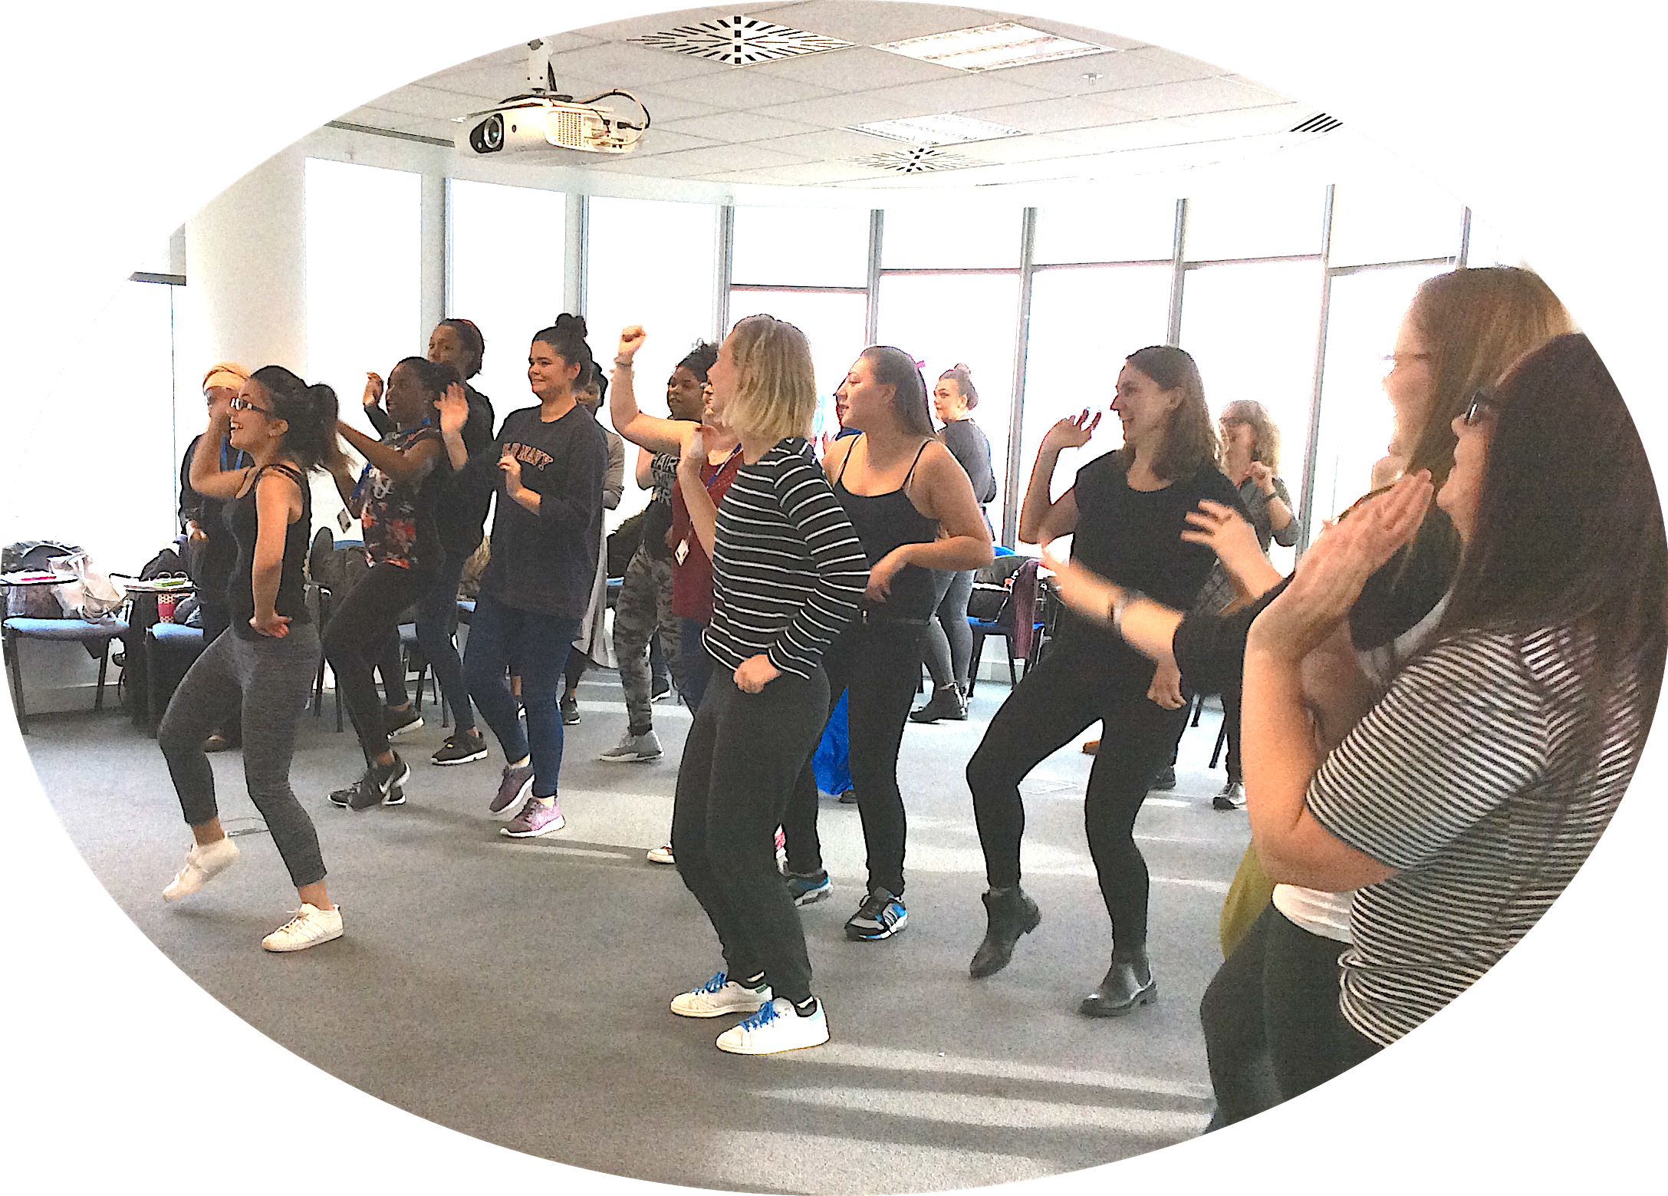
Tackling Obesity- Challenging student midwives to be positive role models for a healthy lifestyle
Lecturers and students from the University of West London take on a healthy lifestyle challenge week aimed at promoting an understanding of the complex issues related to obesity in pregnancy.
Do we have to talk about this?
Responses and insights from the students having undertaken the lifestyle challenge
‘I found that a simple idea of healthy eating and following a moderate exercise regime was actually not as straight forward as I had imagined. When combining a busy lifestyle of university work, placement and part time work, it was very difficult to also fit in exercise and preparation of healthy meals.’
‘The week highlighted the importance of individualising care and avoiding a flippant attitude when approaching health promotion with women and their families.’
Aims:
To improve evidence based knowledge of what constitutes a healthy lifestyle for pregnant women with reference to complications of pregnancy such as diabetes, hypertension, cardiac disease and obesity.
To explore the practicalities of adopting positive health changes
To develop empathy for pregnant women aiming to improve their health.
Address uncomfortable issues in relatively safe environment
For students to reflect on how this experience can be translated into effective care for women
As a result of this challenge, I will never again use simplistic statements in practice about healthy eating (e.g. 'you should eat a balanced diet') without offering an explanation of what this means.'
‘It has opened my eyes to the reality of the challenges that pregnant women face. It has helped me appreciate the extra care and support that women might need
Why we are doing the challenge
We need to look at ourselves first before we can tackle this sensitive issue with women
Midwives find it hard to talk about the problems and are unwilling to risk their relationship with women by raising this sensitive issue
Midwives feel they lack time, confidence, experience and ability (want better training) in this area
Midwives may hold a belief that messages do not ultimately change behaviour
We need to challenge the ‘silence’ on this subject
Why we thought this would benefit our students
Our students represent a spectrum of society- ( mostly women aged 19- mid 30’s) and hence face the similar challenges pregnant women face in our obesogenic environment
Some have poor knowledge- fad diets, and potential to give superficial responses to women
Some exhibited poor diets themselves ( coke, crisps, fast food- not helped by options available at University canteen, living away from home for first time, cultural norms of student life
Some see exercise was something you only do in an expensive gym
Some are busy mums themselves who don’t have time to look after themselves
Limited income
What midwives should be doing?
Calculate BMI at booking and explain how this information will be used to plan care
Discuss eating habits and physical activity
Dispel myths about what and how much to eat when pregnant
Explain obesity related risks to the health of mothers and unborn baby and give women the opportunity to discuss this information
Encourage women to lose weight after pregnancy
NICE (2010), CMACE/RCOG (2010)
The lifestyle challenge week
Aim to improve the nutritional quality of what they eat and to increase the amount of daily exercise they do ( in line with guidance suitable pregnant women)
Designated week on the timetable when they are attending university 3 days that week- support, discussion and sharing ideas
Organised power walk, exercise class, group sport activity within teaching day
What’s in your lunchbox? Choices at canteen
Staff provide fruit snacks for classroom breaks
Lectures and discussion groups on obesity, diabetes, culture of eating, clinical guidelines, research
Students write up a reflection on what the process teaches them in relation to their practice as a midwife
References:s
Bothamley J, Kelly C, Wright T et al. (2014) Tackling Obesity – Challenging student midwives to be positive role models for a healthy lifestyle, MIDIRS Midwifery Digest, 24 (1), pp 52-54
Heslehurst N, Moore H, Rankin J, Ellis LJ, Wilkinson JR, Summerbell CD. (2011) How can maternity services be developed to effectively address maternal obesity? A qualitative study. Midwifery e 170– e177
Furness PJ, Arden MA, Duxbury AMS, Hampshaw SM, Wardle C, Soltani H (2015) Talking about weight in pregnancy: An exploration of practitioners’ and women’s perceptions Journal of Nursing Education and Practice 5(2) pp 89- 10
Oteng-Ntim E, Varma R, Croker H, Poston L, Doyle P. (2012) Lifestyle interventions for overweight and obese pregnant women to improve pregnancy outcome: systematic review and meta-analysis. BMC Medicine10;10:47.
NICE (2010) Weight management before, during and after pregnancy, Available at: https://www.nice.org.uk/guidance/ph27 (Accessed 21/11/16)
RCOG (2010) Management of Women with Obesity in Pregnancy, Available at: https://www.rcog.org.uk/en/guidelines-research-services/guidelines/management-of-women-with-obesity-in-pregnancy/ (Accessed 21/11/16
Presented by Judy Bothamley, Senior Lecturer, University of West London &
Clare Gordon, Programme Leader, Midwifery Lecturer, University of West London
Contact: judy.bothamley@uwl.ac.uk clare.gordon@uwl.ac.uk.

