Slide 1

Tackling Obesity- Challenging midwives to be positive role models for a healthy lifestyle
Judy Bothamley
Clare Beaumont
University of West London

Slide 2
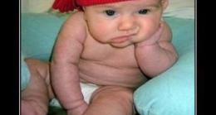
Do we have to talk about this?
Notes:
Certainly not a comfortable subject but the obesity crises is not going to go away. We are going to present the concept that if midwives are going to make any impact on this out of control health crises we need to start by looking at ourselves..
We don’t have all the answers or that we ourselves are paragons of a virtuous lifestyle.
This is about everyone making small achievable changes to improve the nutritional content of their food, cut down on excessive sugar and fats, eat more fruit and veg and move more.
We are suggesting that if Midwives look at improving their own health it will not only help themselves, but will improve the effectiveness of the advice and support they give to women. It is a challenging and controversial suggestion.

Slide 3
Overview
A problem- we can’t ignore the facts
It is difficult to adopt a healthy lifestyle
A need to empower but not pathologise
Midwives on the whole are hesitant to engage with this
Lets start with ourselves
The experience of a lifestyle challenge for student midwives at UWL
Strategies to move forward
Notes:
Clare is going to recap on the key problems of obesity and remind us of why this is an issue we need to engage with. We can’t ignore the facts
Midwives need to develop effective strategies to provide sensitive and effective care for women with obesity with an emphasis on empowerment not pathology.
During AN and PN care midwives have opportunities to provide positive support for the encouragement of a healthy lifestyle which will include all women ( prevention) and women with weight concerns ( action)- so called teachable moments.
It is a tough objective- midwives are hesitant to engage directly with women around issues concerning their weight.
We will present the lifestyle challenge we have introduced for student midwives at UWL

Slide 4
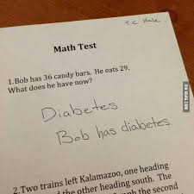
A growing problem!
Prevalence of obesity in the UK has more than doubled in the last 25 years
40% of Britons with be obese by 2025
By 2050 Britain could be a mainly obese society
Estimated cost to the NHS could be £10 billon per annum by 2050
The Foresight report, 2007
Notes:
The foresight report commissioned by the government to look at the population as a whole and how we can deliver a sustainable response to obesity over the next 40 years. The statistics speak for themselves.

Slide 5
Trend in obesity prevalence among adults
Health Survey for England 1993-2012(3 yr average)
Aged 16+ BMI≥30kg/m² Public Health England, 2015
Notes:
Obesity prevalence continues to rise, but the rate of increase appears to be slowing for both sexes.
Obesity prevalence remains higher for women, but the gap between men and women appears to have narrowed over time.
If you are obese you are less likely to be in employment
Increased risk of hospitalisation
Obesity reduced life expectancy by an average of 3 years, severe obesity by 8-10 years

Slide 6
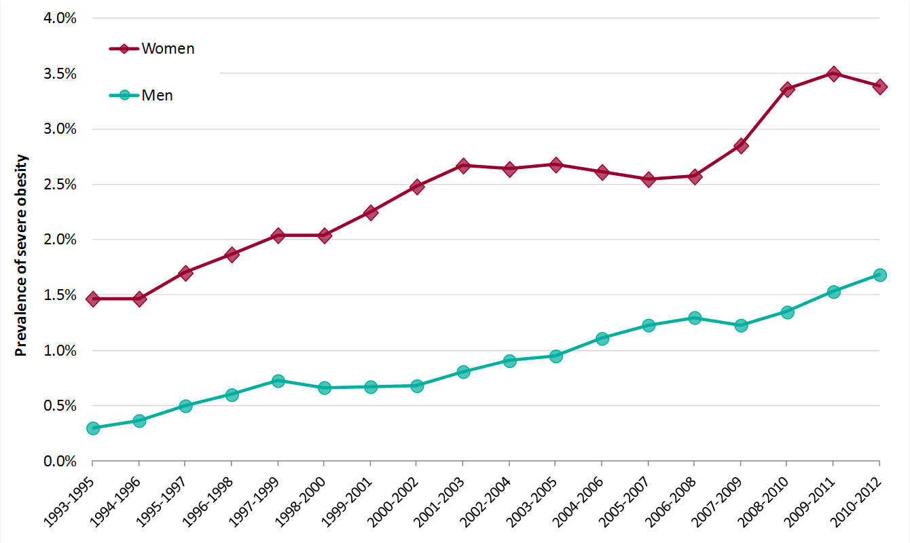
Trend in severe obesity among adults
Health Survey for England 1993-2012 (3yr average)
Aged 16+ BMI≥40kg/m² Public Health England, 2015
Notes:
This chart shows a trend of increasing prevalence of both men and women with a BMI ≥40kg/m².
Severe obesity prevalence is much higher for women.
http://www.noo.org.uk/NOO_about_obesity/Morbid_obesity

Slide 7
Annual cost of obesity
£27 billion to the wider economy
Obesity medication £13.3 million
Cost to the NHS £5.1 billion
£352 million to social care
£16 million related to obesity attributed days sickness
Healthcare costs are likely to continue to rise
Public Health England, 2015
Notes:
Heavy duty stair lifts, purchase and installation costs
Bariatric equipment
Weight management services
Obesity increasing the risks of many long term conditions, greater life expectancy, increasing prevalence of obesity, more people than ever living in ill health.

Slide 8
Factors influencing obesity
Obesity
Age
Education
Deprivation
Income
Ethnic group
Social class
Sex
Notes:
We know that as adults we underestimate our weight, half of parents do not recognised their children are overweight or obese
Over a quarter of women are considered to be physically inactive. (Health Survey for England, 2012) (That is to say not achieving a minimum of 30 minutes of activity per week) 64% of journeys are made by car and only 22% on foot,

Slide 9
Aetiology of obesity
Obesity
Physiological
Individual physical activity
Physical activity environment
Individual psychology
Social psychology
Food production
Food consumption
Notes:
Portion control, gyms, advertising
Obesogenic environment
Food supply affects what we choose or can buy to eat
Very complex set of factors across many areas of our lives
The foresight report challenged the notion that obesity is not simply down to personal willpower – eating too much and doing too little but considered a far wider picture of how we have moved away from a time of relative food scarcity and hard physical work in the forties and fifties to an era where energy dense food is abundant and labour saving technologies continue to develop in the blink of an eye.
We don’t have less willpower or are more gluttonous nor is our biology significantly different from our forefathers however society has changed radically with changes to working patterns, transportation, food production and food sales. For an increasing number of people weight gain is perhaps inevitable consequence of modern lifestyles.
There is no one single influence that determines obesity, it is multifaceted and complex.
Being overweight is becoming the norm. There is a life course component and it is widely recognised that that growth patterns in the first few weeks and months of life affect the risk of obesity in later life

Slide 10

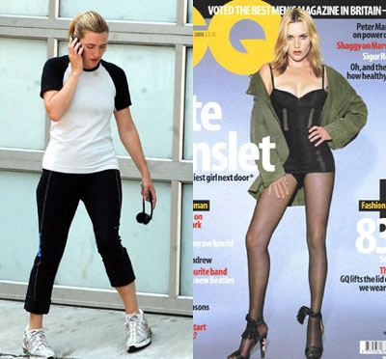

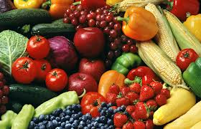
Social marketing and the media
Notes:
BOGOFF deals in the supermarkets, airbrushed images, wealth of sweets and high fat foods readily available.
Mass marketing, flyers in the post or on emails, pop ups on computer screens, high volume of fast food outlets on the high street, ready meals often associated with high fat and high sugar content but are deemed more convenient for our busy lifestyles.
BOGOFF deals or £1 deals in many of the major supermarket chains. More often are the high fat, high sugar foods rather than the health alternatives.
Images of celebrities in the media portraying something that many of us consider to be unachievable.
The public health agenda is to help people live longer by reducing preventable deaths and the burden of ill health associated with obesity amongst other things. As nurse and midwives under the auspices of the 6 C’s need to make sure that we utilise every opportunity to make every contact count, by signposting individuals to people or agencies who can help, to listen and offering support, to provide advice and up to date information and make appropriate referrals. Using teachable moments
Change4Life, Slimming World on referral in some areas, other local initiatives to increase activity, walking groups, gyms and access to healthier foods in the workplace.

Slide 11
Relative risk in the general population
Obesity
Diabetes
Hypertension
Coronary heart disease
Cancers
Polycystic ovaries
Impaired fertility
Increased anaesthetic risk
Dyslipidaemia
Sleep apnoea
Obstetric complications
Notes:
In short, obesity predisposes patients to a variety of diseases and, accordingly, should be considered by the medical profession as a serious, potentially life-threatening condition rather than an affliction brought on by lack of self-control.
The marked rise in childhood obesity is predicted to continue which will mean the proportion of chronic disease such a type 2 diabetes, stroke and chronic heart disease attributable to obesity will continue to increase substantially.

Slide 12
Impact of weight loss
Clinical evidence shows that even a modest weight loss of 5-10%, if sustained can have significant health and quality of life benefits.
  5% weight loss
    Significant reduction in diabetes and cardiovascular risk
  10% weight loss
    20% reduction in the risk of developing stroke or coronary heart disease
    Reduction in medical costs
Oster, G et al, 1999
Notes:
Best evidence I can find at the moment.

Slide 13
Impact of weight loss
 | Benefits
Mortality | 20-25% fall in overall mortality 30-40% fall in diabetes related deaths 40-50% fall in obesity related cancer deaths
Diabetes | Up to 50% fall in fasting blood glucose Reduces the risk of developing diabetes by over 50%
Lipids | Fall of 10% total cholesterol, 30% triglycerides Increase of 8% HDL
Blood pressure | 10mmHg fall in diastolic and systolic pressures

Slide 14
Obese and pregnant - Why should it worry us?
1 in 5 pregnant women are obese
Increasing rate of obesity in all age groups especially in children and adolescents
Increasing numbers of obese women of childbearing age (Irvine & Shaw, 2006)
Associated with over half the total of maternal deaths in the UK (RCM, 2010)
Confidential Enquiries into Maternal and Child Health (Lewis & Drife, 2004, Lewis, 2007, Lewis 2011)
Notes:
2000-2002 CEMACH report 30% maternal deaths were in obese women
2003-2005 CEMACH report obesity was still a key factor and prevalent in women who died

Slide 15
Associated with an array of complications
Cardiac disease
Pre-eclampsia
Gestational diabetes
Thromboembolism
Higher operative births
Post-caesarean wound infection
Postpartum haemorrhage
Low breastfeeding rates
Stillbirth – twice as likely
Macrosomia – twice as likely
Postdate and pre-term birth
Difficulty with ultrasound scanning
Accuracy of monitoring fetal growth
Difficulty with adequate pain relief
Less likely to have a live birth following IVF
Psychological impact
Increased caesarean and operative deliveries
Increased hospital stay
Increased requirement of specialist equipment
Notes:
2 fold increase in stillbirth for obese women
Rowlands I, Graves, N, de Jersey, S, McIntyre, D, Callaway, L 2010, Obesity in Pregnancy: outcomes and economics, Seminars in fetal and neonatal medicine, 15 (2), p 94-99
Macromsomia – 2- fold – associated to maternal obesity >4kg nearly 3 fold >4.5kg
Gaudet, L., Ferraro, Z. M., Wen, S. W., & Walker, M. (2014). Maternal Obesity and Occurrence of
Fetal Macrosomia: A Systematic Review and Meta-Analysis. BioMed Research International, 2014, 640291. doi:10.1155/2014/640291
Major PPH 4 fold increased in obese women
Silva, J.C., Amaral, A.R., Ferreira, B.D., Petry, J.F., Silva, M.R., & Krelling, P.C. 2014, Obesity during pregnancy: gestational complications and birth outcomes, Revista Brasileira de Ginecologia e Obstetricia, 36(11)
Pre-eclampsia 3 - 5 fold chance of developing it in obese women
6.5 fold increase in obese women developing GDM
1.5 times more likely to require IOL and CS than women of normal BMI
Vinturache, A., Moledina, N, McDonald, S., Slater, D., Tough, S., 2014. Pre-pregnancy body mass index and delivery outcomes in a Canadian population, BMC Pregnancy and Childbirth, 14, 422
Athikoraia, C., Rumbold, A.R., Willson, K.J, Crowther, C.A. 2010, The risk of adverse pregnancy outcomes in women who are overweight or obese, BMC Pregnancy and Childbirth, 10:56
Increased psychological vulnerability of obese women
Bogaerts, A,. 2014 Obesity and pregnancy, an epidemiological and intervention study from a psychosocial perspecttive, Facts, views and vision: Issues in Obstetrics, Gynaecology and Reproductive Health, 6(2), p 81-95

Slide 16
What should we be doing?
NICE (2010), CMACE/RCOG (2010)
Calculate BMI at booking and explain how this information will be used to plan care
Discuss eating habits and physical activity
Dispel myths about what and how much to eat when pregnant
Explain obesity related risks to the health of mothers and unborn baby and give women the opportunity to discuss this information
Encourage women to lose weight after pregnancy
Notes:
2 sets of working guidelines that have set out a need for midwives to discuss issues of weight management with women. Measuring weight and height at first contact and calculating BMI is seen as the first step in starting a conversation with women.
Think this should be Clare slide

Slide 17
Antenatal period – an opportunity for lifestyle change
Regular contact over a period of time
Concerns for baby offers increased motivation to change
Long term benefit. Women more likely to determine key food choices in the family (demands of children and partners impact on this) (Khazaezadeh et al 2011).
(but not for all) Bumps and Beyond study – all women over BMI 35 offered intervention- half declined- Good results for those who engaged (McGiveron et al 2015)
Awaiting results from HELP study
Notes:
For women with weight related problems pregnancy offers a good opportunity for intervention. Increased motivation, regular contact and an opportunity to improve health of wider family. Individual intervention programs like the ‘Monday clinic in Doncaster and the Bumps and Beyond service in Lincolnshire have had positive results. Awaiting results from the HELP study Clare was involved in. No easy solution. Intervention expensive so proven benefit needs to be seen. So far positive for those women who engage- the challenge is how to improve that engagement.
But also consider the aspect of prevention- helping women maintain healthy behaviors in pregnancy- not eating for 2
Think this should be Clare slide – your experience of AN care
CLARE TO TALK UP TO THIS SLIDE

Slide 18
What women with raised BMI say about weight issues in pregnancy
Feelings of humiliation, shame, stigma, low self esteem and discomfort were evident ( Furber and McGowan 2011, Khazaezadeh et al 2011)
Woman felt unease at being considered high risk (Furber and McGowan 2011
Pregnant women who have raised BMI feel enhanced awareness of the close supervision and scrutiny of others
Most woman recognised that weight is an issue for the health of themselves and their baby (Mills et al 2013)
Women felt health professional should address issue of obesity but to do so in supportive and positive way (Mills et al 2013)
Obese women feel risks are not adequately explained (Keely et al 2011)
Women were confused by the term ‘healthy eating’ (Khazaezadeh et al 2011)
Notes:
JUDY FROM HERE FORWARD!
A number of qualitative studies have been conducted to give us insight into the experiences of woman and discussions about weight. Some of those findings are summarised here. As you can imagine discussions about weight provokes a range of emotional reactions. This is a highly sensitive and emotionally charged area of practice. In the studies there was a range of responses from women who were keen to get information and help to those who were upset by encounters with health care professionals regarding their weight. A need for clear and consistent messages was evident

Slide 19
What midwives say about discussing weight issues with women
Midwives are unwilling to risk their relationship with women by raising this sensitive issue
Lack of confidence
Lack of time
Lack of experience and ability (want better training)
Hold a belief that messages do not ultimately change behavior
A ‘creeping normality’ (Schmied et al 2010)
Heselhurst et al 2007, Oteng- Ntim et al 2010, Schmied et al 2010, Furness et al 2015
Notes:
The overwhelming theme from studies and anecdotal experience is that midwives are keen not to offend or upset women by raising such a sensitive subject. Constraints such as lack of time, knowledge and confidence are evident.
One of the findings form Schmied’s work I felt was interesting- This concept of obesity being “a creeping normality’. Obesity is gaining acceptance as becoming ‘normal’. Whilst it is positive that we don’t collude with negative stigmatization of women we need to be reminded of a responsibility to promote health and well being for mother and baby.

Slide 20
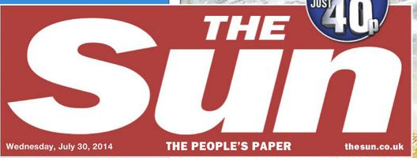
NHS staff are too fat, says Simon Stevens
NHS chief executive Simon Stevens says the health service has to “get its own act together” on obesity by helping staff lose weight
More than half of the NHS’s 1.3 million staff are overweight or obese: “It's hard for the NHS to talk about how important this is if we don't get our own act together.
Notes:
The chief executive of the NHS made this statement late last year urging health professionals to get our act together. You can imagine the newspaper headlines
The Sun’s headline was “weights up doc”
Guardian “Nurses must be fit to fight’
Daily Mail- hospital staff must give up burgers and chips
This is not the first time such a challenge has been issued- back in 2009 the Department of Health similarly called on health service workers to improve their health.
Cathy Warwick at the time defended midwives stating that we should not blame hard working midwives highlighting the universal difficulties of adopting a healthy lifestyle
The new directives from the Chief executive calls for better canteen food and putting gyms in hospitals for staff
I cant see many midwives rushing to use a treadmill at the end of a 12 hour shift.
More midwives, proper breaks and less stressful working conditions are needed.

Slide 21
Why are health professional putting on weight
Why is it so hard ?
Shift work- disrupts routines, affects ability to take part in sport
Long shifts and not getting sensible breaks- getting overtired and over hungry
Food available at work of low nutritional quality
Chocolates and toast
Not looking after ourselves
Notes:
A multitude of reasons- part of the same reason the wider society is but we have some added disadvantages with the demands of shift work, stress, tiredness and the food that is available to us at work.

Slide 22
Weight concerns and body image may impact our ability to support women
‘….personal characteristics including body satisfaction and confidence, and lifestyle factors such as participating in regular physical activity may also play an important role in predicting clinicians compliance with guidelines and their propensity to engage in weight management strategies with their pregnant clients.’
Wilkinson et al 2013, Herring et al 2010
Notes:
Struggling with our own weight concerns and body image may impact on our ability to support women. This is a quote from 2 teams of researchers studying this issue. They questioned midwives about diet, exercise, their own weight, knowledge of guidelines and engagement with women on issues of weight. Their conclusion here makes a link between the midwives own lifestyle and the motivation to discus weight concerns with women.

Slide 23
Lifestyle challenge for student midwives at UWL
Aims
To improve evidence based knowledge of what constitutes a healthy lifestyle for pregnant women with reference to complications of pregnancy such as diabetes, hypertension, cardiac disease and obesity.
To explore the practicalities of adopting positive health changes
Develop empathy for pregnant women.
Reflect on how this experience can be translated into effective care for women
Bothamley et al 2014
Notes:
So to improve confidence, empathy and effective support of women we need to take the journey ourselves.
As lecturers we didn’t want students to get the impression that they just needed to learn and follow guidelines. We acknowledged the sensitive nature of the subject and felt this approach challenged not only knowledge and skills but challenged attitudes as well
Part of year 2 module that looks at pre- existing complications of pregnancy which among other conditions includes diabetes, hypertension, obesity and cardiac disease. For many of these conditions and others, advice about healthy lifestyle is an important aspect of care.

Slide 24
Why we thought this was needed
Poor knowledge- fad diets, superficial responses to women
Exhibited poor diets themselves ( coke, crisps, fast food- not helped by options available at University canteen.
Exercise was something you only did in an expensive gym
Away from home for first time
Busy mums who didn’t have time to look after themselves
Limited income
Wanted to challenge the ‘silence’ on the subject
Address uncomfortable issues in relatively safe environment
Our students represent a normal spectrum of society- ( mostly women aged 19- mid 30’s)
Notes:
I don’t want to do a mis- service to our lovely hard working student midwives at UWL by suggesting they are a particularly unhealthy lot! But they, like all of us, are exposed to the challenges of urban living and lifestyle that makes it hard to be healthy. Some of the problem is a lack of information and knowledge about what constitutes a healthy diet and an optimum amount of exercise. Many see the answer to unhealthy weight gain is a crash or fad diet _ a simple but drastic ‘fix it quick option. Exercise equates to an expensive gym they can’t afford. Students may be in charge of their food intake for the first time- take aways easier than cooking. Healthy food perceived as more expensive. They have their own sensitive issues about perceptions of weight and self esteem

Slide 25
The lifestyle challenge week
Aim to improve the nutritional quality of what they eat and to increase the amount of daily exercise they do ( in line with guidance suitable pregnant women)
Designated week on the timetable when they are attending university 3 days that week- support, discussion and sharing ideas
Organised power walk, exercise class, group sport activity within teaching day
What’s in your lunchbox? Choices at canteen
Staff provide fruit snacks for classroom breaks
Lectures and discussion groups on obesity, diabetes, culture of eating, clinical guidelines, research
Students write up a reflection on what the process teaches them in relation to their practice as a midwife
Notes:
Students need to research the guidance for pregnant women with regard healthy eating and exercise and aim to adopt those recommendations in their own lifestyle for a week. Cutting out alcohol and smoking is recommended as well. They attend university that week offering opportunities for discussion of issues - what they have been eating / how is it going? Staff take on the challenge as well. We facilitate exercise within the teaching day and have used expertise within the student group. An aerobics exercise teacher, a sport science graduate, yoga teacher. A powerwalk around the park opposite the campus which maps out a pleasant 30 minute route is included. Overall it is good fun- particularly the exercise aspect.

Slide 26
Responses from students
- insight into the difficulty
‘I found that a simple idea of healthy eating and following a moderate exercise regime was actually not as straight forward as I had imagined. When combining a busy lifestyle of university work, placement and part time work, it was very difficult to also fit in exercise and preparation of healthy meals.’

Slide 27
Responses from students- women will need support
‘It has opened my eyes to the reality of the challenges that pregnant women face. It has helped me appreciate the extra care and support that women might need. This has been a useful experience for my future practice as a midwife.’

Slide 28
Responses from students- need for sensitive individual care
‘The week highlighted the importance of individualising care and avoiding a flippant attitude when approaching health promotion with women and their families.’

Slide 29
Responses from students- what does a health diet actually mean
'The biggest benefit for me of completing this challenge was developing an understanding of what exactly constitutes a 'healthy balanced diet'. As a result of this challenge, I will never again use simplistic statements in practice about healthy eating (e.g. 'you should eat a balanced diet') without offering an explanation of what this means.'

Slide 30
Responses from students- only 1 week, a danger of trivializing
‘There is a danger that this challenge might belittle the issues that women with disorders in pregnancy have to struggle with by suggesting that we can know how they feel just by modifying our diets slightly for one week.’
Notes:
Most student engage well in the activities although there is always some resistance. A few are negative reflecting the sensitive nature of the subject.
The students comment here reminds us of the complexity of the problem and the danger of thinking there is a quick fix.

Slide 31
How do we move forward?

Slide 32
What can we do- for ourselves
Start our own journey to improve the quality of what we eat and increase regular exercise
Set realistic goals and incremental changes (avoid fads)
Make the journey enjoyable and involve those around you
Include looking at how to modify the work environment- canteen food, getting breaks, healthy food for social gatherings
Take time to look after ourselves

Slide 33
Get ourselves trained up
  Management of women with obesity in pregnancy. (CMACE/ RCOG 2010)
  Weight management before, during and after pregnancy. (NICE 2010)
  RCM- i- learn- Nutrition and obesity. www.ilearn.rcm.org.uk
  Tommys- Managing obesity in pregnant women: an online guide for health professionals www.tommys.org
  Guidance on exercise in pregnancy – (RCOG2006), Tommys
  Change for Life www.nhs.uk/change4life
  e- Learning for Healthcare – obesity www.e-lfh.org.uk/
  Slimming World/RCM Discussing weight during pregnancy: A guide for Midwives www.slimmingworld.com/rcm/
Notes:
Lots of resources out there we can use to equip ourselves with the knowledge and ideas on how to support women

Slide 34
What can we do- for women
Identify “teachable moments’ (Flocke et al 2013) – a drip, drip, drip approach- everyone's responsibility (Furness et al 2015)
Ask, encourage, empathise, support- listen to her own story
Openness and discussion
Strengthen motivation for change
Continuity promoted rapport (Furness et al 2011)
Get alongside (Mills et al 2013)
‘To successfully be alongside women who are overweight involves an understanding of the concerns and experiences of this group of women. ……At an individual level, this requires working to overcome discomfort of talking about weight with women and developing skills and strategies to do this’
Notes:
Women will be on a continuum of change- sometimes they will be receptive- other times not. Need to take our cues from women and of course continuity and rapport are key, but studies have said that women do want the issue to be discussed.
We need to not be confrontational, forceful, authoritarian or adopt scare tactics but rather ask them what there story is, give tailored individual care and support self sufficiency
I find it interesting to reflect on our attitudes to smoking 20 years ago. The reluctance to discuss smoking in those days has similarities to discussions about weight today. Silence on the subject of weight will collude with this culture of
“creeping normality’ and so a drip drip drip approach may bring about a culture change.

Slide 35
Summary
Complex problem – no simple answers
Changing mindset- Smoking attitudes changed, can we do the same for obesity
Start with ourselves
Get alongside women

Slide 36
References
Bothamley J, Kelly C, Wright T, Hellewell C (2014) Obesity- challenging student midwives to be positive role models for a health lifestyle. MIDIRS 24(1) pp52-54
Centre for Maternal and Child Enquiries and the Royal College of Obstetricians and Gynaecologists (2010). CMACE/RCOG joint guideline: management of women with obesity in pregnancy. London: CMACE/RCOG.
Dodd JM, Turnbull D, McPhee AJ, Deussen AR, Grivell RM, Yellan LN, Crowther CA, Wittert G, Owens JA, Robinson JS for the LIMIT Randomised Trial Group (2014) Antenatal lifestyle advice for women who are overweight or obese: LIMIT randomised trial British Medical Journal 348:g1285
Athikoraia, C., Rumbold, A.R., Willson, K.J, Crowther, C.A. 2010, The risk of adverse pregnancy outcomes in women who are overweight or obese, BMC Pregnancy and Childbirth, 10:56
Bogaerts, A,. 2014 Obesity and pregnancy, an epidemiological and intervention study from a psychosocial perspecttive, Facts, views and vision: Issues in Obstetrics, Gynaecology and Reproductive Health, 6(2), p 81-95

Slide 37
References
G Oster, D Thompson, J Edelsberg, A P Bird, and G A Colditz, 1999. Health and Economic benefits of weight loss among obese persons, American Journal of Public Health 89(10), p 1536-1542
Rowlands I, Graves, N, de Jersey, S, McIntyre, D, Callaway, L 2010, Obesity in Pregnancy: outcomes and economics, Seminars in fetal and neonatal medicine, 15 (2), p 94-99
Gaudet, L., Ferraro, Z. M., Wen, S. W., & Walker, M. (2014). Maternal Obesity and Occurrence of
Fetal Macrosomia: A Systematic Review and Meta-Analysis. BioMed Research International, 2014, 640291. doi:10.1155/2014/640291
Silva, J.C., Amaral, A.R., Ferreira, B.D., Petry, J.F., Silva, M.R., & Krelling, P.C. 2014, Obesity during pregnancy: gestational complications and birth outcomes, Revista Brasileira de Ginecologia e Obstetricia, 36(11)
Vinturache, A., Moledina, N, McDonald, S., Slater, D., Tough, S., 2014. Pre-pregnancy body mass index and delivery outcomes in a Canadian population, BMC Pregnancy and Childbirth, 14, 422

Slide 38
References
Flocke SA, Clark E, Antognoli E et al (2013) Teachable moments for health behavior change and intermediate patient outcomes International Journal of Obesity 37(1) pp118-28
Furber CM, McGowan L (2011) A qualitative study of the experiences of women who are obese and pregnant in the UK. Midwifery 27 pp 437-444
Furness PJ, McSeveny K, Arden MA,Garlend C , Dearden A Soltani H (2011) Maternal obesity support services: a qualitative study of the perspectives of women and midwives. BMC Pregnancy and Childbirth 11, 69
Furness PJ, Arden MA, Duxbury AMS, Hampshaw SM, Wardle C, Soltani H (2015) Talking about weight in pregnancy: An exploration of practitioners’ and women’s perceptions Journal of Nursing Education and Practice 5(2) pp 89- 102

Slide 39
References
Herring S, Platek D, Elliot P, Riley L, Stuebe A, Oken E (2010) Addressing obesity in pregnancy: what do obstetric providers recommend? Women Health Issues 19(1) pp 65-77
Heslehurst N, Lang R, Wilkinson JR, Summerbell CD. (2007) Obesity in pregnancy: a study of the impact of maternal obesity on NHS maternity services. British Journal of Obstetrics and Gynaecology 114 pp334- 342
Heslehurst N, Moore H, Rankin J, Ellis LJ, Wilkinson JR, Summerbell CD. (2011) How can maternity services be developed to effectively address maternal obesity? A qualitative study. Midwifery e 170– e177
Keely A, Gunning M Denison F (2011) Maternal obesity in pregnancy: women’s understanding of risks. British Journal of Midwifery 19 pp364-369
Khazaezadeh N, Pheasant H, Bewley S, Mohiddin A, Oteng- Ntim E (2011) Using service-users’ views to design a maternal obesity intervention. British Journal of Midwifery 19 pp 49-56

Slide 40
References
McGiveron A, Foster S, Pearce J, Taylor MA, McMullen S, Langley-Evans SC. (2015) Limiting antenatal weight gain improves maternal health outcomes in severely obese pregnant women: findings of a pragmatic evaluation of a midwife-led intervention. Journal of Human Nutrition and Dietetics. 28 Suppl 1:29-37
Mills A, Schmied VA Dahlen HG (2013) ‘Get alongside us’, women’s experiences of being overweight and pregnant in Sydney, Australia Maternal and Child Nutrition 9 pp309-321
National Institute for Health and Care Excellence (NICE) (2010) Weight management before ,during and after pregnancy. NICE public health guidance 27. London: NICE.
Oteng-Ntim E, Varma R, Croker H, Poston L, Doyle P. (2012) Lifestyle interventions for overweight and obese pregnant women to improve pregnancy outcome: systematic review and meta-analysis. BMC Medicine10;10:47.
Royal College of Obstetrics and Gynaecology (2006) Recreational exercise and pregnancy: Information for you [online] available at https://www.rcog.org.uk/globalassets/documents/patients/patient-information-leaflets/pregnancy/recreational-exercise-and-pregnancy.pdf accessed 23/2/15

Slide 41
References
Wilkinson SA, Poad D, Stapleton H (2013) Maternal overweight and obesity: a survey of clinicians’ characteristics and attitudes, and their responses to their pregnant clients. BMC Pregnancy and Childbirth 13:117
Schmied VA, Duff M, Dahlen HG, Mills AE, Kolt GS (2011) ‘Not waving but drowning’: a study of the experiences and concerns of midwives and other health professionals caring for obese childbearing women. Midwifery 27 pp 424-430

