Slide 1
UWL Learning and Teaching Conference June 29th 2017
Lecturer as Employer:
busting the myths
Dr Jane Thomas

Slide 2
Our experience as employers
Lecturers’ experience (student experience)
2. Active learning employment-
related exercises
3. Concluding slide: references
Notes:
Apprentices in public health meeting – employers went into a separate room – the employers were local authority staff.

Slide 3
Public health staff experience
sit on an interview panel
100%
2. line-manage staff
100%
3. lead a team
100%
4. manage budgets
75%

Slide 4
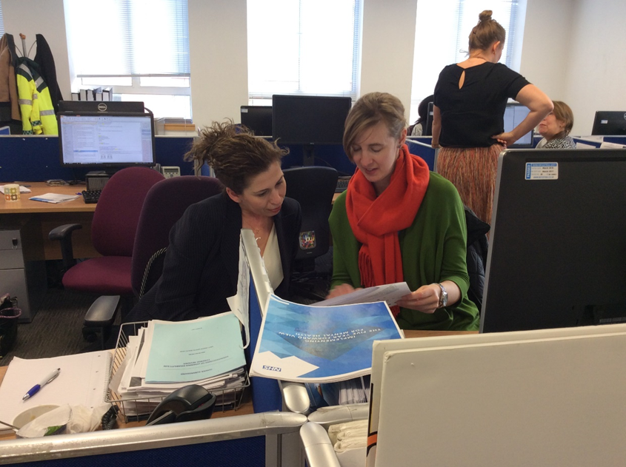
NHS role: on-site training and assessment

Slide 5
MSc students

Slide 6
1. Develop and answer interview questions in groups of three
Group
Group
Answer
Question
Group
Group
Notes:
Employers should not interview with untrained panel members. Conflated questions. Pre and post discussion. Theme of questions.

Slide 7
2. Journalist interviews staff member
1. Groups two, prepare questions and answers
2. Whole Group
Question
Answer
Notes:
Line managing staff -- Providing feedback

Slide 8
3. Student debates
Group ‘for’
Group
‘against’
Evidence
Evidence
Notes:
Team work.

Slide 9
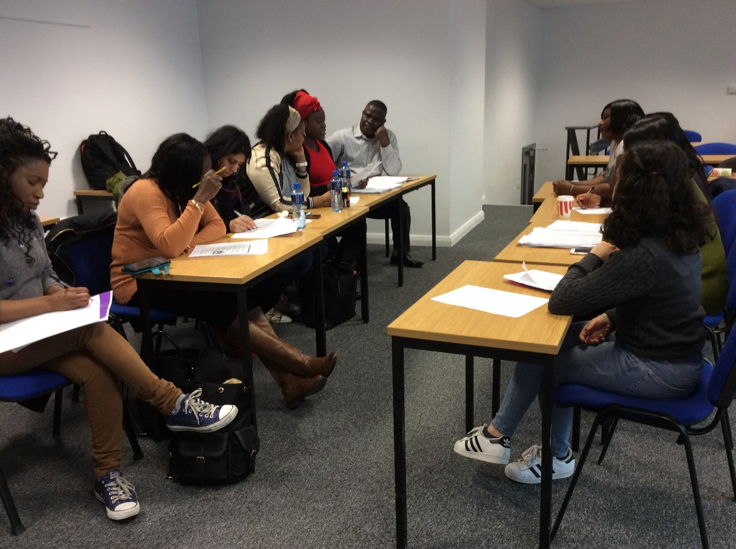
3. Student debates: Heathrow expansion

Slide 10
4. Use organisations’ online financial information
1. Whole group discuss top 5 tips on managing budgets
2. Small group work apply tips to £75,000 refurbishment of A&E waiting room
Notes:
What’s over and underspend; recurring/non-recurring; staff/non-staff; on-costs and capping/efficiency savings; accruals; reporting cycle.

Slide 11
The End
References
Atkins, M. (1999) Oven-ready and self-basting: Taking stock of employability skills, Teaching in Higher Education, Vol 4, Issue 2, p267-274.
Faculty of Public Health (2016) CPD Guidance for Academics, London, FPH.
Foley, P. (1999) Transferable skills teaching: contextual pressures and personal dilemmas, Teaching in Higher Education, Vol 4, Issue 1, p5-21.
Gibbs, G. (2015) Maximising student learning gain. In Fry, H., Ketteridge, S. and Marshall. S. (eds.) (2015) (4th ed.) A Handbook for Teaching and Learning in Higher Education. London: Routledge. pp.193-208.
Ishiyama, J., Miller, W.J., Simon, E. (eds) (2016) Handbook on Teaching and Learning in Political Science and International Relations, Cheltenham: Edward Elgar Publishing Limited.
Public Health England (2016) Public Health Knowledge and Skills Framework User Guide, London, PHE.
Siebert, S. and Walsh, A. (2013) Reflection in work-based learning: self-regulation or self-liberation? Teaching in Higher Education, Vol 18, No 2, 167-178.
Stevens, R. (2015) Role-play and student engagement: reflections from the classroom, Teaching in Higher Education, Vol 20, Issue 5, p481-492.
Usherwood, S. (2017) Active Learning in Political Science (ALSP) http://activelearningps.com/2017/04/11/designing-curricula-when-you-have-a-blank-sheet-of-paper/#more-7005 [downloaded: 29.4.17]

