Slide 1
Using wiki technology to actively involve students in collaborating to create a repository of clinical practice knowledge.
Zeller Pimlott
June 2017

Slide 2
A brief introduction...
A wiki is being used on the BSc Nutritional Therapy course to enable students to build up an online repository of clinical knowledge.
The aim is that this will help them in their preparations for clinical practice in the final year of the course.
This project was started three years ago.

Slide 3
Wikis in HE
In its simplest form, a wiki is a collection of pages of information that can be added to and edited by anyone within the group of users (Karasavvidis, 2010).
In the past ten years wikis have been adopted increasingly as tools for collaborative learning.
Research shows wikis can be used effectively to enhance students' collaborative work in HE contexts (Karasavvidis, 2010; Altanopoulou et al., 2015; Chu et al., 2017).
Typically, students work together to produce a piece of text.
But, wikis can also be used for creating repositories of knowledge that supplement and extend the module material (Cole, 2009).

Slide 4
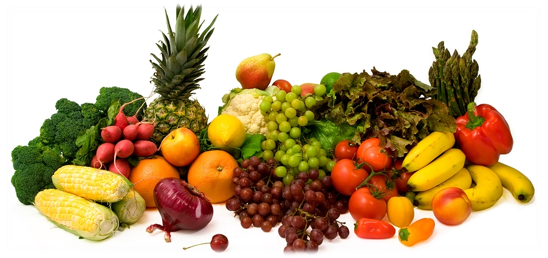
BSc Nutritional Therapy Programme
Distance-Learning Course
Taken over 5 years
Students can opt to do a further year to get a BSc (Honours)
In the final year, students must attend to take the clinical practice assessment
Accredited by the Nutritional Therapy Education Commission

Slide 5
Why is there a need for a knowledge repository?
Nutritional therapists give clients advice about diet, supplements and lifestyle to support their health and wellbeing.
This is normally done within a face-to-face consultation.
After completing the course, students can join a professional association and register, and then start work as nutritional therapists.
A large amount of practical professional knowledge is needed to give effective and safe advice.

Slide 6
Why use a wiki?
The practical professional knowledge that students need for the final year clinical practice assessment (and for future practice) is gained gradually over the course.
The wiki enables the pieces of information collected on different modules to be stored together in a resource that can be accessed easily throughout the course.
The wiki enables students to work collectively by pooling the information that they have each collected.

Slide 7
How is the project implemented?
A new wiki is set up for each new cohort of students – so each cohort has its own wiki.
The Blackboard wiki facility is used.
The wiki is built up through formative assignments across the course.
Students are asked to make a contribution to the wiki on a particular topic.
At present, 6 of the 14 modules have wiki formatives.

Slide 8
Module 3
Practical clinically-focused information related to module 3
Module 7
Practical clinically-focused information related to module 7
Wiki
Module 9
Practical clinically-focused information related to module 9
Module 10
Practical clinically-focused information related to module 10
Module 11
Practical clinically-focused information related to module 11
Module 12
Practical clinically-focused information related to module 12

Slide 9
Examples – students are asked to contribute:-
Information about a chosen nutrient – recommended intake, therapeutic uses, commercial products and dosages.
A low GI snack suitable to recommend to clients for blood sugar balance.
3 high quality websites about stress management therapies, techniques or activities suitable to recommend to clients.
A list of what you will take with you into the final year clinical assessment consultation and how you will prepare yourself.

Slide 10
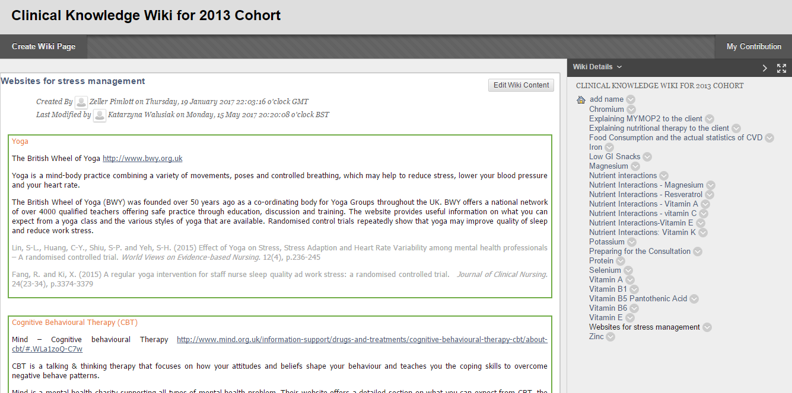

Slide 11
Future work?
The aim is to help students to prepare for their clinical practice assessment in the final year of the course.
The first cohort to have a wiki is now approaching their final year, with the clinical assessment in Spring 2018.
It is planned to collect feedback from the students during AY2017-18 – What has been their experience of contributing to the wiki, and have they found it helpful for the clinical assessment?

Slide 12
References
Altanopoulou, P., Tselios, N., Katsanos, C., Georgoutsou, M. & Panagiotaki, M. (2015) 'Wiki-mediated activities in higher education: evidence-based analysis of learning effectiveness across three studies', Educational Technology & Society, 18(4), pp. 511-522.
Chu, S.K.W., Zhang, Y., Chen, K., Chan, C.K., Lee, C.W.Y., Zou, E. & Lau, W. (2017) 'The effectiveness of wikis for project-based learning in different disciplines in higher education', Internet and Higher Education, 33, pp.49-60.
Cole, M. (2009) 'Using wiki technology to support student engagement: lessons from the trenches', Computers & Education, 52, pp.141-146.
Karasavvidis, I. (2010) 'Wiki uses in higher education: exploring barriers to successful implementation', Interactive Learning Environments, 18(3), pp.219-231.

