Slide 1
‘But she can’t really hurt him though, can she?’: Investigating variations in judgements towards domestic violence scenarios varying by perpetrator and victim gender, and type of abuse
Dr Ben Hine
Senior lecturer, University of West London

Slide 2
What does Domestic Violence look like?
Notes:
Play on answers
I asked my first year psychology students this question and they produced this answer
Strong, intimidating male, aggressively physically assaulting/abusing a weaker, smaller female. This may be the image of domestic violence that some of you hold in your mind, and this is not without cause. But we will come to that. First we need to look and see what the actual pattern of domestic violence looks like in the UK at present, and the definition as used by the government and in legislation.

Slide 3
Background
“Any incident or pattern of incidents of controlling, coercive or threatening behaviour, violence or abuse between those aged 16 or over who are or have been intimate partners or family members regardless of gender or sexuality. This can encompass but is not limited to the following types of abuse:
Psychological
Physical
Sexual
Financial
Emotional”
Domestic Violence in England and Wales – House of Commons Briefing Paper 2016

Slide 4
Background
ONS CSEW Focus on Violent Crime and Sexual Offences 2014/15
  27.1% of women (4.5m) and 13.2% (2.2m) of men say they have been a victim of domestic abuse since they were 16
  1/4 women and 1/6 men will suffer from domestic abuse in their lifetime
  Year ending March 2015 1.3 million women (8.2%) and 600,000 men (4%) had experienced domestic abuse
  1.1m women and 500k men suffered partner abuse during this time period

Slide 5

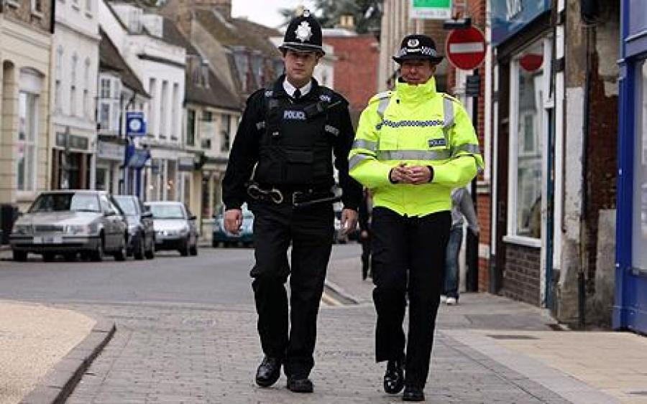

Background
Person schemas
  Best friend
Role schemas
  Police officer
Scripts
  Events
Self-schemas
  About yourself

Slide 6
Background
Sandra Bem, 1981
  Networks of information regarding gender
  Own-sex and Other-sex schemas
  Information comes from a number of sources
Masculinity (Men) | Femininity (Women)
Aggressive Independent Strong Dominant Stoic & Unemotional Self-confident Sexually Dominant Perpetrators | Non-Aggressive Interdependent Weak Passive Emotional Caring/Nurturing Sexually Submissive Victims

Slide 7
Perceptions & Experiences
Dr. Anna Shum-Pearce – Clinical Psychologist –University of Auckland, NZ (2015)
  Interviewed 9 male victims of domestic abuse
    Invisibility
    Not viewed as a serious issue
    Real men don’t seek help
    Risk as being labelled as the abuser
    Pretend to be OK
    Lack of social support

Slide 8
Perceptions & Experiences
Dr. Anna Shum-Pearce – Clinical Psychologist –University of Auckland, NZ
  Focus Groups with 19 young adults
  Men as powerful
        In control of the situation
          Allowing it
          Can’t be manipulated
          Could leave easily
        Don’t need our help
    Women as incapable of harm
  Lack of support from social network and services (Tsui et al, 2010; Tsui, 2014)

Slide 9
Perceptions & Experiences
Dr. Jessica McCarrick – Teeside University (2016)
  Guilty Until Proven Innocent
  Masculine Identity
  The Pressure Cooker: Negative Psychological Impact
  Light at the End of the Tunnel

Slide 10
Perceptions & Experiences
Male victims report poor satisfaction with care from officers (Buzawa & Austin, 1993)
Female perpetrators are more likely to receive lower sentences or have their cases dismissed (Henning & Feder, 2005)
Male victims are more likely to be blamed for their victimization than female victims (Stewart & Maddren, 1997)
Male victims believe that officers won’t be able to help to a greater extent than female ones (Drijber, Reijnders, & Ceelen, 2013)
Prejudice against men is extreme, and has link to underreporting (George, 2007), and more men being put into the system if counter charges are made
The same actions are judged as actionable when performed by men as opposed to women (Sorenson & Taylor, 2005)
Male victims are sometimes completely ignore by police and other services (George & Yarwood, 2004)
Lack of funding for male services (Pizzey, 2000)

Slide 11
Perceptions & Experiences
Research by Harris & Cook (1994) & Seelau, Seelau & Poorman (2003 & 2005)
  Severity
  Resolution
  Action by Police
  Responsibility
  Sentencing
Letellier (1994), Brown & Groscup (2009), Renzetti & Miley (2014)
  Just as common in these relationships
  Chronically misunderstood
  Chronically under investigated (heterosexism)
  Influenced by Gendered Beliefs
  Perceived as less serious

Slide 12
Perceptions & Experiences
Lack of research exploring perceptions based on the type of abuse
Capezza & Arriaga, 2008
  More negative perceptions of abuse involving physical as opposed to psychological aggression
This is surprising considering the serious impact of psychological aggression (Corker et al., 2002; Johnson, 1995) and that emotional abuse is more difficult to cope with (Herbert, Silver, & Ellard, 1991)
Furthermore, studies suggest that tolerance and acceptance of psychological then allows for physical abuse to develop (Capezza & Arriaga, 2008)
Even less is known about financial abuse…

Slide 13
The Present Study
Aimed to examine the influence of abuse type and perpetrator-victim pairing on judgements of domestic abuse
H1: Physical abuse would be judged differently to psychological and financial abuse across all questions
H2: Scenarios involving male perpetrators and female victims (M-F) would be judged differently to those involving female perpetrators and male victims (F-M) and homosexual pairings (M-M and F-F)
Interactions between factors would also be examined

Slide 14
Methods
Design
  Two independent variables – Abuse Type (Physical, Psychological/Emotional, Financial), Scenario (M-M, M-F, F-M, F-F)
  Twenty-three dependent variables - Questions on seriousness, humour, reponsibility etc.
Participants
  242 undergraduates (M = 22.84, min = 18, max = 54, 137 women)
  102 were third-year undergraduates
  53 (21% reported previous history of abuse)
  63% were White, 19% were Black

Slide 15
Methods
Materials
  Vignettes were created depicting an incident of domestic violence
  These varied on perpetrator gender, victim gender, and type of abuse
Please read the following account of a dispute involving a romantically involved couple, Tom, a 26-year old male, and Anna, a 26-year old female. They have been together for approximately two years. They both weigh roughly 11 stone, are both around 5 foot 10 inches tall, and both have full-time jobs.
One night, Anna returns home late after stopping off at a local bar after work and drinking with friends. Tom is suspicious of Anna, and begins yelling at her and accusing her of being unfaithful. Anna says that Tom is being stupid, that she hasn’t been unfaithful, and that she is tired and wants to go to bed. Tom insists that they continue to talk, again accusing Anna of being more interested in her friends than in him. As the argument escalates, Anna decides she has had enough and goes to leave the room. Tom grabs Anna by the shoulder to stop her leaving. Anna pushes Tom off and heads for the bedroom. Tom grabs Anna again, and holds her tightly enough on the arms to leave bruises. When Anna struggles, Tom pushes Anna violently into the door frame of the bedroom. Anna hits her face on the door frame and stumbles into the bedroom. Anna shuts the door, and Tom stays in the main room.
Please now answer the questions below to the best of your ability.

Slide 16
Methods
Questions
Seriousness
Humorous
Overhead – Likely to intervene
How much help should police give
Sorry for victim
Sorry for perpetrator
Responsibility – victim and perpetrator
Reasonability of action – victim and perpetrator
Justified in action – victim and perpetrator
Capable of serious injury
Seriousness of injury
Aggression of victim and perpetrator in daily life
Closeness of couple
Couple stay together
Future domestic problem
Future perpetrator and victim abuse in new relationships
Severity of punishment
Also - appropriateness of intervention

Slide 17
Results
Very few!
Seriousness
  Borderline significance (p = .56) for Scenario
  5.09 (M-F) and 4.94 (F-F) vs. 4.57 (M-M) and 4.48 (F-M)
Overheard
  Abuse Type (p < 0.05)
  4.09 (Physical) vs. 3.63 (Psychological) and 3.41 (Financial)
Police Help
  Abuse Type (p < 0.001)
  3.62 (Physical) vs. 2.73 (Psychological) and 2.91 (Financial)

Slide 18
Results
Capable Harm
  Abuse Type (p < 0.001)
  5.58 (Physical) vs. 4.58 (Psychological) and 4.69 (Financial)
Seriousness of Injury
  Abuse Type (p < 0.001)
  4.37 (Physical) vs. 3.77 (Psychological) and 3.30 (Financial)
Appropriateness of Intervention by police
  p < 0.001
  6.16 (M-F) vs. 6.04 (M-M), 6.03 (F-M), 6.00 (F-F)

Slide 19
Discussion
Whilst some results suggest differences in judgements of scenarios involving different gender perpetrators and victims (seriousness)
Differences were mainly found for type of abuse
Therefore doesn’t support previous work on gender
But does support previous work on type of abuse

Slide 20
Discussion
This could suggest a change in attitudes towards domestic violence occurring towards traditionally ‘overlooked’ victims
Could this be a result of increased public discourse, advocacy work, awareness campaigns?
However, this is largely not supported by colloquial evidence from practitioners etc.
Attitude change is usually not this quick, especially when intertwined with such deeply ingrained gender beliefs

Slide 21
Discussion
Limitations
  Undergraduate population
  Large proportion of third years – many from psychology course with options such as Gender Psychology and Violent Relationships
  20% of sample reported experiencing previous abuse
  Higher numbers of participants may strengthen some results
  Similar pitfalls to other studies of this nature – presents abuse as one-time, with distinct victim and perpetrator

Slide 22
Conclusion
Results from this study suggest that abuse type is more influential than the gender of perpetrator or victim in influencing judgements of DV
This is surprising, and further research is needed to confirm these findings and explore this area further
Important considerations include representative samples, accurate presentation of abuse, and larger sample sizes
Further mixed-methods work is also called for

Slide 23
Thank you! Any Questions?
Ben.Hine@uwl.ac.uk
Acknowledgements
  Undergraduate Students
  Maria Amenabar, Harry King, William Hopkin, Kirsty Williams, Kate Clemmings

