Slide 1
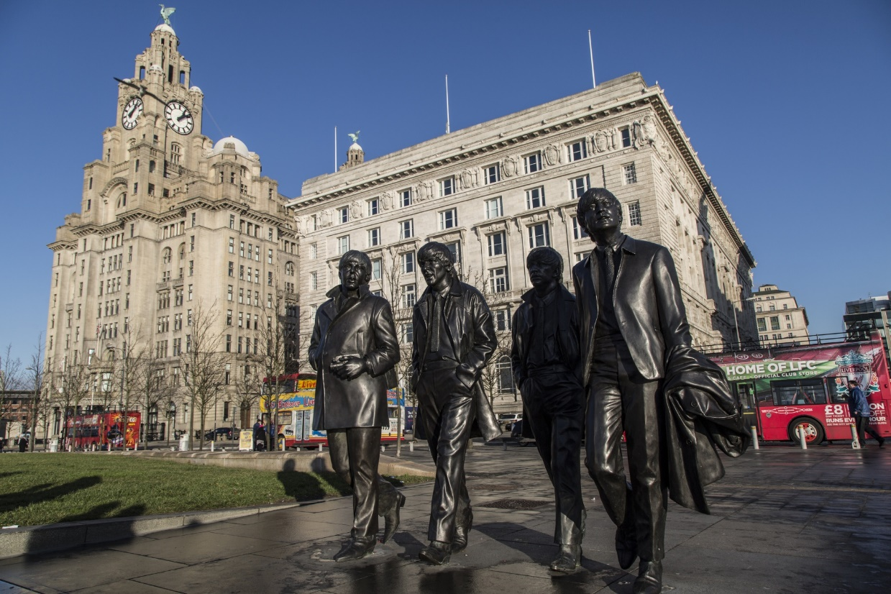
Information literacy in the workplace
Marc Forster University of West London
Stéphane Goldstein InformAll
LILAC 2018
Liverpool
4 April 2018
Photo:www.publicdomainpictures.net, License: CC0 Public Domain)
Notes:
SG: 2, 5,7, 9,10,11,15,16
MF: 3,4, 6, 8, 12,13,14,17

Slide 2
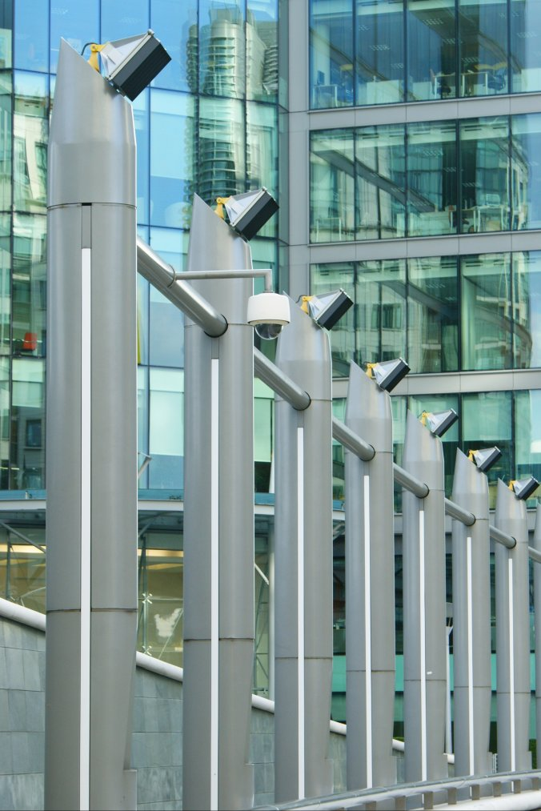
Our talk today
Unique characteristics of Information Literacy in the workplace
The challenges it poses for researchers and information professionals

Slide 3
Not what we (and you) were expecting….
The vicissitudes of Information Literacy research
Ethical approval
Confidentiality
Notes:
One of the things research into IL in the workplace has underlined for us, is that information is both sensitive, both ethically and confidentially and so is closely guarded!
Research studies, especially if conducted with organisations not your own must be handled carefully and flexibly. Fulfilling all reasonable requirements of confidentiality.
Even then….

Slide 4
As we know, IL evolved 'academically’
The locus of information retrieval was the 'library'
The dynamics of IL were thought to involve the use and application of 'academic' literature
Its value and significance based on academic citation
Or to facilitate research in the academic sense – addressing intellectual questions
Notes:
Any discussion of IL still, to some extent, begins in the academic sphere where it originated.
IL research in the workplace is still in part how it is different to academic IL. Though perhaps now beginning to exist on its own terms.
IF not a library…where does information come from
If not about using academic information, what information
How is value measured in information and information use if not be academic citation etc.
How in Information terms is workplace research different to academic research?

Slide 5
There has been a comparatively small but influential body of research into workplace IL
A growing body of scholarly/empirical research on IL in the workplace charted in two literature reviews – Williams, Cooper & Wavell (2014) and Inskip (2014)
That research has shown how unexpected and dislocating workplace IL is when compared with academic environments

Slide 6
Examples of individual studies – the personal experiences of information literate employees
Lloyd (2005; 2009) (Firefighters; ambulance drivers)
Forster (2015) (Nurses)
Sayyad Abdi, Partridge, and Bruce (2016) (web designers)
Inskip and Donaldson (2017) (insurance workers)
Often with the awareness of that dislocation and the intention of improving resources and IL education for professionals and students of the professions
Notes:
What have studies which describe how individuals experience Information Literacy in the workplace shown us? These studies have looked at IL experience, usually through in-depth interviews.
Participants are encouraged to talk about their ‘information lifeworld’ and researchers determine what are the common experiences of the group and how they relate to each other.
A number of things which individuals in different contexts and professions have in common.
Information is shared – Information Literacy is a team pursuit much of the time.
It’s therefore often relationship-based, with immediate colleagues, other professions and also fellow professionals in virtual communities of practice.
Experiences of IL are varied in complexity depending on context, although higher levels workers tend to have higher level experiences.

Slide 7
Examples of individual studies – the workplace culture and environment
Goldstein and Whitworth (2014)
The concrete benefits enterprises derive from recruiting, retaining and developing individuals who are information literate

Slide 8
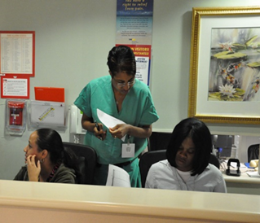
Definitions?
A definition of IL adapted for the workplace, which summarises the relationship to employability:
“A set of abilities for employees to recognize when information is needed and to locate, evaluate, organize and use information effectively, as well as the abilities to create, package and present information effectively to the intended audience. Simply speaking, it is a set of abilities for employees to interact with information when they need to address any business issues or problems at work.” (Cheuk, 2008)
A definition which focuses on IL as professional learning and competency development:
“Information Literacy in the workplace is learning, experienced as task-focused information need and its fulfilment through effective information engagement as knowledge development, ontologically grounded in a discourse community [the professional knowledge environment] and its domain [its information world].” (Forster, 2017)
Notes:
IL definitions are numerous. There as many as there are perspectives on IL
IL in the workplace has several and they tend to be of interest based on the perspective:
Employability; personal learning; being part of a team;
Emphases may be on organising and applying information; learning how to solve a problem or learning how to become and expert.

Slide 9
Workplace information environments are rather different from those in academia
Workplaces are ‘messier’ than scholarly learning environments, characterised by business challenges that are often less linear, less predictable and more open-ended
In the workplace, greater emphasis on people and networks as sources of information and knowledge
IL as acquired at university does not necessarily translate well to business settings – this can be disconcerting for students who need to adapt rapidly to unfamiliar, non-academic information practices

Slide 10
In the workplace, IL can help address organisational goals
Business and customer awareness – keeping proactively informed about:
practices, expectations and goals of businesses
dynamics of the workplace
evolving nature of business environments in which businesses operate
needs of customers and users
Using, handling, interpreting and analysing information to resolve business challenges, with the aim of proving practical, timely solutions to meet organisational goals
Understanding this contributes to employability

Slide 11
Information use is not only task oriented but pervasive and universal
Information is used in many different contexts not only to better complete a work task or project but also:
to learn as an individual
to establish relationships with colleagues, customers and clients
to operate as part of a team, and as part of a leadership and teaching role
to develop management strategy and new philosophical horizons within the profession
Thus information is sought to obtain knowledge in organisational, strategic, project developmental and day to day contexts.

Slide 12
Information is not just textual
It can be verbal, even physical
Studies such as Lloyd (2005) and Forster (2015) suggest that information might be unrecognisable from an academic perspective, even non-documentary or non-verbal
Workplace IL can depend on networking and informal communication, physical demonstration and conversation.
Notes:
Research into IL in the workplace has provided many new and interesting takes on the nature of information itself.
As librarians we are text and document biased, but in the workplace world (and one wants to say, the ‘real’ world outside academia generally) information my be verbal, physical, diagrammatical.
These different formats both give shape to and are given shape by the means of communication and sharing they form part of.
For example, Firefighters, in their physical, closely bonded teams, communicate information via gesture and demonstration.
Nurse’s support each other and patients with an extraordinary range of information from research evidence to physical comfort.

Slide 13
The Information Horizon
Employees use information in differing ways within an organisation, often depending on their role.
Variations of complexity of experience of IL can mirror variation in workplace role and the corresponding complexity of knowledge needed on a day to day basis to fulfil that role.
Senior roles, involving strategic thinking, involve very complex information experiences in comparison to those employees whose horizons are comparatively limited.
Of course, work activity is seldom this distinct. In ‘short term’ activities dealing with immediate information need the individual may operate outside a level of IL complexity associated with their role.
Sometimes senior figures have simpler experiences and more junior one more complex – especially if the latter are involved in group or team work which may have a complex aim.
(Lloyd, 2006; Forster, 2017)
Notes:
Workplace role equals complexity of information experience.
Senior roles, involving strategic thinking, involve very complex information experiences in comparison to those employees whose horizons are comparatively limited.
Each role’s has something which has been given the name ‘Information Horizon’. The way the role uses, thinks about and ‘lives’ information.
It has a number of dimensions to it, such as.
the range and variation in type, detail and origin in its information and information sources;
the complexity and number and interconnectedness of ‘information based relationships’;
the ways in which information is transformed into knowledge - simple factual or transformed beyond recognition into means of deciding strategy.
However workplaces are a mixture of information tasks, not always of the same level. Simple tasks are sometimes required.

Slide 14
The empowerment of clients, patients
The flow of complete and reliable information from professionals to clients/customers/patients helps establish a relationship between the two groups which is empowering and/or reassuring in itself.
This relationship may well result in the client, patient or family member feeling more comfortable in sharing certain types of information than would have been the case in a more formal context.
Notes:
Information is power, and patients, clients, patient families can be empowered with the right information from an information literate professional. Not only the information itself but the nature of the relationship is empowering if the patient/client feels they are receiving the right information but often, also, if they feel they can share information confidentially with a responsive and clearly competent professional

Slide 15
Workplace IL is fundamental to effectiveness…
…in the constantly evolving workplace environment
As the nature of the workplace diversifies away from physical spaces to more virtual ones (Sayyad Abdi, Partridge, and Bruce, 2016) and from fixed procedure to knowledge-accumulating evolutionary development, the information literate worker is likely to be the most valuable and effective.

Slide 16
The changing nature of work environments and practices
How can IL help individuals find their way around fast-evolving situations where work is:
more flexible, but less secure and more casualised
more fragmented and isolating
subject to trends such as greater self-employment (including bogus self-employment) and the gig economy
affected by automation, machine-learning and artificial intelligence
characterised by increasingly pervasive collection of performance and behavioural data from workers

Slide 17
How can IL in the workplace be developed?
IL development in the workplace (and in HE for the workplace)
What future research, and what educational interventions based on that research, can be developed and applied?
Who can contribute to this research and to these interventions, and how?
Information scientists, librarians, businesses (commercial, public, not-for-profit), professional bodies, employability/careers managers, others?
Notes:
Research into IL in the workplace, both to increase awareness of its significance and to develop educational interventions can be performed
by individuals, groups of professionals, especially interdisciplinary, and businesses and other interested organisations.
Research can be in areas of business information flow; team information dynamics and individual information experience

Slide 18
References (1)
Cheuk, B. (2008), ‘Delivering business value through information literacy in the workplace’, Libri, 58(3), pp. 137-143
Forster, M. (ed) (2017) Information Literacy in the workplace. London: Facet.
Forster, M. (2015) Six ways of experiencing information literacy in nursing: the findings of a phenomenographic study. Nurse Education Today, 35 (1). pp. 195-200.
Goldstein, S. and Whitworth, A. (2014) DeVIL - Determining the value of information literacy for employers. Available at: https://www.informall.org.uk/wp-content/uploads/2015/11/DeVIL_report_final_draft_v05.pdf
Inskip C. (2014) Information literacy is for life, not just for a good degree: a literature review. Available at: http://discovery.ucl.ac.uk/1448073/1/IL%20in%20the%20workplace%20literature%20review%20Dr%20C%20Inskip%20June%202014.%20doc.pdf
Inskip, C. and Donaldson, S. (2017) On The Move: Transitioning from Higher Education into Insurance Work. The Fifth European Conference on Information Literacy (ECIL) Saint Malo, France 18-21 September, 2017.

Slide 19
References (2)
Lloyd, A. (2009). Informing practice: information experiences of ambulance officers in training and on-road practice. Journal of Documentation, 65(3), pp.396-419.
Lloyd, A. (2006) Information literacy landscapes: an emerging picture. Journal of Documentation, 62(5), pp.570-583.
Lloyd, A. (2005). Information literacy: Different contexts, different concepts, different truths? Journal of Librarianship and Information Science, 37(2), pp.82-88
Sayyad Abdi, E. and Bruce, C. S. (2016) From Workplace to Profession: new focus for the information literacy discourse. in Information Literacy: moving toward sustain - ability, Communications in Computer and Information Science, 552, pp.59–69.
Williams, D., Cooper, K. and Wavell C. (2014) Information Literacy in the Workplace – an annotated bibliography, Robert Gordon University, Institute for Management, Governance and Society (IMaGeS), in association with InformAll – Available at: http://www.researchinfonet.org/wpcontent/uploads/2014/01/Workplace-IL-annotated-bibliography.pdf

Slide 20
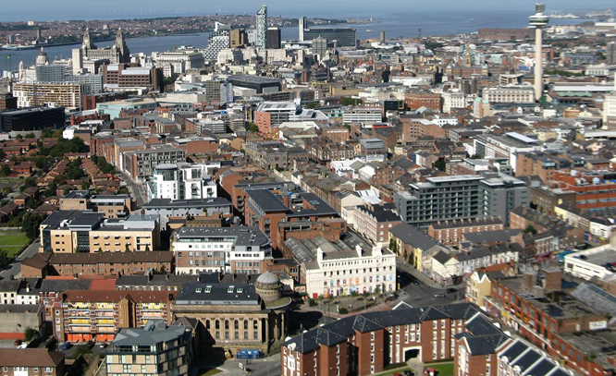
Thank you for your attention!
Stéphane Goldstein
sg@informall.org.uk
https://www.informall.org.uk
@stephgold7
Marc Forster
marc.forster@uwl.c.uk
@MarcForster18
Photo A view of Liverpool city centre viewed from the Anglican Cathedral, on Flickr – CC BY 2.0

