Slide 1

Special Interest Tourism
Spiritual Tourism
A case study of the Holy Grail Project

Slide 2
Aims
To discuss what is meant by spiritual tourism
To examine its significance as a tourist motivator
To introduce GRAIL a project that proposes to develop a new spiritual and cultural tourism route in Europe linked to myths stories and legends associated with the Holy Grail
To discuss what was achieved.
To consider is being planned with the opening of the route.

Slide 3
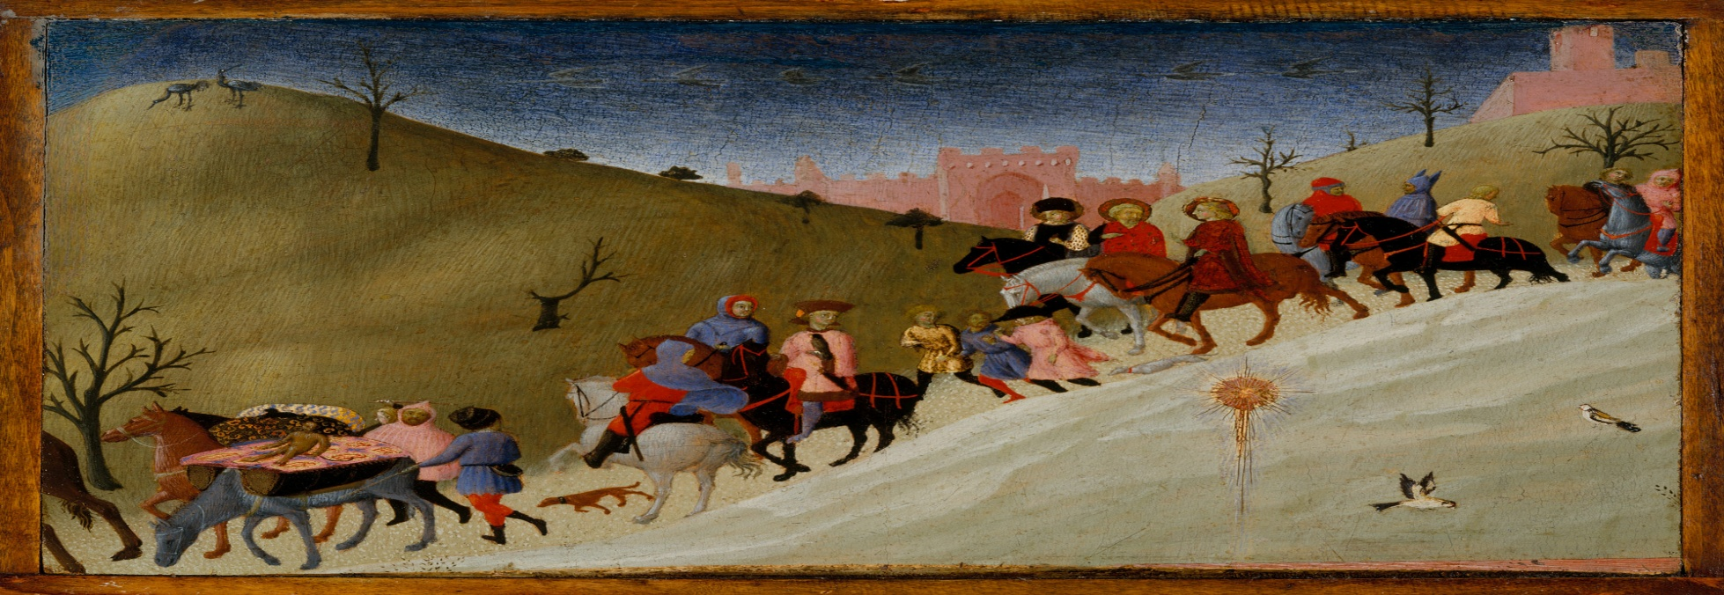
Spiritual Tourism
Tourism involves
The motivator for trips
ST one of the earliest forms of travel / Pilgrimage as a forerunner of tourism

Slide 4
What could this involve?
Visit to a shrine or holy place
Trip to a religious building
Pilgrimage
Missionary travel
Faith-based volunteer tourism
Religious retreat – strengthen beliefs
Attending a service, religious convention or event
The search for religious enlightenment (study visit)

Slide 5
How significant is Spiritual Tourism?
100’s millions visiting various religious sites
Global phenomenon
Some of the largest tourism gatherings are spiritual in nature e.g.
Muslim Haj (2 million p.a.)
Hindu Khumba Mela (50 million)
Christmas in Bethlehem or Easter in Rome (1 million plus)
Economically: Saudi Arabia – 7% GDP / £30bn

Slide 6
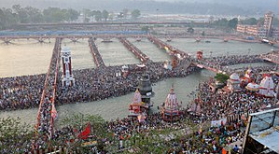

Slide 7
Why the growth in Spiritual Tourism?
Macro
Time, ability, mobility, desire
Micro
Media (travel shows)
Promoted by governments and NTO’s
Revival of the Camino (pilgrimage)
The development of tourist infrastructure – routes, hostels, passports, TO’s & TA’s
The cult of celebrity

Slide 8
Issues in Spiritual Tourism
There are many:
Religion as a commodity
The impacts of tourists on religious/spiritual sites (environmental & social)
Visitor management issues: Policing; Health and safety; provision of tourist infrastructure
Authenticity
Religion and politics

Slide 9
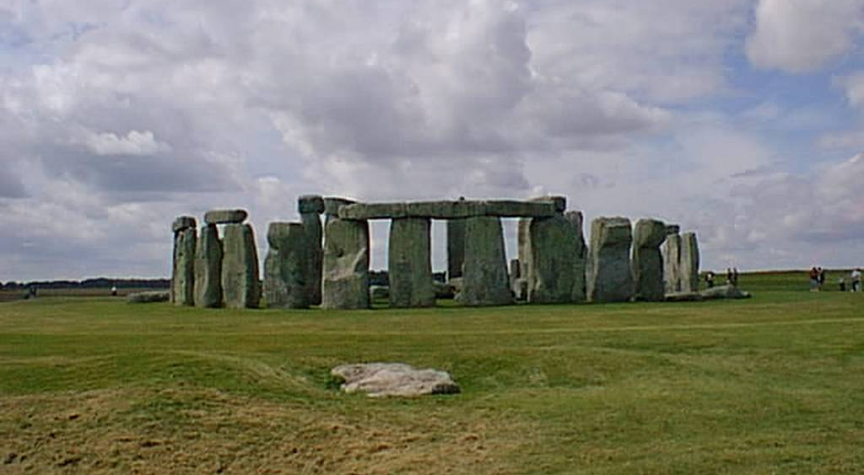

Slide 10
The Grail Project
What is it about?

Slide 11
The project is sponsored by the EU Enterprise and Industry Directorate General (Directorate E – Service Industries)
It proposes to develop and promote a new pan-European spiritual and cultural tourism route based on the legend of the Holy Grail
To identify along the route a number of key emblematic locations and attractions associated with the Grail via stories myths and legends.

Slide 12
Within this framework the project envisages:
To produce a Tourism Atlas of the route
Design an interactive website outlining the route that allows access to a range of materials designed to tell the grail story and its association with particular places.
To design a symbol or brand name for the route.
To plan a series of itineraries for anyone wishing to follow the route
To disseminate information about the route and liaise with local communities and tourism providers as to how to maximize its tourism potential

Slide 13
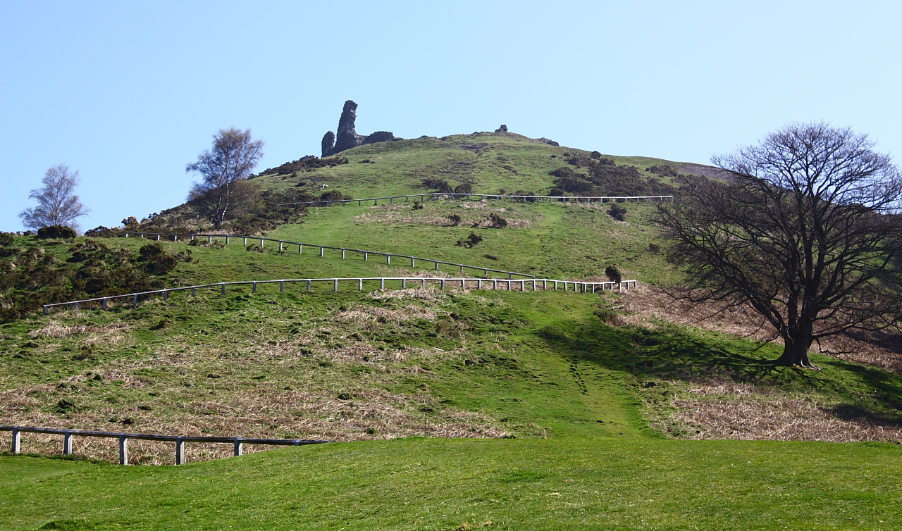

Slide 14
The Project Team
Features nine partners:
University of Zaragoza (Spain)
University of West London (Great Britain)
Bournemouth University (Great Britain)
Technological Educational Institute of Crete (Greece)
5 Senses (Malta)
NGO My World (Bulgaria)
D.G. Turismo Gobierno de Aragón (Spain)
Comarca Jacetania (Spain)
Sargantana (Spain)

Slide 15
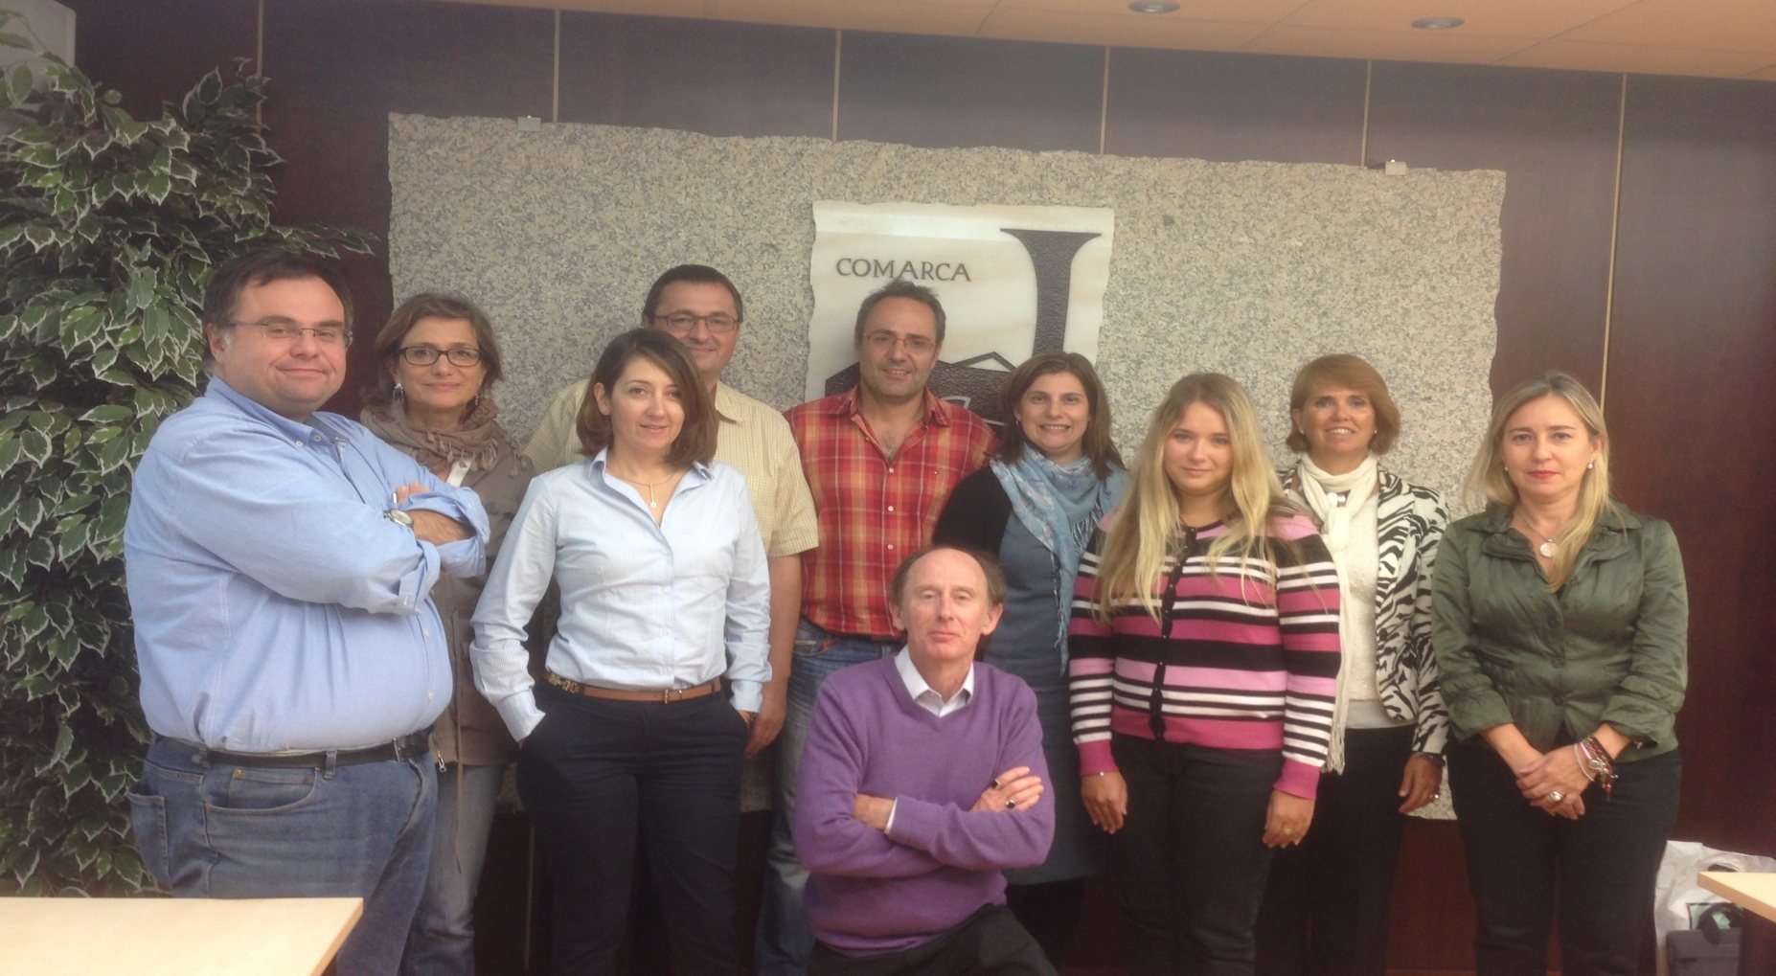

Slide 16
What is a Grail?
‘A bowl or dish’ (Chrétien de Troyes )
“Wide and deep saucer“ (Helinand of Froidmont )
‘A stone (called lapis exillis)’ (Wolfram von Eschenbach )
‘Platter’ (Mabinogion)
‘A chalice or vessel’. (Robert de Boron)

Slide 17
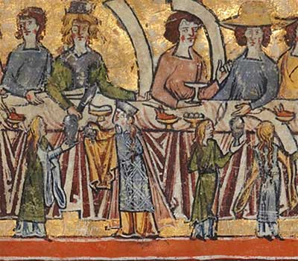

Slide 18
Where did it obtain its ‘holy’ origins?
In Christianity, the Holy Grail is linked to the story of Joseph of Arimathae
He was said to have used a cup or vessel (the Grail) to catch Jesus' blood during his crucifixion.
This cup or vessel was said to have the power to heal all wounds.

Slide 19
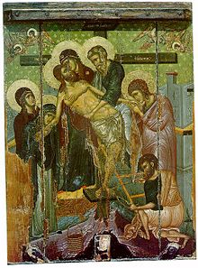

Slide 20
In Northern Europe the search for this object is joined to Arthurian myth

Slide 21
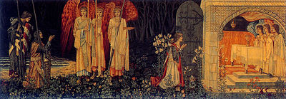

Slide 22
However it is also an object closely linked to the Roman Catholic Church as the object Jesus drank from at the last supper.

Slide 23
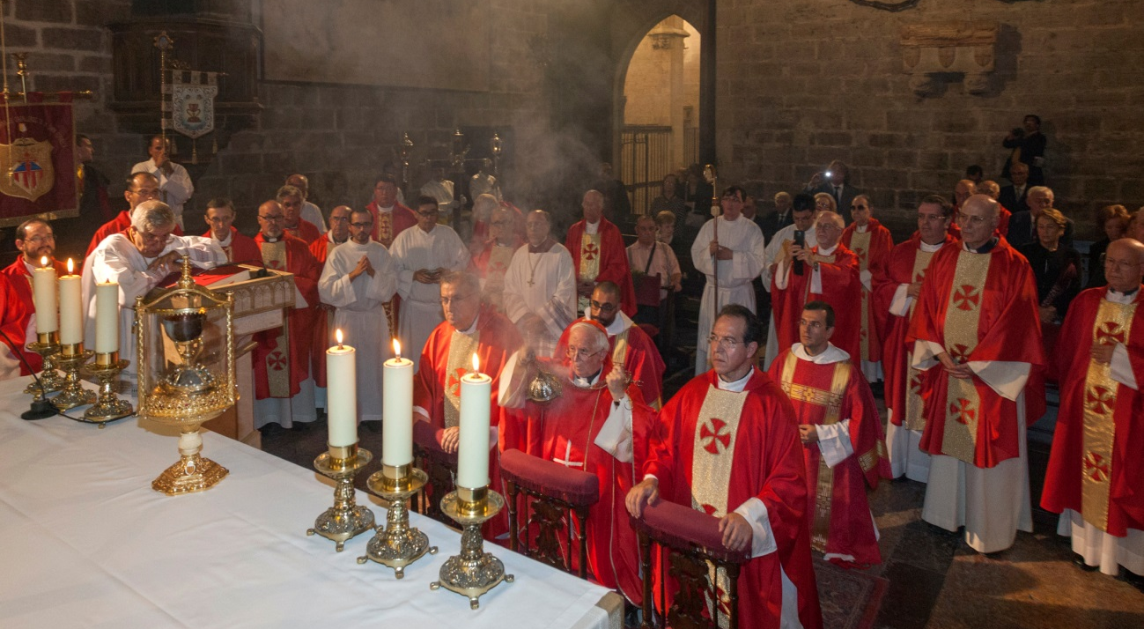

Slide 24
A Simple Story?
There are different schools of thought as to where the Grail legend began

Slide 25
Celtic Tradition: Loomis, Nutt, and Weston (1992) holds that it derived from early Celtic myth and folklore and stories of magical dishes and platters symbolising otherworldly power
Arthurian Tradition: C12th Medieval romances
Catholic Tradition: St. Laurence (Adell 2014) Barber 2004)
Goering and Rynor (2005) the inspiration has come from wall paintings in found in churches in the Pyrenees that pre-date the medieval romances.

Slide 26
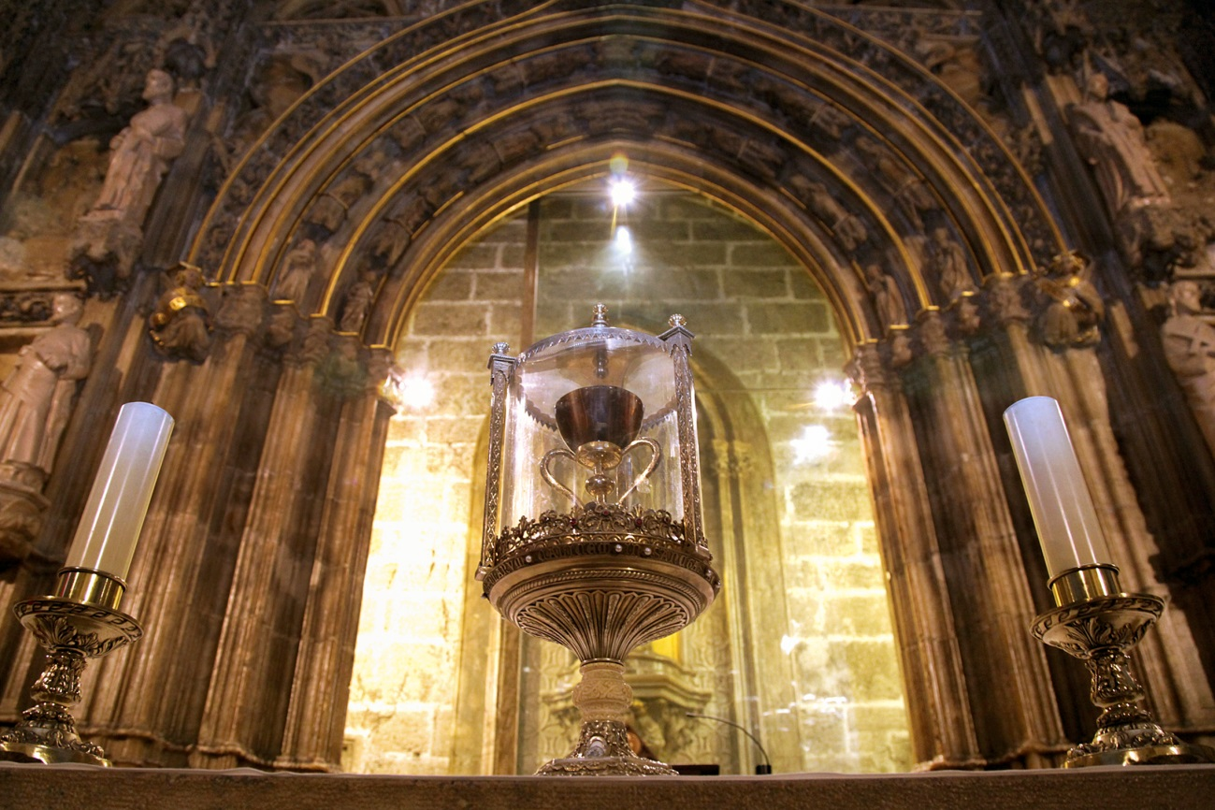
There are also different contenders for the title of the Holy Grail

Slide 27
These include:
St Mary of Valencia Cathedral, Spain*
The Emerald Chalice of Genoa
The Chalice of Dona Urraca at the Basilica of San Isidoro, Leon, Spain

Slide 28
Other more ‘fanciful’ stories have the Grail:
Buried (In the Money Pit, Oak Island, Nova Scotia / Temple, Scotland / Glastonbury, England)
Propose ‘alternative’ Grails e.g. Marian Chalice, Nanteos Healing Cup
Invent other Grail genres e.g. Baigent & Leigh (1983) Brown (2003)

Slide 29
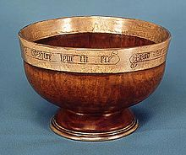
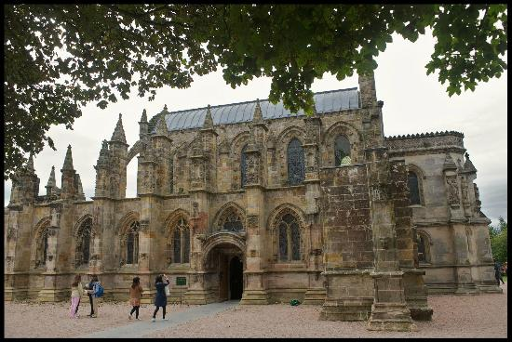
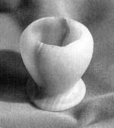

Slide 30
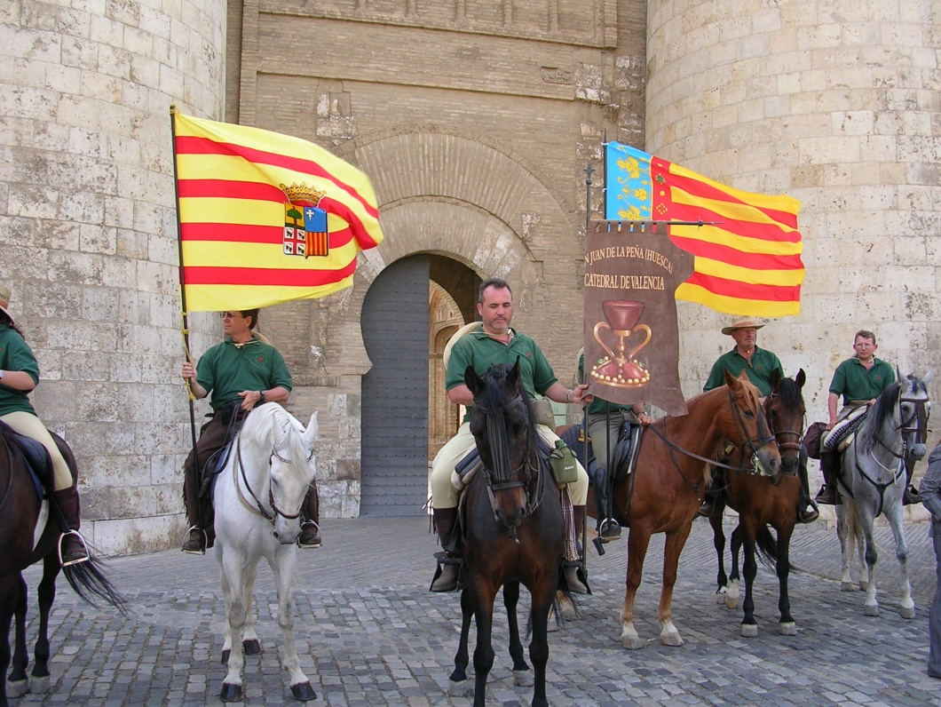
The Background to the Project

Slide 31
San Juan de la Pena/Teruel Regional Administration/Regional Government of Aragon (31st March 2002) San Juan de la Pena-Valencia Pilgrimage
The aim of the pilgrimage – ‘El Camino del Santo Grial’

Slide 32
Second Official Pilgrimage (2004)
Meeting of the Board of the Spanish Holy Grail Association
EU bid featuring universities, public authorities, NGO’s and the private sector
Won EU funding in May 2015 – project began in September 2015

Slide 33

Developing a Holy Grail Route

Slide 34
Grail Methodology
GRAIL uses a participative methodology
Phase 1 Document analysis & sharing
Literature review
Interviews with Grail & route experts
Production of a tourism atlas
Identification of emblematic places
Phase 2 Application of a 6A framework to identified emblematic places (Buhalis 2003)
Website design

Slide 35
Phase 3 Industry & community familiarisation & training
Focus groups (August-December 2016)
World Travel Market Workshop (2016)
Phase 4 Impact Analysis

Slide 36
What is a Tourism Route?
“Tourism routes are tourist attractions” (Timothy and Boyd 2006; Stoddart and Rogerson 2009).
“Tourism routes can tie up several places of interest that would independently not have the potential to entice visitors to spend time and money” (Meyer et al. 2004).
“Routes are associated with a selected theme (natural or created) and can be accessed by a variety of means of transport” (Puczko and Ratz 2000).

Slide 37
Types of Route:
Religious – pilgrim, cathedrals, churches, etc.
Cultural – including literature, music, arts, crafts, etc.
Historical – history, architecture, fortresses, etc.
Culinary – local, regional, national food
Drinks – wine, sherry, whiskey, champagne, etc.
Nature – ecotourism, cycling, bird-watching, soft and hard adventure tourism, etc.
Old Trade Roads – the Silk Road, the Spice Road

Slide 38
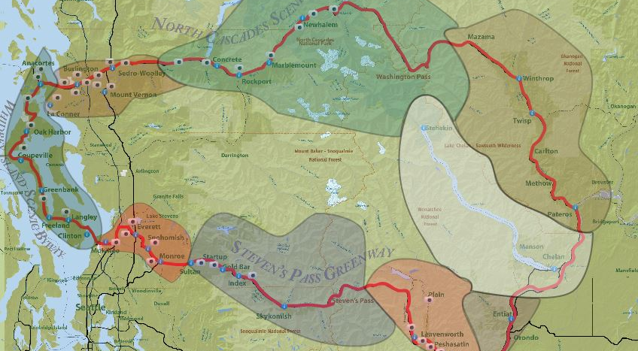
The Cascade Way

Slide 39
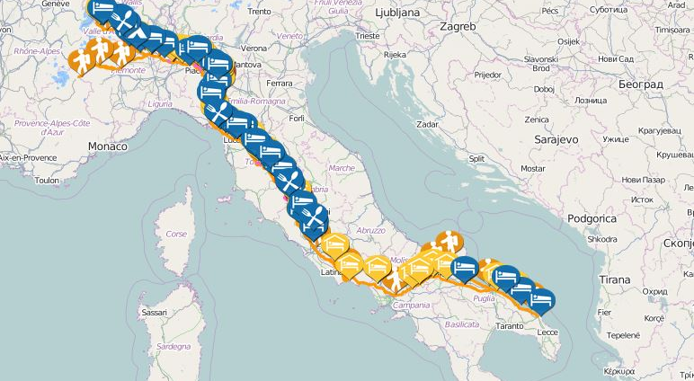
Via Francigena Pilgrim Route

Slide 40
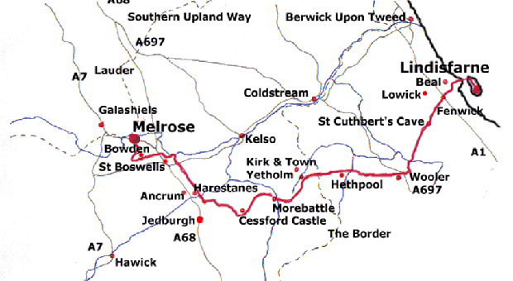
St Cuthbert’s Way

Slide 41
Other Examples in Europe
The Romantic Road in Germany (1950)
Alsace Wine Route in France (1953)
In 1987 the Council of Europe set up the cultural routes program and the first official cultural routes were inaugurated.
The Santiago de Compostela Pilgrim Route was the first one, established in 1987.
Today the Council of Europe recognises 29 certified cultural routes

Slide 42
The Benefits of Tourism Routes
Economic Benefits of Tourism Routes
Minimize the seasonality of tourism demand
Stimulate the usage of not so popular tourism resources
Created with minimal investment
Attract new target markets for differently themed routes
Boost the development of more attractions and accommodation facilities
Bring profits to local people
Creation of joint marketing and product development practices
Establishment of public-private partnerships
Socio-cultural Benefits of Tourism Routes
Promote and raise awareness of common cultural/religious/historical heritage among destinations
Preserving cultural resources
Cultural tourism products and services development
Allowing tourists to immerse into the cultures and traditions of many regions of a route
Environmental Benefits of Tourism Routes
Disperse tourism demand
Preserving natural resources
Stimulate the usage of tourism resources which have not been popular before

Slide 43
The Holy Grail Route

Slide 44
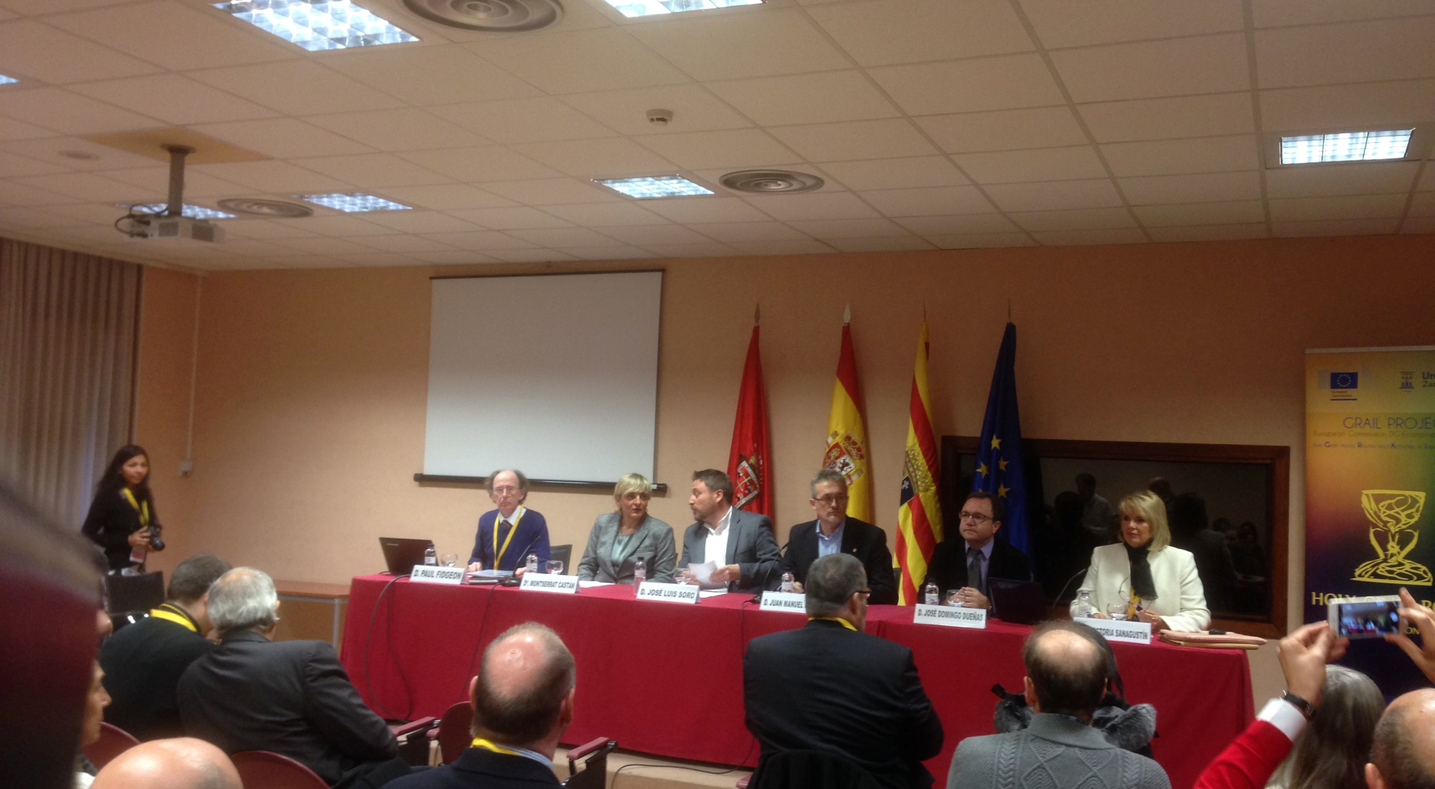
Launched (Jaca November 2016)

Slide 45
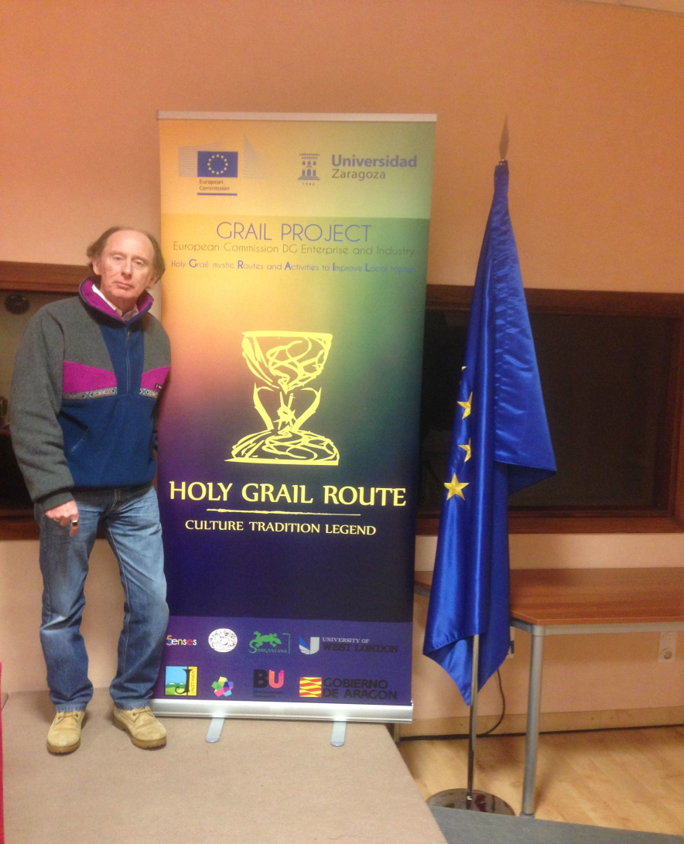
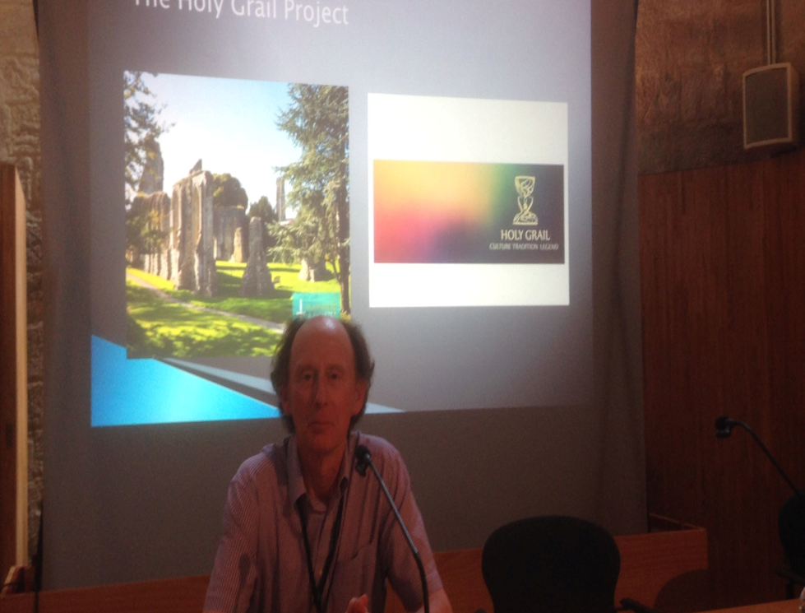

Slide 46
Great Britain

Slide 47
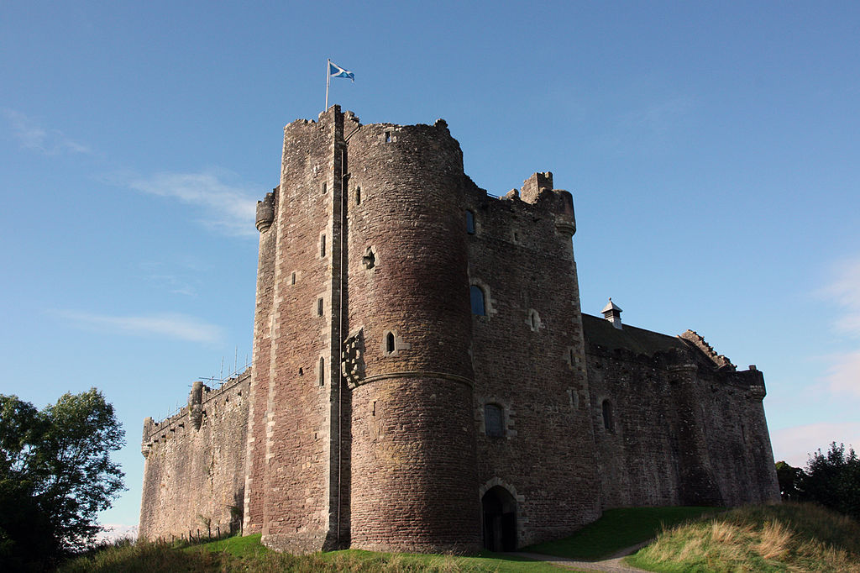
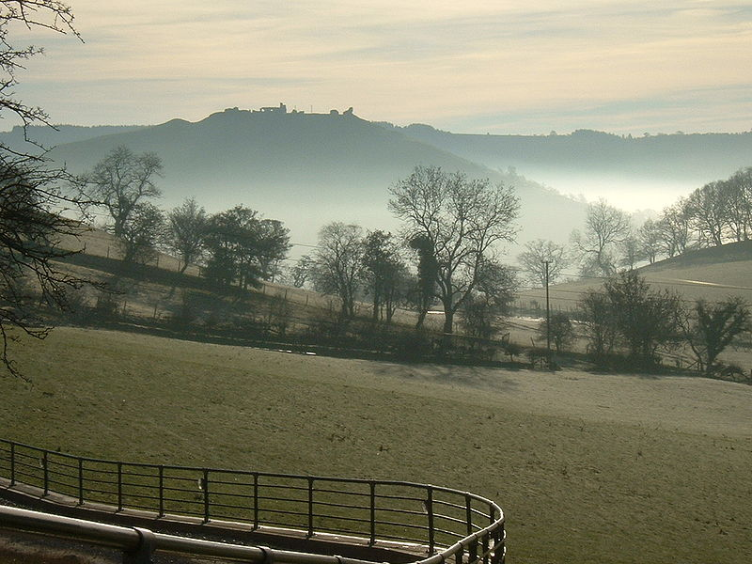
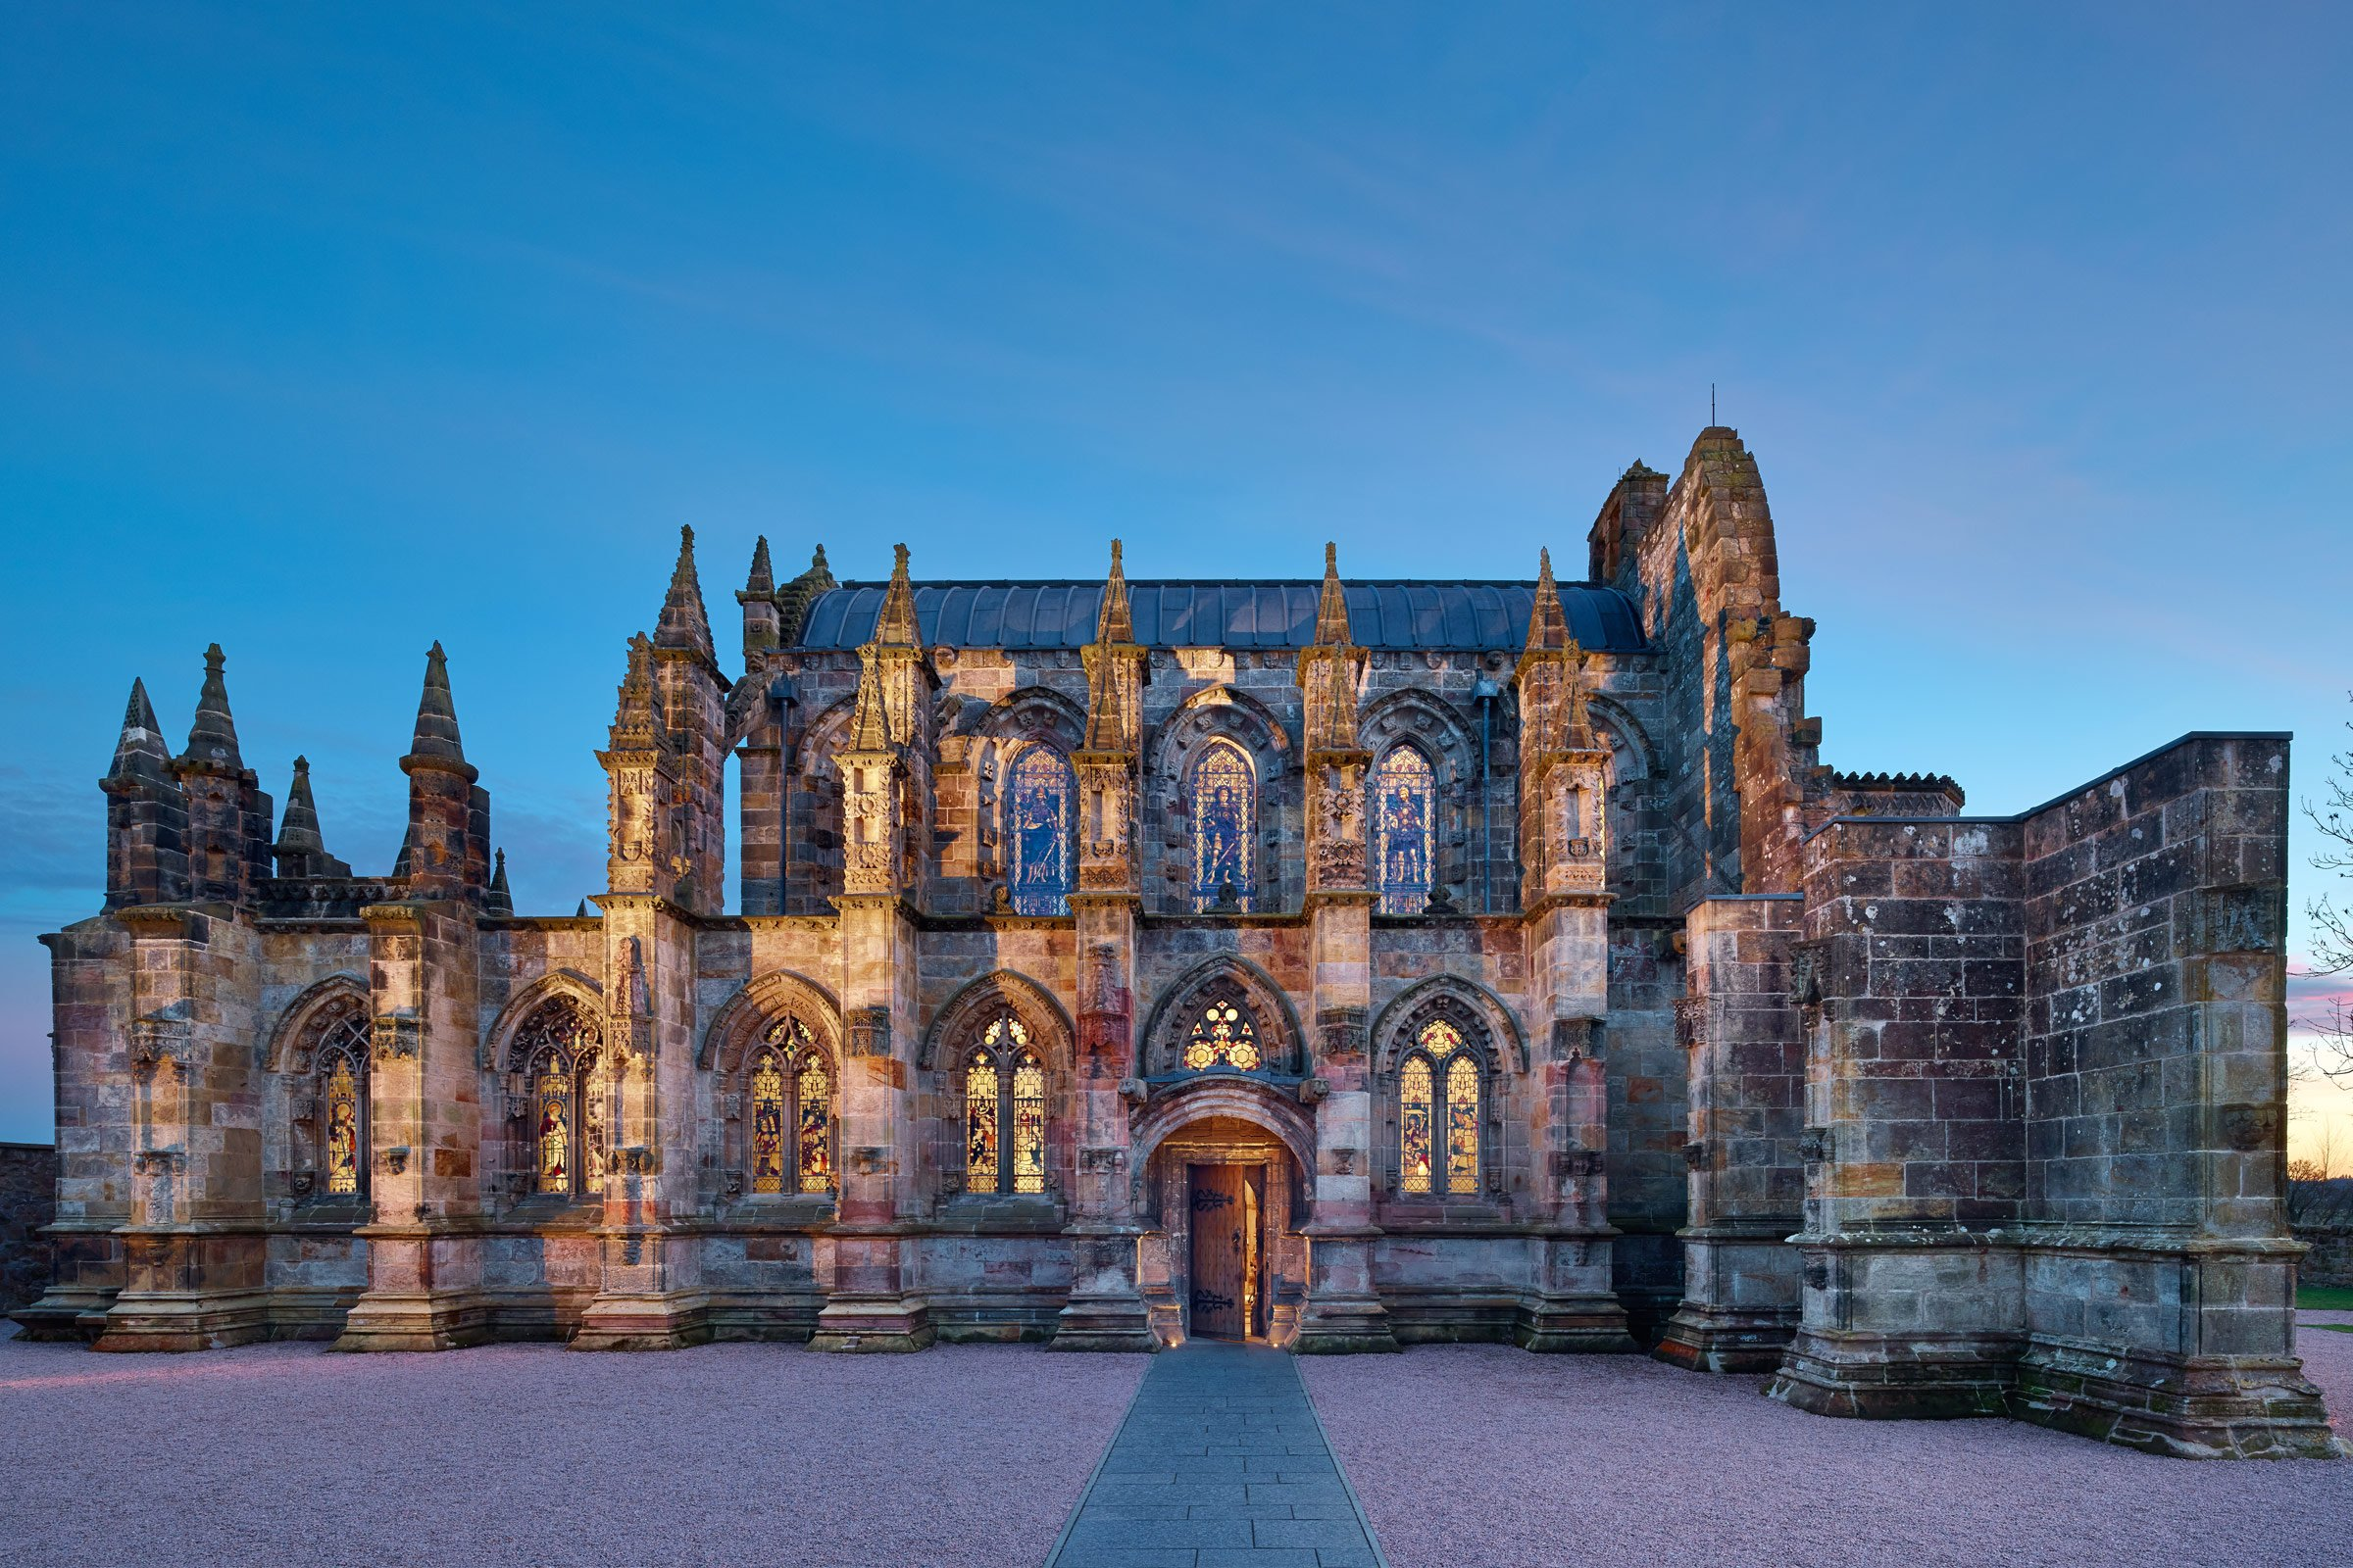

Slide 48
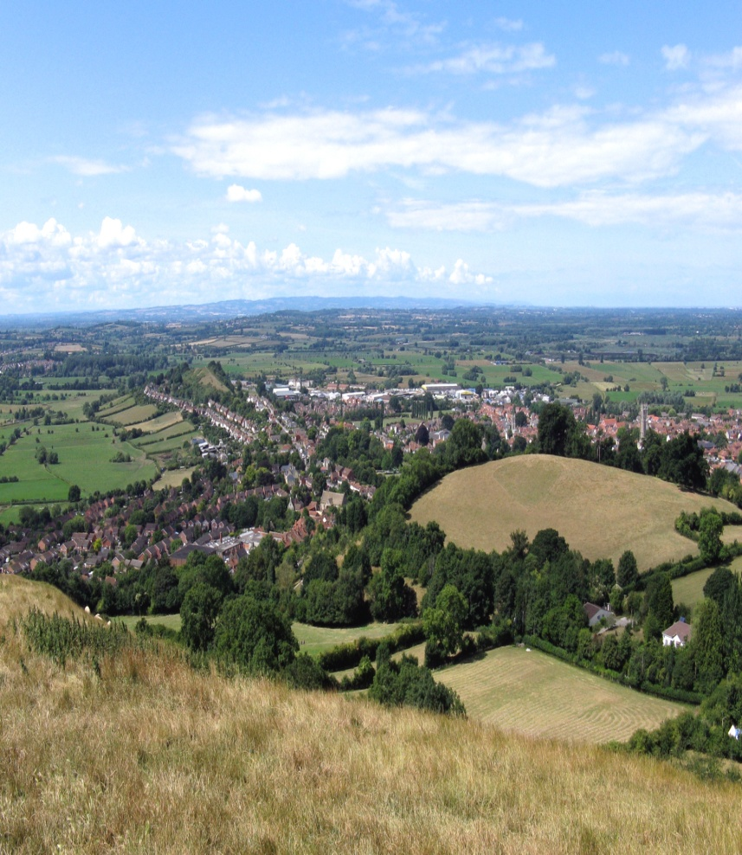
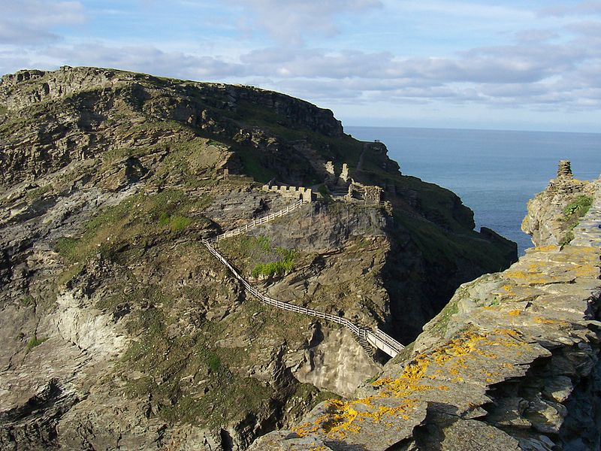

Slide 49
Bulgaria

Slide 50
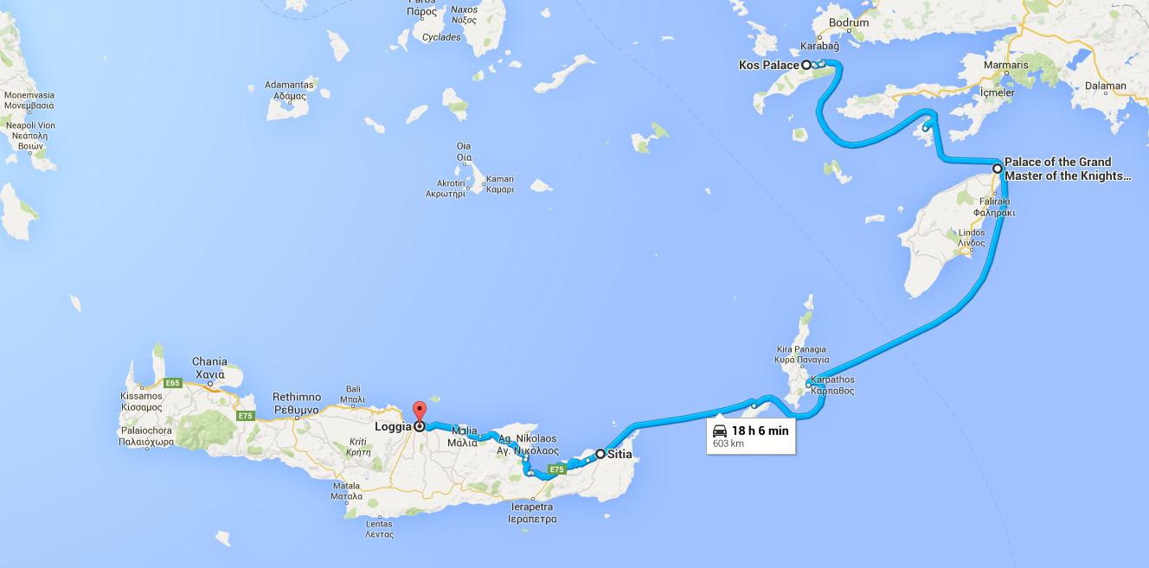
Greece

Slide 51
Malta

Slide 52
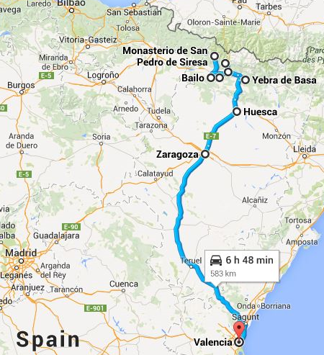
Spain

Slide 53
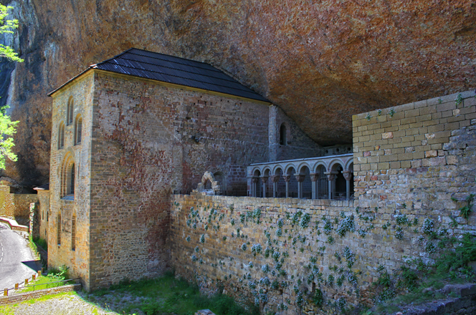
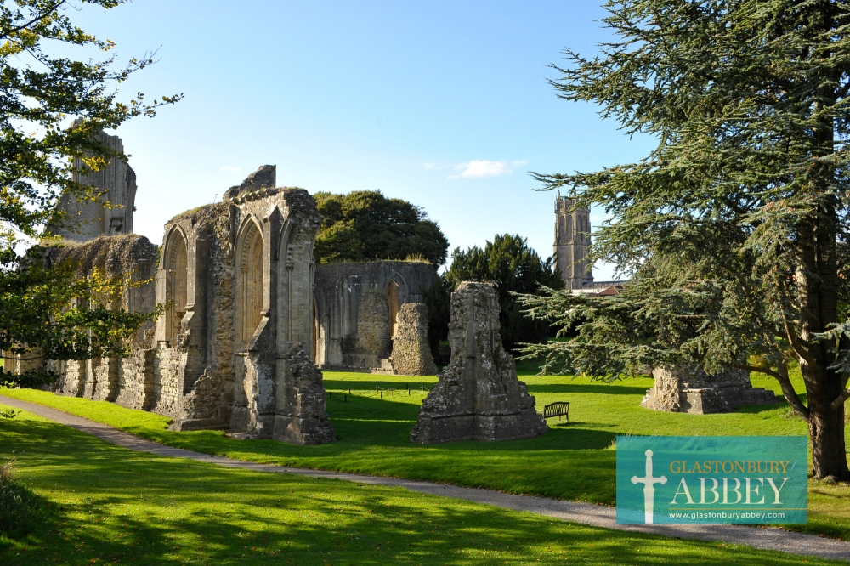
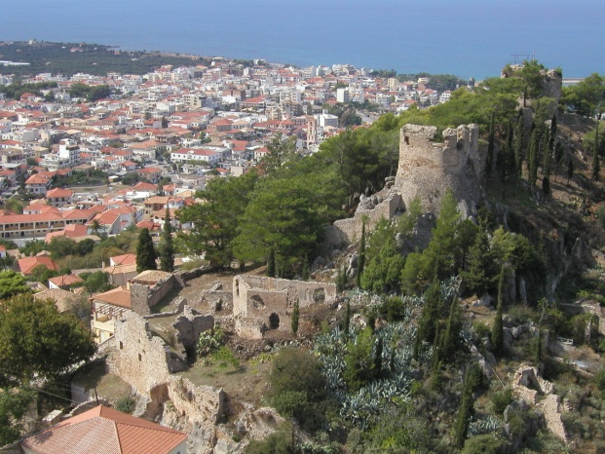
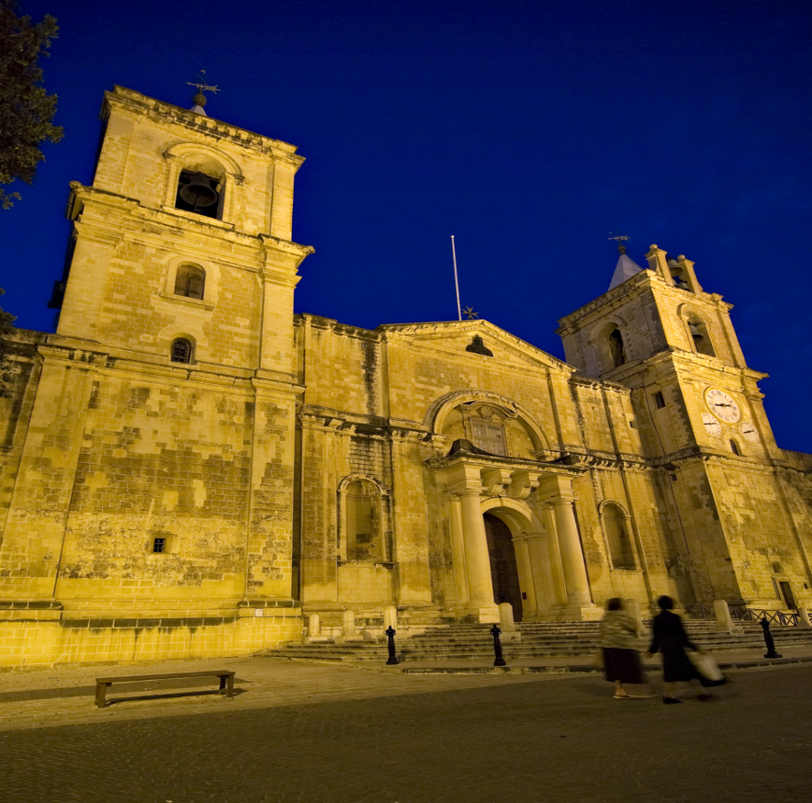
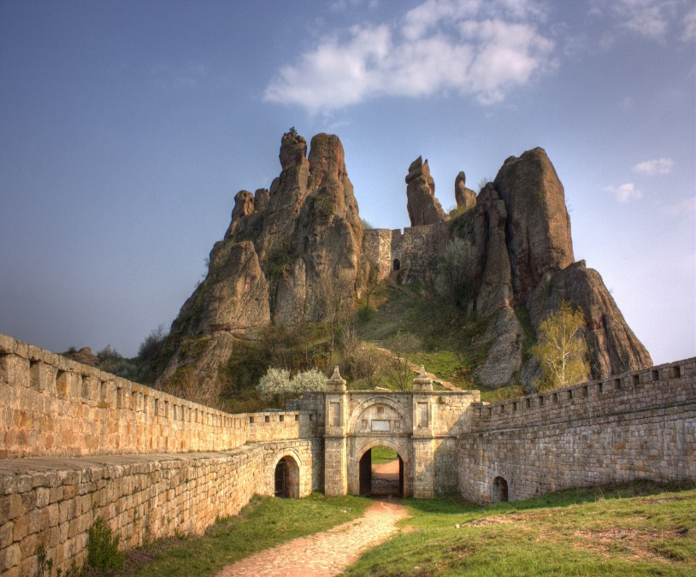

Slide 54
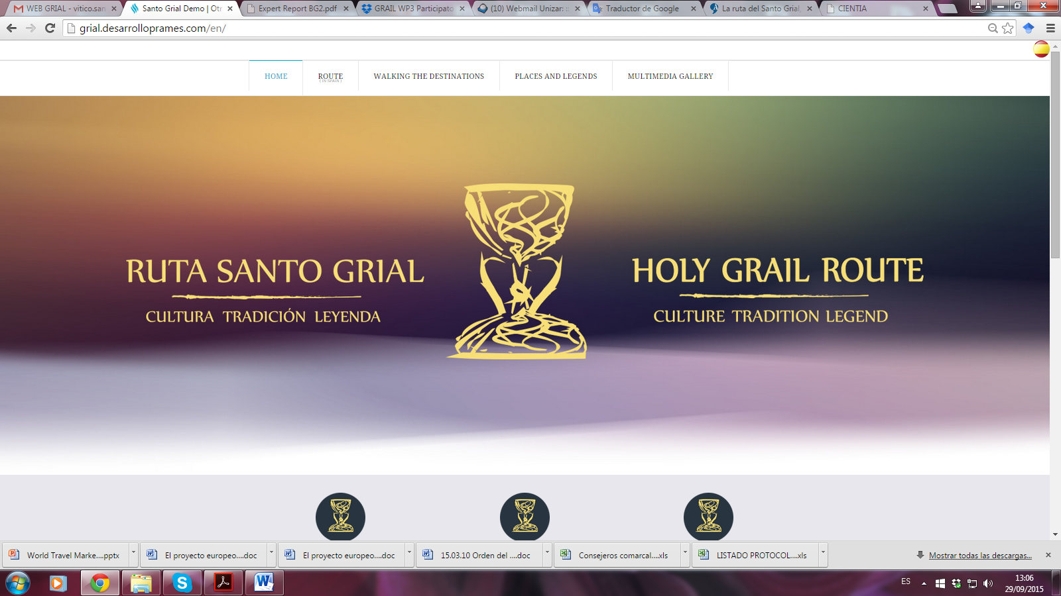
We have a website

Slide 55
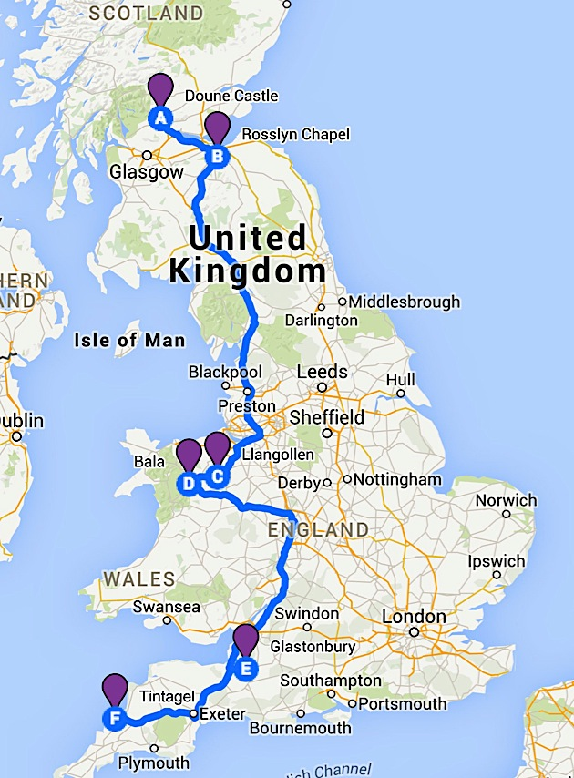
We have identified a number of possible itineraries

Slide 56
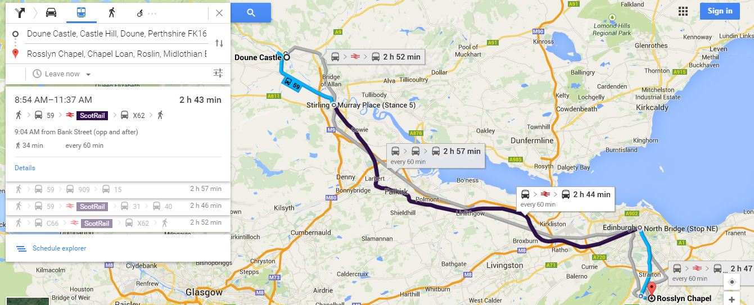
Doune Castle – Rosslyn Chapel by bus and rail
Bus 59 & ScotRail & Bus X62– 2h 43min – 2 stopovers
Bus 59 & 909 & 15 – 2h 57 min – 2 stopovers

Slide 57
Bringing the route to the market place
A series of focus groups have been conducted with key stakeholders across Europe
These aim to familiarise participants with the project
The story of the Grail
Get participants to buy-into the project & realise its potential
Establish co-operative networks between locations

Slide 58
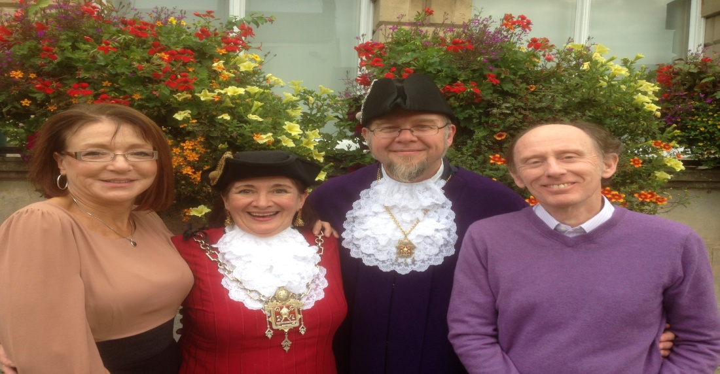
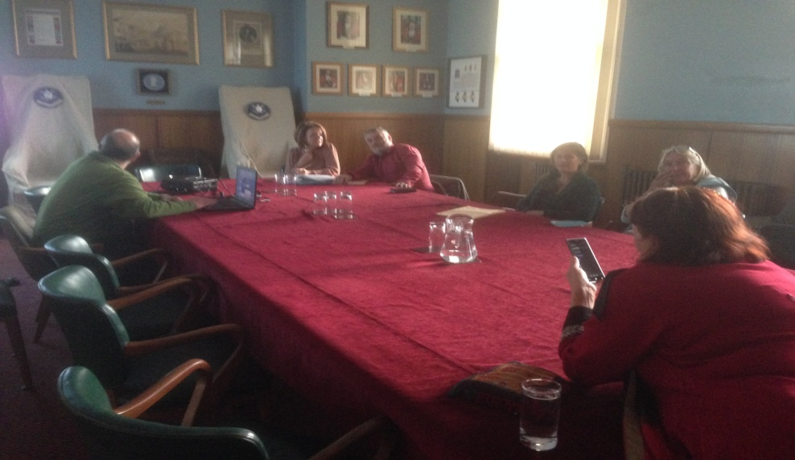
For example: In the UK

Slide 59
We are we now trying to do?
Raise the profile of the project
Starting to measure impact

Slide 60
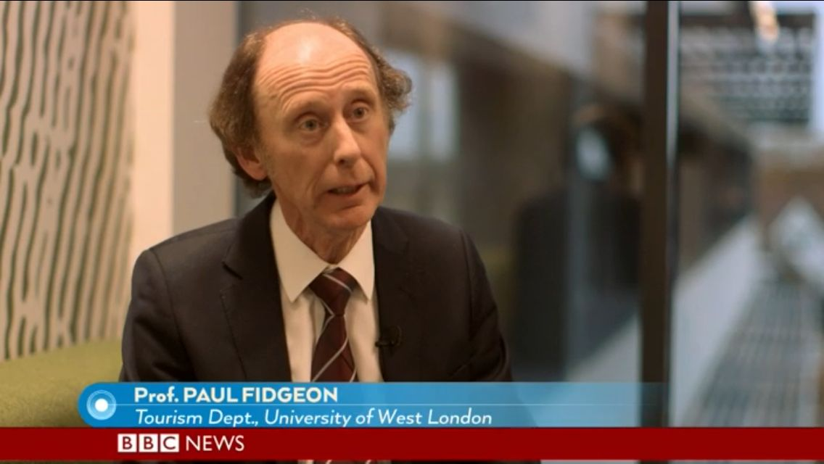
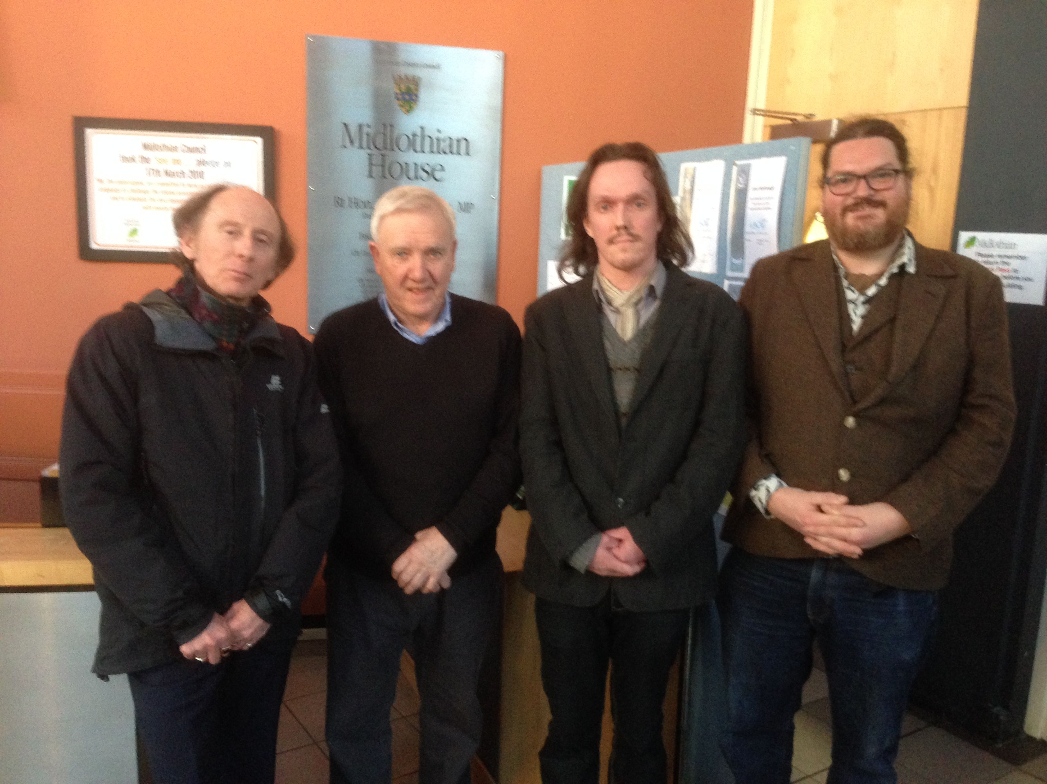

Slide 61
There have been problems
Conceptually
Grail fact or fiction?
Identifying emblematic places based on fiction e.g. Corbenic, Camelot
One route or several? (The British Country Report raised the possibility of five separate strands based on Grail literature)
The number of emblematic places (Arthurian route)

Slide 62
Stories have been embellished or created to attract pilgrims (John of Glastonbury, William of Malmesbury, Hailes Abbey)
There is a lack or records or no documented sources (Mabinogion)
The medieval romances mix stories (vulgate and post-vulgate cycles) and are hard to follow and understand(medieval French)
There are inconsistencies (The grail appears in Britain and Spain at the same time. If it is buried underneath Glastonbury Tor how can it be in Valencia?)
Reconciling cultural traditions (the Grail story is different in certain countries e.g. Spain & Bulgaria)

Slide 63
Logistical challenges
Developing the product and creating a brand (logo)
Developing common marketing activities at targeted groups e.g. maps, brochures, catalogues (both online /print)
Creating awareness about a tourism route and strengthening its image among tourists (Media).
Finance - common marketing activities demand a lot of finance as they are done on an international scale and include all destinations of a tourism route (Puczko and Ratz, 2007).
Maturity - It can take 20-30 years for a tourism route to mature (Lourens 2007)

Slide 64
The success of the route is largely bound up in its ability to engage with and capture the imagination of a range of stakeholders and communicate common ideas and values. Quieroz (2010) and Courtney (et al. 2010)
Success is also determined by the ability to achieve cooperative networks. Cooperative networks imply cooperation among stakeholders, authorities and inhabitants which will not only ensure synergies between and within destinations, but also the sharing of common knowledge and expertise
It is important to interlink locations with other tourism route thereby providing for and improving the tourist experience Gunn (1988), Hallo and Manning (2009)

Slide 65
The success of any tourism route is dependent on obtaining the support of government and private sector (Lourens 2007) e.g. Santiago de Compostela
The quality of interpretation and the opportunity to learn will be vital – (Hardy 2003)
Finally any tourism route is only as good as the quality of its ancillary service provision (Antonson and Jacobsen 2014)

Slide 66
There will be many more
There are interesting times ahead for this project

Slide 67
Thank you for listening

