Slide 1
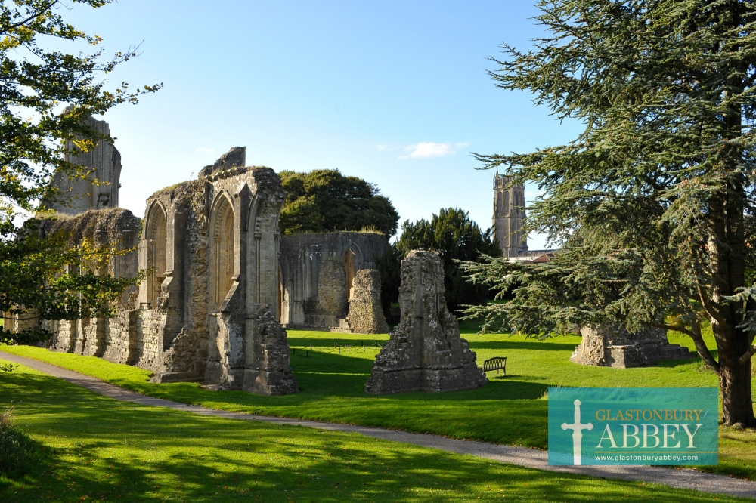
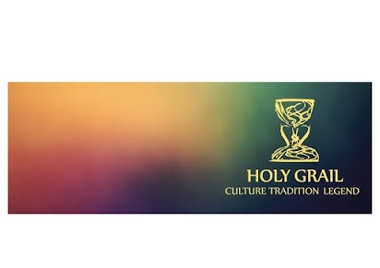
Creating a Spiritual Tourism Route
Challenges & Opportunities

Slide 2
Aims
To outline the basis of a new spiritual and cultural tourism route in Europe linked to myths stories and legends associated with the Holy Grail
To discuss some of the challenges and opportunities associated with the initial development of the route.

Slide 3
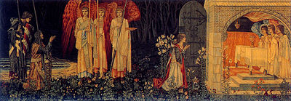

Slide 4
What is a Grail?
The term comes from Graal (old French) Grazal (old Provencal) Gresal (old Catalan) which can be translated as a "a cup or bowl of earth, wood, or metal" (Diez 1864)
A Grail appears as a bowl or dish when first described by the French poet Chrétien de Troyes in his medieval story The Fisher King.

Slide 5
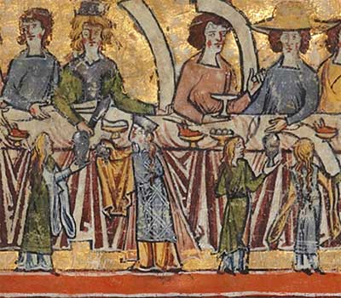

Slide 6
In later literature Helinand of Froidmont described a grail as a "wide and deep saucer" (scutella lata et aliquantulum profunda).
Other authors had their own ideas: Robert de Boron portrayed it as the vessel of the Last Supper.

Slide 7
In the Mabinogion, an ancient book of Welsh legends, one of its heroes Peredur had no cup or bowl per se, and was presented with a platter containing his kinsman's bloody, severed head.
In Parzival, Wolfram von Eschenbach citing the authority of a certain (probably fictional) Kyot the Provencal claimed the Grail was a stone (called lapis exillis) that fell from Heaven following a fight between God and Lucifer.

Slide 8
Such interpretations have only added to its mythical status and our complexity of understanding.

Slide 9
Where did it obtain its ‘holy’ origins?
In Christian mythology, the Holy Grail was said to be the dish, plate, cup or vessel that caught Jesus' blood during his crucifixion.
It is regarded to have the power to heal all wounds.
It is a theme linked closely to the Catholic Church and in Northern Europe joined to Arthurian myth and linked to its quest.

Slide 10
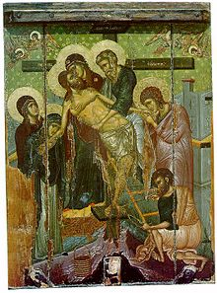

Slide 11
A simple story?
There are different schools of thought as to where the Grail legend began (First Challenge)

Slide 12
School 1:
Loomis, Nutt, and Weston (1992) holds that it derived from early Celtic myth and folklore.
All parallel links between Welsh & Irish medieval literature and the Grail ‘romances’ or poems.
These include similarities between the Mabinogion's Bran the Blessed and Bran's life-restoring cauldron and Arthurian legend and the grail of the Fisher King.
Other legends feature magical platters or dishes that symbolize otherworldly power.
These items generate great knowledge and wisdom (referred to in The Cauldron of Ceridwen by Taliesin) and a never-ending supply of food (The Horn of Brân Galed)

Slide 13
School 2
Goering and Rynor (2005) have identified sources for Grail imagery in 12th-century wall paintings from churches in the Pyrenees (now mostly removed to the Museu Nacional d'Art de Catalunya, Barcelona),
These present unique iconic images of the Virgin Mary holding a bowl that radiates tongues of fire, images that predate the first literary account by Chretien de Troyes.
Goering argues that they were the original inspiration for the grail legend.

Slide 14
School 3
Barber (2004) holds that the earliest stories that cast the Grail in a Christian light were meant to promote the Roman Catholic sacrament of the Holy Communion
Holy Communion was first alluded to in the Christian Bible and defined by theologians in the first centuries A.D., around the time of the appearance of the first Christianized Grail literature
The Roman Catholic church was beginning to add more ceremony and mysticism around this particular sacrament. Thus, the first Grail stories may have been celebrations of a renewal in this traditional sacrament
This theory has some backing by the fact that grail legends are almost entirely a phenomenon of the Western church

Slide 15
School 4:
The legend of St Laurence (Bennett 2014)
This postulates that the Grail is taken by St Peter to Rome in the 1st century, and then to Huesca in Spain by Saint Laurence in the 3rd century.
According to legend, the monastery of San Juan de la Peña, protected the chalice from the Islamic invaders of the Iberian Peninsula.
It was given to King Martin I of Aragon in 1399 in exchange for a gold cup.
Eventually it found its way into the Cathedral in Valencia
This remains the Official Papal Chalice sanctioned most recently by most recently by Pope Benedict XVI on July 9, 2006 to celebrate mass

Slide 16
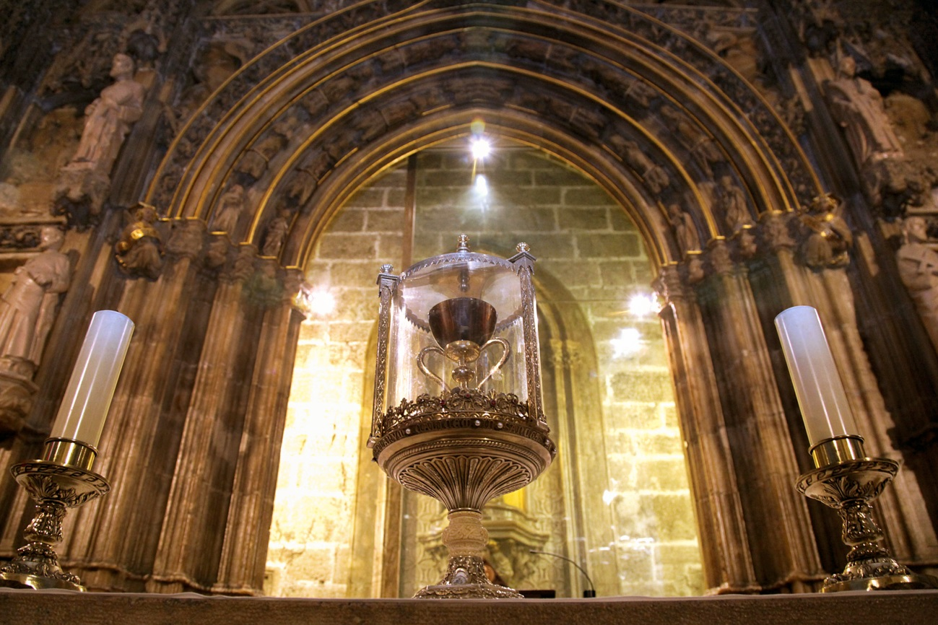

Slide 17
Most British scholars today accept that both Christian and Celtic traditions contributed to the legend's development (Loomis 1992, Wood 2013, Hunt 2014).
The general view is that the central theme of the Grail is Christian, even when not explicitly religious, but that much of the setting and imagery of the early romances is drawn from Celtic material.

Slide 18
2. There are also different contenders for the title of the Holy Grail
(Challenge 2)

Slide 19
Ownership has been attributed to various groups including medieval Kings, religious orders, the Roman Catholic Church and private individuals
These include:
St Mary of Valencia Cathedral, Spain
The Emerald Chalice of Genoa
The Chalice of Dona Urraca at the Basilica of San Isidoro, Leon, Spain

Slide 20
Other more ‘fanciful’ stories have the Grail:
Buried (In the Money Pit, Oak Island, Nova Scotia / Temple, Scotland / under Glastonbury Tor, England)
Propose ‘alternative’ Grails e.g. Marian Chalice, Nanteos Healing Cup
Invent other Grail genres e.g. Baigent & Leigh (1983) Brown (2003)

Slide 21
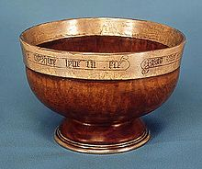
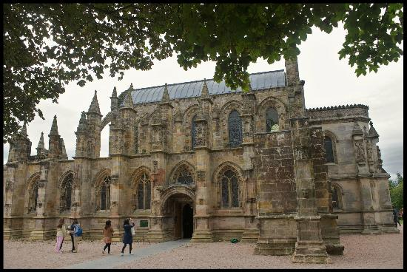
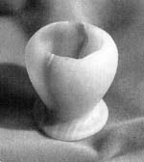

Slide 22
The Grail Project
What’s it about?

Slide 23
The project aims
To develop and promote a new pan-European spiritual and cultural tourism route based on the legend of the Holy Grail
The route endeavors to combine and number tourism destinations linked by an association with the Grail outlined in a set of stories myths and legends – many of which date back over hundreds of years.
The project is sponsored by the EU Enterprise and Industry Directorate General (Directorate E – Service Industries)

Slide 24
Initial research suggested
The possibility of creating not one, but two branches to the route:
Arthurian Epic Holy Grail Route, from Great Britain (where the Holy Grail first went), across France to Valencia, Spain (where it is suggested the Holy Grail now resides).
Spiritual, Mystic/Mythic and Religious Holy Grail Route, by the sea from Bulgaria across Crete (Greece) and Malta to Valencia.

Slide 25
Within this framework the project envisages:
To identify the tourist potential of the Holy Grail Route.
Analyze and describe the main historic milestones, places, characters, enigmas associated with any route.
To design an initial/ basic Tourism Atlas of the route
Design an interactive website outlining the route that allows access to a range of materials designed to tell the grail story and its association with particular places.
To design an identity a symbol or brand name for the route.
To organize networks and itineraries for anyone wishing to follow the route
To disseminate information about the route and liaise with local communities and tourism providers as to how to maximize its tourism potential

Slide 26
To plan and examine ways of signposting the route according to international principles.
To create a Think Tank about the Route linked to the Spanish Holy Grail Association.
To get national, European and International accreditation for the route.
To organize the III Holy Grail Pilgrimage and the 2nd International Conference on the Grail designed to promote and to spread the knowledge about the route.

Slide 27
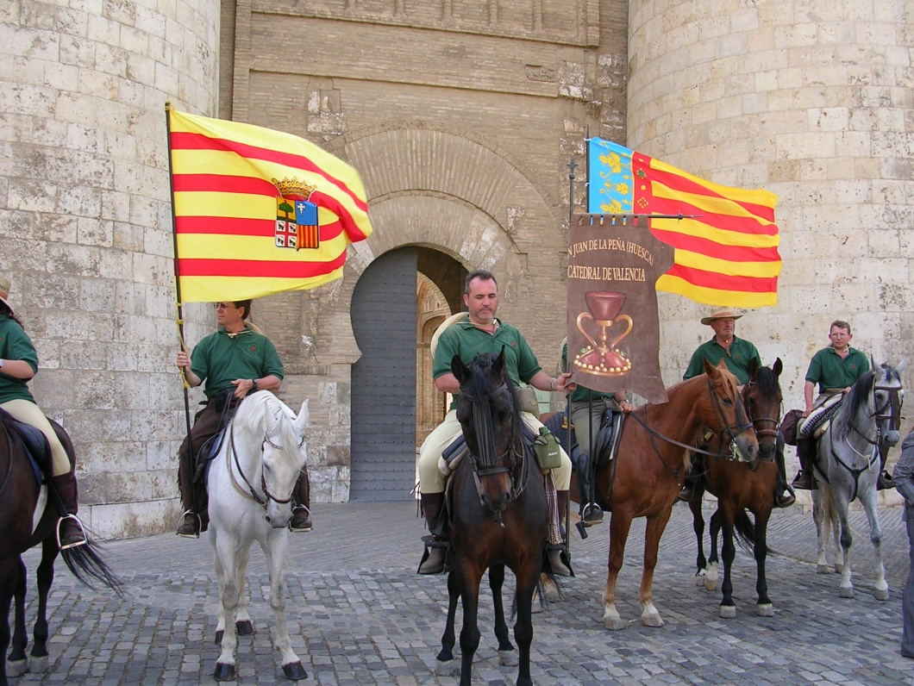
Background to the Project

Slide 28
San Juan de la Pena/Teruel Regional Administration/Regional Government of Aragon (31st March 2002) San Juan de la Pena-Valencia Pilgrimage
The aim of the pilgrimage
Meetings with local & regional administrations in Jaca & Zaragoza (Cultural Association ‘El Camino del Santo Grial)
Associated aims of the Camino
Second Official Pilgrimage (2004)

Slide 29
Meeting of the Board of the Spanish Holy Grail Association
EU bid featuring universities, public authorities, NGO’s and the private sector

Slide 30
The Project Team
Features nine partners:
University of Zaragosa (Spain)
University of West London (Great Britain)
Bournemouth University (Great Britain)
Technological Educational Institute of Crete (Greece)
5 Senses (Malta)
NGO My World (Bulgaria)
D.G. Turismo Gobierno de Araagon (Spain)
Comarca Jacetania (Spain)
Sargantana (Spain)

Slide 31
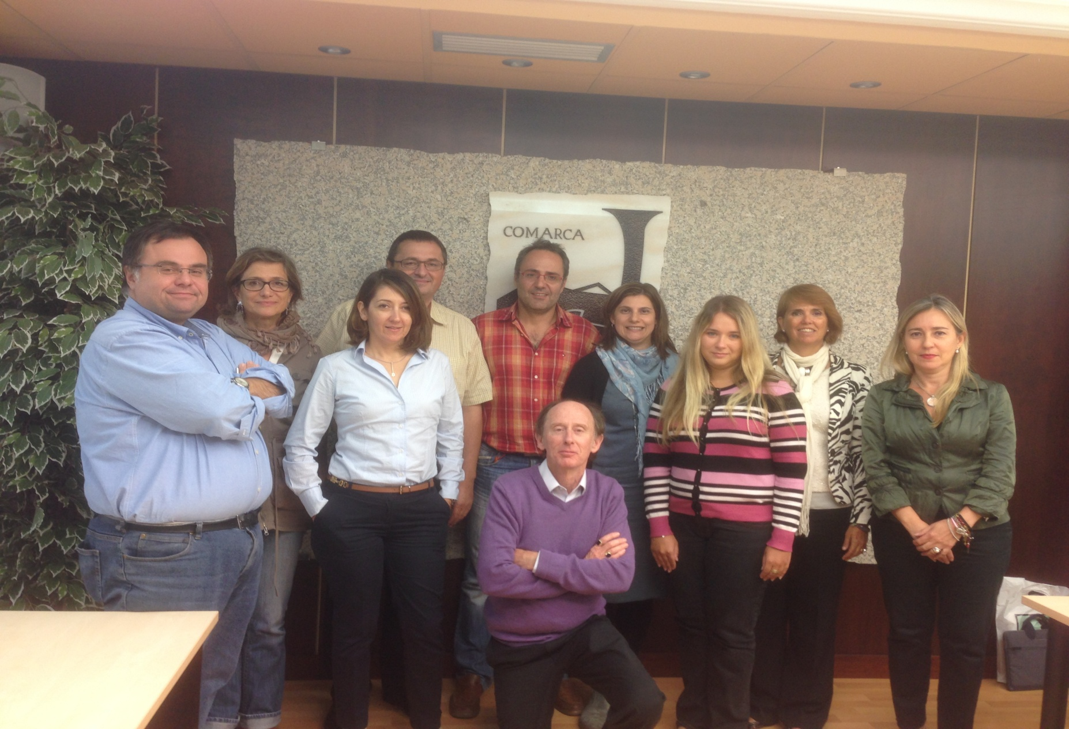

Slide 32
What is a tourism route?
‘Tourism routes are tourist attractions’ (Timothy & Boyd 2006)
‘Tourism routes brings together places and activities in a particular geographical area under a specific marketing theme’ (Lourens 2007)
‘They tie up several attractions that would independently not have the potential to entice visitors to spend time and money” (Meyer et al. 2004)
‘Tourism routes connect tourism resources from smaller destinations and promote them as a common tourism destination region’ (Briedenhann and Wickens 2004

Slide 33
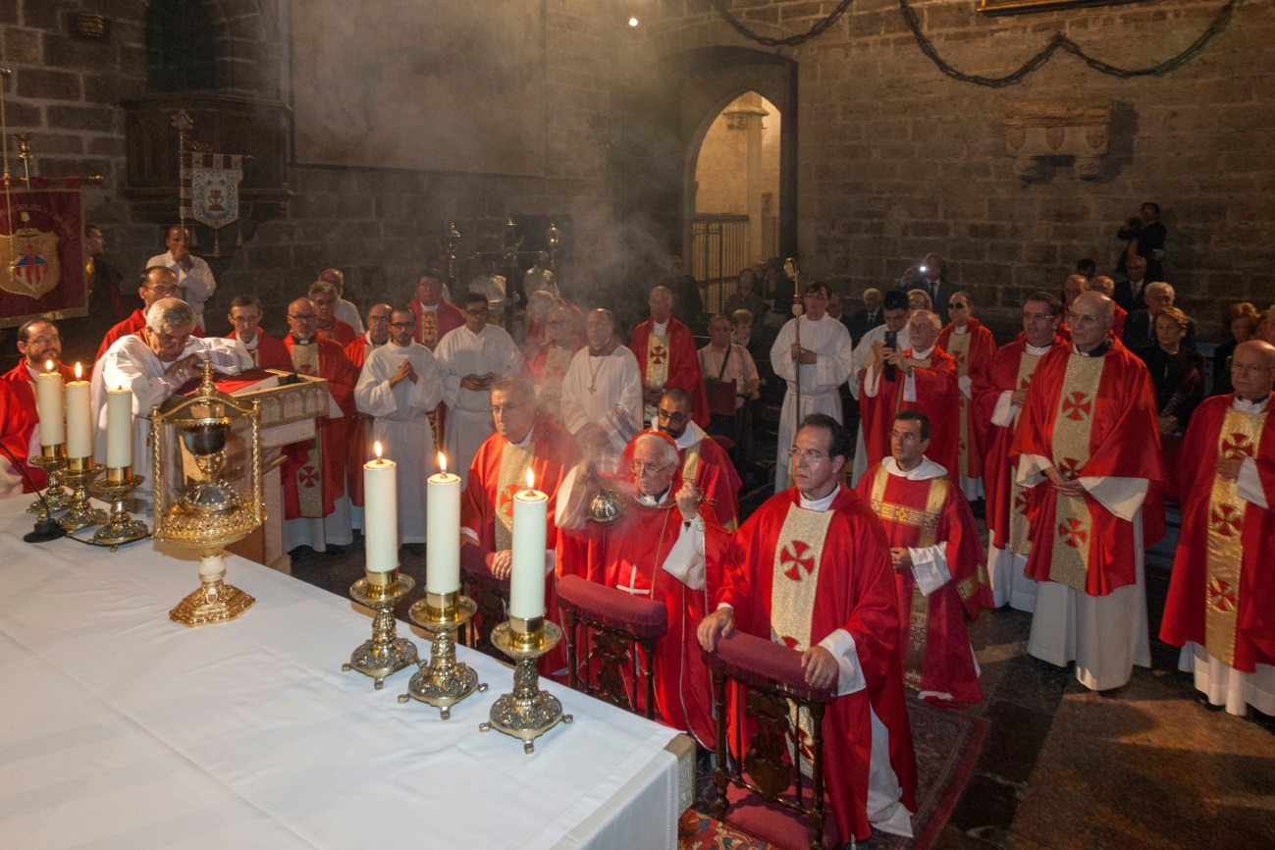
‘Tourism routes interlink attractions and their destinations under a certain theme’(Puczko and Ratz 2007)
In this case the Holy Grail

Slide 34
Tourism routes can have different themes
Religion – linking cathedrals, churches, places of pilgrimage etc.
Culture – focused on places in literature, music, arts, or local crafts.
History – featuring architectural attractions, fortresses, etc.
Gastronomy – highlighting local, regional, national food
Beverage – including wine, sherry, whiskey tours.
Nature – routes include ecotourism, cycling, bird-watching, soft and hard adventure tourism, etc.
Trade – for example, the Silk Road, the Spice Road
Thermalism – linking hot springs, geysers and pots

Slide 35
Routes can also be:
Local
Regional
National
International (Puczko and Ratz, 2007)
In Europe, they date from:
Romantic Road, Germany (1950)
Alsace Wine Route, France (1953)

Slide 36
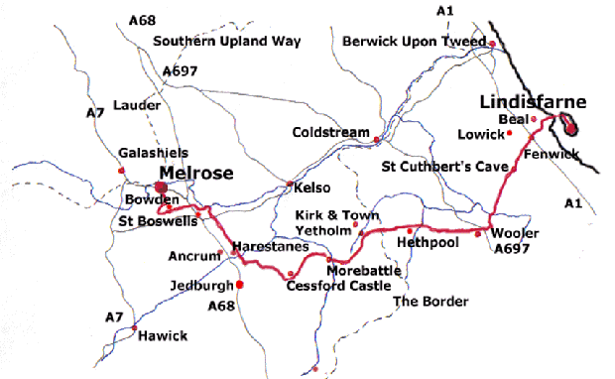
Examples of tourism routes – St Cuthbert’s Way

Slide 37
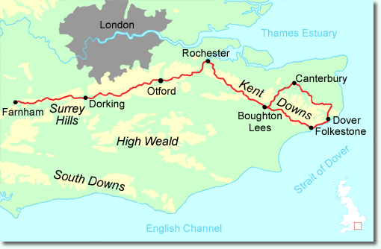
The Pilgrim’s Way

Slide 38
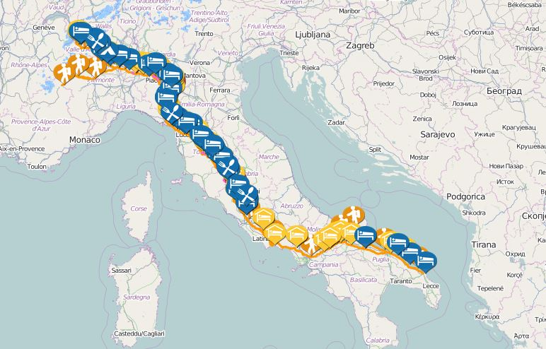
Via Francigena Pilgrim Route

Slide 39
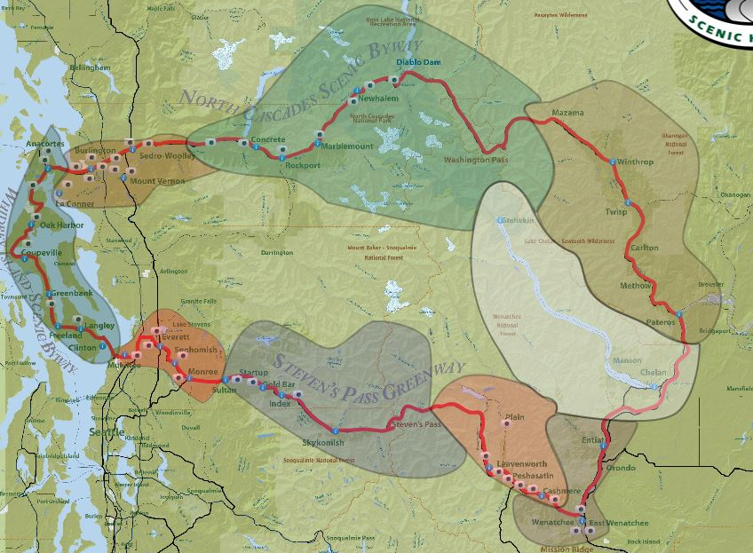
The Cascade Loop

Slide 40
The advantages of tourism routes
Meyer (2004) notes tourism routes can:
Disperse tourists and bring economic benefits for smaller tourist regions
Raise awareness among tourists about less popular attractions and regions.
Improve the attractiveness of a destination
Inspire tourists to stay longer and spend more while on the route
Achieve an increase in tourists’ arrivals and encourage repeat visitation
Create sustainable tourism products

Slide 41
Critical success factors in developing a tourism route
Grail found some of the CSF’s they had to address were:
Was there a market for a Holy Grail route?
What should be the key emblematic places or locations identified along the route?
Could these places be linked to a consistent story about the grail and be supported by documented evidence & various myths and legends
Would these locations have tourist appeal and are they supported by tourist infrastructure?

Slide 42
Would any proposals be accepted by the tourism industry and the local community?
Could a realistic daily itinerary be produced for each country and for the route as a whole – taking into account time, distance, available transportation and cost?
How would the route be signposted taking into account the need for identifying emblematic places and assuring route continuity?

Slide 43

Opportunities and Challenges

Slide 44
Grail offers the opportunity.
To develop a new tourism product
Expand the market for spiritual and cultural tourism in Europe
Bring together diverse cultures unified in one common theme – the understanding of a spiritual icon
‘At its most basic the Grail Route will take you to some interesting geographical locations. However for me any grail quest should be a journey into discovery – into European culture; cultural ideas and spiritual values and the world of the metaphysical’
Chris Gidlow – UK Grail Expert

Slide 45
The Challenges
There have been many!
Conceptually
Grail fact or fiction?
Identifying emblematic places based on fiction e.g. Corbenic, Camelot
One route or several? (The British Country Report raised the possibility of five separate strands based on Grail literature)
The number of emblematic places (Arthurian route)

Slide 46
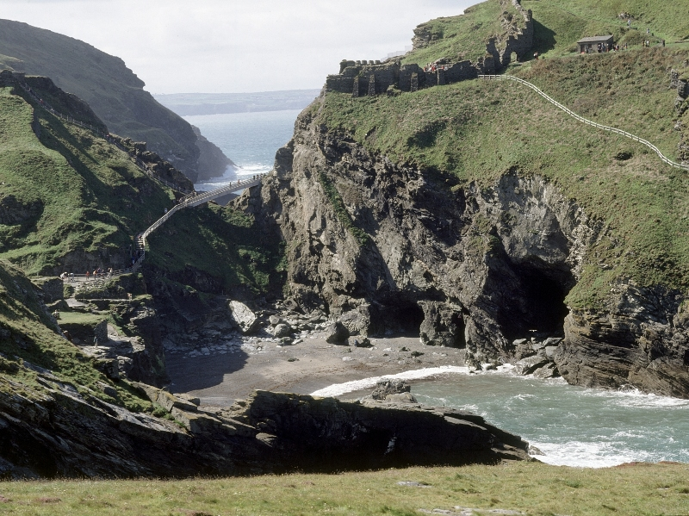
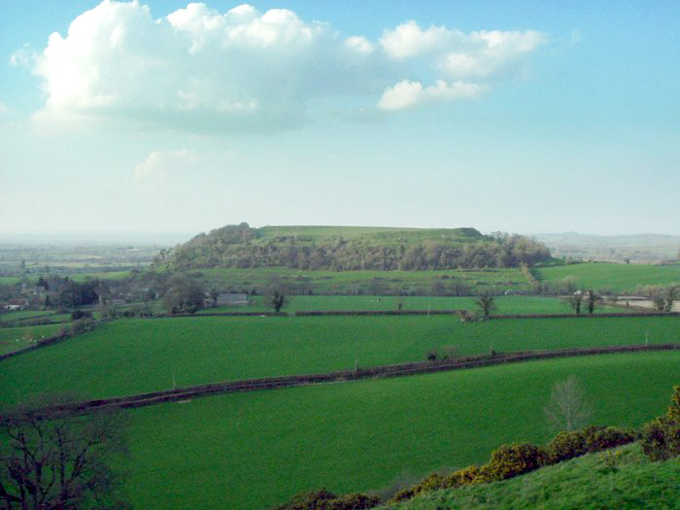

Slide 47
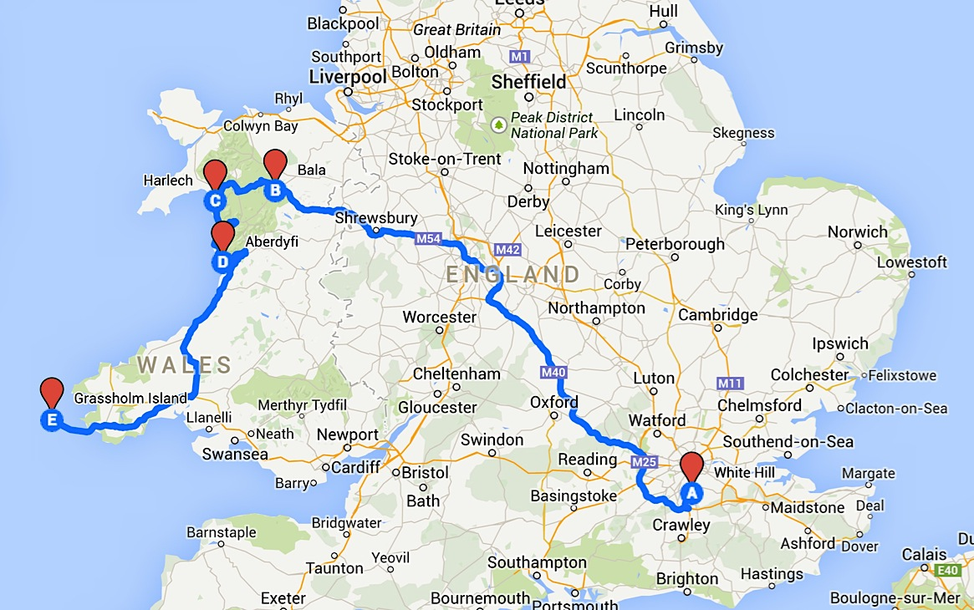

Slide 48
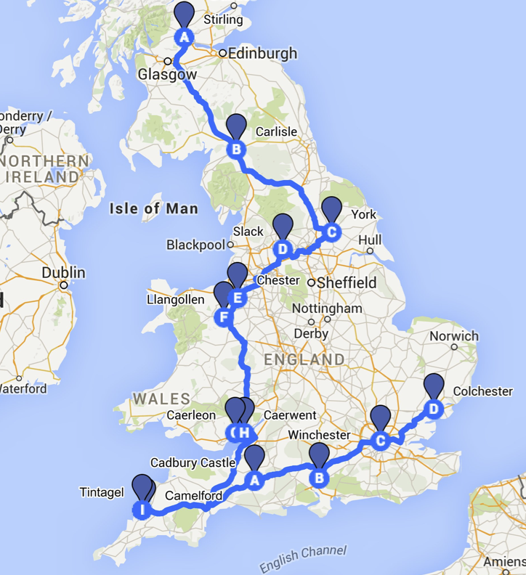

Slide 49
Stories have been embellished or created to attract pilgrims (John of Glastonbury, William of Malmesbury, Hailes Abbey)
There is a lack or records or no documented sources (Mabinogion)
The medieval romances mix stories (vulgate and post-vulgate cycles) and are hard to follow and understand(medieval French)
There are inconsistencies (The grail appears in Britain and Spain at the same time. If it is buried underneath Glastonbury Tor how can it be in Valencia?)
Reconciling cultural traditions (the Grail story is different in certain countries e.g. Spain & Bulgaria)

Slide 50
Logistical challenges
Developing the product and creating a brand (logo)
Developing common marketing activities at targeted groups e.g. maps, brochures, catalogues (both online /print)
Creating awareness about a tourism route and strengthening its image among tourists (Media).
Finance - common marketing activities demand a lot of finance as they are done on an international scale and include all destinations of a tourism route (Puczko and Ratz, 2007).
Maturity - It can take 20-30 years for a tourism route to mature (Lourens 2007)

Slide 51
The success of the route is largely bound up in its ability to engage with and capture the imagination of a range of stakeholders and communicate common ideas and values. Quieroz (2010) and Courtney (et al. 2010)
Success is also determined by the ability to achieve cooperative networks. Cooperative networks imply cooperation among stakeholders, authorities and inhabitants which will not only ensure synergies between and within destinations, but also the sharing of common knowledge and expertise
It is important to interlink locations with other tourism route thereby providing for and improving the tourist experience Gunn (1988), Hallo and Manning (2009)

Slide 52
The success of any tourism route is dependent on obtaining the support of government and private sector (Lourens 2007) e.g. Santiago de Compostela
The quality of interpretation and the opportunity to learn will be vital – sustainability debate (Hardy 2003)
Finally any tourism route is only as good as the quality of its service provision (Antonson and Jacobsen 2014)

Slide 53
Progress to date
A resource analysis has been done on each country (country report)
These have identified key emblematic locations linked to any such route
A ‘6 A’ framework is being applied to these locations (Buhalis 2003)
A number of ‘grail & tourism experts’ have been identified and interviewed
In order to ascertain the potential of a Grail Route and confirm/repudiate the validity of places identified in the country reports.

Slide 54
We have a route!
This will be outlined at an International Conference on the Grail to be held in Jaca in late November 2015

Slide 55
Currently
The team are engaging with stakeholders with a view to developing the product:
This involves:
Familiarising the tourism industry and local communities with the project.
Getting them to spot its tourism potential
Training them as to the association between place and the grail
Undertaking press & media with a view to raising destination and product profile

Slide 56
Conclusions
Exciting times ahead!
We thank you for listening & welcome any questions.

Slide 57
Dr Paul Fidgeon (paul.fidgeon@uwl.ac.uk)
Dr Victoria Sanagustin-Fons (vitico@unizar.es)
Dr Jose

