Slide 1
Developing Film-Induced Tourism:
The Film-Set Project
Paul Fidgeon
University of West London
Academic Year 2015-2016

Slide 2
Aims
To define Film-induced Tourism
To consider its importance and appeal as a tourism product
To review, with reference to various case studies, the impact of film-induced tourism
To introduce the Film Set project considering its aims and objectives
To discuss its methodology
To examine progress to date

Slide 3
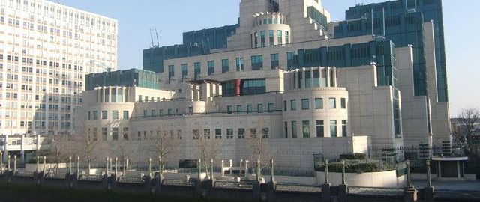
Film-induced Tourism

Slide 4
Research evidence shows that exposure of a place on film can inspire interest in visiting a location (Connell 2005, Young 2011)
This interest can remain long after the crews have left
Films have become virtual brochures (Boylan 2011, Boy and Bell (2011)
They provide 2-3 hour adverts for a destination potentially watched by 1bn consumers worldwide

Slide 5
Film-induced tourism can be defined as:
‘ a pattern of tourism that drives visitors to see screened places during or after the production of a feature film’. Hudson (2011)
‘It can be expanded to include television, video and DVD’ Butler (2011)

Slide 6
There are many derivatives:
Cinetourism (used in Europe) (Klug 2011)
Teletourism (TV-inspired tourism) (Connell 2012)
Screen or screen-based tourism (Catch-all term including music and games) (Fernandez 2013)
Set-jetting Tourism (Asinari 2012)
‘Blockbuster breaks, location vacations (Visit London)

Slide 7
On-location / off-location film tourism (natural / artificial or created locations – Spectre Solden / Pinewood Studios) Roesch 2009

Slide 8
Film or TV Does it Matter?
Films tend to be a one-off or limited experience / TV series have a longer screening period
The implications?
Empathy with the story, characters, setting is developed and maintained over a longer period of time leading to a longer-term impact (Beeton 2015)
TV audiences tend to be more passive / film audiences tend to be more inquisitive and connect with the narrative and meaning
There are, of course, exceptions to this rule (Sound of Music / Line of Duty)

Slide 9
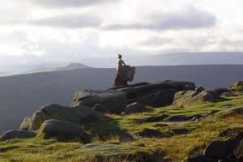
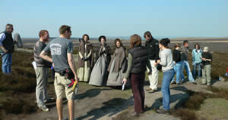
Film as a tourist attraction

Slide 10
The tourism market is continually changing
Today’s travellers are seeking unique and experiential experiences together with cultural immersion (Roesch 2009)
Explosion of interest in Film (3D, CGI, Video on demand, internet streaming, Digital TV, Hand-held devices, Apps – all have helped to stimulate an interest in film locations

Slide 11
Size and Significance of the Market
‘If you film it they will come’
Tony Reeves (2015) ‘Worldwide
Guide to Movie Locations’.
Film-induced tourism is not an exact science – it is impossible to automatically calculate box-office success

Slide 12
The influence on destinations

Slide 13

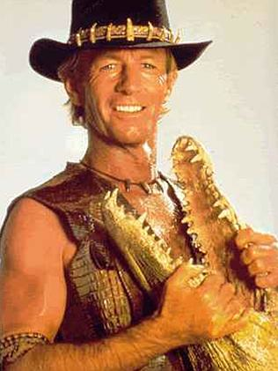
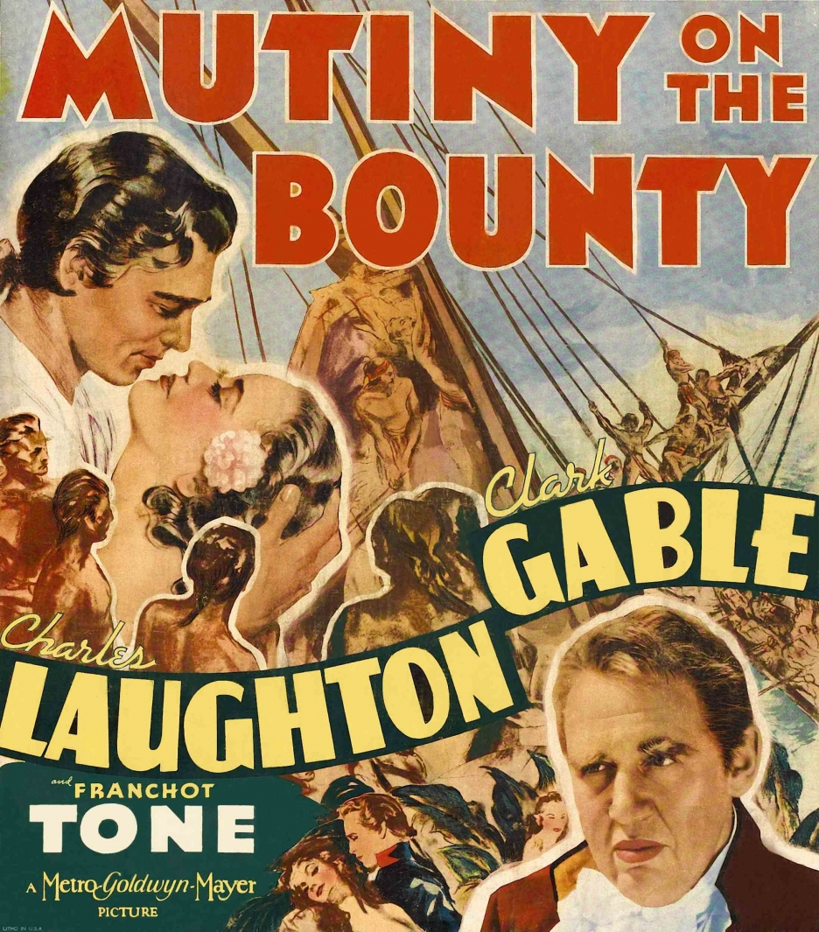


Slide 14
The influence on the product itself

Slide 15
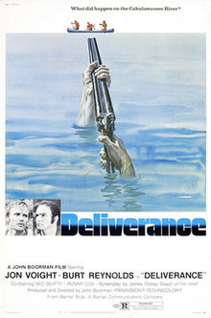
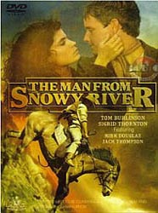


Slide 16
Deliverance – Canoeing, Raburn County, Californa
Man from Snowy River - Horseback Riding, Australia
Titanic - Cruising

Slide 17
Influence on specific locations

Slide 18
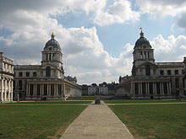
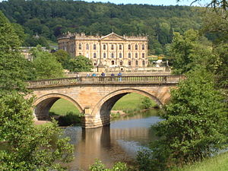
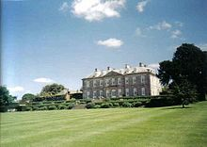

Slide 19
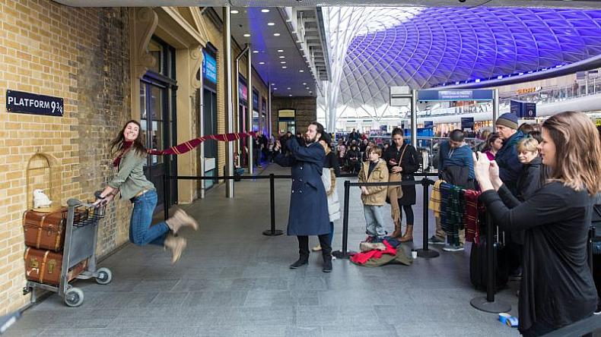

Slide 20
13% increase at the Old Naval College (Pirates of the Caribbean – On Stranger Tides)
10% increase at Chatsworth House (Film of the same name)
X4 increase in visitor numbers with Tim Burton’s Alice in Wonderland at Antony House Cornwall
Harry Potter at the Box Office maybe over but platform 9 ¾ lives on a London Kings Cross and features in the Warner Bros. studio tour opened in March 2012

Slide 21
Overall conclusions
A successful international film can increase visitor numbers in a region by 4-10%
Strongest effect 3-4 years after release
£2.1 bn of visitor spend is attributed to UK films
1 in 10 of visitors to the UK is inspired by film
Creates 22,000 jobs
UK Film Council (2016)

Slide 22
Success Factors in Film Induced Tourism
Important
Strong narrative (story, characters, emotional resonance)
High visibility screen products (high budget, star driven, broad appeal, positive & uplifting)
Films linked to an established brand
Literary, historic or geographical significance
Not Important
Pure entertainment genres e.g. action or adventure films
Olberg/SPI (2017)

Slide 23
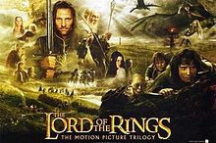
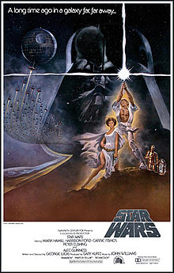
Film-induced tourism – a short lived product?

Slide 24
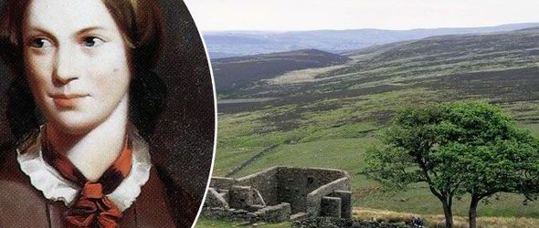
Film and Human Perception

Slide 25
Geographical perception: Jane Eyre (Charlotte Bronte) rolling moors and dales
Cultural perception: The Full Monty – Yorkshire grit and determination

Slide 26
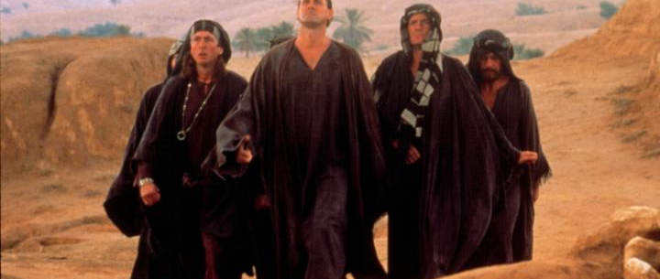
The Benefits of Film-Induced Tourism

Slide 27
The right film can breathe new life and meaning into places
Draws visitors to lesser know areas
Provide original themes or a twist on an old one
Encourage the seasonal and regional spread of tourism
Attract a new international market or demographic
DMO’s consider them to be powerful marketing tools

Slide 28
Examples of Film-induced Tourism
Multiday travel itineraries (Miss Potter & James Bond)
Visit Britain/Film London movie maps
Muggle Tours, London Walks, Celebrity Planet (Walks)
Premium Tours (Black Taxi Tours around the Capital)
Empire Magazine ‘ Dark Knight Location Travel Guide

Slide 30
Impact on Communities
The Positives
FIT can bring substantial numbers of visitors to even remote areas (Da Vinci Code)
Revive ‘flagging’ attractions
Gets tourists off the primary tourist trail
Encourage repeat visiting (Visit Britain 2015)

Slide 31
The negatives
Can put pressure on basic tourist infrastructure
Communities can resent the sudden influx of visitors (Connell 2005)

Slide 32

Film Set

Slide 33
What is it?
What does it hope to achieve?

Slide 34
What is Film Set?
Film Set is a pan-European research project
Sponsored by COSME (the European Union’s programme for small businesses).
It brings together 7 partners – lead by the University of Zaragoza
Co-ordinated by FDS Europa
The project was launched in November 2015 and lasted for 2 years

Slide 35










Slide 36
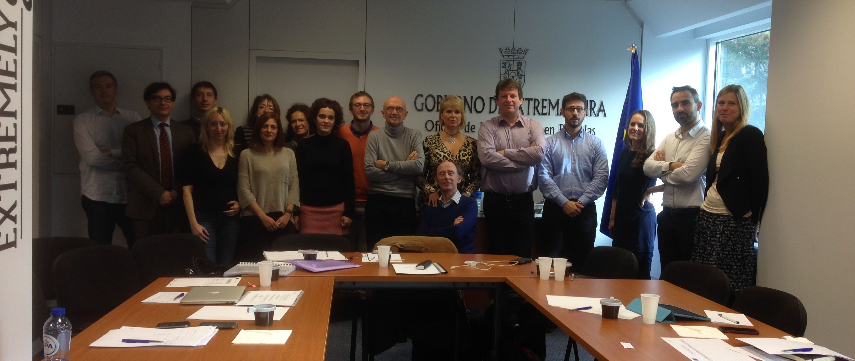

Slide 37
What does it hope to do?
The aim of Film Set is to develop and promote a European thematic tourist route based on cinema
The project recognizes the importance of cinema in European culture and how European towns and landscapes have inspired film makers when shooting their films
Many of these locations have subsequently become important tourist destinations e.g. Notting Hill
They illustrate the emotional link tourists attach to their surroundings and how these can motivate individuals to visit particular locations

Slide 38
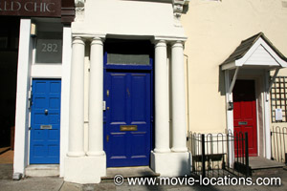

Slide 39
So the project seeks to identify a number of specific films that showcase aspects of European culture through the medium of film
Their association to particular locations is examined and in doing so this provides the foundation of a cinematic tourist route and a Film Set brand
A common strategic plan and communications strategy seeks to reinforce this brand and enhance consumer awareness of the product.

Slide 40
Film Set seeks to adopt a sustainable tourism paradigm in that the places featured aim to provide a positive economic social and cultural contribution to tourism in that region
Each location is of real historic and cultural value and provide a unique experience for tourists visiting those locations

Slide 41
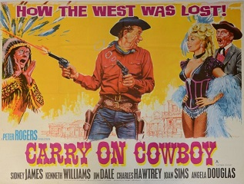
Various work programmes support the development of the project’s overall aim

Slide 42
WP2 Compilation of a national database of key films of the C20th-C21st
Using this database to select 5-10 films based on a Delphi analysis with participants from the artistic and creative industries using five selection criteria
WP3 Mapping Film Set sites pertaining to each film
Using these sites to create a tourism route

Slide 43
WP4 The development of tourism route products designed to showcase the route. (Vis: website, Android & iOS applications and a promotional video)
WP 5 Dissemination and communication of the route to a variety of industry and non-industry led stakeholders including local authorities, national and regional tourist boards, tour wholesalers, retailers and the general public through a programme of national seminars.
The organisation of an international film tourism conference designed to highlight and launch the route

Slide 44
WP6 The establishment of a network of film tourism towns with a view to establishing an organisational structure and a Decalogue among network members.
WP7 The establishment of a EU recognised centre for film tourism in each respective country

Slide 45
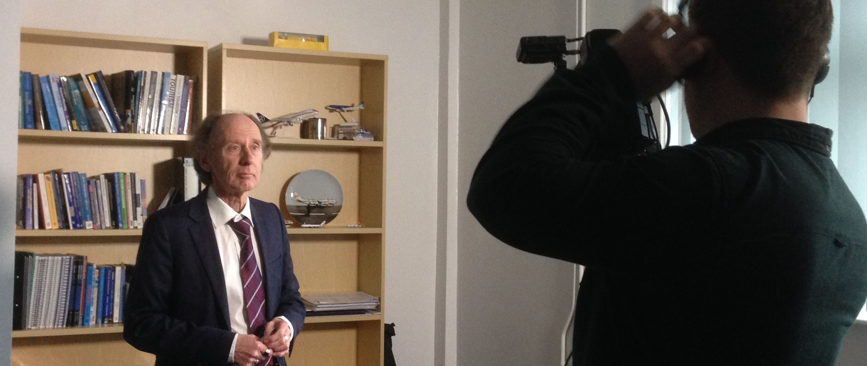
Progress to Date

Slide 46
The Creation of the Tourist Route
Step 1 The compilation of a database of ‘classic European films’ of the C20th-21st

Slide 47
This was based on a literature review drawn from a range of different sources including national entertainment magazines, the specialist press, film institutes, national broadcasting organizations, film critics, newspapers and academics

Slide 48
These Included:
The Daily Telegraph (2015) – 75 Great British Movies
Time Out Magazine (2015) – 100 Best British Films
Empire Magazine (2013) – Top 100 British Films
BFI (2016) – Greatest British Films of the C20th
BBC Culture (2015) – Classic British Films/Your Best Films
Barry Norman’s (2013) – 50 Best British Films
Prof. Jeremy Strong (2016) – Significant British Films
This produced a database of 216 different films
This was reduced this to 15 based upon multiple entries in 6 lists (only 4 appeared in all 7)

Slide 49
Top 15
The 39 Steps (1935)
Brief Encounter (1945)
Four Weddings and a Funeral (1944)
Great Expectations (1946)
Gregory’s Girl (1981)
Kes (1969)
A Clockwork Orange (1971)
If (1968)
Kind Hearts and Coronets (1949)
The Lady Killers (1955)
The Long Good Friday (1975)
A Matter of Life and Death (1946)
Secrets and Lies (1996)
Withnail and I (1987)
Get Carter (1971)

Slide 50
Step 2 Reducing the number of Films from 15 to 5-10
Methodology: Produced a Delphi Questionnaire
The was distributed it to 147 individuals (including Producers, Directors, Actors, Critics, Film Institutes, Cinematographers) following a pilot
They were asked to score the 15 films based on 5 criteria / 7 point likert scale. These scores were then used to rank the films in order of importance
Artistic value (critical acclaim within the film industry, media & the general public)
Visual attractiveness (cinematography & sets)
Historical content/significance
Social Impact
Commercial success

Slide 51
Delphi (1st Spin) N=15
39 Steps (196)
Kes (162)
Four Weddings (158)
Great Expectations (157)
Withnail & I (138)
Secrets and Lies (130)
Brief Encounter (128)
Long Good Friday (125)
Clockwork Orange (123)
Matter of Life & Death (119)
Gregory’s Girl (115)
Kind Hearts (112)
If (110)
Lady Killers (99)
Get Carter (97)

Slide 52
Delphi (2nd Spin) N=15
39 Steps (192)
Kes (186)
Four Weddings (168)
Secrets and Lies (157)
Withnail & I (149)
Great Expectations (145)
Brief Encounter (130)
Clockwork Orange (127)
Long Good Friday (125)
If (120)
Matter of Life & Death (119)
Kind Hearts (112)
Gregory’s Girl (112)
Lady Killers (99)
Get Carter (96)

Slide 53
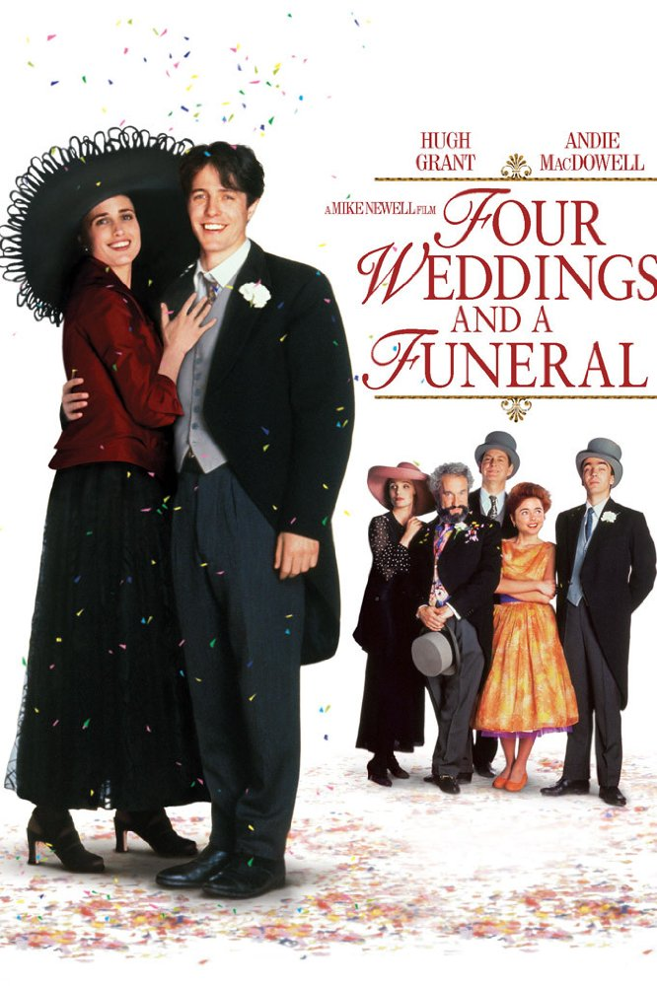
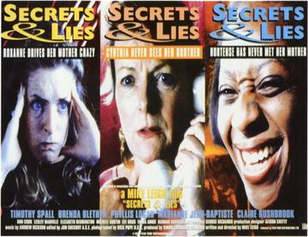
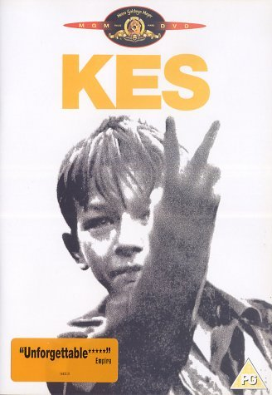
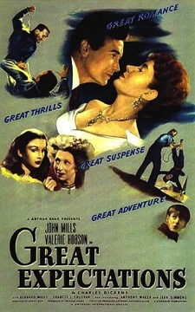
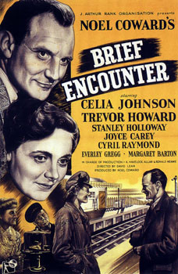
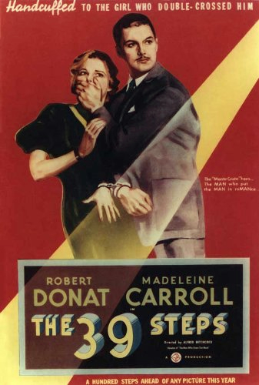

Slide 54
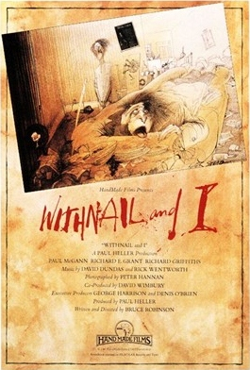

Slide 55
Film Descriptions
39 Steps (Murder Mystery – Hitchcock)
Kes (Working class social deprivation & educational underachievement – Ken Loach)
Four Weddings & a Funeral (Comedy – Richard Curtis)
Secrets and Lies (Political Agenda: Adoption records & Race – Mike Leigh)
Withnail & I (Semi autobiographical dark comedy: Homosexuality & Drug Culture – Bruce Robinson)
Great Expectations (Classic fiction: Charles Dickens – David Lean)
Brief Encounter (Wartime love story – David Lean)

Slide 56
Links
https://www.youtube.com/watch?v=WgDUrczqnPU (39 steps)
https://www.youtube.com/watch?v=eXyo68s-f1E (Great Expectations)
https://www.youtube.com/watch?v=PvMdN_i-D9I (4 Weddings)
https://www.youtube.com/watch?v=awU3_elyQMI (Secrets & Lies)
https://www.youtube.com/watch?v=VRgwbkdoIcY (Withnail & I)
https://www.youtube.com/watch?v=hubyFqSUaGA (Brief Encounter)
https://www.youtube.com/watch?v=Yu-5LCr1kwg (Kes)

Slide 57
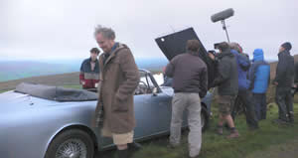
Step 3 Identification of Film Locations
This used Reeves (2003) movie-locations.com, imdb.com et al.
This provided the basis of the route in the UK

Slide 59
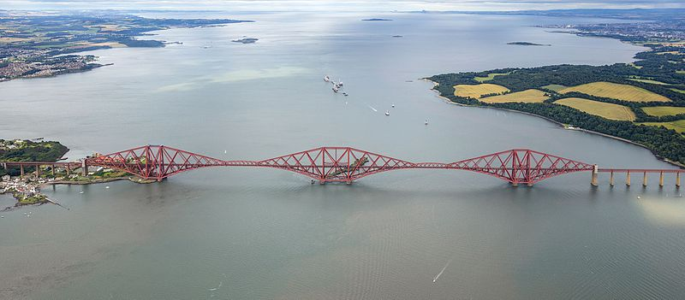
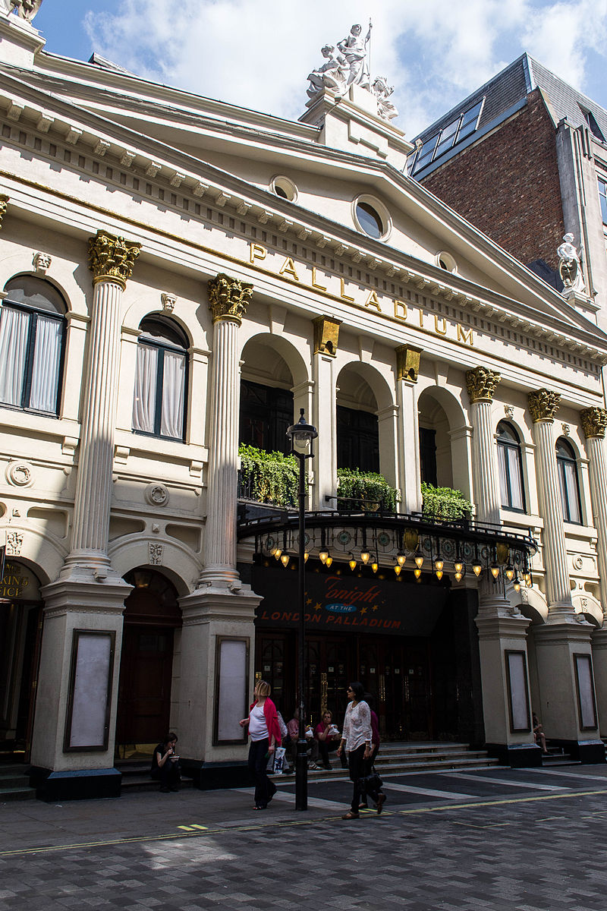
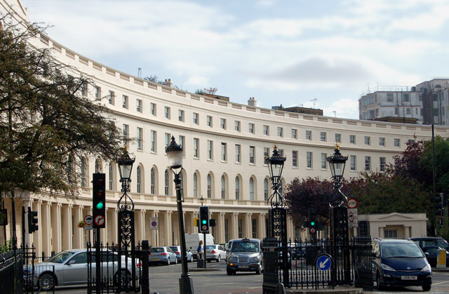

Slide 61
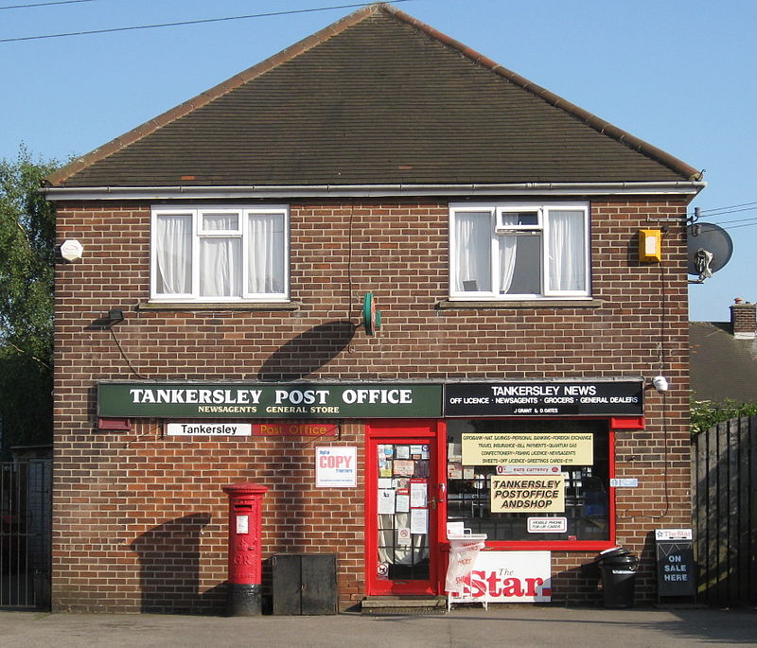
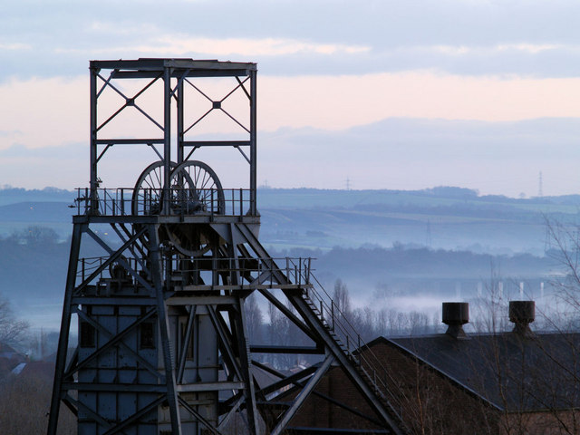
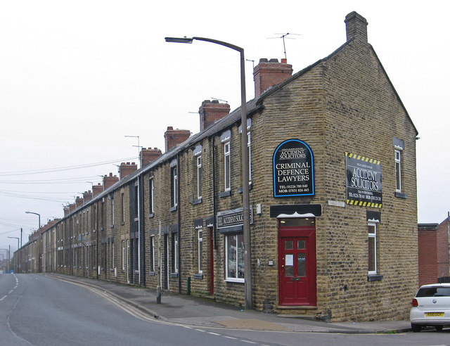

Slide 63
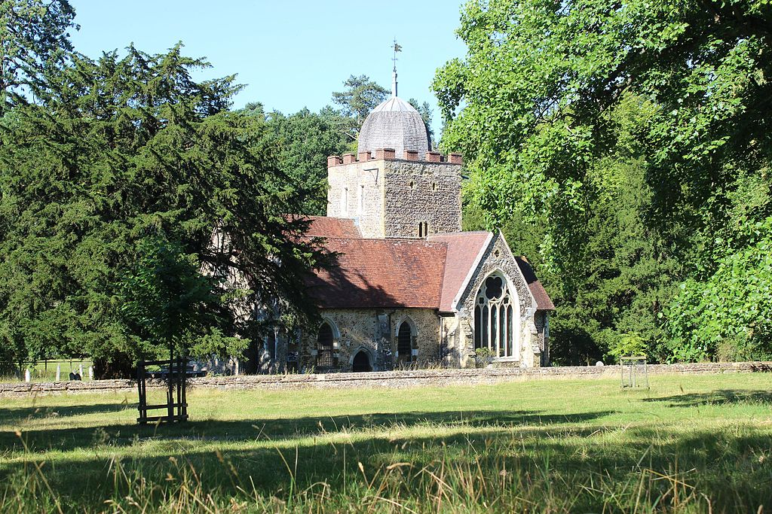
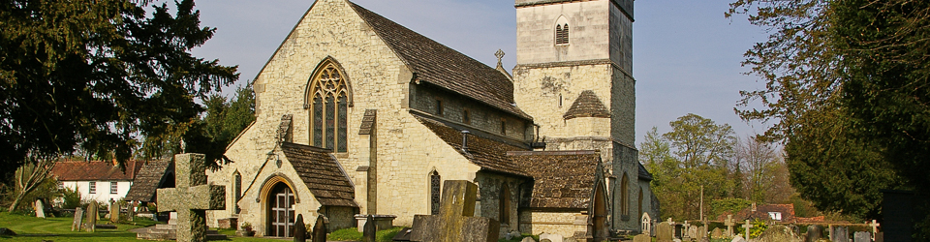

Slide 65
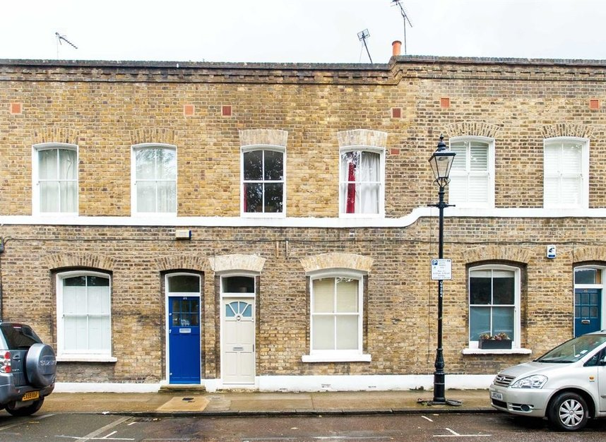
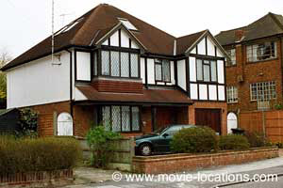
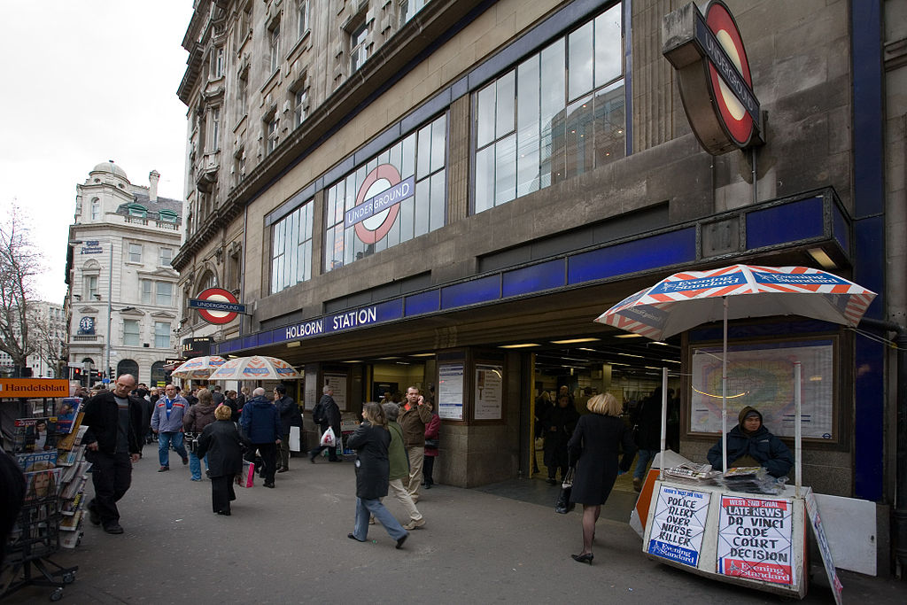

Slide 67
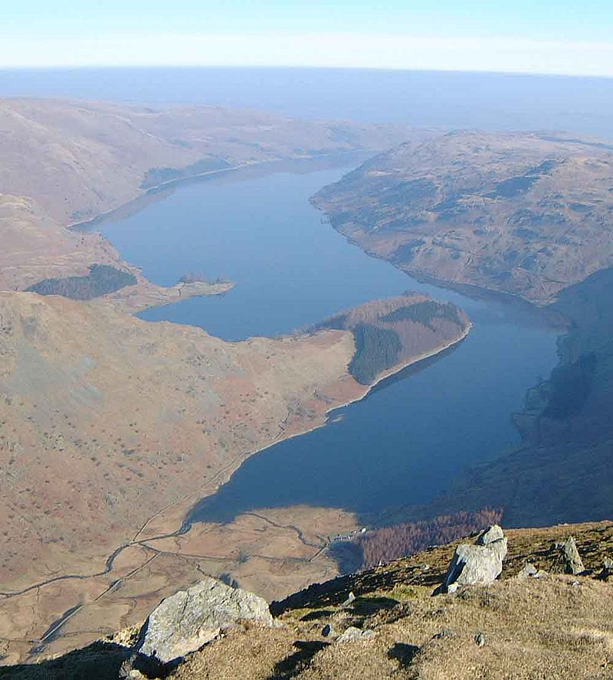
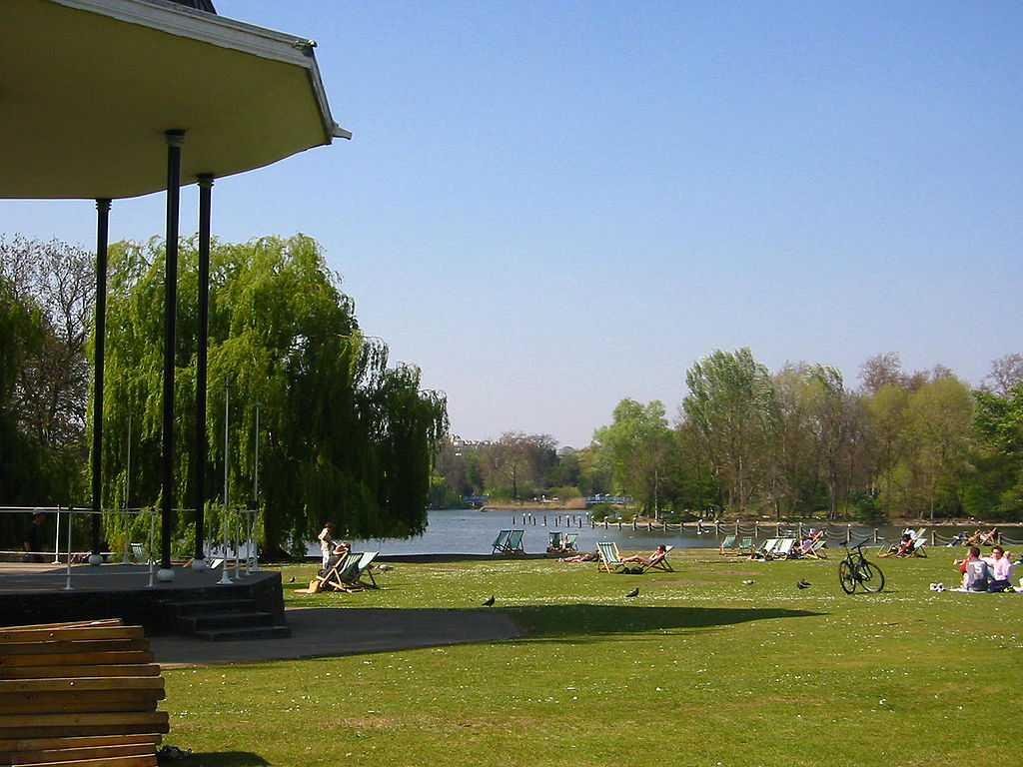

Slide 69
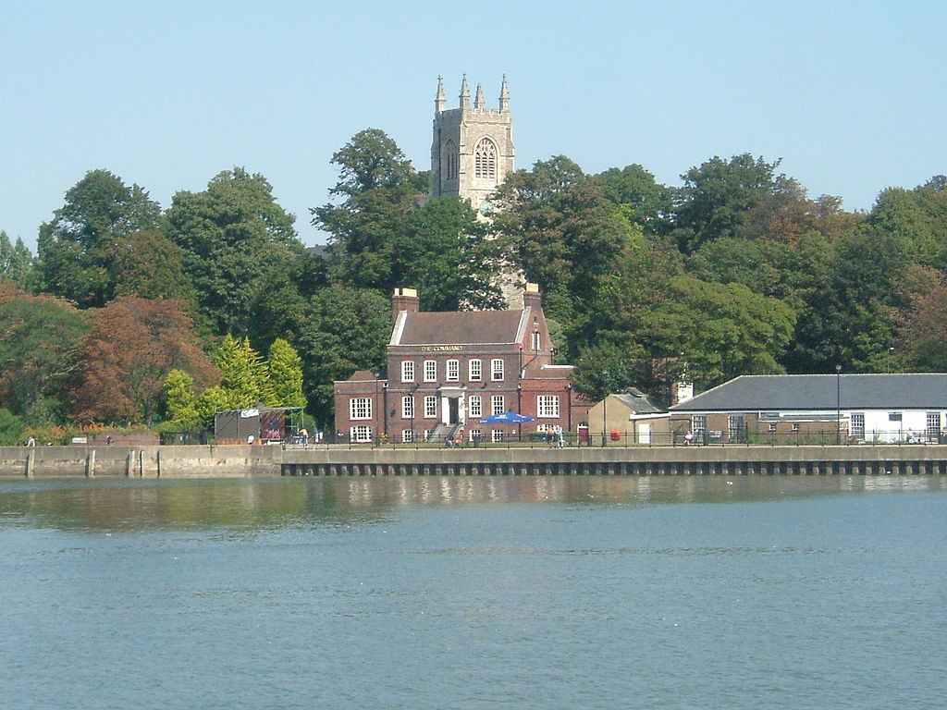

Slide 71
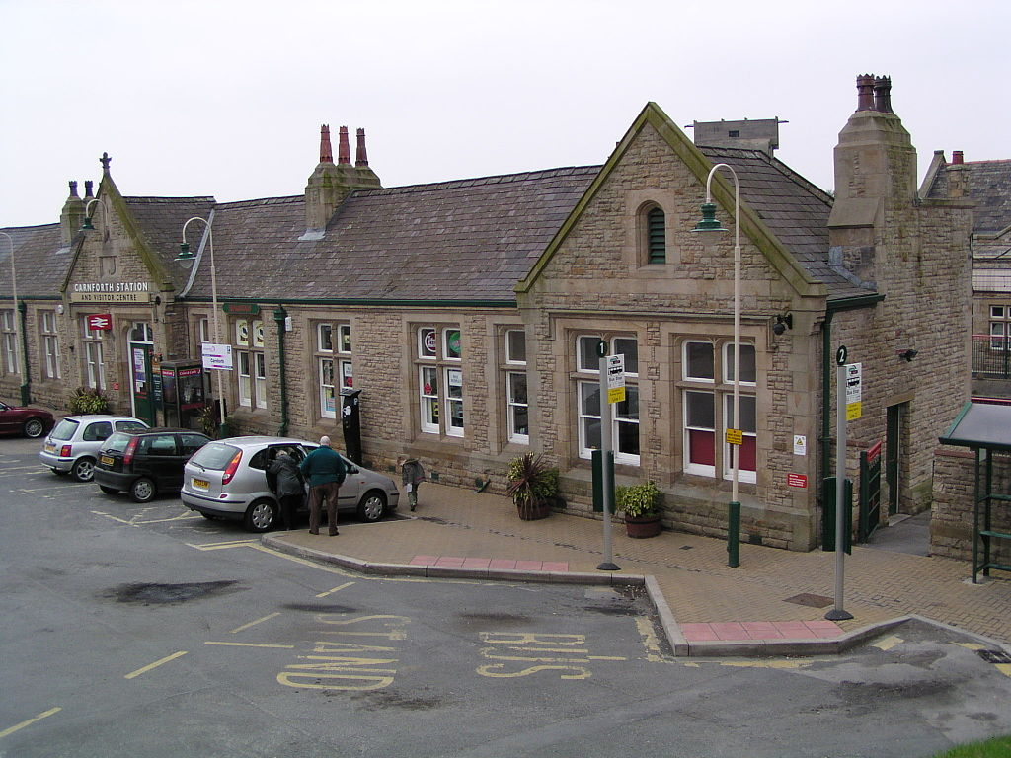
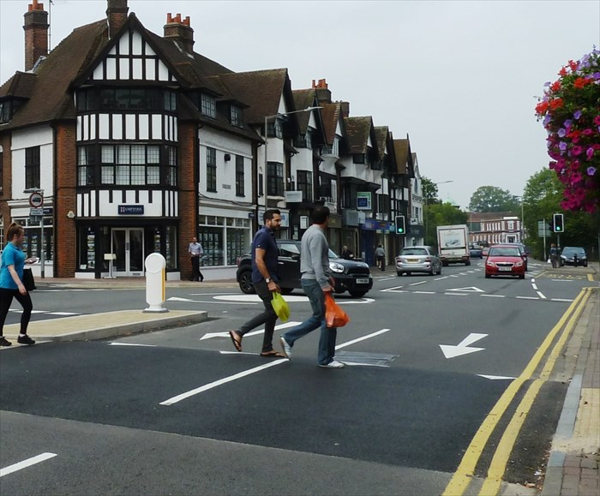

Slide 72
Step 4 To each location a 6A framework was applied
Buhalis (2003)
Association * Accommodation * Attractions * Amenities * Accessibility * Ancillary Services
This material was incorporated into the Film Set website, IOS and android applications and a promotional video

Slide 73
Step 5: The Development of a multi-media communications strategy (Mazedia)
Facebook (https://www.facebook.com/filmsetproject/ )
Website ( http://www.filmsetroute.eu/en )
Apps
TV, Radio, Conference Presentation, Publication, Press Releases, Newsletter

Slide 75
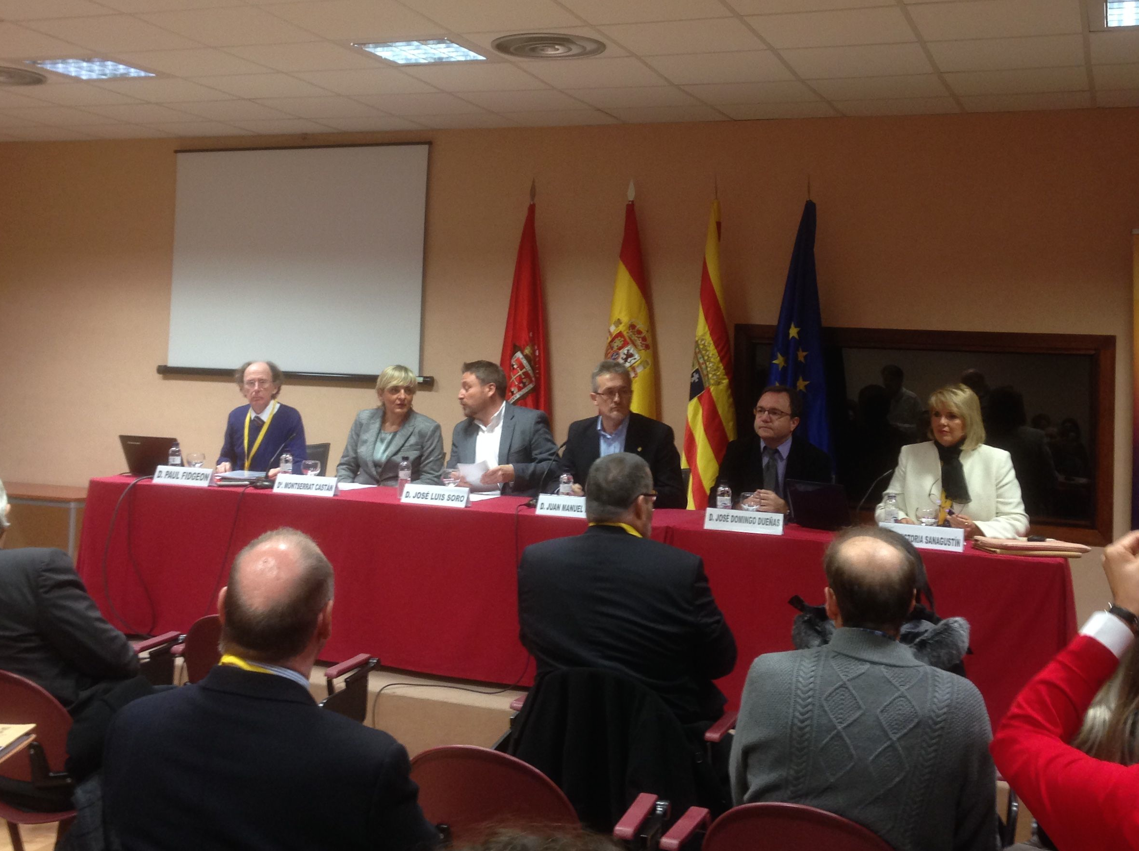
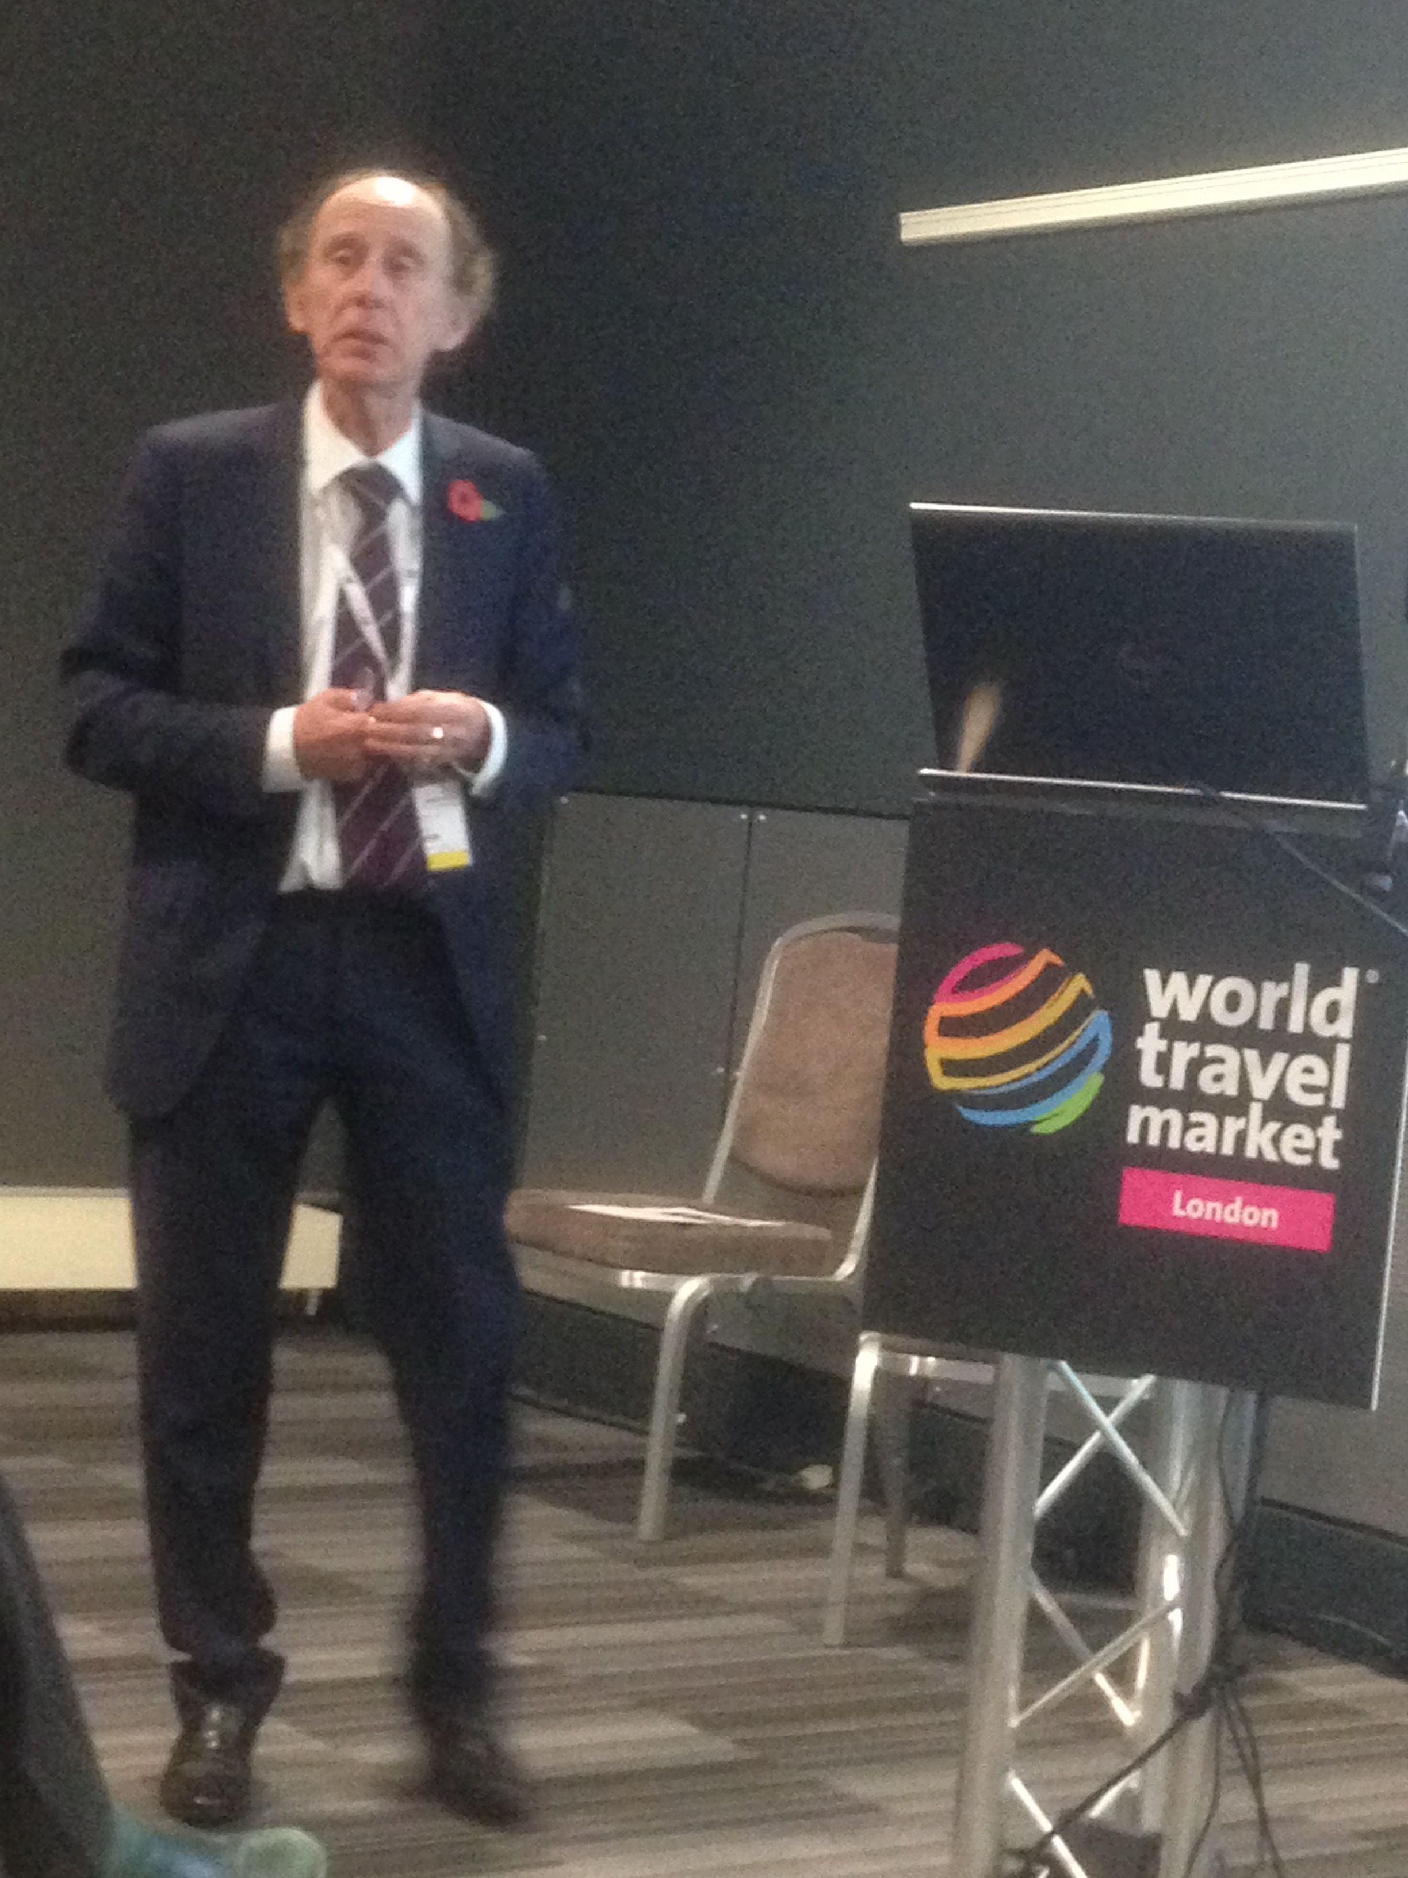

Slide 76
Developing a Film Set Promotional Video
Partners were asked to:
Arrange a series of interviews with stakeholders from the film and creative industries and get them to discuss our films
It was suggested that we should get interviewees include any anecdotes about locational filming, the cast or the Director
Get them to explore any social messages the film director sought to portray
Consider what the film meant to that individual & the impact of that film on society (its legacy)
Get interviewees to highlight the tourism potential of the film

Slide 77
Who was approached?
Went back to the original Delphi participants (and added a few more)*
Who agreed to take part?

Slide 78

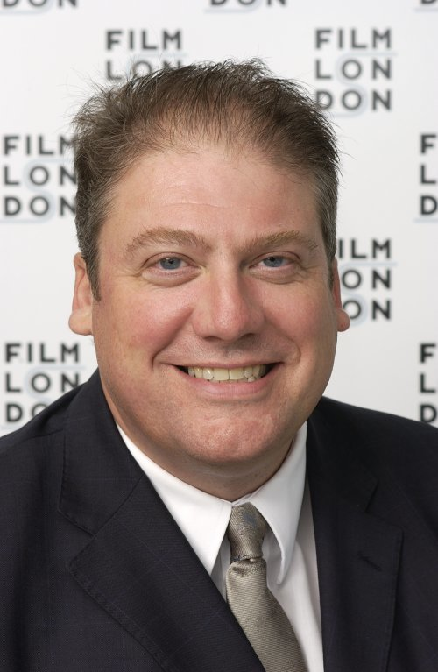
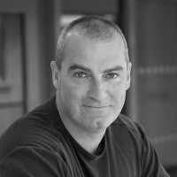
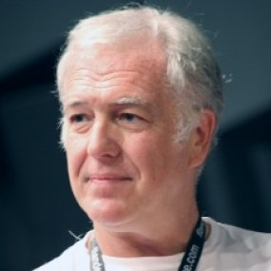
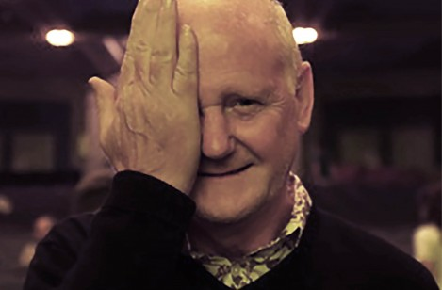


Slide 79
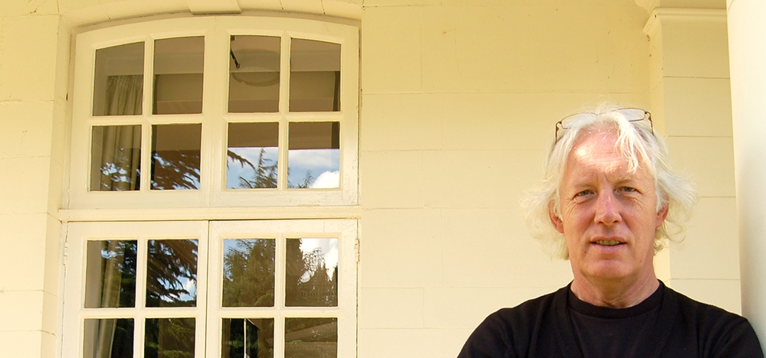







Slide 80
Partners were also asked
Get some contemporary locational footage of film locations relevant to their routes
Supplement this with stills and scenes taken from the various films (negotiation of film rights)
Produce a narrative to their video
Work with Rodando in editing content

Slide 81
I filmed with a Spanish crew in mid-May 2017 & finished editing the UK element of the video in early June
(Taster)

Slide 82
Further Developments?
Step 6 Built our network of Film Tourism Towns
Step 7 Establish a EU recognized Centre for Film Tourism in the UK

Slide 83
There have been many problems & challenges
Logistical
Arranging filming dates
Who would film?
Flexibility in schedules (Richard, Geoff & Francine) (Ken Loach)
Limited window of opportunity (just 45mins with Adrian Wotton)
Underestimation of distances involved
Time limitations (2 days)
Over ambitious expectations (interviews & location filming)
Transporting equipment (Underground)

Slide 84
Technical
UWL or on location?
Suitability of sites (Geoff/home) (John/UWL)
Problems with equipment (battery expired, sound did not work)
Some initial ideas (use of drones) raised legal issues

Slide 85
Acquiring permits/permission to film
Debate whether this was necessary (laws in the UK are very different)
Filming schedules were cancelled twice (e.g. Carnforth, London Palladium & Greenwich resulting in a loss of goodwill)
Some locations were not prepared to entertain a film crew (Rotherfield Park, East Tisted)

Slide 86
Response Rate
Low
People were busy / did not want to participate
Felt the project had been done before
Clashed with London Film week / Ben Gibson of LFS was willing, but out of the country
Participants expected payment (Barry Norman)

Slide 87
Interviewees
Were these always the best people?
Were they able to speak to camera? (Adrian v John) (One take v several)
Were they always able to answer the questions?
Were they prepared to answer the questions? (Some films were dated making them difficult to recall / Some Directors were personal friends / Some films were simply not liked)
They wanted to see the questions in advance to plan their answers

Slide 88
Film Rights/Stills
Raised issues of copyright
Costs
Extending filming to include locational shots
Raised additional resource constraints (Time, money, people)
There was very little left of original locations (Kes)

Slide 89
Conclusions
It has been great fun!
Come a long way
We are putting in an INTERREG and COSME bid to extend & operationalise the project

Slide 90
Thank you for your attention

