Slide 1
CELEBRITY CHEFS AND THE CONSTRUCTION OF TASTE: FROM ÜBER MACHO TO CULINARY CRUSADER
Ariane Lengyel
London Geller College of Hospitality and Tourism
SOAS 24 February 2017

Slide 2
Content
Research context
Taste
Factors influencing the construction of taste
Celebrity chefs
The chefs as a media and social phenomenon

Slide 3
Research Context
Food is crucial physiologically and sociologically
Cultural phenomenon of food and taste
Celebrity chefs as actors of this phenomenon
Taste as a social discriminator and marker of distinction
Link between the chefs and the construction of taste yet under-explored
The role of celebrity chefs as a wider socio-cultural phenomenon

Slide 4
Definitions of Taste
The term taste refers originally to gustatory taste
Is also used to describe aesthetic sensibility (Korsmeyer 2005)
Taste acts as a classifier as well as a marker of identity and difference and implies discrimination (Bourdieu 1984, Mennell 1996, Short 2006, Hyman 2008, Strong 2011, Milne 2013, Finkelstein 2014).

Slide 5
How is taste acquired – the theoretical backgrounds
Structuralist approach
Taste is culturally shaped and socially controlled (Bourdieu 1984, Warde 1997, Atkins and Bowler 2001, Seymour 2004, Levi – Strauss 2008)
A manifestation of the accrual of cultural capital which can be converted into economic, symbolic and social capital (Bourdieu 1984, Warde 2007)
Formal groups and society act as classifiers
Symbolic meanings
Taste is intrinsically linked to social class (Bourdieu 1984)

Slide 6
How is taste acquired – the theoretical backgrounds
Materialist/developmentalist approach
Taste is connected to external influences such as economic and political changes (Goody 1982, Mennell 1996, Mintz 2008)
Social position linked to consumption
Focus on structure
Power, exclusion and inclusion (Goody 1982)

Slide 7
How is taste acquired – the theoretical backgrounds
Post-modernist approach
Taste is central to the construction of individual identity (Warde 1997, Holt 1998, Warde et al. 2008, Warde and Gayo-Cal 2009, Warde 2016)
Cultural omnivores (Arsel and Bean 2012)
Consumption
Standardisation and modernisation (Ritzer 2013)
Blurring of class delineators

Slide 8
Food Taste
Discourse of exclusivity
Marker of identity though choices and openness to novelty
What is acceptable to eat
Distinguishes those that know from those that don’t
Culinary capital
Jamie v Gordon
Foodies v chowhounds (Naccarato and Lebesco 2012)
Relationship between food choices and social categories
Status and power

Slide 9
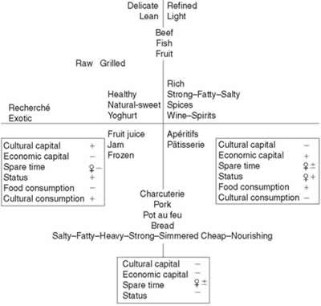
The food space map (Seymour 2004 adapted from Bourdieu 1984:186)

Slide 10
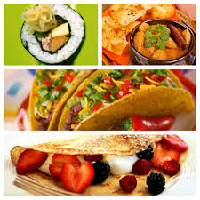
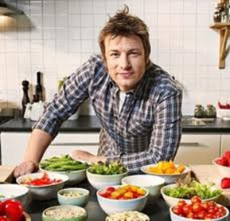
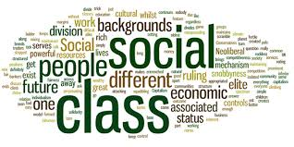
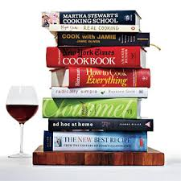
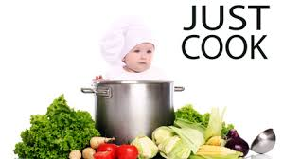
TASTE

Slide 11
Factors Influencing the Construction of Taste
Internal
Gender
Age
External
Lifestyle
Peers
Influencers
Food critiques
Food guides
Economic and cultural capital
Availability
Time
Culinary capital
Celebrity chefs
Socialisation
Education
Status
Habitus
Cookbooks
TV shows
Internet
Media
Identity
Culture
Religion
Class
Distinction

Slide 12
A chosen definition of Celebrity Chefs
Someone with a professional background who enjoys a certain element of recognition… unconfined to the world of professional restaurants. They exercise popular appeal in a market that comprises diners, television viewers, book readers, internet users and consumers of food and food related products. (Henderson 2011)

Slide 13
A second definition
A diverse collection of individuals who are famous for cooking or talking about and presenting cookery via various kinds of media…accompanied by supporting cookbooks and, in many cases, websites and other branded goods (Piper 2013)

Slide 14
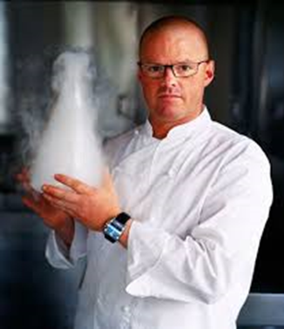
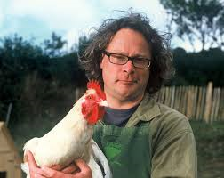
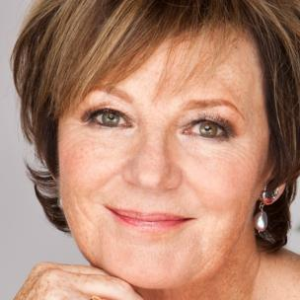
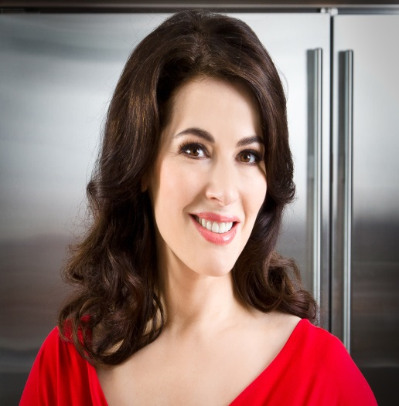
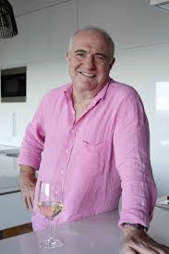
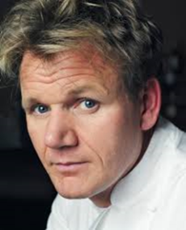

Slide 15
Moral entrepreneur (Bell and Hollows 2010) Culinary Crusader (Scholes 2011) Food Revolutions (Scholes 2011) Public Pedagogue (Piper 2012) Social and Health | Jamie Oliver (Jamie’s Ministry of Food)
Instructional Matriarch (Scholes 2011) | Delia Smith (Delia through the decades) and Nigella Lawson (Nigellisima)
Vocational expert (Bell and Hollows) Uber-Macho (Scholes 2011) | Gordon Ramsey (The F Word)
Aspirational Wizardry (Scholes 2011) | Heston Blumenthal (Heston’s Fantastical Food)
Adventurer (Scholes 2011) Travel and culture | Jamie Oliver (Jamie in Italy) Rick Stein (Mediterranean Escapes)
Real Food (Scholes 2011) | Hugh Fearnley- Whittingstall (River Cottage)

Slide 16
The Chefs and the Media
Entertain and educate
Chefs as entertainers mediating the notion of good and bad food (Piper 2012)
Lifestyle (Piper 2013)
Arbiters of taste
Personas – rock stars and cultural icons
Food citizens (Barnes 2014)

Slide 17
The Chefs as agents of change
Tensions around work and leisure (Lewis 2014)
Ethics and consumption
Culinary capital (Naccareto and Lebesco 2012)
Cookbooks (Bell and Hollows 2005, Humble 2005)
Food governance
Public pedagogy
Consumption
Legitimacy and experts
(Hollows 2003 , Hansen 2008, Hollows and Jones 2010 a and b, Lewis 2010, Arsel and Bean 2012, Piper 2013, Stringfellow et al. 2013 , Barnes 2014, Lewis 2014)

Slide 18
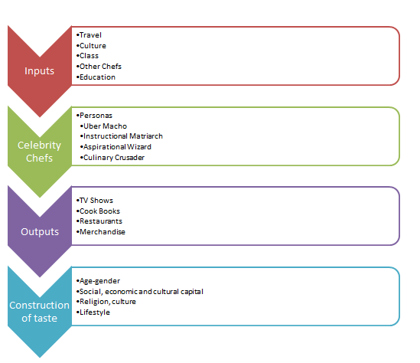

Slide 19
Conclusion
Proposed conceptual framework based on the review of literature
Evaluate the diversity and essence of how the celebrity chefs operate
How do celebrity chefs impact upon the construction of taste and what is their role in modern society?

Slide 21
List of References
Arsel, Z. and Bean, J. (2012), ‘Taste Regimes and Market-Mediated Practice’, Journal of Consumer Research, 39, pp.899-917.
Atkins, P. and Bowler, I. (2001), ‘Food in Society: Economy, culture, geography’, New York: Oxford University Press.
Barnes, C. (in press), ‘Mediating good food and moments of possibility with Jamie Oliver: Problematising celebrity chefs and talking labels’, Geoforum. (Accepted for publication September 2014).
Bell, D, and Hollows, J. (2005), ‘Making senses of ordinary lifestyles’, in D. Bell and J. Hollows. (eds), Ordinary Lifestyles, Popular Media, Consumption and Taste, Maidenhead: Open University Press, pp. 1-18.
Bell, D. and Hollows, J. (2010), ‘From River Cottage to Chicken Run: Hugh Fearnley-Whittingstall and the class politics of ethical consumption, Celebrity Studies, 2:2, pp.178-191.
Bourdieu, P. (1984), ‘Distinction: a social critique of the judgement of taste’, London: Routledge.
Finkelstein, J. (2014), ‘Taste – In an Age of Surfeit’, Gastronomica: The Journal of Food and Culture, 14: 2, pp. 41-45.

Slide 22
List of References
Goody, J. (1982), ‘Cooking, Cuisine and Class’, Cambridge: Cambridge University Press.
Hansen, S. (2008), ‘Society of the Appetite Celebrity Chefs Deliver Consumers’, Food, Culture and Society, 11:1, pp. 50-67.
Henderson, J. (2011), ‘Celebrity chefs: expanding empires’, British Food Journal, 113:5, pp.613-624.
Hollows, J. (2003), ‘Oliver’s Twist: Leisure, labour and domestic masculinity in the Naked Chef’, International Journal of Cultural Studies, 6: 2, pp. 229-248.
Hollows, J. and Jones, S. (2010a), ‘At least he’s doing something: Moral entrepreneurship and individual responsibility in Jamie’s Ministry of Food’, European Journal of Cultural Studies, 13: 3, pp. 307-322.
Hollows, J. and Jones, S. (2010b), ‘Please Don’t Try this at Home’, Food, Culture and Society, 13: 4, pp. 522-537.
Holt, D.B. (1998), ‘Does Cultural Capital Structure American Consumption?’, Journal of Consumer Research, 25:1, pp.1-25.
Humble, N. (2005), ‘Culinary Pleasures Cookbooks and the Transformation of British Food’, London: Faber and Faber Limited.
Hyman, G. (2008), ‘The Taste of Fame: Chefs, Diners, Celebrity, Class’, Gastronomica: The Journal of Food and Culture, 8: 3, pp 43-52.

Slide 23
List of References
Korsmeyer, C.(ed.) (2005), ‘The Taste Culture Reader Experiencing Food and Drink’, Oxford: Berg.
Levi-Strauss, C. (2008), ‘The Culinary Triangle’, in: C. Counihan, and P. Van Esterik (eds), Food and Culture A Reader. 2nd ed., New York: Routledge, pp.36-43.
Lewis, T. (2010) ‘Branding, Celebritization and the Lifestyle Expert’, . Cultural Studies, 24:4, pp. 580-598.
Lewis, T. (2014), ‘Lifestyle Media’, in J. Smith Maguire and J. Matthews, (eds), The Cultural Intermediaries Reader, London: Sage. pp. 134-144.
Mennell, S. (1996), ‘All Manners of Food’, 2nd ed., Chicago: University of Illinois Press.
Milne, R. (2013), ‘Taste’, in P. Jackson, (ed.), Food Words. London: Bloomsbury, pp. 214-221.
Mintz, S. (2008), ‘Time, Sugar and Sweetness’, in: C. Counihan, C. and P. Van Esterik (eds), Food and Culture A Reader. 2nd ed., New York: Routledge, pp. 91-103.
Naccarato, P. and LeBesco K. (2012), ‘Culinary Capital’, New York: Berg.
Piper, N. (2012), ‘Audiencing Jamie Oliver: Embarrassment, voyeurism and reflective positioning’, Geoforum, 45, pp. 346-355.
Piper, N. (2013), ‘Celebrity Chefs’, in: P. Jackson, (ed), Food Words, essays in culinary culture, London: Bloomsbury, pp. 40-43.

Slide 24
List of References
Scholes, L. (2011), ‘A slave to the stove? The TV celebrity chef abandons the kitchen: lifestyle, TV, domesticity and gender’, Critical Quarterly, 53:3, pp. 44-59.
Seymour, D. (2004), ‘The Social Construction of Taste’, In Sloan, D. (ed) Culinary Taste Consumer Behaviour in the International Restaurant Sector, . Oxford: Elsevier Butterworth Heinemann, pp 1-22.
Short, F. (2006), ‘Kitchen Secrets: The Meaning of Cooking in Everyday Life’, Oxford: Berg.
Stringfellow, L., Maclaren, A., Maclean, M. and O’Gorman, K. (2013), ‘Conceptualising taste: Food, culture and celebrities’, Tourism Management, 37, pp. 77-85.
Strong, J. (ed) (2011), ‘Educated Tastes: Food Drink and Connoisseur Culture,’ Lincoln: University of Nebraska Press.
Warde, A. (1997), ‘Consumption, Food & Taste’, Sage: London.
Warde, A. (2007), ‘Does Taste Still Serve Power? The Fate of Distinction in Britain’, Sociologica, 3, pp. 1-27.
Warde, A. Wright, D. and Gayo-Cal, M. (2008), ‘The omnivorous orientation in the UK’, Poetics, 36, pp. 148-165.
Warde, A. and Gayo-Cal, M. (2009), ‘The anatomy of cultural omnivorousness: The Case of the United Kingdom’, Poetics, 37, pp. 119-145.
Warde, A. (2016), ‘The Practice of Eating’, Cambridge: Polity Press.

