Slide 1
Developing Creativity through Conceptual Structural Design
Joseph Rizzuto
BSc MSc PhD CertEd CEng MICE MIStructE MCIHT
School of Computing and Engineering
Festival of Teaching and Learning, 27 June 2018

Slide 2
Summary
Introduction
Structures prime purpose
High-profile projects
Factors in Conceptual Design
Learn from failures
Field Courses
Conclusions

Slide 3
Introduction
The Civil Engineering Profession
Fundamental to economic and social prosperity
Creates and manages the built environment
Covers the design and supervision of construction of all kinds of structures
Every construction project is unique
Profession requires well-qualified and motivated people
Universities make graduates ready to embark on a career as a professional civil and or structural engineer
Important to inspire and make engineering fun

Slide 4
Structures
Basic need as food and clothing
Hallmark of civilization
Classification
Residential – houses, apartments, hotels
Commercial – offices, banks, shopping centres, carparks
Institutional – schools, universities, hospitals, prisons
Exhibition – theatres, museums, sports stadia
Industrial – factories, aircraft hangers, power stations
Bridges – truss, arch, cable, suspension
Towers – pylons, water towers, telecommunications
Special Structures – offshore structures, radio telescopes

Slide 5
Structures Prime Purpose
Carry loads and transfer them safely to the ground
Each of these structures can be constructed using a variety of materials, structural forms or systems
Primary aim of all structural design is to ensure that the structure will perform satisfactorily during its design life.

Slide 6
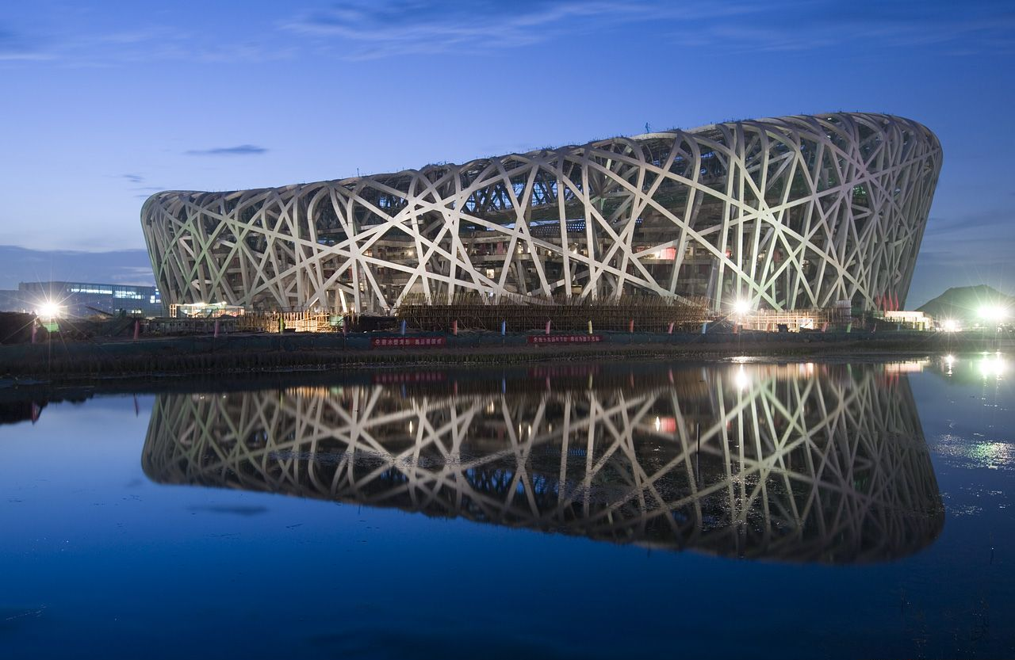
High-profile projects
Olympic Stadium Beijing 2008
40 000 T of steel used. Cost $ 500 m
Architects: Herzog & de Meuron. Structural engineers: Arup

Slide 7
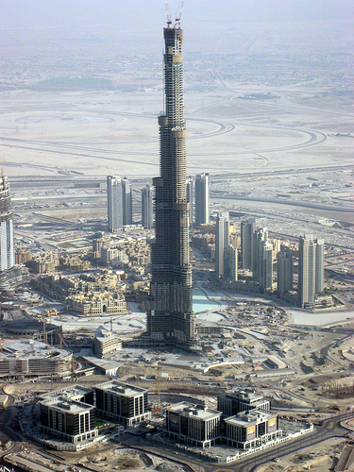
Burj Dubai
The tallest tower in the world at over 800 m high.
Consulting engineers: Hyder Consulting Ltd
Architects: Skidmore, Owings & Merrill

Slide 8
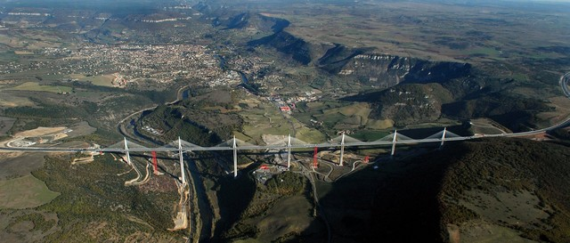
Millau Viaduct, France
The largest cable-stayed bridge in Europe
Norman Foster design. Cost 300 m Euros

Slide 9
Educational preparation
Aim to produce graduates
Ability to deal with the complexities of the industry
Accept a high level of responsibility
Imaginative, innovative, versatile
Degree courses designed
To develop graduates who provide the future leadership of the profession
To have a clear thread of design running through them
Design experience developed through the levels of study

Slide 10
Factors in Design
Buildability
Durability
Performance
Structural Form
Load Transfer
Structural Behaviour
Structural Stability
Whole-life costs
Health and Safety
Risk Management
Sustainable Construction Principles
Aesthetics

Slide 11
Physical modelling and studio-based learning
Earlier students are exposed to design the more beneficial the experience
Students able to explore and exploit their creativity and imagination
Physical modelling enables students to augment their understanding of structures
Enables consideration of structural complexity, load transfer, stability and element connection
Develops a feel for structural response
Experienced designers from practice

Slide 12
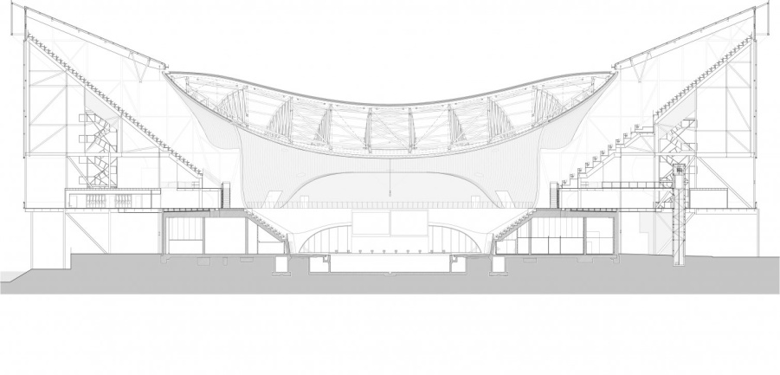
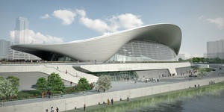
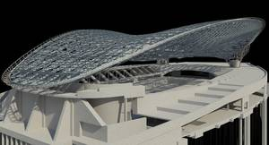
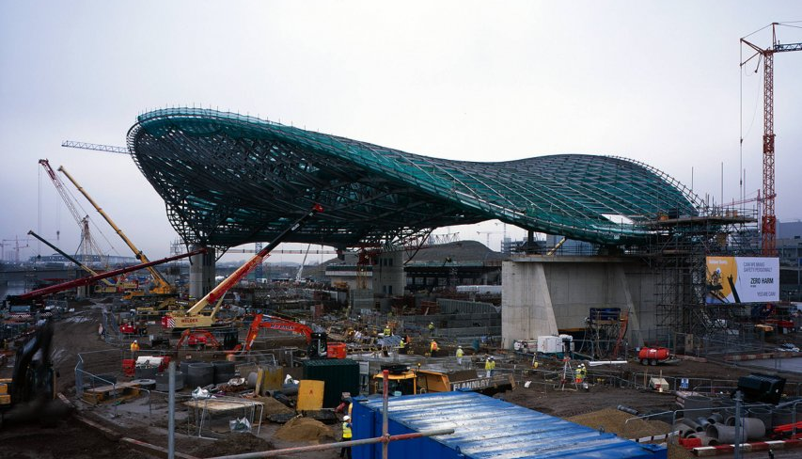
Teaching
Make design projects set for students realistic, relevant and exciting
Important to inspire and make Engineering FUN
Recent high-profile construction projects
London Olympics 2012
Aquatics Centre
Architects: Zaha Hadid
Structural Engineers:
Ove Arup & Partners
Cost £269 m
160 m long sweeping roof frame – 3000 tonnes

Slide 13
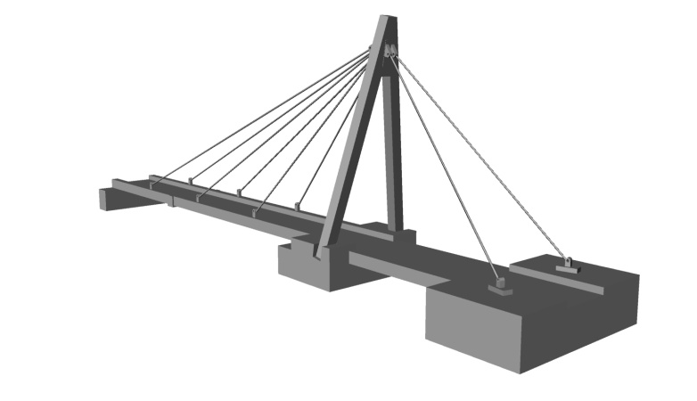
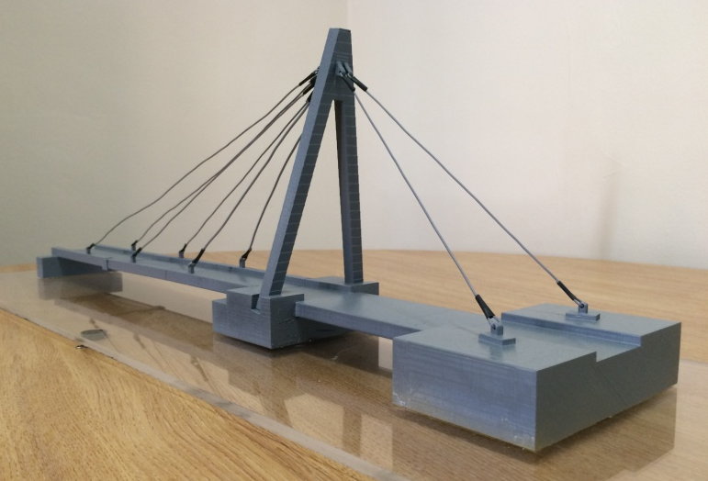
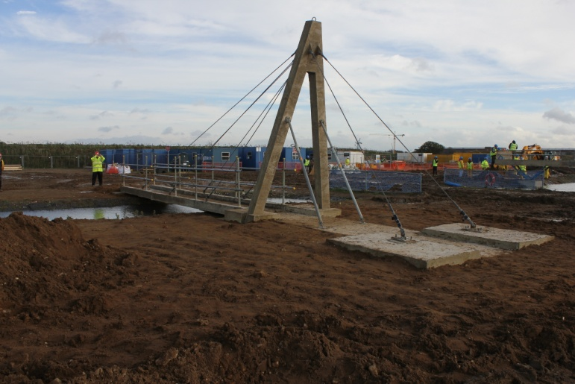
Design and Construction
3D rendered drawing of the bridge.
3D printed bridge model.
Bridge in the final stages of construction on site.

Slide 14
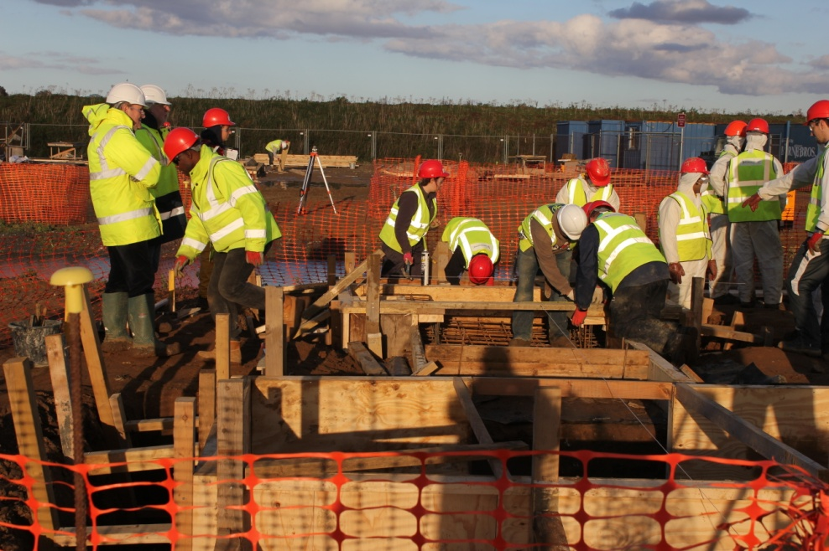
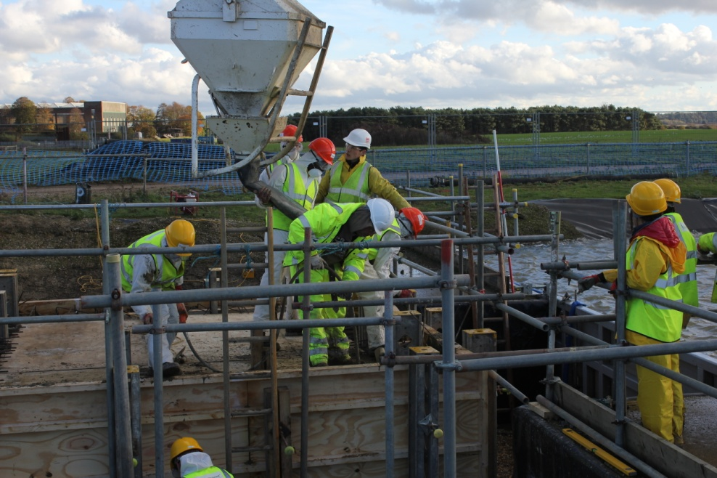
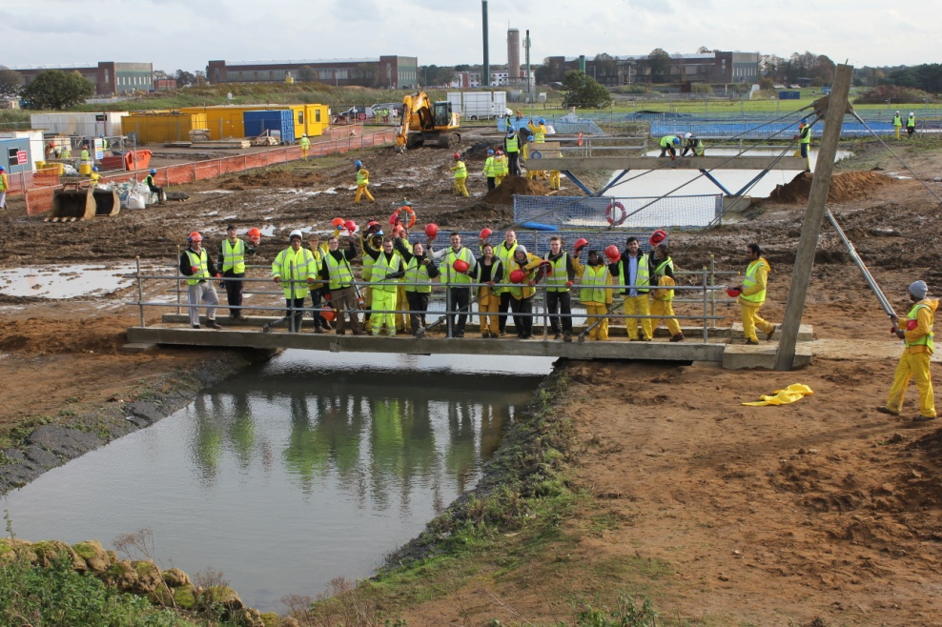
Constructionarium provides opportunity for students to see how theory translates into construction

Slide 15
Student creativity and imagination
Work as part of a team
Develop ability to cope with the uncertainties
Engineering is about making systems that are fit for purpose - not fit for purpose if it is unsafe
Legal and professional responsibilities for safety (Health & Safety at Work, CDM)
Knowledge of historical precedent important
Understand that there are limits to what we know and what that may imply for safety – learn from failures

Slide 16
Examples of Failures
Tacoma Narrows Bridge, USA, 1940: Suspension bridge,
wind-induced vibrations, vertical oscillations and torsional instability

Slide 17
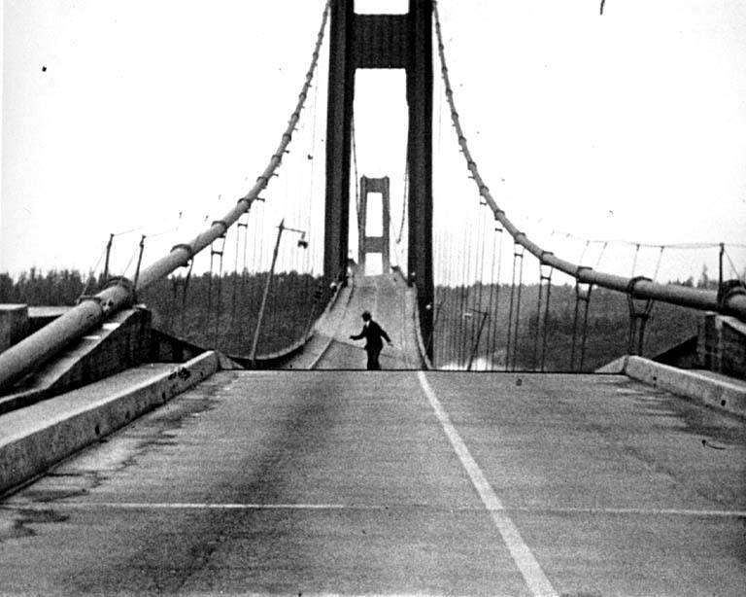

Slide 18
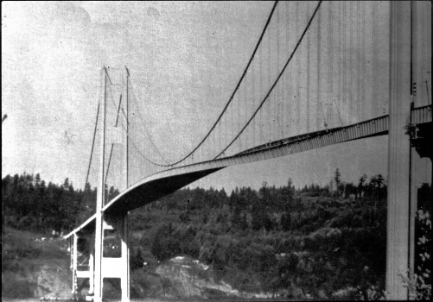
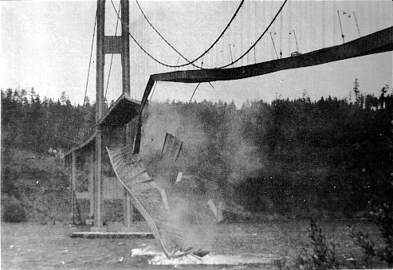
Tacoma Narrows Bridge in steady wind of 42 mph brought down
Plate girders caused buffeting

Slide 19
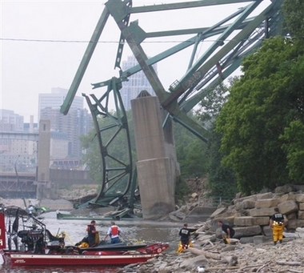
Examples of Failures
I-35W Mississippi River Bridge, Minnesota, completed 1967 13 killed, 145 injured (Catastrophically failed rush hour 1 August 2007)

Slide 20
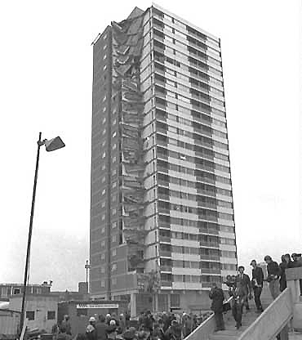
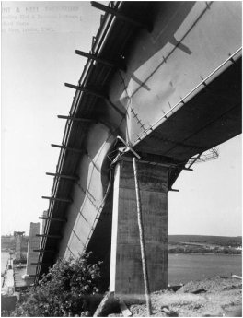
Examples of Failures
Ronan Point, East London, 1968: Progressive collapse
Milford Haven Bridge, Wales, 1970
Box girder bridge, plate buckling

Slide 21
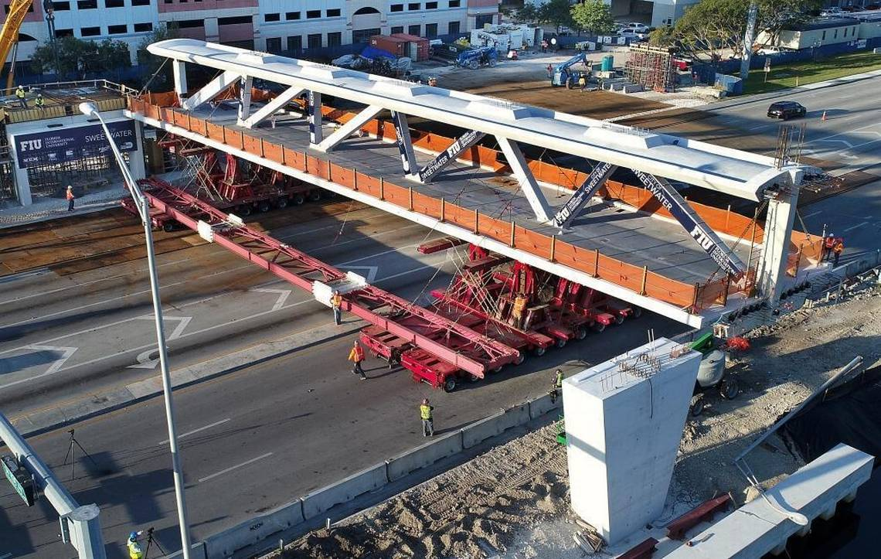

Slide 22
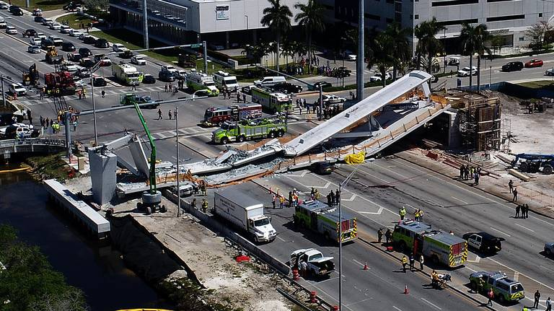

Slide 23
Codes of Practice and Research
Codes regarded as a consensus of what is acceptable at the time written
Contain a balance between accepted practice and recent research
Amended in light of new knowledge
Research has considerable importance
Means of advancing knowledge
Important underpinning to the teaching process and the quality and development of courses

Slide 24
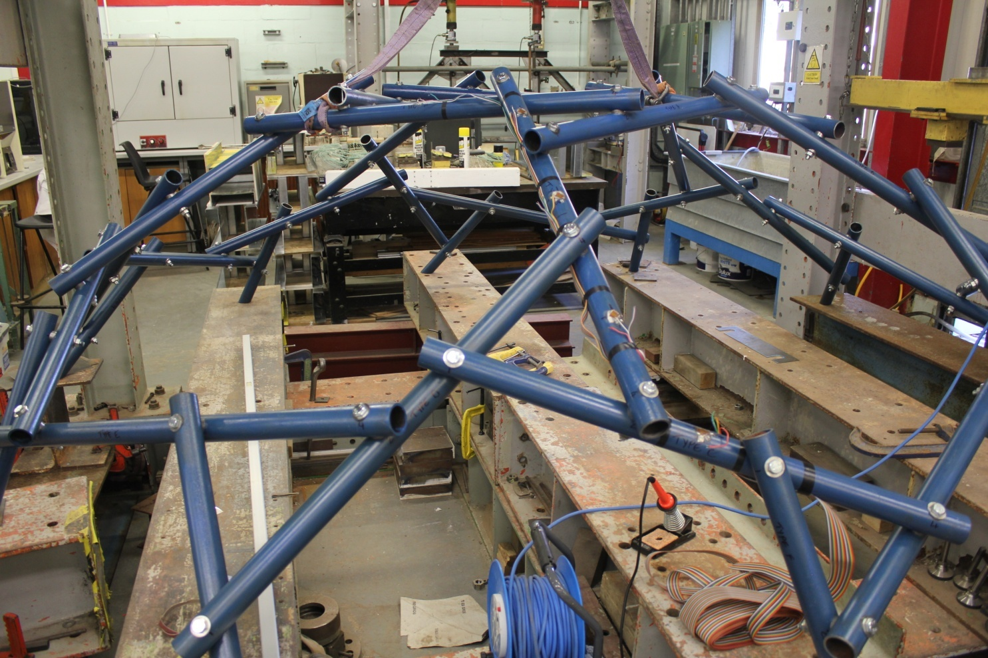
Honeycomb MSE Dome Test Structure
Experimental Investigation Structural behaviour

Slide 25
Links with Industry
Guest Lectures by practitioners
Collaboration on research and development work
Consultancy
Arranging site visits
Mentoring and supporting students’ final year projects
Industrial Placements
Recruitment (employment of graduates)
Interaction with academic and research staff

Slide 26
Case Study
Structure over test tank in a disused dry dock
Client's requirements:
Single-storey structure supporting services and observation walkways required over large test tank (See Sketch).
Natural lighting above the middle 15% of the tank.
Roof & side coverings: lightweight insulated profiled sheeting.
Disused dry dock existing side walls buttressed every 15m and will afford strong points.
No internal columns permitted.
Conceptual Design Assignment
Prepare an illustrated design appraisal indicating at least two distinct and workable concept arrangements for the structure. Identify clearly the functional framing, load transfer and stability aspects of each scheme.
Describe the alternative schemes considered giving reasons why the alternatives were rejected.
Clearly show how the design has been developed to minimise the carbon footprint.

Slide 27
150 000
2 000 R.C. wall
1 500 thick buttresses
B
A
A
60 000
54 000 tank
2 No sliding doors, each
10 000 wide x 7 000 high to be provided about centreline of elevation.
2 000 R.C. wall
B
R. C. buttresses at 15 000 centres
5 500
5 500
Plan
2 000
2 000
Inside roof line
Structure over Test Tank
Figure TC60044E/01
NOTE: All dimensions in millimetres
(NOT TO SCALE)
4 000
Walkway
Walkway
7 000 clear
4 000
Centre line
3 500 tank
Cross section B - B

Slide 28
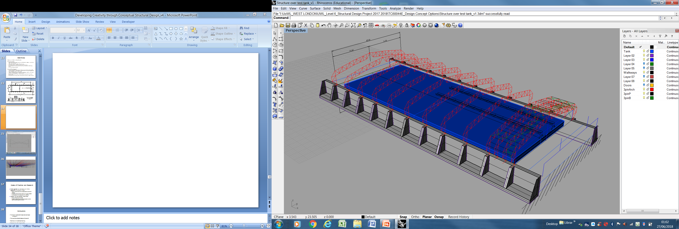

Slide 29
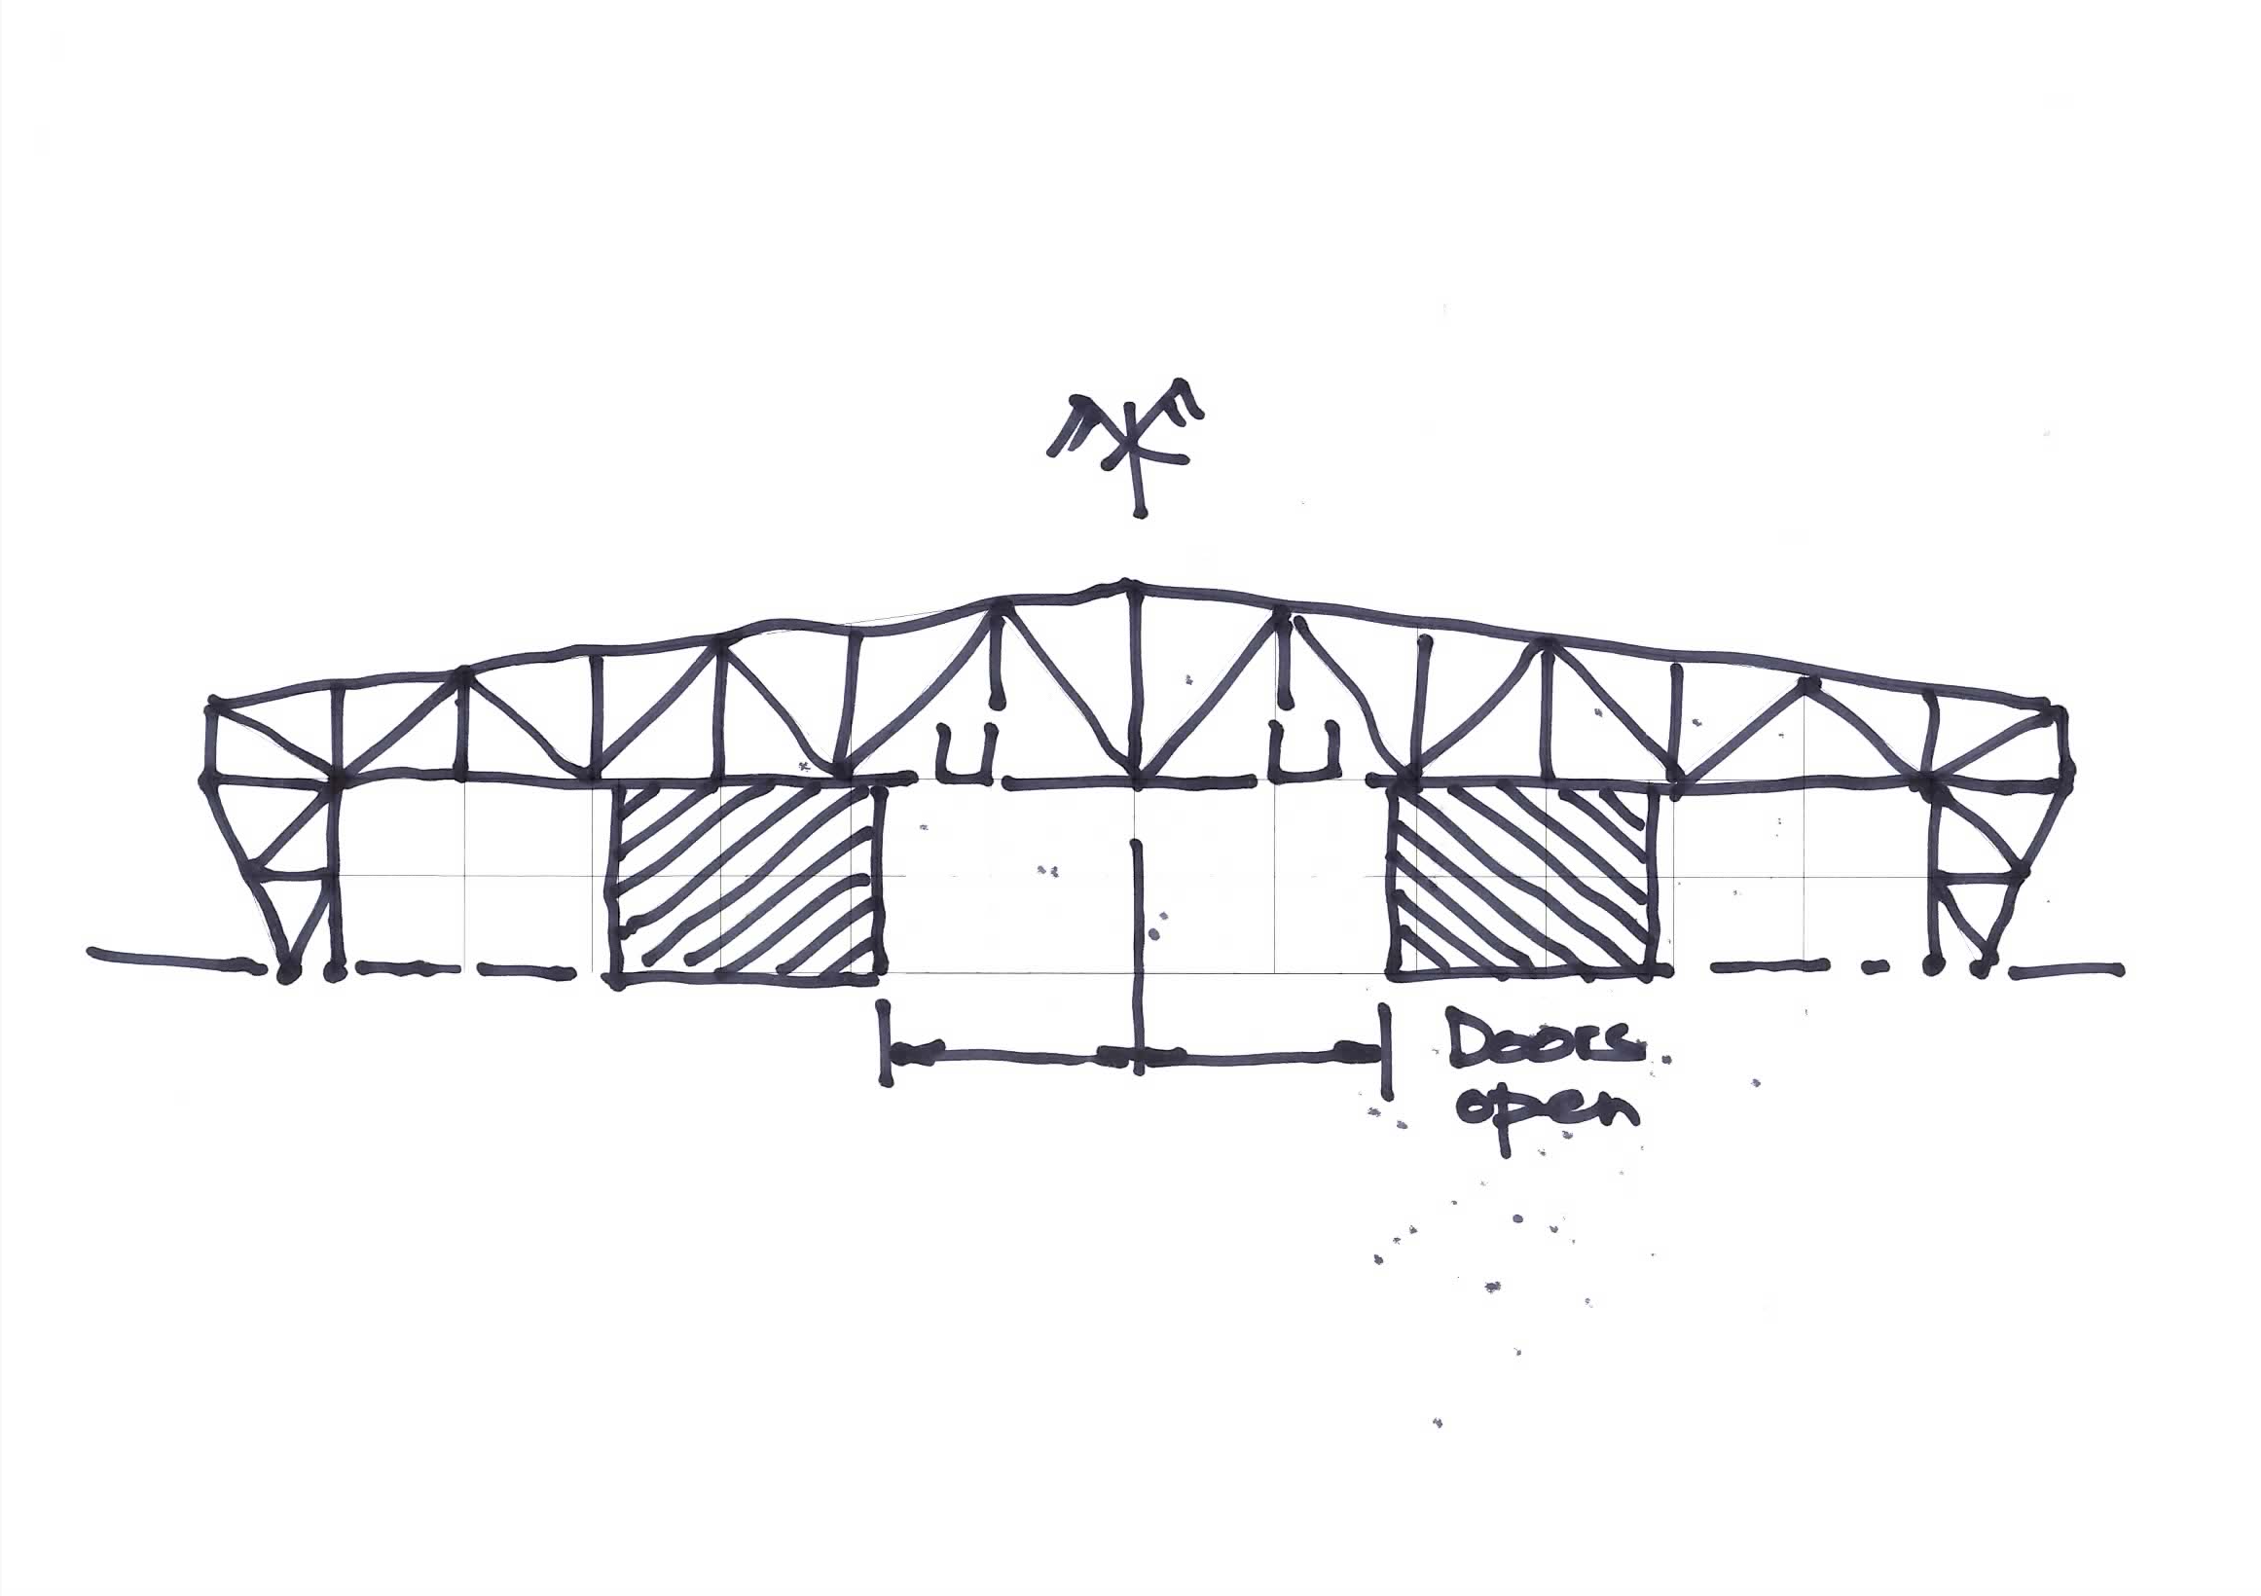

Slide 32
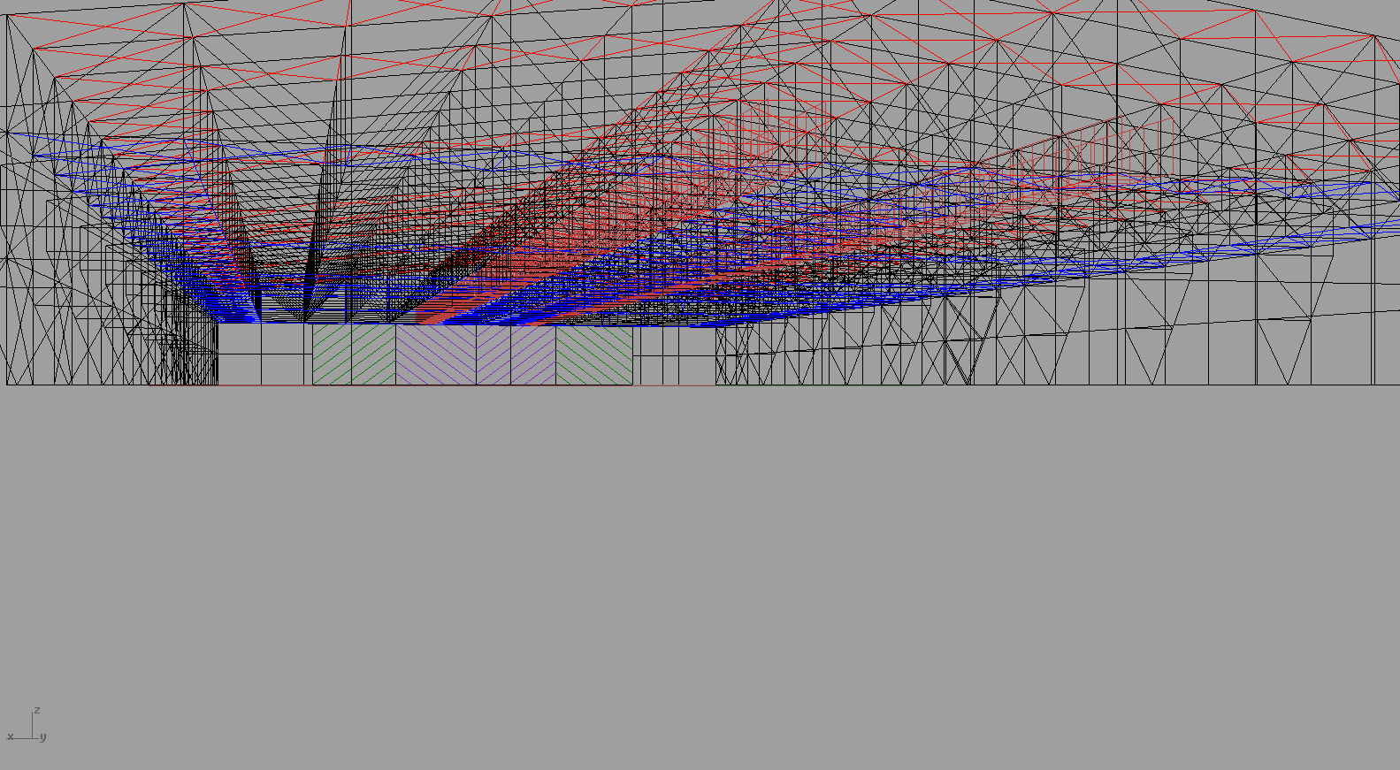

Slide 34
Conclusions
Design experience developed through levels of study
Emphasis on studio-based learning
Designers brought in from practice
Practical experience essential for graduate employability
Learn from historical precedent and failures

