Slide 1
The Pen is Mightier with the Words
Hendrik van der Sluis
Colin Loughlin
Academic Development Centre
Kingston University
ALT-C 2012
http://goo.gl/U7rmG
Notes:
van der Sluis, H. & Loughlin, C. (2012). The Pen is Mightier with the Words. Alt-C 2012 A confrontation with reality, available at: http://goo.gl/U7rmG
Hendrik van der Sluis, H.vanderSluis@kingston.ac.uk, (Academic e-Developer & Researcher)
Colin Loughlin, C.Loughlin@kingston.ac.uk, (Academic E-Learning Developer)
'The Pen is Mightier with the Words' by Hendrik van der Sluis & Colin Loughlin is licensed under a Creative Commons Attribution-NonCommercial-NoDerivs 3.0 Unported License.
Abstract
Effective note-taking and subsequent review, are essential skills for students in Higher Education. Studies have highlighted the diverse range of cognitive abilities required to fully participate in lectures and produce meaningful notes and that although students develop individual note-taking strategies, the resultant product can impact on academic performance and be a significant barrier to learning (e.g. Kiewra, 1985).
A possible step towards overcoming the limitations of current technologies that aid note-taking (such as passive lecture recordings) is the use of digital/audio pens. Here, notes are taken in the traditional way, but onto specially printed paper with a digital pen; the digital images are transferred to a PC together with synchronously recorded audio. The notes can then be revised and edited by listening to specific sections of the audio relating to particular notes; alternatively, the file can be manipulated with software to create a more comprehensive set of revision notes.
The object of this study is to examine the capacity of digital/audio pens to enhance student note-taking and the possible consequences on their current patterns of learning. Students from a UK HEI agreed to use the digital pen over several weeks; semi-structured interviews were then used to capture their individual contextual experience (Kvale & Brinkmann, 2009). The study is structured according to the Engeström (1987) adaptation of Activity Theory.
The findings show the pen and software to be useful in a variety of contexts, including; classroom note-taking, revision and student research projects. Most students report that the pens can be an effective augmentation of note-taking skills, supporting some of the expectations of Van Schaack (2009). However, there appear to be some issues surrounding the integration of the pen into existing routines, such as, the organisation of digital and paper copies of the same notes. In some cases software compatibility across systems limited collaboration and the sharing of resources.
This presentation will report from the work in progress and will focus on the students’ experiences, exploring how this technology might best fit into existing practices and, its relevance for a wider audience.
(F11 for full screen)

Slide 2
Objective
Evaluating students & staff experience with a digital pen. Its impact and value for note taking practices, ease of use, usefulness.
“I take really copious notes when I do my lectures and stuff, but no matter what, I always miss out on something”
Notes:
So having something […] where there is a much easier link between that particular piece of text and that part of the recording was attractive.
I was studying a module and my note-taking has always been poor and I wanted to try it to see if it would improve the situation at all.
One of the other reasons I got the pen was that I am a bit unorganised with my notebooks and I occasionally lose them […] I ended up having three at one stage, one research meetings, one learning and teaching, and one general and it was just a mess. And I thought fine, I am just going to have one pad which will get recorded on the computer so I can always refer back to it.
I take really copious notes when I do my lectures and stuff, but no matter what, I always miss out on something

Slide 3
Research approach
Exploratory study with qualitative research methods (Durrheim, 1999)
Theoretical framework
Activity theory (Engeström, 1987; Wali et al., 2008)
“I tried it to see if it worked and it did work, it was pretty effective, pretty accurate with my handwriting which surprised me”
Notes:
So having something […] where there is a much easier link between that particular piece of text and that part of the recording was attractive.
I was studying a module and my note-taking has always been poor and I wanted to try it to see if it would improve the situation at all.
One of the other reasons I got the pen was that I am a bit unorganised with my notebooks and I occasionally lose them […] I ended up having three at one stage, one research meetings, one learning and teaching, and one general and it was just a mess. And I thought fine, I am just going to have one pad which will get recorded on the computer so I can always refer back to it.
I take really copious notes when I do my lectures and stuff, but no matter what, I always miss out on something

Slide 4
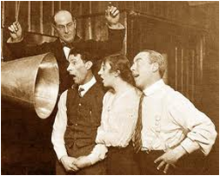
Trial
Students or staff borrow e-pen for 6 weeks and used it in their own context.
Recruitement
Volunteers sign up after reading e-mail, ADC newsletter, promotion through show and tell.
“the audio says something and the pen is writing something ”
Notes:
So having something […] where there is a much easier link between that particular piece of text and that part of the recording was attractive.
I was studying a module and my note-taking has always been poor and I wanted to try it to see if it would improve the situation at all.
One of the other reasons I got the pen was that I am a bit unorganised with my notebooks and I occasionally lose them […] I ended up having three at one stage, one research meetings, one learning and teaching, and one general and it was just a mess. And I thought fine, I am just going to have one pad which will get recorded on the computer so I can always refer back to it.
I take really copious notes when I do my lectures and stuff, but no matter what, I always miss out on something

Slide 5
Pedagogical value of note taking
“Well I do worry when I see the students sitting there with the only thing on the desk is a recording device and that’s it, nothing else [...] there’s much more memory involved by writing things down in note form, than just recording. ”
Notes:
So having something […] where there is a much easier link between that particular piece of text and that part of the recording was attractive.
I was studying a module and my note-taking has always been poor and I wanted to try it to see if it would improve the situation at all.
One of the other reasons I got the pen was that I am a bit unorganised with my notebooks and I occasionally lose them […] I ended up having three at one stage, one research meetings, one learning and teaching, and one general and it was just a mess. And I thought fine, I am just going to have one pad which will get recorded on the computer so I can always refer back to it.
I take really copious notes when I do my lectures and stuff, but no matter what, I always miss out on something

Slide 6
Impact e-pen on note taking
“It’s helped me to realise what [...] elements were missing from my physical note-taking.”
Notes:
So having something […] where there is a much easier link between that particular piece of text and that part of the recording was attractive.
I was studying a module and my note-taking has always been poor and I wanted to try it to see if it would improve the situation at all.
One of the other reasons I got the pen was that I am a bit unorganised with my notebooks and I occasionally lose them […] I ended up having three at one stage, one research meetings, one learning and teaching, and one general and it was just a mess. And I thought fine, I am just going to have one pad which will get recorded on the computer so I can always refer back to it.
I take really copious notes when I do my lectures and stuff, but no matter what, I always miss out on something

Slide 7
Long Term
“I could imagine that my note-taking would get lazy and it to a certain extent become passive, and that was a concern that I had because there’s absolutely no doubt that I remember things far better when I have written them down ”
Notes:
So having something […] where there is a much easier link between that particular piece of text and that part of the recording was attractive.
I was studying a module and my note-taking has always been poor and I wanted to try it to see if it would improve the situation at all.
One of the other reasons I got the pen was that I am a bit unorganised with my notebooks and I occasionally lose them […] I ended up having three at one stage, one research meetings, one learning and teaching, and one general and it was just a mess. And I thought fine, I am just going to have one pad which will get recorded on the computer so I can always refer back to it.
I take really copious notes when I do my lectures and stuff, but no matter what, I always miss out on something

Slide 8
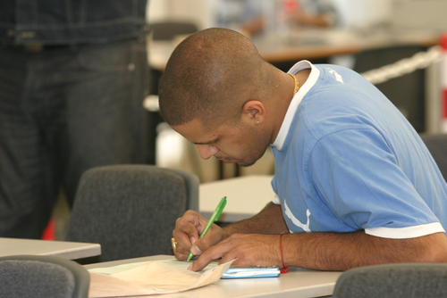
Ergonomics
“It's quite a big pen and it’s bigger than I am used to, so it did take a little while to adapt”
Notes:
So having something […] where there is a much easier link between that particular piece of text and that part of the recording was attractive.
I was studying a module and my note-taking has always been poor and I wanted to try it to see if it would improve the situation at all.
One of the other reasons I got the pen was that I am a bit unorganised with my notebooks and I occasionally lose them […] I ended up having three at one stage, one research meetings, one learning and teaching, and one general and it was just a mess. And I thought fine, I am just going to have one pad which will get recorded on the computer so I can always refer back to it.
I take really copious notes when I do my lectures and stuff, but no matter what, I always miss out on something

Slide 9
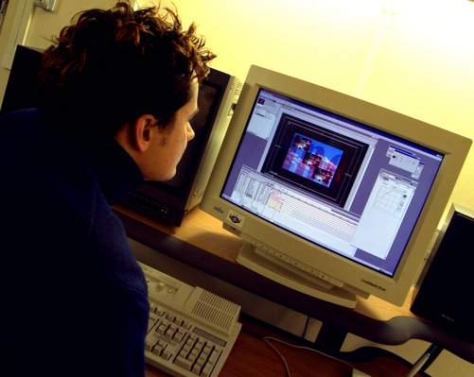
Would they buy one?
“No, and I am sort of surprised at myself really that that’s the case. I mean if somebody gives me one, I will use it, but for some reason I am reluctant to spend any money on it.”
Notes:
So having something […] where there is a much easier link between that particular piece of text and that part of the recording was attractive.
I was studying a module and my note-taking has always been poor and I wanted to try it to see if it would improve the situation at all.
One of the other reasons I got the pen was that I am a bit unorganised with my notebooks and I occasionally lose them […] I ended up having three at one stage, one research meetings, one learning and teaching, and one general and it was just a mess. And I thought fine, I am just going to have one pad which will get recorded on the computer so I can always refer back to it.
I take really copious notes when I do my lectures and stuff, but no matter what, I always miss out on something

