Slide 1
Information Literary and Feedback
Marc Forster
Davina Omar

Slide 2

This Photo by Unknown Author is licensed under CC BY-SA-NC
Notes:
This brief talk is about the value and significance of ‘Information Literacy’ in the learning process generally, but specifically in response to feedback.
The first part will discuss the nature and contexts of Information Literacy as a phenomenon. We will then move on to discuss how we believe Information Literacy can help students react to and gain benefit from feedback, through the ways in which it helps students engage more coherently with their subject’s ‘Information Lanscape’.

Slide 3
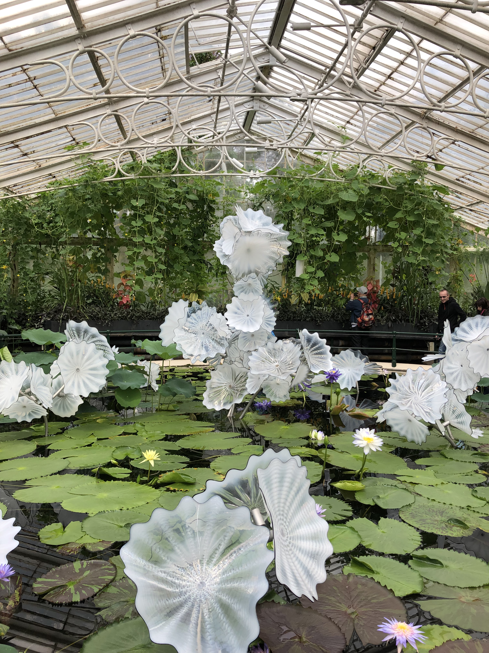
Interrelated pattern of information and knowledge domains which form the intellectual framework of the subject area.
Notes:
What is the information landscape?
This is the interrelated pattern of information and knowledge domains which form the intellectual framework of the subject area.
The backbone / core knowledge / the seminal / the new / the experimental / the diverse / doesn’t have to be written
When a student receives feedback which indicates that ideas or authors need to be revisited or were missing from their work, this will make more practical sense for an information literate student who will be able to contextualise the comments and recommendations as well as act on them
We hope this talk clarifies further the value of integrating information literacy throughout the curriculum, so that students can not only respond effectively to feedback but can become fully-functional independent learners.

Slide 4
The information literate person identifies knowledge gaps, can find, appraise and make balanced judgements about information, and curate and use it in an ethical and inclusive manner to attain increased understanding, competency, expertise, autonomy, and creativity
Notes:
In order to understand and learn, students need to be able to engage with that body of thought and factual knowledge that illuminates and elaborates the subject they are studying.
They must be able to become aware of, and to competently deal with, relevant
ideas,
research,
narratives
analysis.
But what is information literacy?
Information Literacy is awareness of an information lack and knowledge deficit and the effective identification, seeking out and synthesising of the information needed to increase knowledge and facilitate learning and understanding in whatever context.

Slide 5

This Photo by Unknown Author is licensed under CC BY-SA
Notes:
Information Literate students develop a feel for the ‘information landscape’ of their subject area and can competently negotiate it.
Information which can be used in assignments consists of more than just books and scholarly journals but a living landscape of research, professionally and creatively generated, interrelated and mutually dependent information of various sources and formats.
For instance, the Information landscape for nurses involves not only the key texts published by nurse academics and researchers and the journals papers which discuss key issues and report on research studies, but also evidence-based clinical guidelines, reports into failures in practice, descriptions of professional competencies and a broader hinterland of medical, social science, ethics and psychology literature
The engineer will be considering journal papers but also case studies from the profession, standards, technical briefings, conference proceedings etc
The formats and type of information source will change from subject to subject and this is completely understandable for an information literate student

Slide 6

This Photo by Unknown Author is licensed under CC BY-SA-NC
Notes:
As their information literacy develops, students become increasingly independent as learners and more confident in their learning.
They can more easily understand where they are going wrong and why, and what they need to do to resolve difficulties and improve.
To understand what they are lacking information and knowledge on and to go on to independently find, critique and apply information to address this issue whilst knowledgeably negotiating and understanding the subject’s ‘information landscape’ is the key ‘information dimension’ of independent learning.
Information Literacy gives a student an increasing awareness of a subject’s landscape and dimensions; a clearer picture of how information domains relate to each other and which of these needs to be addressed next.
Learning, when done independently can often be patchy and unstructured, with key areas missed and the wider informing context missing from the developing understanding. Awareness of the ‘Information Landscape’ is the key to coherent independent learning.

Slide 7
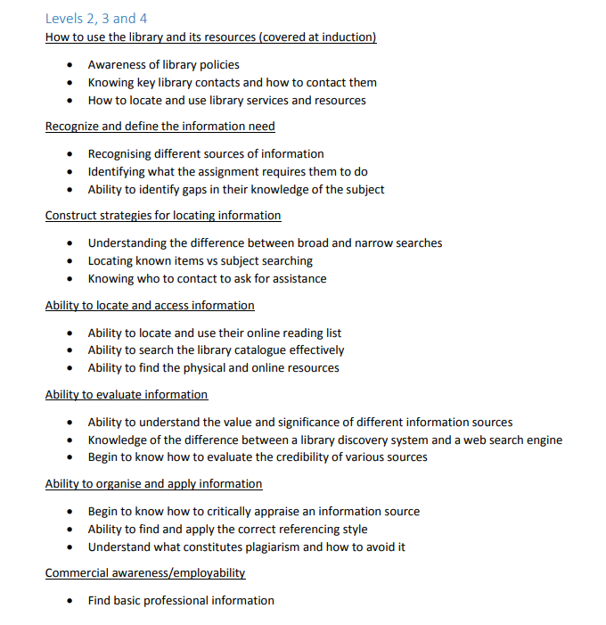
UWL Library Services (2018) UWL’s Information Literacy Policy. Available at: https://www.uwl.ac.uk/sites/default/files/Departments/Library/information_literacy_policy_version_3_november_2018.pdf (Accessed: 30 January 2019)

Slide 8
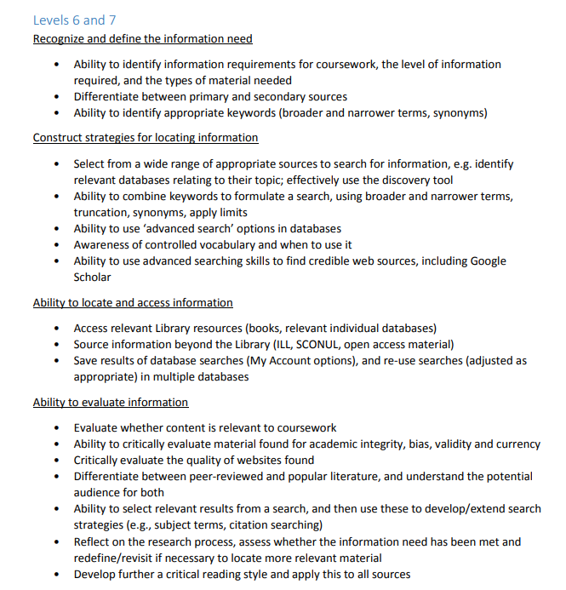
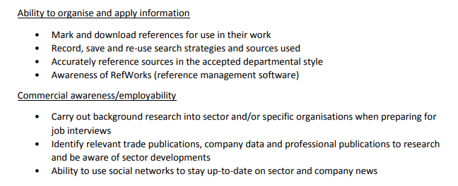
UWL Library Services (2018) UWL’s Information Literacy Policy. Available at: https://www.uwl.ac.uk/sites/default/files/Departments/Library/information_literacy_policy_version_3_november_2018.pdf (Accessed: 30 January 2019)

Slide 9
UWL Graduate Attributes
Thoughtful and proactive
Possessing strong Information Literacy, our graduates can explain, interpret, analyse, evaluate and draw inferences from a range of sources
This Photo by Unknown author is licensed under CC BY.
Notes:
In fact, it is recognised that Information Literacy is not only fundamental to effective student performance, it is a professional and graduate attribute, necessary to function effectively as a professional and citizen.
The recognition of its significance and value as a concept has slowly spread, as academic, workplace and social/cultural/political environments have become overwhelmed with information; much of it of dubious provenance or doubtful accuracy, with the most visible sources often not the most valuable or appropriate.
It is now widely accepted that Information Literacy is needed, and should be promoted in the workplace, and the wider world of often complex and confusing political and social agendas.
To be able to locate an appropriate range of information to complete an assignment is mirrored in the workplace in which Information Literacy is required in order to fulfil professional tasks and roles, as well as in the wider world of citizenship; however this often involves working in teams or developing information focused relationships with customers, clients and patients and their families.

Slide 10
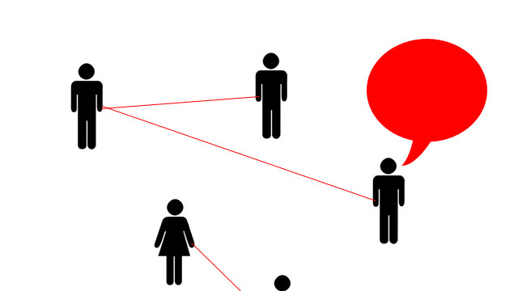
This Photo by Unknown Author is licensed under CC BY-SA
Notes:
What kind of feedback is given additional meaning through the lens of Information Literacy? Feedback may contain a description of the topics or competencies the student has not addressed or addressed fully, or not properly contextualised or shown relationships between; or may highlight key authors that have not been read and critiqued or critiqued properly.
All of these suggest how Information Literacy could have improved outcomes. The student could have better engaged with each aspect of their information landscape and would have been aware of the information types and sources that they have overlooked. They would have been able to locate and apply them successfully and critically appraise and determine the significance of what they’ve read. Consequently, they may have seen more clearly how key ideas and authors are derived from, give rise to, oppose or support each other, and in general would have been more fully aware of what has been written, and how to judge the value of each contribution.
If students have not been fully able to do this, then this can be addressed in two ways: Firstly, 1-2-1 tutorials or appropriate self-directed activities. These use the feedback to develop in the student a greater awareness of the significance of their apparent problems negotiating the Information Landscape and how they might be addressed in the future. And secondly, using the feedback to guide and focus Information Literacy education for the whole group or future groups.

Slide 11
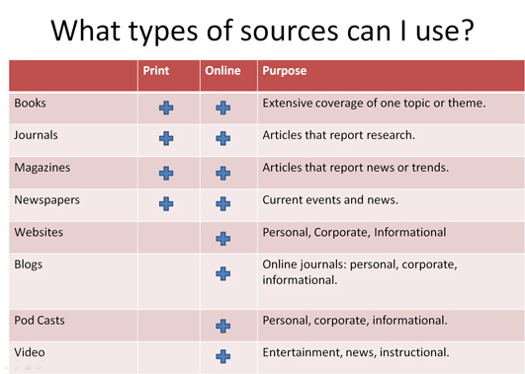
Notes:
Directing students to engage with feedback in this constructive and developmental manner suggests the possibility of greater engagement with Information Literacy, as they become more aware of its role in improving their academic outcomes. One aspect of good feedback may include ‘shock’ value in the most positive sense. The development of a greater understanding of the range and scope of what is yet to be known and learnt can be aided by, and show the need for, Information Literacy competencies. How did I not know about these authors and their ideas? Why was I not aware of this whole landscape of information relevant to my subject and course? How are these new ideas and authors related to each other and what I already know, and what would these new relationships mean for my view of my subject? “If I’m going to really get to grips with my subject, then I need to develop my information skills.” Information Literacy specialists are strongly aware that these responses are great motivators to seek out information competencies and engage with the Information Landscape more effectively. Students often come for 1-2-1 Information Literacy development sessions with their librarians with a greater sense of urgency, and with a more focused awareness of deficit, in response to detailed feedback.
This can also work even when the feedback to the student was highly positive with only a small need for any feedforward feedback. When a student realises through their feedback that their knowledge of the information landscape was high, the confidence gained from this is a great motivator to try and achieve even more understanding and seek out additional authors and knowledge. This is generally linked with a high level of independent learning and the support needed from their librarian is to encourage this independence and reinforce this growth in confidence.

Slide 12
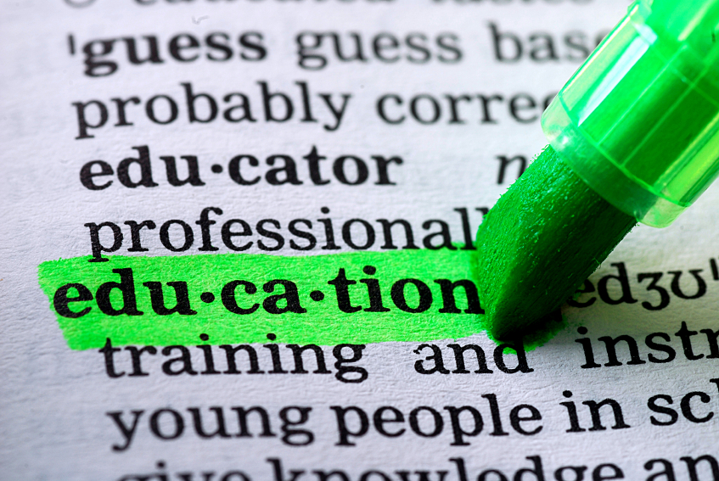
Notes:
Information Literacy education can have many approaches and practical facets but can be summarised as the development of awareness of a subject’s Information Landscape, and how information is effectively identified and applied within context. This may involve, to begin with, work which facilitates knowledge of relevant information types and formats, their relative value and significance, and practical engagement with tools that allow us to locate and critique that information.
More sophisticated follow-up approaches might involve scenario-based work based on academic, professional or other personal knowledge-sensitive and learning-rich real-life contexts in which the Information Landscape manifests itself.
Feedback can be used by librarians and academics as a useful guide in the development of future sessions that help students obtain a clearer grasp of the structure and value of their information landscape through an awareness of where difficulties, as highlighted in the feedback, are likely to arise.

Slide 13
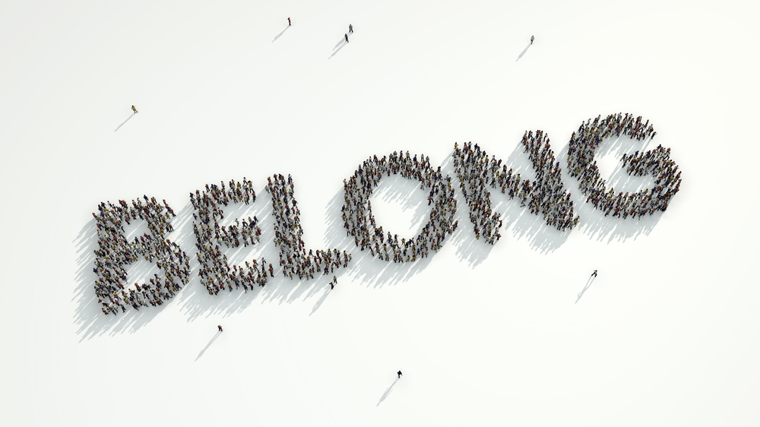
This Photo by Unknown Author is licensed under CC BY-SA-NC
Notes:
The above ideas suggest a significant way in which Information Literacy could have an impact in reducing attrition. Students who feel empowered to competently and even creatively engage with the information landscape may feel more connected to their studies and more hopeful of success; they may develop a greater understanding of the meaning and value of those studies for their future careers.
A deeper and more connected view of the subject often results in a deeper sense of engagement and commitment. As we know, students who feel that the subject of study ‘isn't for them’, ‘is beyond them’ or ‘alien to their experience’ are prone to disengage from and abandon their studies. Information Literacy is a means by which the student can increase their sense of being part of an intellectual and cultural community. The contemporary digital environment allows students, if guided in navigation and critique, to become tourists, students, citizens, scholars, creators and leaders within learning communities.

Slide 14

This Photo by Unknown Author is licensed under CC BY-SA-NC
Notes:
Information Literacy may also help address the ‘attainment gap’ through helping students successfully find and contextualise relevant knowledge through the lens of their own culture and background. How is the information landscape informed and enriched by the cultural and political experiences of those groups that are often excluded from power within the academy?
What is the nature of the ‘canon’ in terms of cultural and political assumptions and power structures and how can Information Literacy make these structures and assumption understood? Can this be a way of empowering students who are otherwise unengaged by an information landscape which ignores their experiences?
‘Critical’ Information Literacy can investigate those structures of power and status which clarify how information is created, supressed, made ‘relevant’ and essential in the development of knowledge. Where does information come from and who is responsible for its creation and dissemination, is the how information literacy helps us engage with the contemporary world.
Information Literacy is a lens through which feedback takes on added meaning and effectiveness. Contact your academic support librarian to discuss how the library can work with you to improve student outcomes.

Slide 15
Davina Omar
Head of Academic Support
Library Services
University of West London
Davina.Omar@uwl.ac.uk
0208 231 2252
Follow on twitter: @davinaom
Marc Forster
Academic Support Librarian
Library Services
University of West London
Marc.Forster@uwl.ac.uk
020 8209 4039
Follow on twitter:
@MarcForster18

