Slide 1

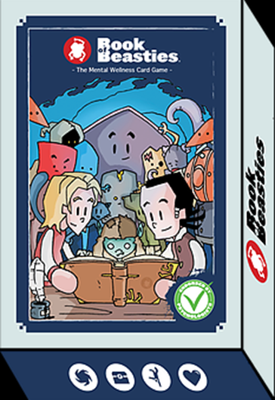
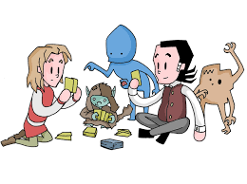
Dealing Children a Helping Hand with ‘Book of Beasties’: The Mental Wellness Card Game
Dr Michelle Jayman and Dr Annita Ventouris
University of West London

Slide 2
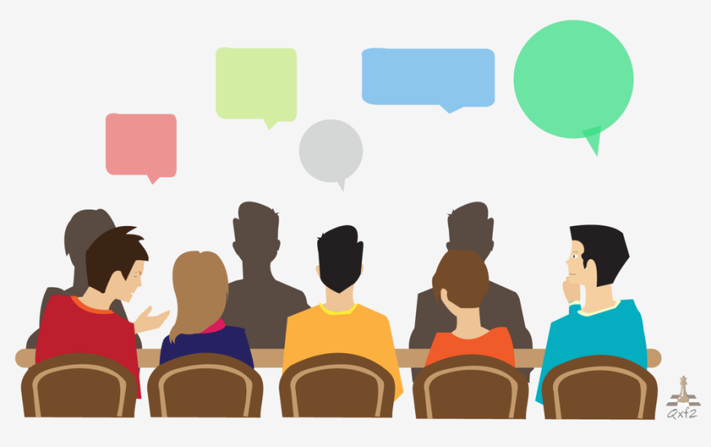
Today’s talk
Context: Children and young people’s mental health and wellbeing and the role of schools
Introducing ‘Book of Beasties’ (BoB)
The pilot study research
Key findings
Conclusions and next steps

Slide 3
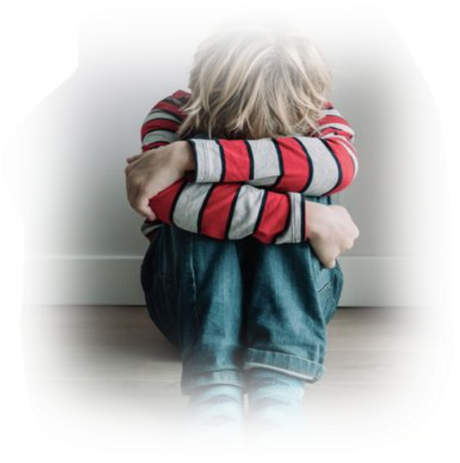
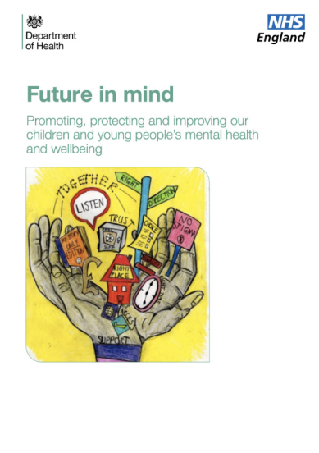
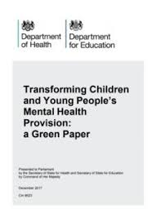
Children’s mental wellbeing: a snapshot
Increasing numbers of children and young people are experiencing emotional difficulties (Sadler et al., 2018)
Children’s happiness is in decline (The Children’s Society, 2019)
Many CYP do not access timely and appropriate support (Thorley, 2016)
Pivotal role of schools in supporting children’s mental wellbeing well documented (DfE 2016, 2018; DoH & NHS England, 2015; DoH & DfE, 2017)

Slide 4
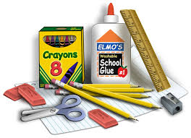
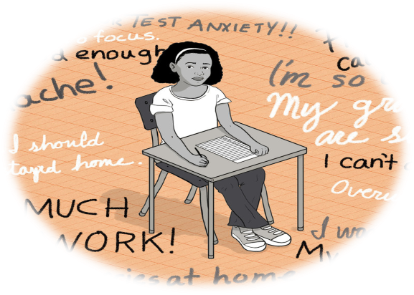
The role of schools
Well placed to address school-related stressors?
Can ease the pressure on specialist CAMHS?
Facilitates a wider culture within schools that values mental health? But…
Increasing demands, competing priorities; school staff ‘overwhelmed’ (Education Support, 2019)
Relationships and health curriculum (DfE, 2019)
School leaders need to be better supported to make informed commissioning decisions
Case studies of good practice for schools to share
(Brown, 2018)

Slide 5
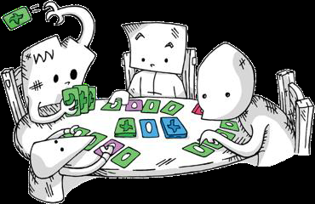

Introducing ‘Book of Beasties’ (BoB)
Every child should have the confidence to talk openly about their emotions and mental wellbeing
Aims: to de-stigmatise mental health, promote wellbeing and raise emotional literacy
Centred around a traditional card game with linked, sensory-focused activities embedded in play
Guided learning, playful learning approach (Weisberg et al., 2013; Hirsch-Pasek & Golinkoff, 2003)
https://www.youtube.com/watch?v=ohzrCt3RjFI

Slide 6

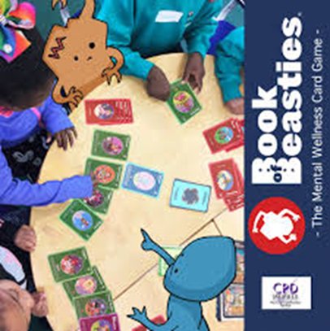
Overview of the game
Manualised programme, one hourly sessions run over five consecutive weeks
Facilitated by trained school staff to small groups of children
BoB is set in an imaginary world inhabited by ten ‘beasties’
Each beastie has attributes (e.g. self- consciousness) associated with an emotional issue (e.g. anxiety)
The objective is for players to help as many beasties as possible
How: using ‘action’ cards and locating certain ‘item’ or ‘comfort’ cards

Slide 7
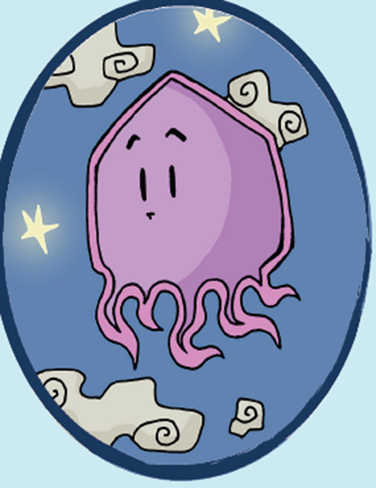
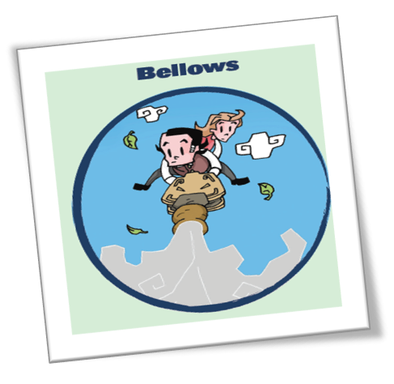
Meet Populo
Character description: ‘Everyone has a foggy brain sometimes, especially poor Populo who loses her puff and can’t bring herself to do anything’
Characteristics associated with emotional difficulties: low mood, loss of concentration
‘Item’ card and brief descriptor: ‘Bellows’: ‘Our breath has the power to calm us’
‘Action’ card activity: Make paper boats to race (practising deep breathing/relaxation)
‘Comfort' card: ‘French rabbit’ (a cuddly toy for physical comfort)

Slide 8
Helping Gagatek and benefitting yourself
Items that help Gagatek

Slide 9

The pilot study research
The potential value of any new intervention should be tentatively established first (Kabat-Zinn, 2003)
Aims: To investigate key stakeholders’ (child recipients, staff (delivery agents) and parents/carers) perceptions and experiences of BoB and determine the feasibility of a full evaluation
Exploratory method - single case design comprising one west London primary school (four Yr 5 children, two staff, four parents)
Data from observations, focus group (children), interviews (adults) thematically analysed (Braun & Clarke, 2013)
Jayman & Ventouris (in press) Educational & Child Psychology, 37(3)

Slide 10
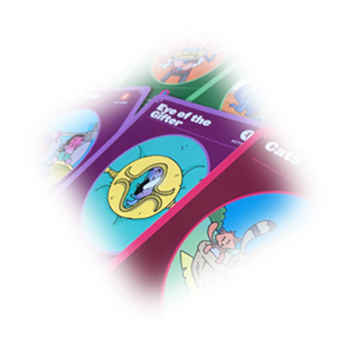
Findings
Four thematic categories and eight subthemes were generated
1. Making sense of BoB
Perceptions of purpose
Perceptions of play rules
‘I thought it would help him open up to us...he doesn’t like to talk a lot and he is always keeping things to himself’(Parent)
‘You help her [Deki beastie] to know that she’s really beautiful [inside]’(Bea)
‘You really need to get your head around the cards first. It took me a couple of times before I felt confident’ (Staff)

Slide 11
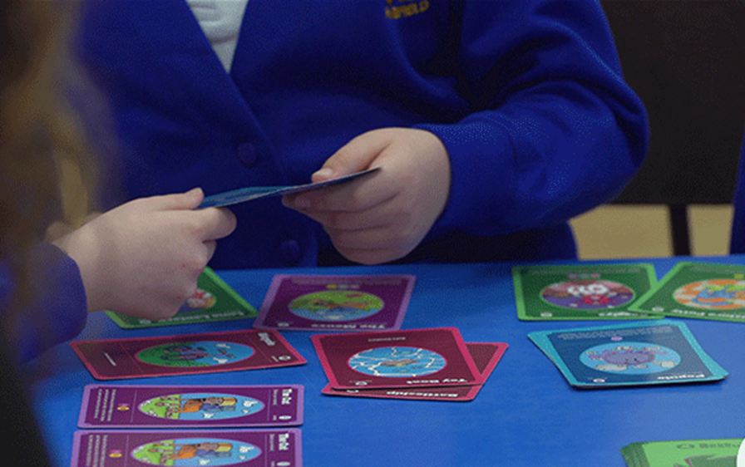
Findings
2. Fantasy world component vs. real world component
- Pretend level engagement
- Literal level engagement
‘He [Bronze Child beastie] is sometimes stressed … and I think it’s worth helping him’ (Dave)
‘I feel it’s nice to help [the beasties], to encourage them to do something’ (Olivia)
‘I kind of just find drawing really calming...it’s also really fun’ (Olivia)

Slide 12

Findings
3. Knowledge and application of socio-emotional literacy
- Language and awareness
- Strategies of support/coping
mechanisms for self and others
It’s kind of annoying that people try to change themselves to fit in….you should just stay who you are’ (Olivia)
‘His whole outlook on actions has changed, as has the way that he views those around him’ (Parent)
‘I also sometimes have a foggy brain. I need to take a deep breath in and so does Populo [beastie]’ (Bea)
‘She is going to use the breathing technique in class when she gets these feelings to help her calm down’ (Staff)

Slide 13
Findings
4. Assessment and development of BoB
- Perceptions of value and acceptance
- Building a better BoB experience
‘Every time I get annoyed or when I couldn’t sleep, I took deep breaths and it really helped ‘cos it calmed me down’ (Olivia)
‘It was an effective intervention. [Children] wanted to come. There was a structure… which was easy for us to pick up every week’ (Staff)
‘My husband and I were not prepared for the dramatic [positive] transformation we saw in our son over the past few months’ (Parent)
‘I think it helped her, but something like this needs to be ongoing’ (Parent)

Slide 14
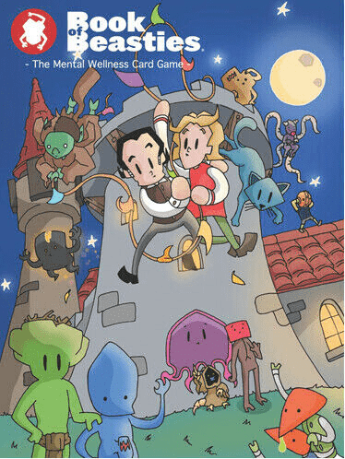

Conclusions from the pilot research
Feasibility of a full evaluation of BoB supported
Evidence BoB benefitted recipients: socio-emotional skills; subjective wellbeing
Social validity
Potential underpinning mechanisms: reality inhibition associated with the fantasy element
Specific procedures: sensory-focused, therapeutic activities
BoB is a promising resource for primary schools and
can be delivered by a range of practitioners

Slide 15

Next steps and the broader picture
Physical games: important pedagogical tools for SE development (Lancy, 2017)
Embedding a school wide culture of supporting mental wellbeing for all: ‘low-level’, preventative approaches (Children’s Commissioner, 2019)
Research to practice: supporting informed decision-making
Adapting to change? - returning to school post-lockdown

Slide 16
References
Brown, R. (2018). Mental health and wellbeing provision in schools: Review of published policies and information.
Braun, V. & Clarke, V. (2013). Successful qualitative research: A practical guide for beginners. Sage
Children’s Commissioner (2019) Early access to mental health support. Children’s Commissioner.
Department for Education (2016). Counselling in schools: a blueprint for the future Departmental advice for school leaders and counsellors. https://dera.ioe.ac.uk/25515/1/Counselling_in_schools.pdf
Department for Education (2018). Mental health and behaviour in schools. https://www.gov.uk/government/publications/mental-health-and-behaviour-in-schools--2
Department for Education (2019). Relationships education, relationships and sex education (RSE) and health education.
Department of Health & Department for Education (2017). Transforming children and young people’s mental health provision: A Green Paper. https://assets.publishing.service.gov.uk/government/uploads/system/uploads/attachment_data/file/664855/Transforming_children_and_young_people_s_mental_health_provision.pdf
Department of Health and NHS England (2015). Future in mind Promoting, protecting and improving our children and young people’s mental health and wellbeing. https://assets.publishing.service.gov.uk/government/uploads/system/uploads/attachment_data/file/414024/Childrens_Mental_Health.pdf
Education Support (2019). Teacher Wellbeing Index 2019. https://www.educationsupport.org.uk/resources/research-reports/teacher-wellbeing-index-2019
Hirsh-Pasek, K. & Golinkoff, R.M. (2003). Einstein never used flash cards: How our children really learn and why they need to play more and memorize less. Emmaus, PA
Jayman, M. & Ventouris, A. (In press). Dealing children a helping hand with Book of Beasties the mental wellness card game. Educational & Child Psychology, 37(3).
Kabat-Zinn, J. (2003). Mindfulness-based interventions in context: Past, present, and future. Clinical Psychology: Science and Practice, 10(2), 144-156.
Lancy, D.F. (2017). Raising children: Surprising insights from other cultures. Cambridge University Press.
Sadler, K., Vizard, T., Ford, T. et al. (2018). Mental health of children and young people in England, 2017: Trends and characteristics. NHS Digital.
The Children’s Society (2019). The good childhood report 2019. https://www.childrenssociety.org.uk/sites/default/files/the_good_childhood_report_2019.pdf
Weisberg, D.S., Hirsh-Pasek, K. & Golinkoff, R.M. (2013). Guided play: Where curricular goals meet a playful pedagogy. Mind, Brain, and Education, 7, 104–112
Thorley, C. (2016). Education, education, mental health: Supporting secondary schools to play a central role in early intervention mental health services. Institute for Public Policy Research.

Slide 17
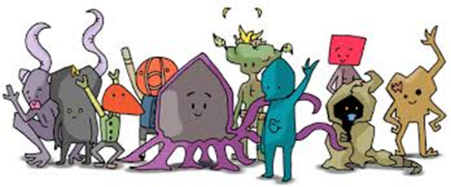

Any questions?
Thank you!

