Slide 1

Stay calm and e-educate: Exploring HE staff experiences of online teaching and learning in the wake of Covid-19
Dr Michelle Jayman and Dr Siobhan Lynam
University of West London

Slide 2

Today’s talk
Context
Rationale for the study
Preliminary findings
Conclusions and next steps

Slide 3

A global pandemic and a MH crisis
The Covid-19 pandemic is the defining global health crisis of our time (WHO, 2020)
Dramatic acceleration in the adoption of learning technologies for teaching within universities
HE staff working in uncertain, rapidly changing and worrying times; Wellbeing (WB) is at risk
New working regimes; huge cultural shift for teaching staff and students

Slide 4

The rise of learning technologies
Benefits: access, flexibility, differentiation of learning etc.
With physical classroom removed, unique challenges are introduced
Engagement, resources, assessment & accountability, and supports (Rovai & Downey, 2010)
2020/1 balance of F2F vs online learning shifted rapidly and significantly towards digital formats

Slide 5
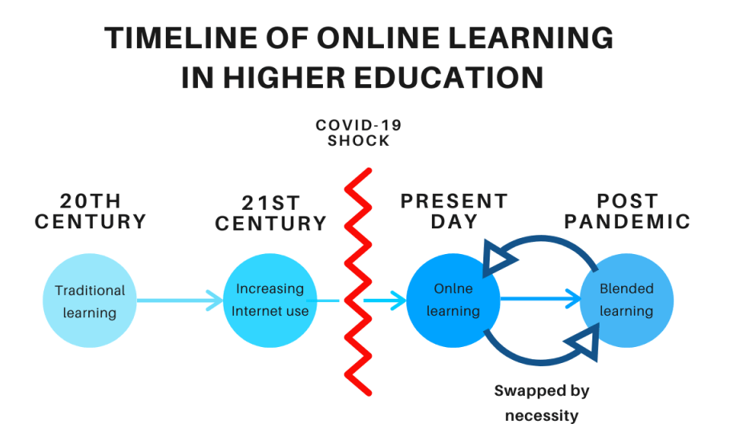
The rise of learning technologies
Figure 1: Higher Education Policy Institute (HEPI) (2020)

Slide 6
Blended Learning
“Learning that happens in an instructional context which is characterised by a deliberate combination of online and classroom-based interventions to instigate and support learning” (Boelens et al., 2015, p.5)
Face-to-Face Activities
Classroom lectures
Group discussions
Lab activities
Presentations
Student-student interaction
Student-lecturer interaction
Assessment & feedback
Online Activities
Individual learning activities
Collaborative learning activities
Online tutorial/blog/chat rooms
Discussion board activities
Synchronous/recorded lectures
Online assessment and feedback
Blended Learning
Person mediated
Technology mediated
Figure 2: Key aspects of Blended Learning (Graham, 2013; Moskal; et al., 2013)

Slide 7
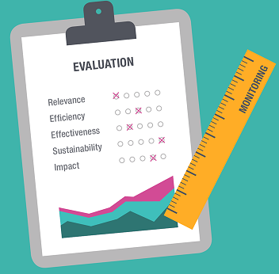
Evaluating blended learning
Systematic review (Bokolo et al., 2020): 94 studies 2004-2020
Evaluation criteria
Data on course outcomes (attendance, retention and students’ marks etc.)
Measures of student satisfaction
Measures of student engagement
Data collection methods
Mainly author-designed questionnaires and course outcomes data

Slide 8
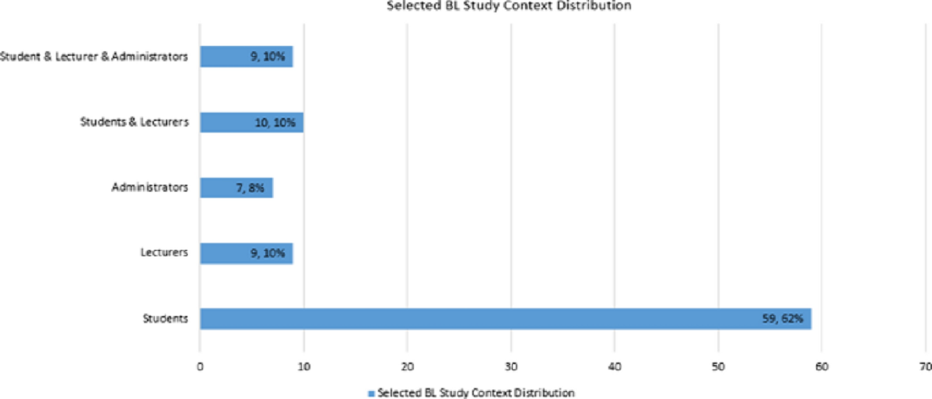
Evaluating blended learning (Bokolo et al., 2020)

Slide 9
Evaluating BL (Bowyer & Chambers, 2017)
Perspectives of all stakeholders need to be taken into account
An effective transition from teaching in a face-to-face classroom to an online environment requires planning, resources, time, and training
Training is critical in universities where lecturers are responsible for curriculum and assessment design in addition to implementing blended learning
The success of blended learning programmes inevitably relies on equitable access to technology

Slide 10

Higher Education: An ‘anxiety machine’?
Escalation of poor mental health among university staff from 2009 to 2016 (Morrish, 2019)
Data from 59 HE institutions on referrals to counselling and occupational health services
Rises of 50% common, some universities as high as a 316% increase
Excessive workloads
Precarious contracts
Audit and metrics
Performance management

Slide 11

HE staff wellbeing
Research study for Education Support Partnership (O’Brien & Guiney, 2018)
Conducted 25 in-depth, semi-structured interviews covering 25 HE institutions
Which key factors have a positive/ negative impact on HE staff wellbeing in the workplace?
How could wellbeing be improved in the workplace?

Slide 12

Factors influencing staff WB (O’Brien & Guiney, 2018)
Positive
The role/style of management
Relationships
Professional acknowledgment
Professional value
Negative
A sense of isolation
A culture of bad management
The consumer model

Slide 13

HE academic staff said…
Wellbeing was widely perceived as achieving ‘balance’: seen as essential to “coping”, “surviving” and “not being dragged down”
“Reducing workload would help me more than a group yoga session”
“If we do not take the wellbeing of staff seriously then Higher Education is not sustainable. Look after staff, value and trust them or else the system will implode”

Slide 14

Interactive slide
Word cloud
Name one thing that you believe would improve your wellbeing in the workplace

Slide 15

Rationale for the exploratory study and RQ
HE staff often poorly prepared due to speed of transition to digital formats
High sense of personal responsibility for students’ WB (O’Brien & Guiney, 2018); intensified in current circumstances
Mental WB among university academics in decline (Morrish, 2019)
Major adaptations to work routines, demanding workloads and competing priorities; increased risk to WB
Good relationships with students/colleagues important for maintaining positive wellbeing while feeling isolated linked to poor wellbeing
RQ: What is the experience for HE lecturers of adjusting to online teaching and blended learning models in the wake of the Covid-19 crisis?

Slide 16

Methodology
Qualitative design; solicited diary method
Ecological validity
Particularly pertinent when attempting to gain intimate details of experiences (Polit & Beck, 2010)
Allow for a contemporaneous insight into the lived experience of the participant
Suitable to address questions concerning process and change

Slide 17



Methodology
Participants
Convenience sample; 3 HE academics (lecturers) from UK universities (female; age range 2: 35-55, 1: 18-35)
Procedure
Solicited diary – completed daily for 4 working weeks; data uploaded to Qualtrics
Analysis
Inductive Thematic Analysis (Braun & Clarke, 2013)
Two coders; cross-validation of themes

Slide 18
Findings
‘A complete farce’-Dynamics of transition
Disorientation
Unique stressors
The consumer-model
‘It has been hard to process…none of it makes any sense…After a few weeks I realised there is no distinction between home and work’ (P1)
‘I spend much more time on dealing with students concerns about learning, stress and mental health’ (P2)
‘I am snowed under with work and I cannot really reflect on what is going on around me’ (P3)
‘We literally are not allowed to hold students to account or expect respect’ (P1)

Slide 19
Findings
‘I cried with her’-
Interpersonal Relationships
Sources of support
Sources of tension
Tutor-student alliance
‘There is an expectation [from managers] for us to attend all [online] meetings…I could skip some of them and use my time on a more productive task’ (P2)
‘A meeting with my tutees and some lovely colleagues cheered me up’ (P2)
‘A student typed in the chat “You are doing great…”. I truly hate teaching online but somehow we have still become connected as a little community’ (P1)
‘I need to feel supported and someone to tell me I’m not worthless…talking to my husband helped’ (P3)
‘Those in leadership are so out of touch with what is happening on the ‘shop floor’…systems [for online teaching] made no sense…we need to work more hours because it ticks a box’ (P1)

Slide 20
Findings
‘My spirit is broken’-Professional identity
Sense of achievement/ satisfaction
Feeling acknowledged/valued
Agency and autonomy
‘I managed to do quite a lot today, but not for my own research, this frustrates me…spent lots of time on a task that wasn’t worth it’ (P3)
‘I feel trapped at a place where no-one recognises my efforts’ (P3)
‘I feel like all the creativity that comes from F2F teaching has been taken away, and I barely feel a sense of purpose teaching online’ (P1)
‘Feelings of tiredness and low satisfaction…caused by long procedures or tasks that I need to do in order to tick another box’ (P2)
‘I often think how it could have been if the powers that be had taken just a minute of their time to consult with staff and students’ (P1)

Slide 21
Findings
‘I’m drowning’-Wellbeing environment
Self-care and coping strategies
Responsibility for others’ wellbeing
Institution-wide culture of wellbeing
‘Research is a break from the whole madness of this new way of working…I felt refreshed’ (P2)
‘Wellbeing is so far down the list of [my insititution’s ] priorities’ (P1)
‘It is 9 in the evening now and I’m not even done with work’…I am drowning, and I feel helpless (P3)
‘Covid-19 has exacerbated mental health issues in our students and we are not trained to deal with all these challenges’ (P2)
‘Everyone demands something from me…there is no support, no leadership’ (P3)

Slide 22

Conclusions from the study and next steps
Over-reliance on staff to ‘stay calm and e-educate’ but not sustainable
HE staff - elevated risk of poor wellbeing and burnout
Current situation characterised by unique stressors, lack of strategic direction, absence of professional acknowledgement/value (no consultation); inadequate (appropriate) training; low agency; no-buy-in
Involving all stakeholders is imperative for managing effective transitions and evaluating T & L models
More qualitative research to unpick important process issues
Shift from models of individual resilience to models of collective resilience needed

Slide 23
References
Bokolo, A., Kamaludin, A., Romli, A., Rafei, A., Eh Phon, D. N., Abdullah, A., & Ming, G. L. (2020). Blended Learning Adoption and Implementation in Higher Education: A Theoretical and Systematic Review. Technology, Knowledge and Learning. https://doi.org/10.1007/s10758-020-09477-z
Boelens, R., Van Laer, S., De Wever, B., & Elen, J. (2015). Blended learning in adult education: towards a definition of blended learning. https://biblio.ugent.be/publication/6905076
Bowyer, J. & Chambers, L. (2017). Evaluating blended learning: Bringing the elements together. Research Matters: A Cambridge Assessment publication. http://www.cambridgeassessment.org.uk/research-matters/
Clarke, V. and Braun, V. (2013). Successful qualitative research: A practical guide for beginners. Sage.
Graham, C. R. (2013). Emerging practice and research in blended learning. In M. G. Moore (Ed.), Handbook of distance education, (3rd ed., pp. 333–350). Routledge.
Higher Education Policy Institute (HEPI) (2020). Timeline of online learning in Higher Education.
https://www.hepi.ac.uk/2020/05/13/online-learning-are-we-asking-the-right-questions/
Morrish, L. (2019). Pressure Vessels: The epidemic of poor mental health among higher education staff. HEPI Occasional Paper 20. HEPI.
Moskal, P., Dziuban, C., & Hartman, J. (2013). Blended learning: A dangerous idea? The Internet and Higher Education, 18, 15–23.
O’Brien, T. & Guiney, D. (2018). Staff Wellbeing in Higher Education. A research study for Education Support Partnership. Education Support Partnership.
Polit, D. & Beck, C. (2010). Essentials of Nursing Research: Appraising Evidence for Nursing Practice (7th ed.). Lippincott Williams & Wilkins.
Rovai, A. P. & Downey, J. R. (2010). Why some distance education programs fail while others succeed in a global environment. Internet and Higher Education, 13(3).
WHO (2020, March 18). WHO Director-General's opening remarks at the media briefing on COVID-19. https://www.who.int/director-general/speeches/detail/who-director-general-s-opening-remarks-at-the-media-briefing-on-covid-19---16-march-2020

Slide 24

Any questions?
Thank you!

