Slide 1



Learning through the pandemic: First Year students’ perceptions
Indira Chauhan and Fehmida Mohamedali

Slide 2


Background
COVID- 19 pandemic and impact on the students’ learning experiences
Predominantly online learning in lieu of the face-to face learning
‘UWL Flex’ as an online learning platform
Students perceptions as new entrants
Online learning at the onset for L3 and L4
Useful insights based on digital competence, socioeconomic circumstances and access to technological tools

Slide 3
Accessing online learning
% of students
Sample size: L3 students of Computing ( 60) & L3 Built Environment (40) No of responses: 45

Slide 4
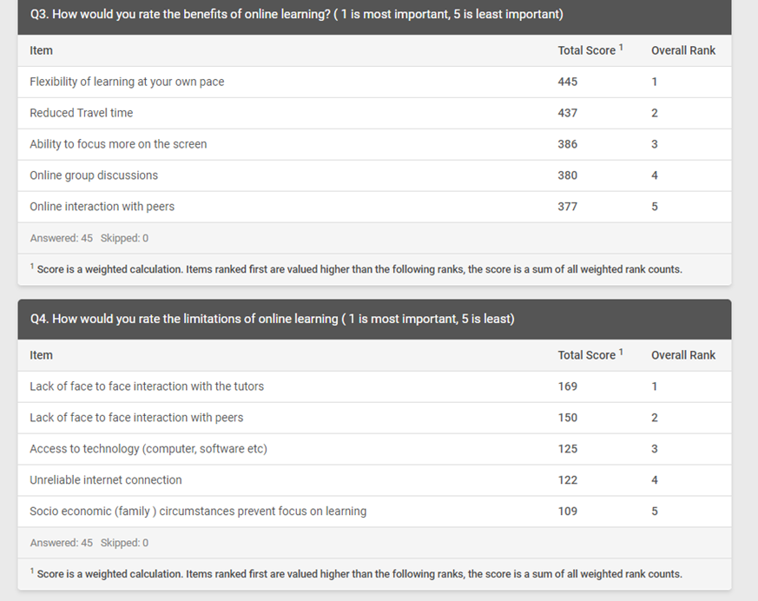
Benefits and limitations
Flexibility was ranked as top benefit
Lack of face to face interaction with tutors found to be main limitation
Students’ general perceptions were captured as open comments

Slide 5
What did they really like?
‘Online learning is highly flexible and gives room for a good life-work-study balance
‘Extremely helpful and can come handy especially if you want more comfort while learning.’
‘Am glad I can revise via video recording.’
‘Online learning suited me well (as a mature student I could find it challenging to blend in well, when we return to campus).
‘ Mixed reactions on this- there are some very good advantages of online learning. As I work part time, I found it easier with online learning. I would have to travel 1.5 hours every day to get to uni.’

Slide 6
Limitations
‘Can be difficult and the attention span is very poor among many individuals. Online behind a screen minimises the together feeling of a class.’
‘I personally prefer face to face lectures because i get distracted too easily at home.’
‘Struggled a lot more than anticipated while being at home as a Single Parent also self-employed, my office was my dinning room which is also my children's learning space too’
‘It was difficult for me to stay motivated.’

Slide 7
Conclusion
Student Covid Insights Survey (SCIS) conducted by the Office for National Statistics (ONS) collected information in three pilots during October and November. (Tinsley, 2020)
One of the areas of research was the students’ perception of online learning.
Only 16% of students disagreed or strongly disagreed that they felt equipped to engage with this mode of learning
Findings from the Opinions and Lifestyle Survey (OPN) conducted by the Coronavirus and the social impacts on Great Britain (ONS, 2020) also revealed a similar finding. 21% students felt that online learning mode will adversely affect their learning.
The extent of positive comments about online learning reflects that a hybrid or blended learning mode could be a way forward.
References
  Tinsley, B. (2020). Coronavirus and the impact on students in higher education in England: September to December 2020 - Office for National Statistics.
  www.ons.gov.uk. (n.d.). Coronavirus and the social impacts on Great Britain - Office for National Statistics. [online] Available at: https://www.ons.gov.uk/peoplepopulationandcommunity/healthandsocialcare/healthandwellbeing/bulletins/coronavirusandthesocialimpactsongreatbritain/4december2020 (Accessed 20 June 2020).

