Slide 1

Long-term clinical and cost-effectiveness of psychological intervention for family carers of people with dementia: a single-blind, randomised, controlled trial
Prof Gill Livingston, MD, Julie Barber, PhD, Penny Rapaport, DClinPsych, Prof Martin Knapp, PhD, Mark Griffin, MSc, Derek King, PhD, Renee Romeo, PhD, Debbie Livingston, MChS, Cath Mummery, PhD, Zuzana Walker, MD, Juanita Hoe, PhD, Claudia Cooper, PhD
The Lancet Psychiatry
Volume 1 Issue 7 Pages 539-548 (December 2014)
DOI: 10.1016/S2215-0366(14)00073-X
Copyright © 2014 Livingston et al. Open Access article distributed under the terms of CC-BY-NC-ND Terms and Conditions

Slide 2
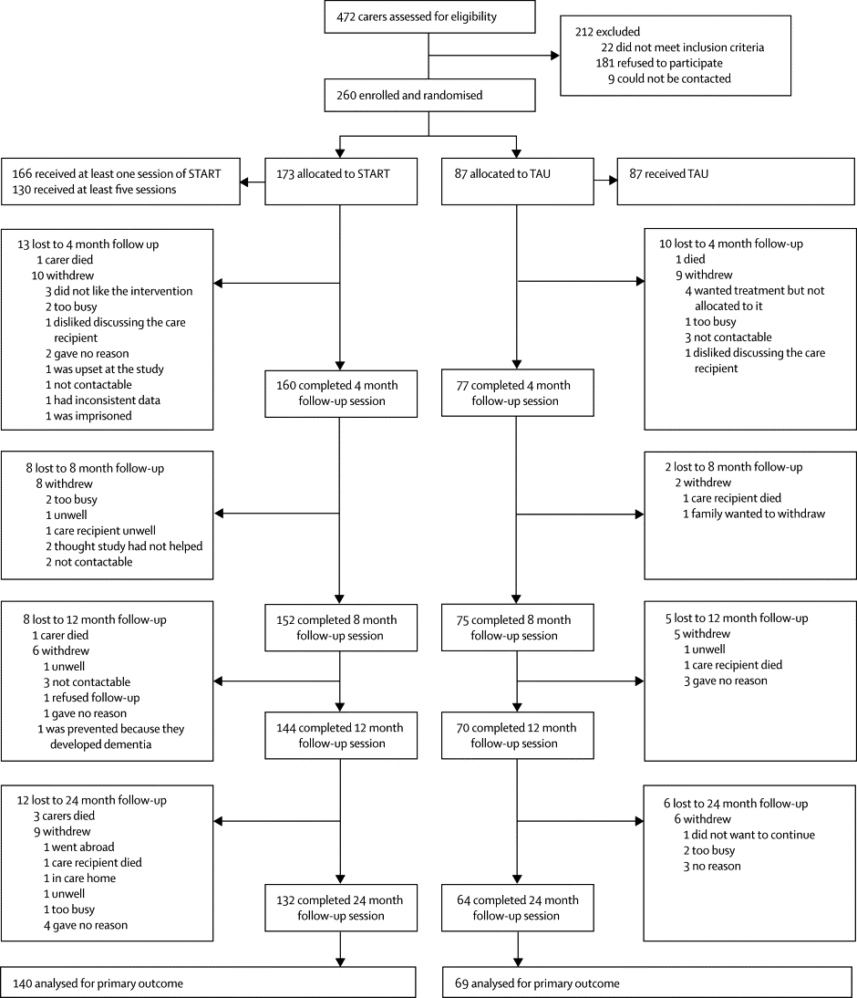
Figure 1
The Lancet Psychiatry 2014 1539-548DOI: (10.1016/S2215-0366(14)00073-X)
Copyright © 2014 Livingston et al. Open Access article distributed under the terms of CC-BY-NC-ND Terms and Conditions
Notes:
Trial profile
To be included in the primary long-term analysis, the individual should have had at least one Hospital Anxiety and Depression Scale (HADS) score at 12 or 24 months. START=STrAtegies for RelaTives (intervention). TAU=treatment as usual (control). People were included in the final analyses if they gave data about the HADS at 12 or 24 months.

Slide 3
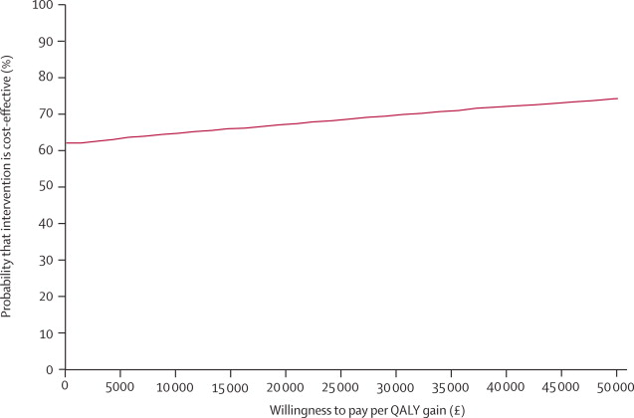
Figure 2
The Lancet Psychiatry 2014 1539-548DOI: (10.1016/S2215-0366(14)00073-X)
Copyright © 2014 Livingston et al. Open Access article distributed under the terms of CC-BY-NC-ND Terms and Conditions
Notes:
Cost-effectiveness analysis for carer QALY gain
Cost-effectiveness acceptability curve analysis done over 24 months. QALY=quality-adjusted life-year.

