Slide 1
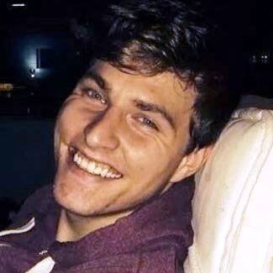
A qualitative study to assess the impacts of bereavement by suicide
Approved by SoBS Leadership & University of West London Ethics Panel
Alex Whitebrook
03-Feb-1991 ~ 01-May-2017
John Whitebrook

Slide 2



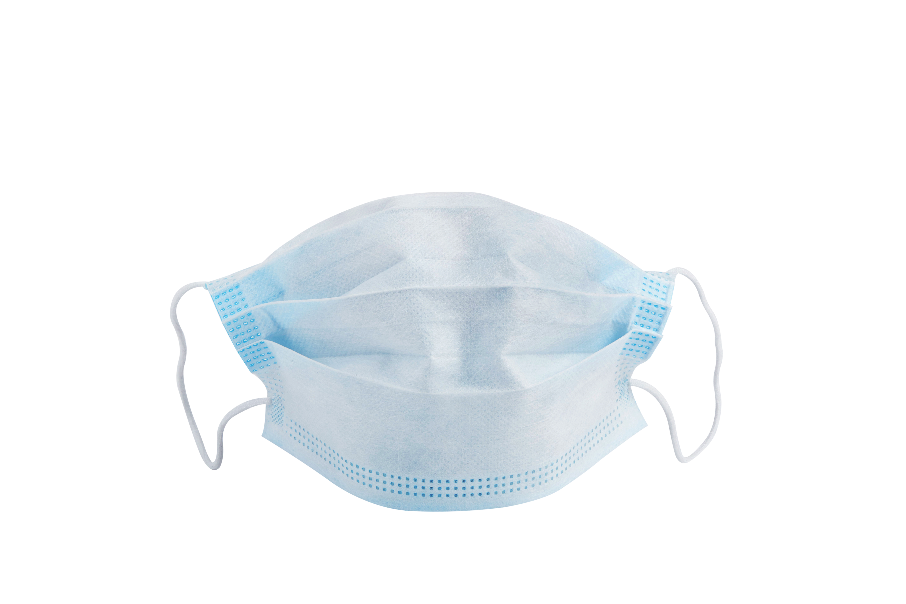

Background
Knapp, M., McDaid, D., & Parsonage, M. (2011). Mental health promotion and mental illness prevention: The economic case. Department of Health: London, UK:
The economic impact of each suicide, by someone of working age, in England, covering emergency services, funeral expenses and lost productivity, plus some intangibles, is estimated at £1.67 million per incidence, at 2009 costs
2021 suicide deaths in England (same press release) > 5,000
Using 2009 figure => cost of more than £8.35 billion!!!
Press release:
Recipients of £5.4 million suicide prevent fund revealed in Mental Health Awareness Week
From:
Department of Health and Social Care, Helen Whately MP, and The Rt Hon Sajid Javid MP
Published 9 May 2022
113 charities have benefited from £5.4 million to prevent suicide in high-risk groups, including people from black communities and men
Demand for services has increased during the pandemic and funds have bolstered services including therapy, stigma-busting workshops and helplines
Government will publish a suicide prevention plan later this year to outline further support for those in need
800,000 annually; many suicides unreported due to misclassification and cultural taboos
Rates vary both between and within countries; as much as x 10 across locations
Gov’ts (incl. UK & IRL) have suicide prevention initiatives, w/postvention
Suicide is widely acknowledged as a significant, and pervasive, global public health issue
⇧ rates after prior widespread illnesses; impact of COVID-19 could spike later
UK & IRL: M to F suicides c. 3:1; suicide bereavement support participation typically 80-91% F

Slide 3



Impacts & Support
“…to facilitate recovery after suicide and to prevent adverse outcomes including suicidal behaviour”
Prone to stress, self-blame, anxiety, depression, ‘Complicated Grief’; increased risk of suicide
…experience with others has been shown to be a major alleviant of such conditions
‘Postvention’
activities are
Sharing…
“A suicide survivor is typically considered to have lost a family member/friend, with whom they had a significant relationship, and where their life is permanently shifted by the bereavement.”
Survivors are often unaware of the frequency of their situation, and support available, and therefore do not seek help
Attempt control, put others’ first; ⇨ depression, insomnia, substance abuse, ailments, &  work
Admitting need for help, self-medicating, over-work, esp. by men, are barriers to accepting support
Men

Slide 4
Contributing Factors
The Individual / Internal:
Relationship to those lost
Family & Friends
History / Prior Trauma
Health
Ethnicity
Culture & Language / Taboos
Education – Learning & Knowledge
Media Consumption
Psychology (Stigma / Shame / Guilt)
Job
Society / External:
Socio-economic
COVID-19
World Events
Healthcare
Immigration
Policy
Education – Teaching
Media – Social & Press
Expectations
Work
Complex and highly interwoven

Slide 5
Five main Themes emerged
Pre-bereavement issues
Consequences
Perceptions
Organisations
Support Network
Massive effect & let down by healthcare system
Variation by relationship and elapsed time
Peer support positive but services fragmented / lack of input
Need greater awareness & understanding in society
Education & training on bereaved needed by services
Eight people from SoBS participated in the study:
  7 Female / 1 Male
  Those lost 1 Female / 8 Male

Slide 6
Quotes
“This was out of character, looking back, because…it was a definite change, you know, that maybe should have signalled something.”
“…what is probably one of the worst pains in the world.”
“…from my role as, in SoBS, sadly there needs to be more awareness of…just support! I mean, there's so many people that I've spoken to, that will mention that they don't know we exist!”
“…I just wanted to…highlight the role of SoBS, in my journey. It has, like I said, it saved my life.”
“…but it was, I think, that's the thing [SoBS] that kept me alive.”
“…I always say that the biggest achievement in my life is surviving that loss.”
“…people give the throwaway comments like, ‘I just want to kill myself’, and I sit there festering inside, thinking seriously?”
“…none of the practitioners has a…complete picture in order to offer the best help or…range of therapies or strategies.”

Slide 7
Conclusions
No individual professional has a complete overview of the health of someone who may be considering taking their own life
Public considers suicide as something that happens to ‘other people’ rather than it being a very real risk to everyone
Often, there is no immediate assistance available, and survivors’ trauma is often exacerbated by encounters with officialdom and some unsympathetic individuals within
Coping does appear to get better over time, but the adjustment is far from linear
For core, long-term, meaningful support, survivors rely to the very greatest extent on the voluntary sector
Fragmented approach to prevention & postvention, lacking leadership, proper funding & survivor input
Suicides have a devastating impact upon whole families
The effects are far-reaching, radically, and permanently changing the lives of those left behind

Slide 8
What’s next?
“Suicide postvention uptake and efficacy in UK & Ireland adult male survivors”
Early stages
Systematic Literature Review
Qualitative Study of Enablers and Barriers (users and providers)
Quantitative Study to assess prevalence
Six year programme of research (part-time)

Slide 9
Thank you!
Full study report available at :
https://uksobs.org/news-information/study-to-assess-the-impacts-of-bereavement-by-suicide/
John Whitebrook
london@uksobs.org
21412615@student.uwl.ac.uk
johnwhbk@hotmail.com
SoBS Annual Assembly 18-Jun-2022

